Slide 1
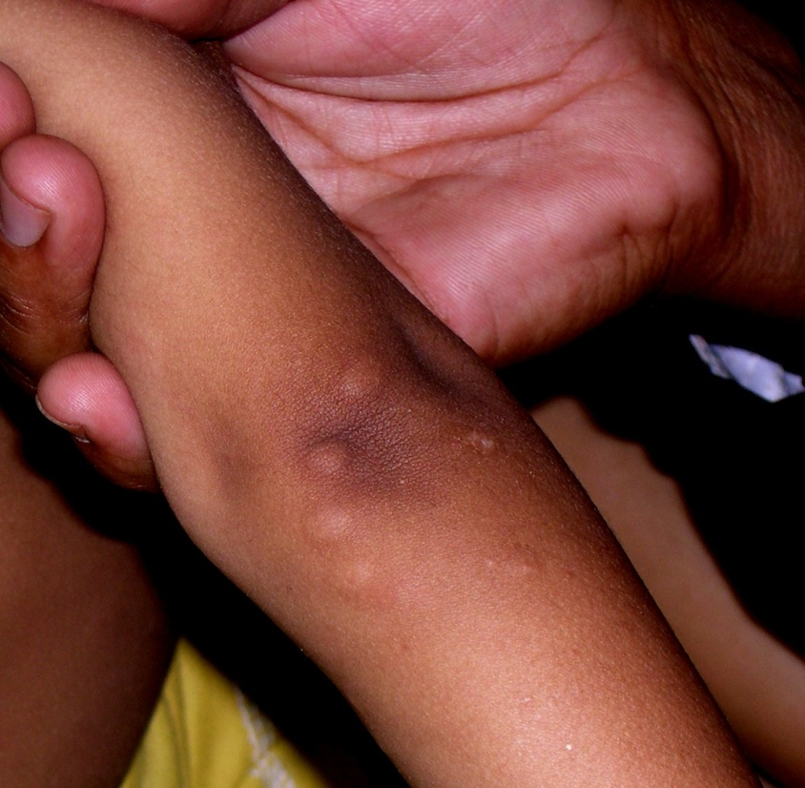
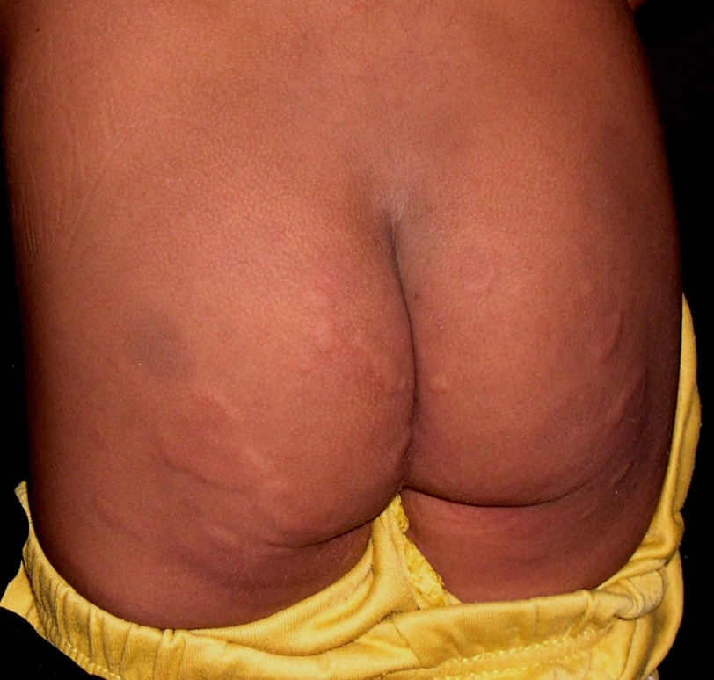
THIS CHILD PRESENTED WITH FEVER AND THIS RECURRENT RASH.
THE RASH HEALS WITHIN A FEW DAYS TIME . WHAT IS LIKELY DIAGNOSIS?
Notes:
Erythema marginatum

Slide 2
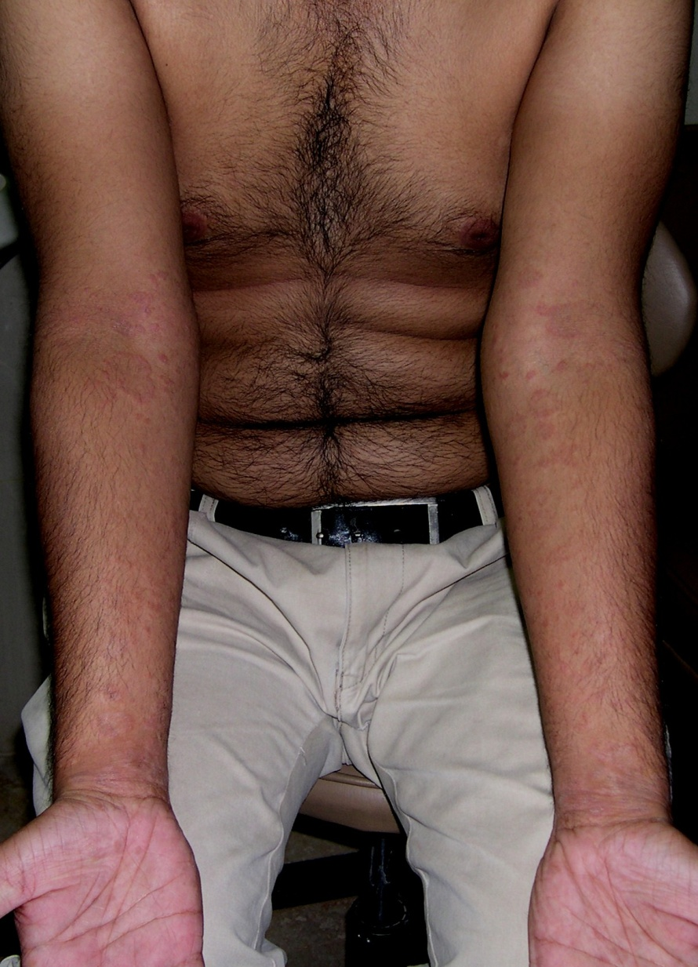
WHAT IS LIKELY DIAGNOSIS?
Notes:
Acral P. rosea

Slide 3
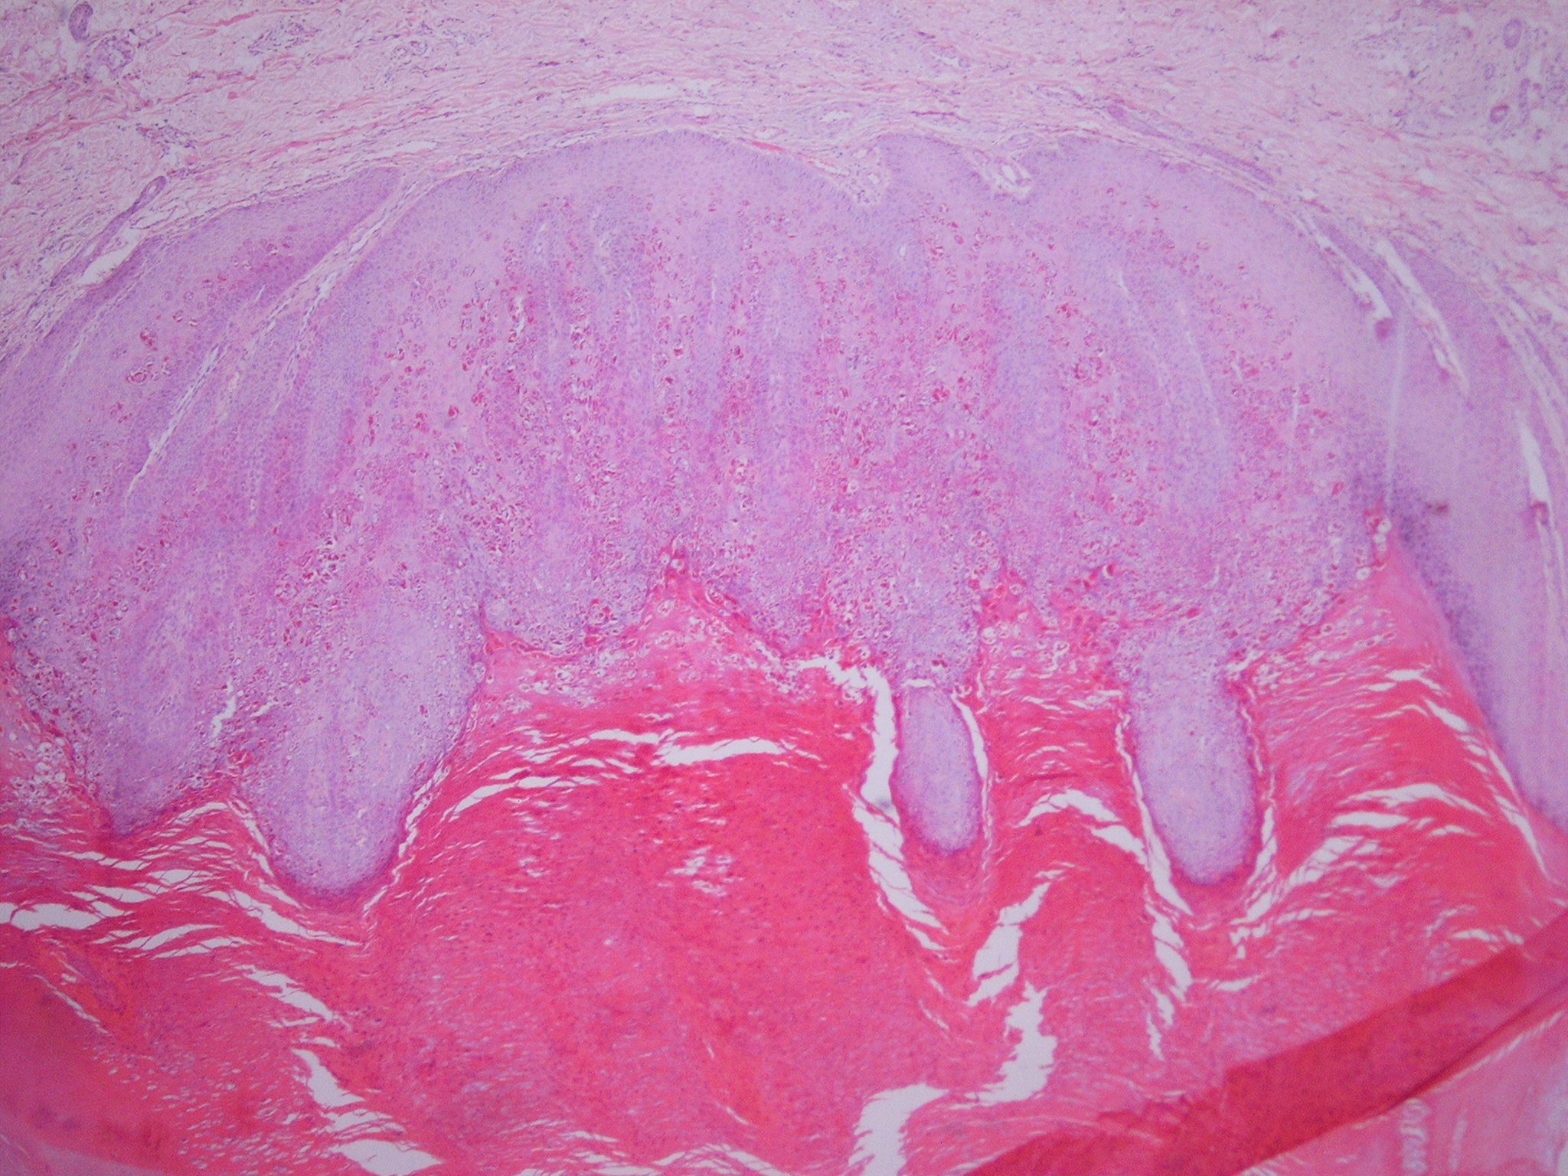
WHAT IS LIKELY DIAGNOSIS?
Notes:
Wart
(what is the difference between normal verruca vulgaris, plane wart and plantar wart)

Slide 4
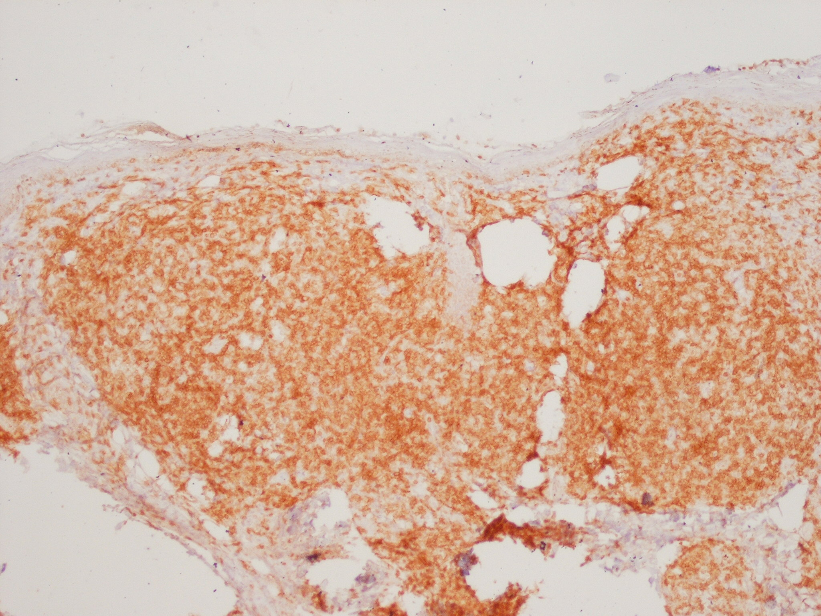
WHAT IS SHOWN AND
WHAT IS ITS IMPORTANCE
Notes:
Immunohistochemistry shown

Slide 5
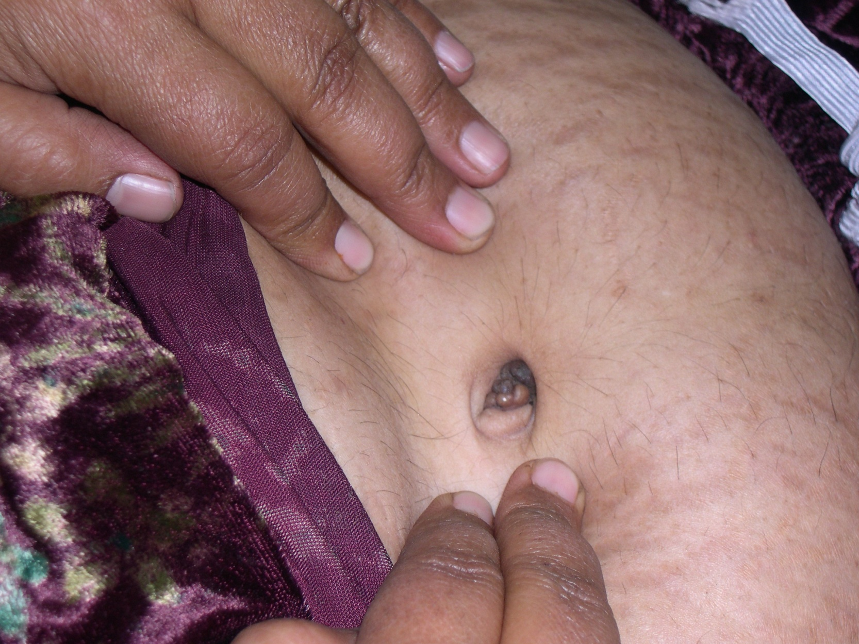
DIFFERENTIAL DIAGNOSIS?
Notes:
Endometriosis
Sister Mary Joseph’s nodule (associated with stomach CA)
Foreign body granuloma
Soft tissue tumors (polyps in umbilicus)

Slide 6
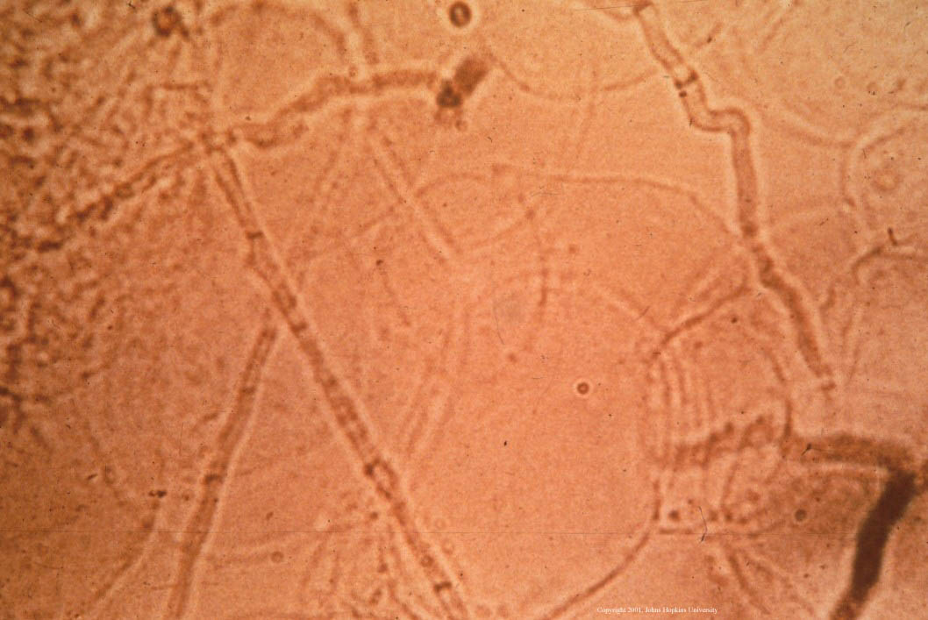
WHAT IS THIS ?
NAME THE STRUCTURES MARKED
A AND B.
A
B
Notes:
Microscopy
Hyphae
Epithelial cells

Slide 7
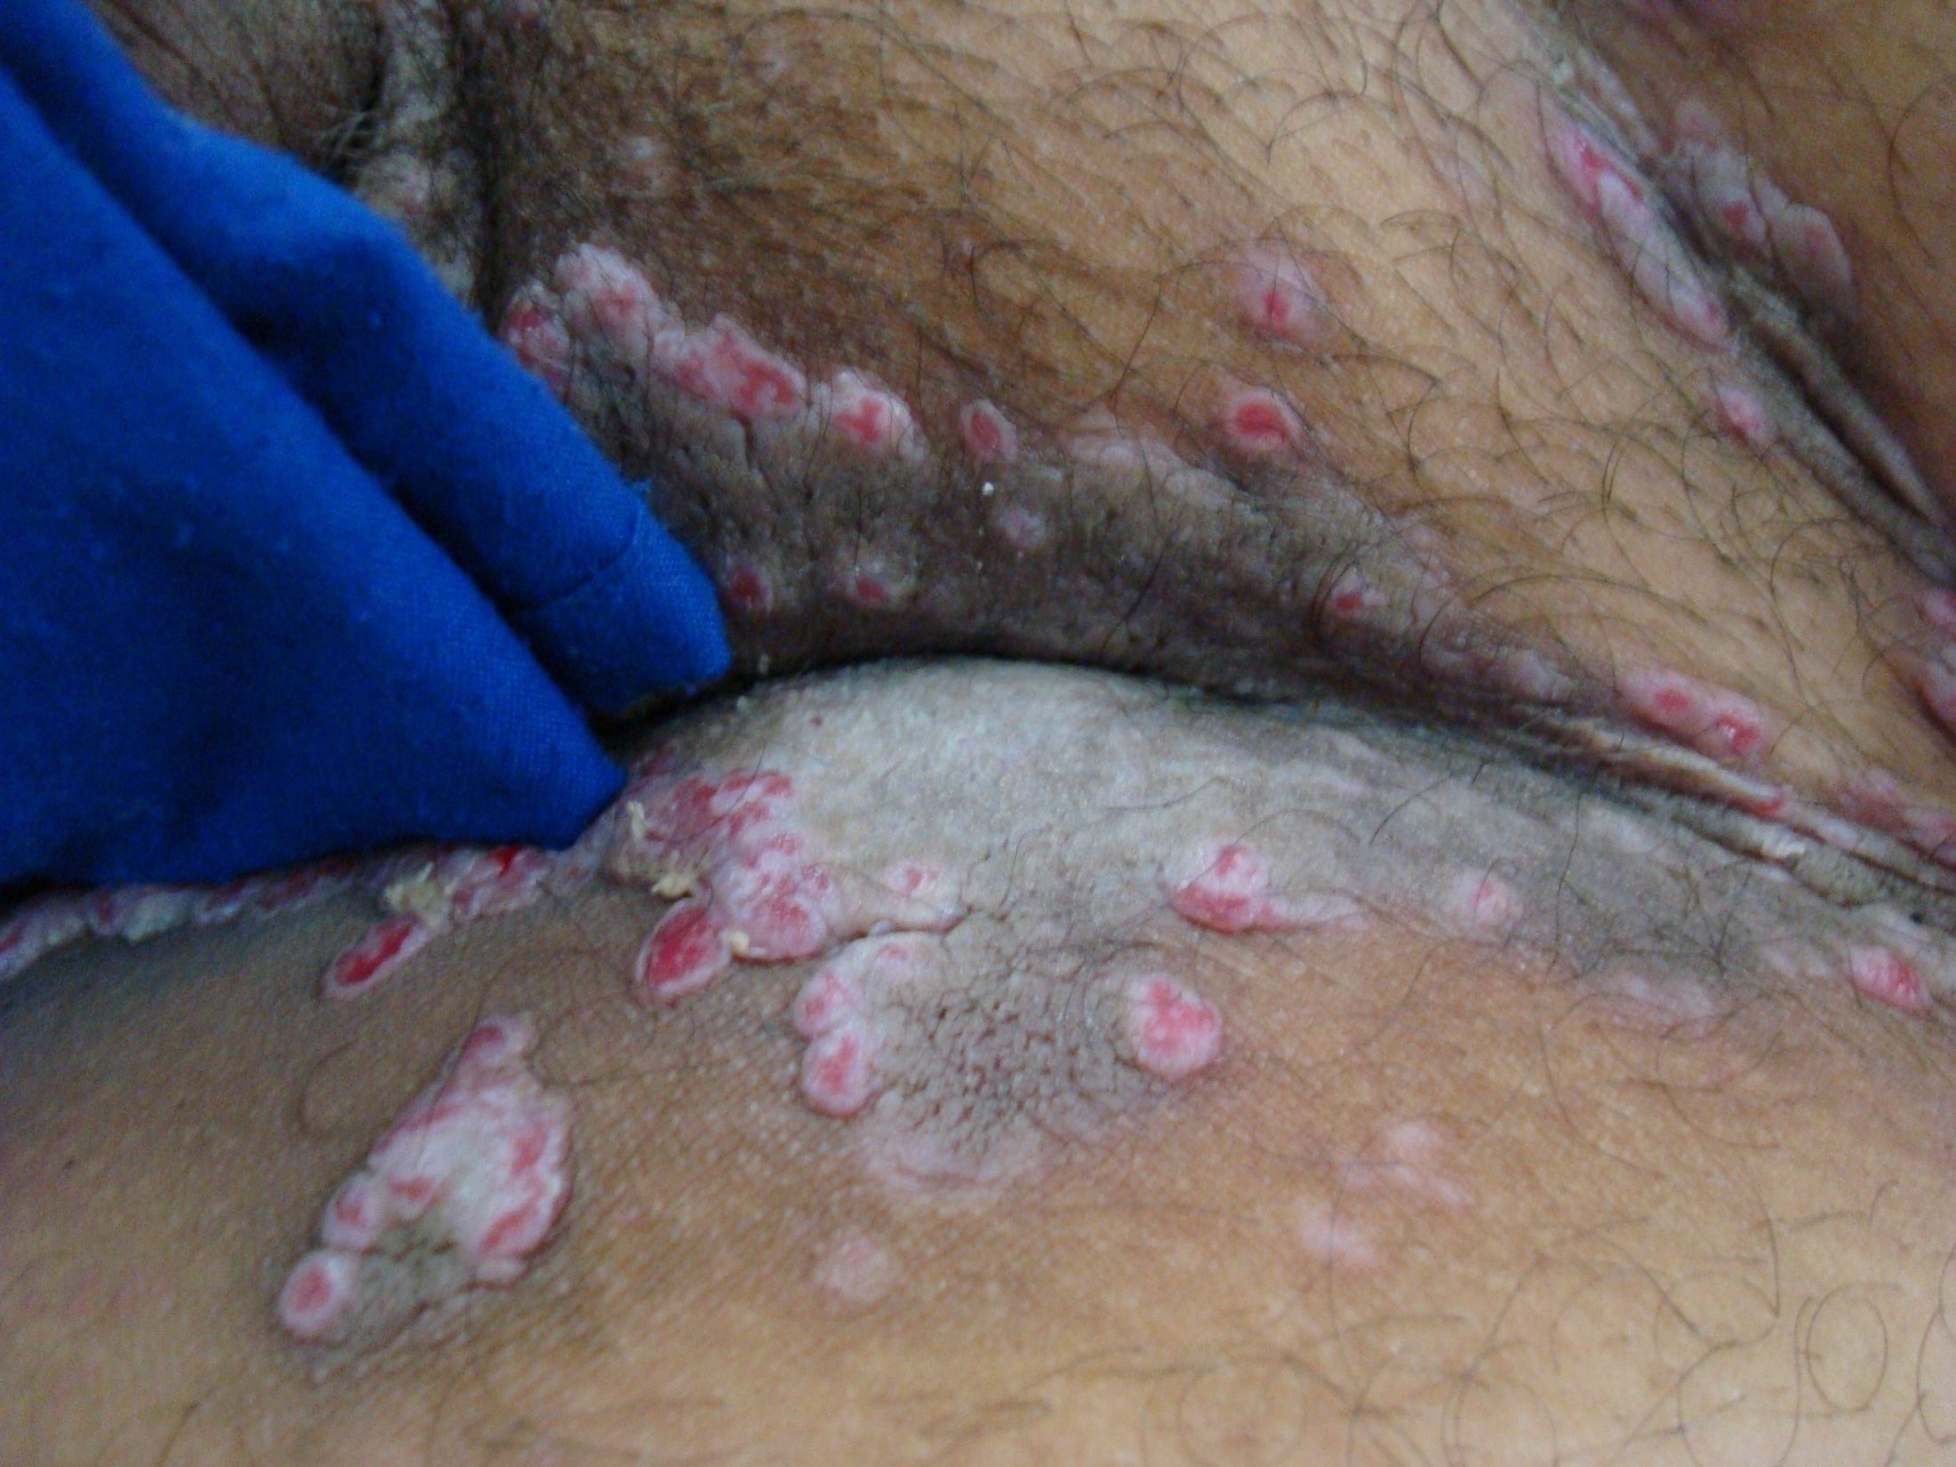
DIFFERENTIAL DIAGNOSIS?
Notes:
Pemp vegetans
Condylomata lata
Pyoderma vegetans of hallopeau

Slide 8
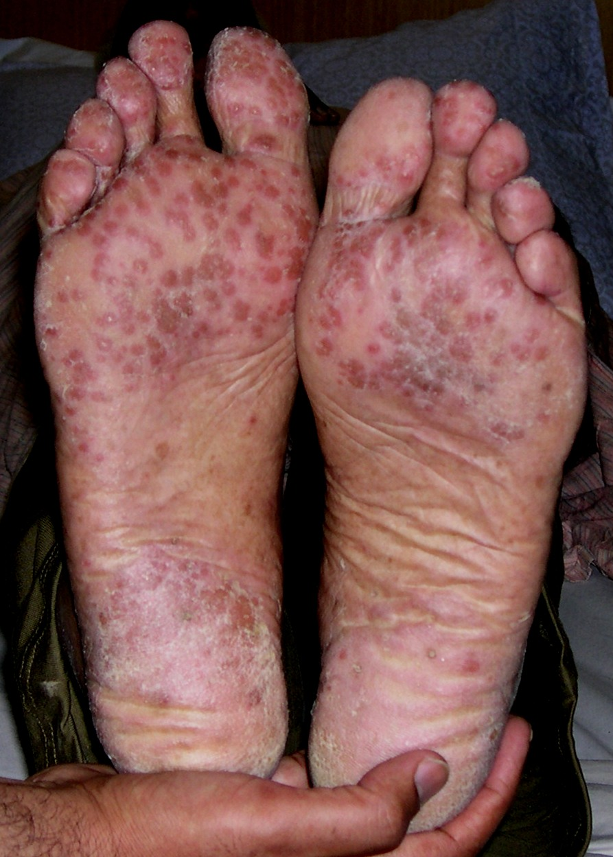
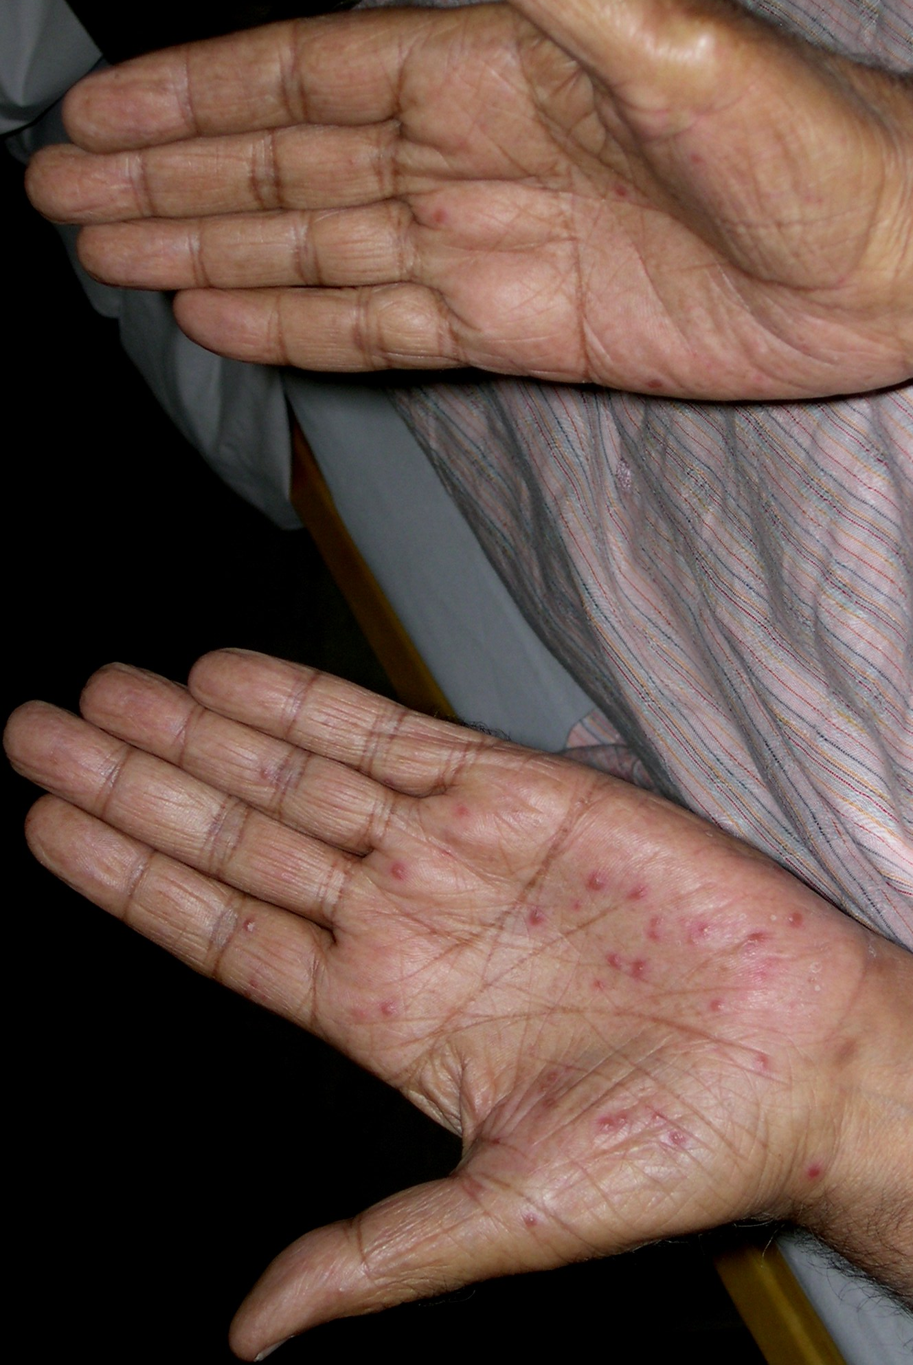
THIS PATIENT WITH CA LUNG
DEVELOPED DIRRHOEA AFTER
FIRSTCOURSE OF
CHEMOTHERAPY FOLLOWED
BY THIS RASH.
DIFFERENTIAL DIAGNOSIS
Notes:
Eccrine neutrophilic adenitis
Keratoderma blenoorhagicum (Reiter’s dis)
Syphilis

Slide 9
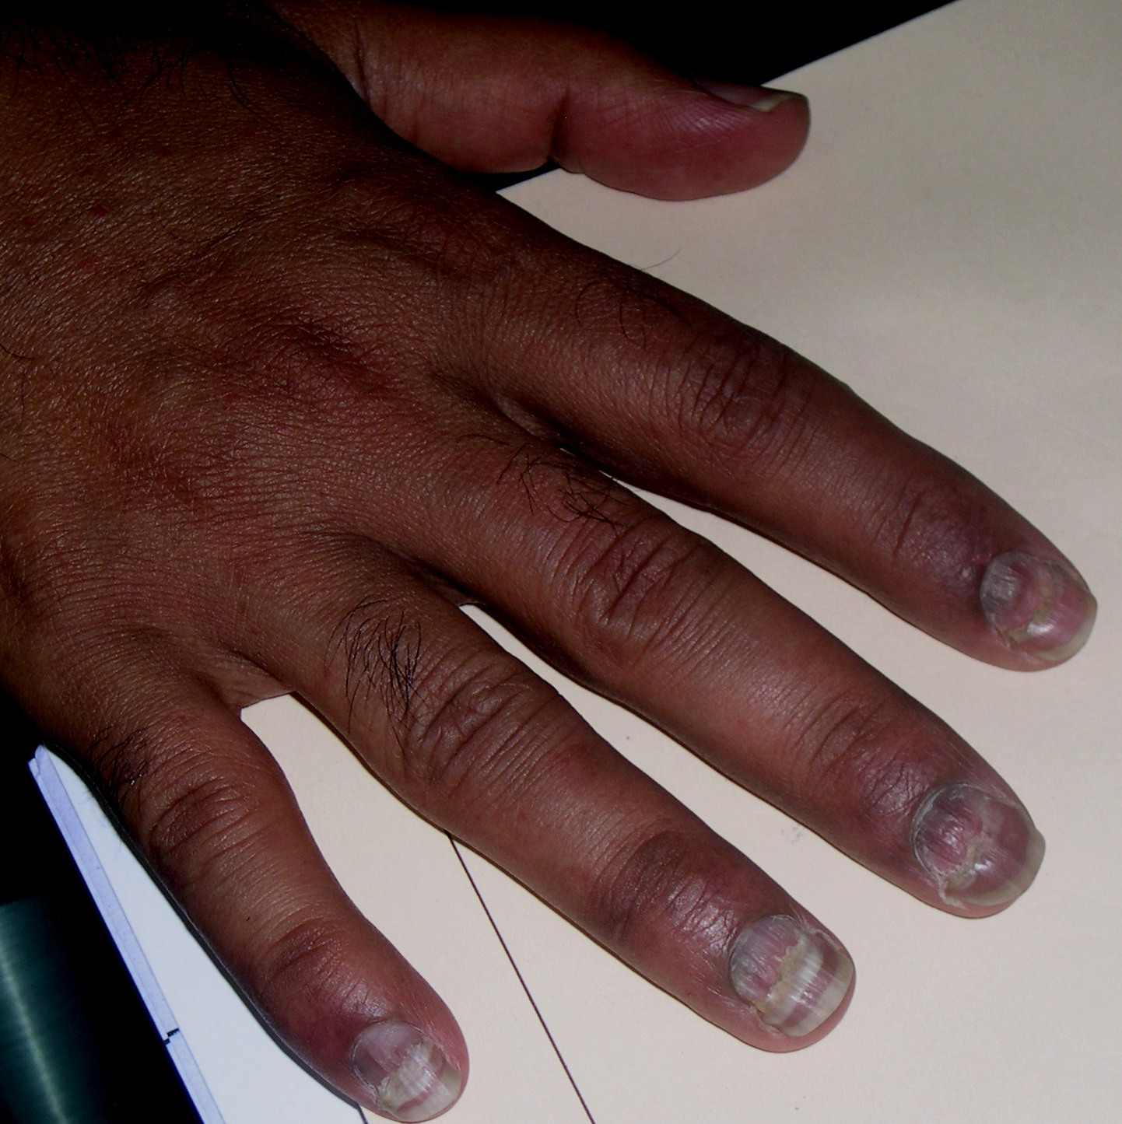
WHAT IS LIKELY DIAGNOSIS?
Notes:
Beau’s lines (nail growth is arrested)

Slide 10
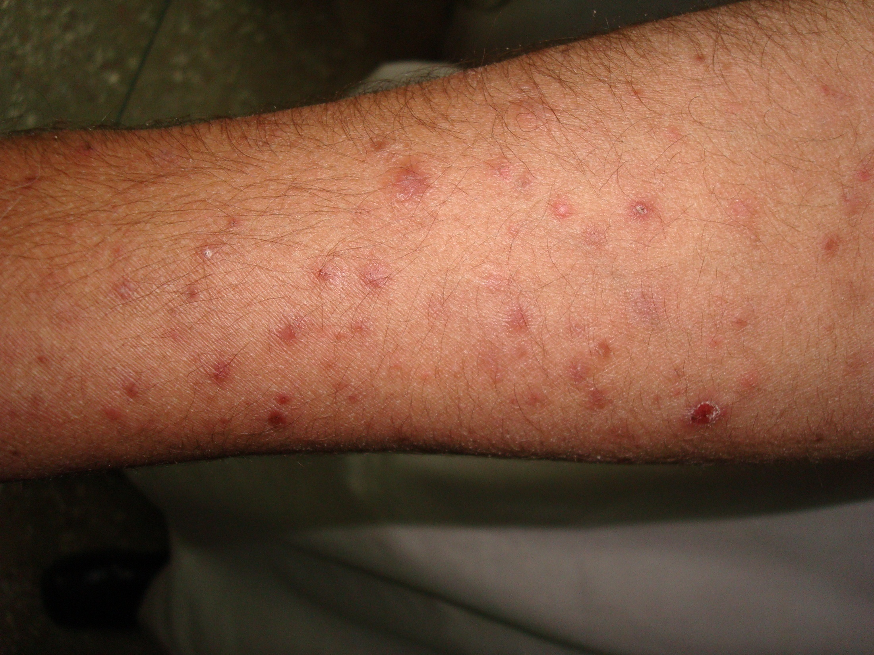
HISTOLOGY SHOWED A LICHENOID PICTURE
WHAT IS LIKELY DIAGNOSIS?
Notes:
Kryle’s dis/flagyl’s dis

Slide 11
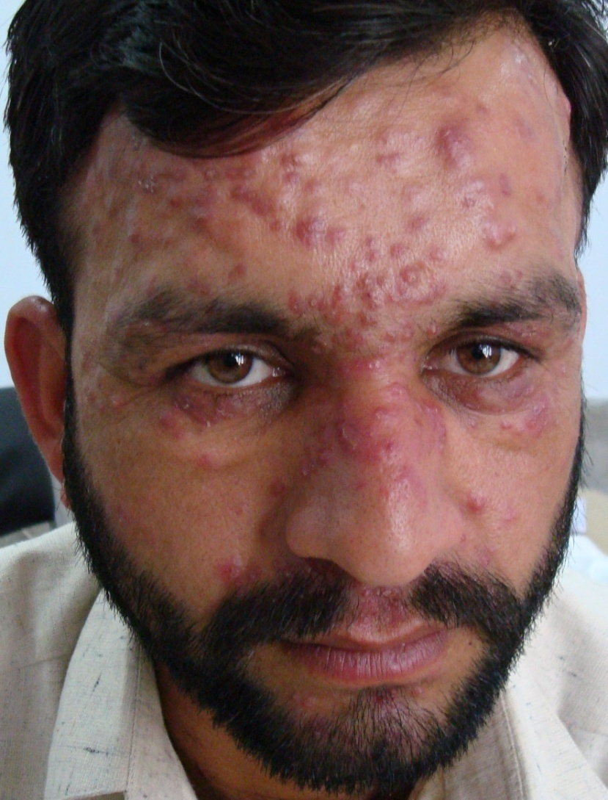
DIFFERENTIAL DIAGNOSIS?
Notes:
Pseudolymphoma
PMLE
Sarcoidosis
Tumid LE
Acne agminata

Slide 12
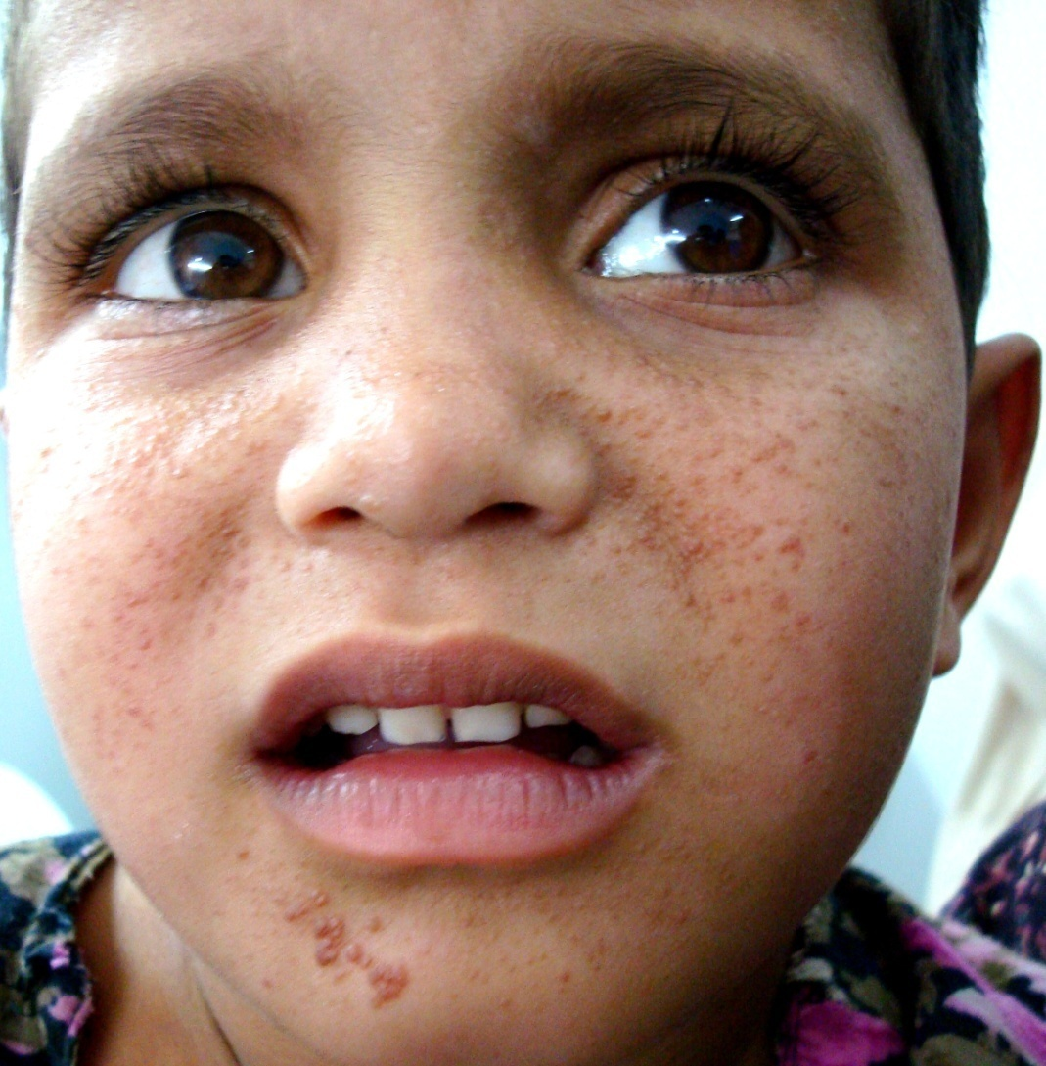
DIFFERENTIAL DIAGNOSIS?
Notes:
Angiofibroma
Plane warts
Trichoepitheliomas
Benign histiocytosis

Slide 13
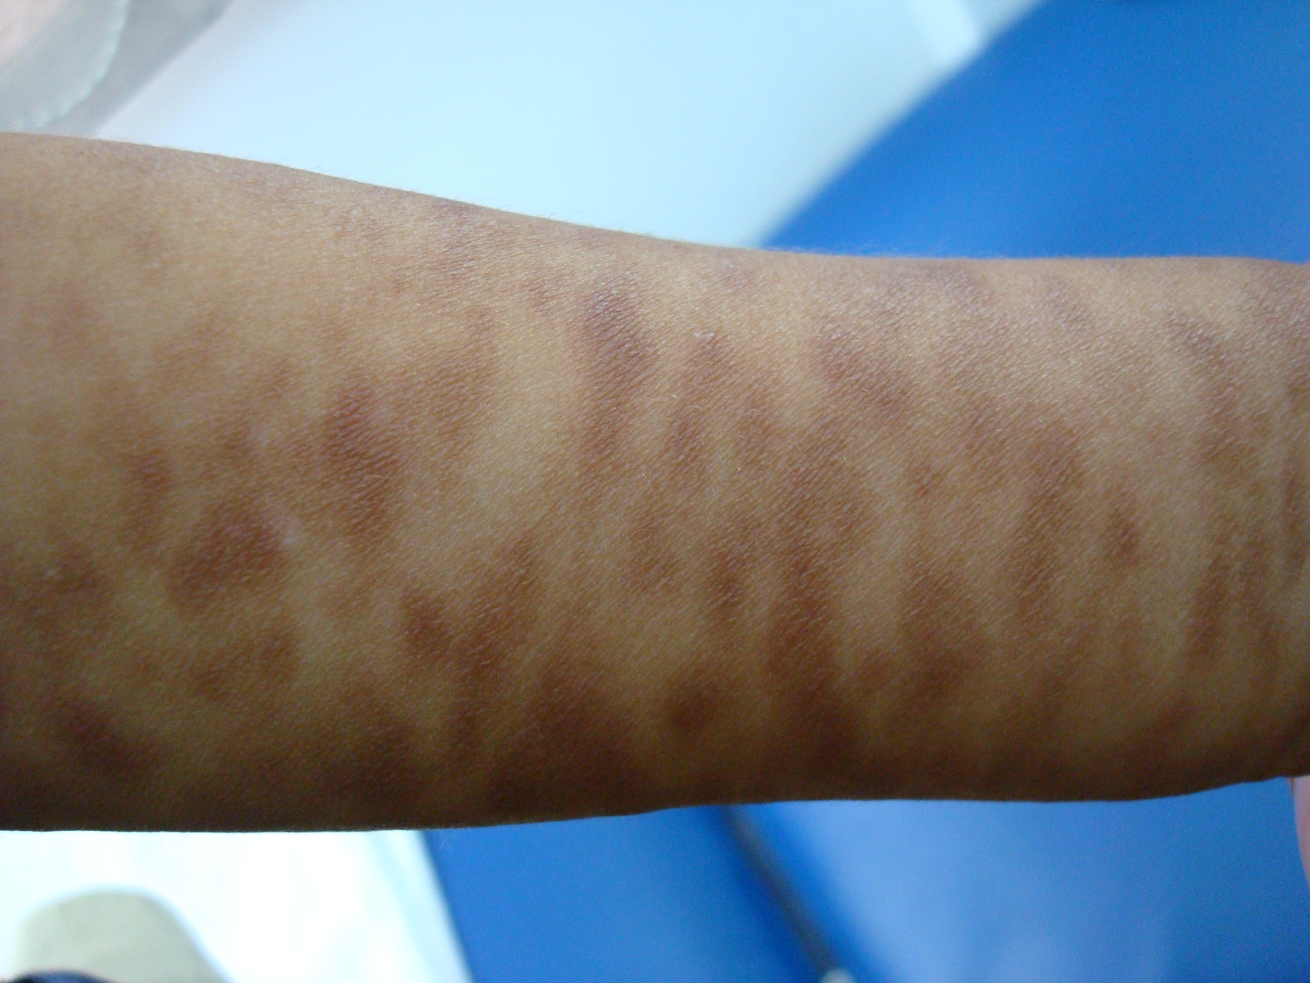
DIFFERENTIAL DIAGNOSIS?
Notes:
Parapsoriasis (digitate)
Plaque stage CTCL
Phytophotodermatitis
Urticaria pigmentosa

Slide 14
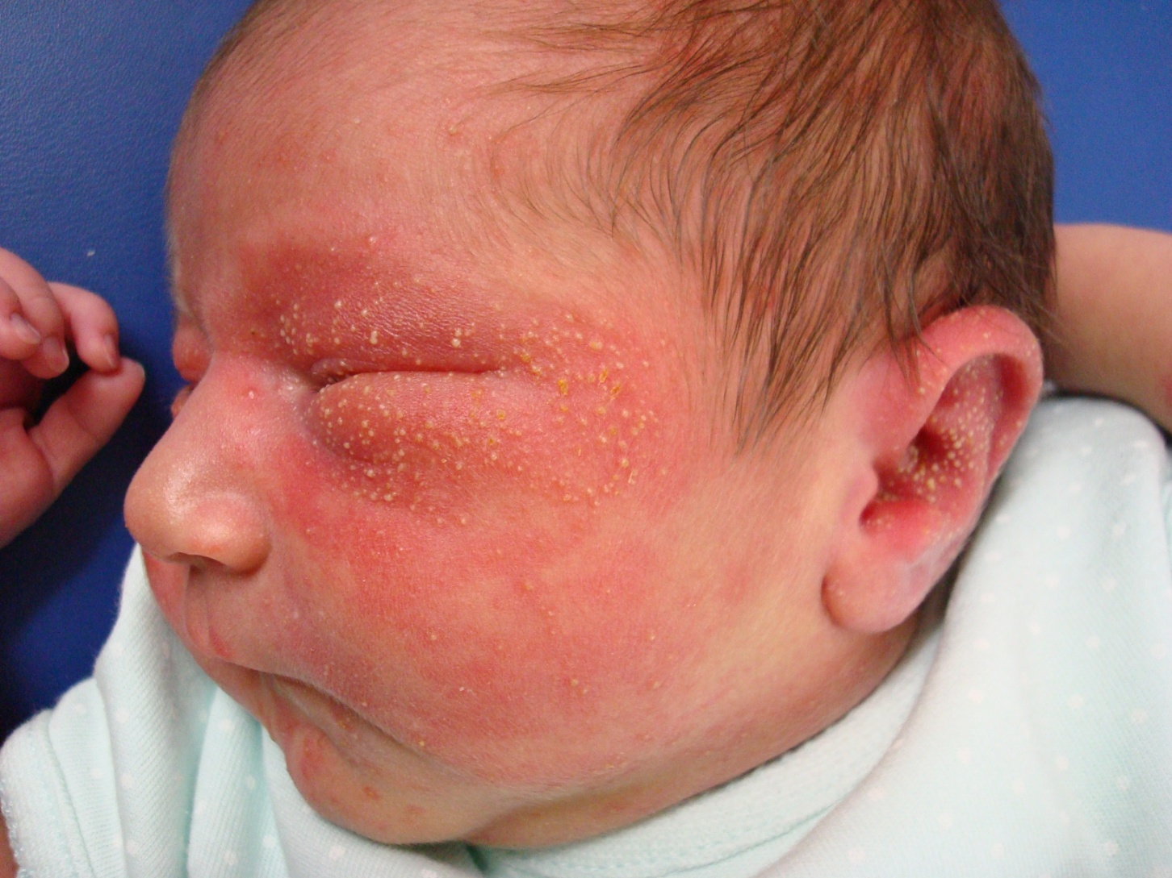
DIFFERENTIAL DIAGNOSIS?
Notes:
Erythema neonatorum toxicorum
Eosinophilic folliculitis
Miliaria pustulosa
impetigo

Slide 15
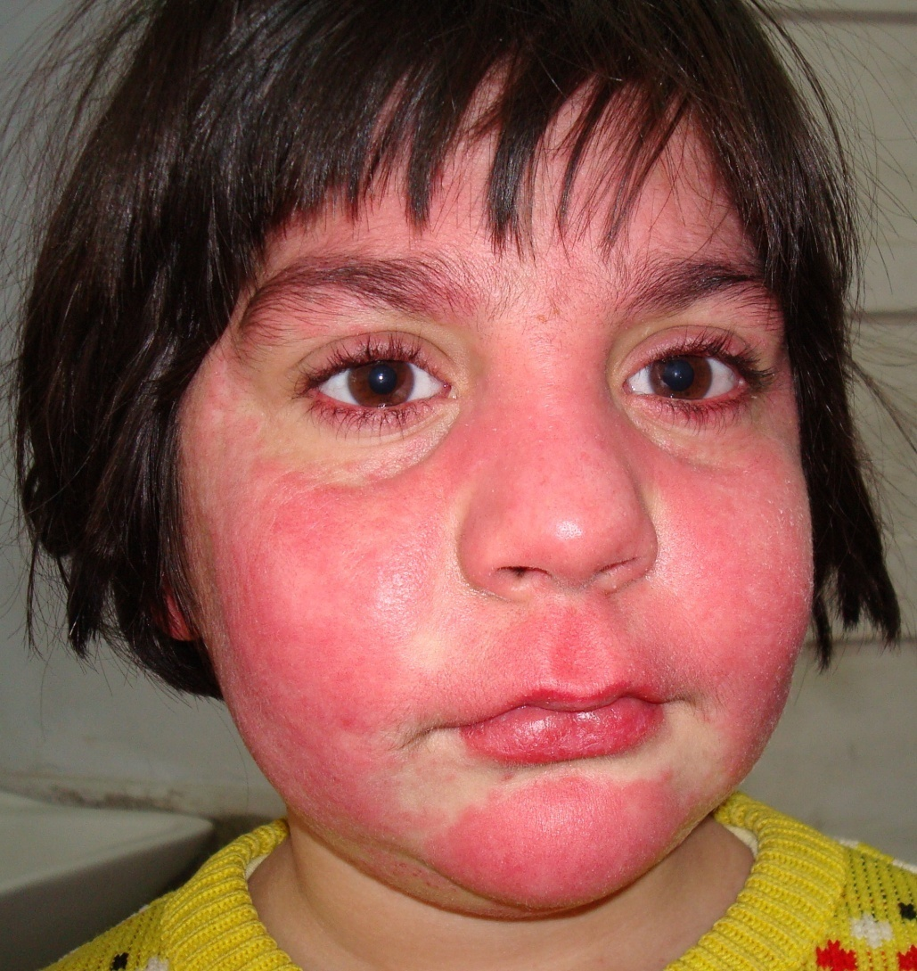
WHAT IS LIKELY DIAGNOSIS?
Notes:
Photoirritant dermatitis

Slide 16
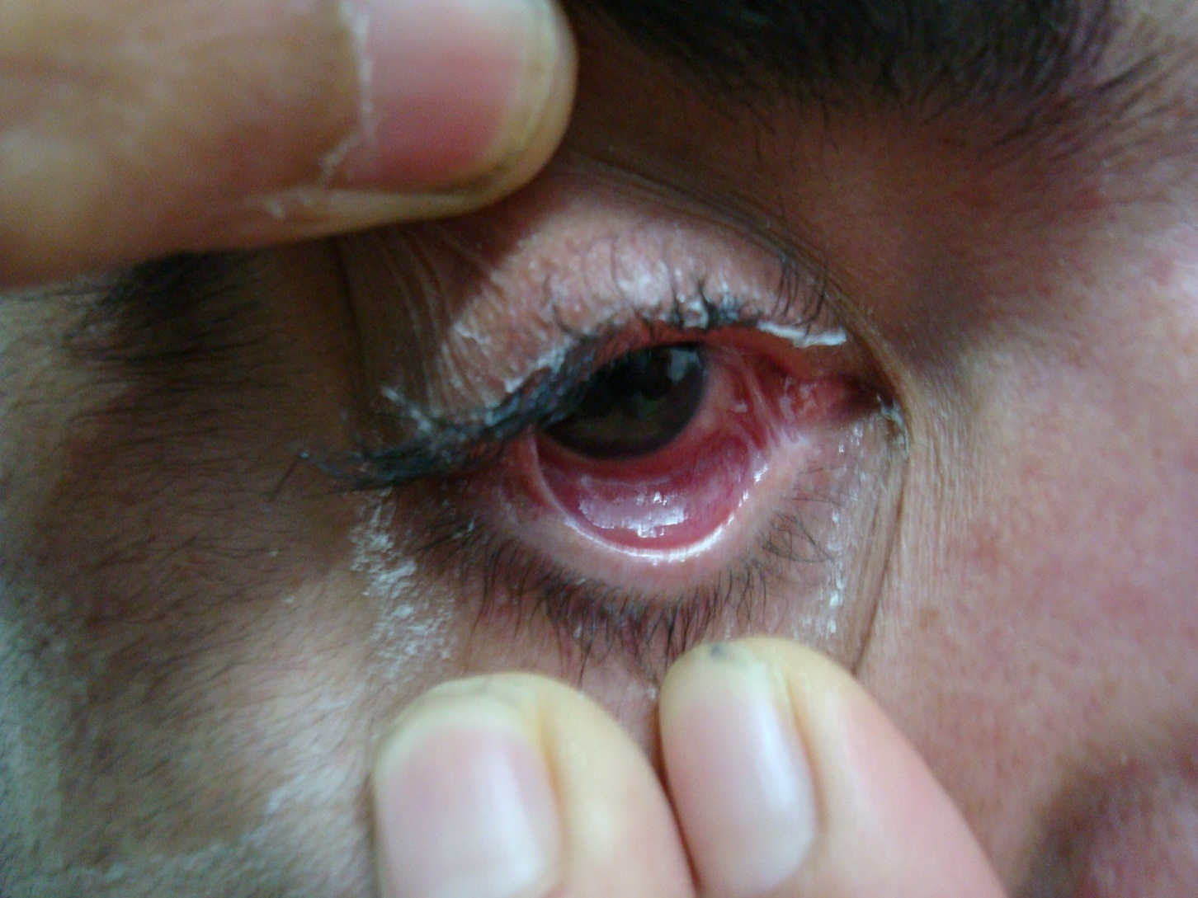
DIFFERENTIAL DIAGNOSIS?
Notes:
Cicatricial pemphigoid
Paraneoplastic pemp
TEN/SJS
Burn

Slide 17
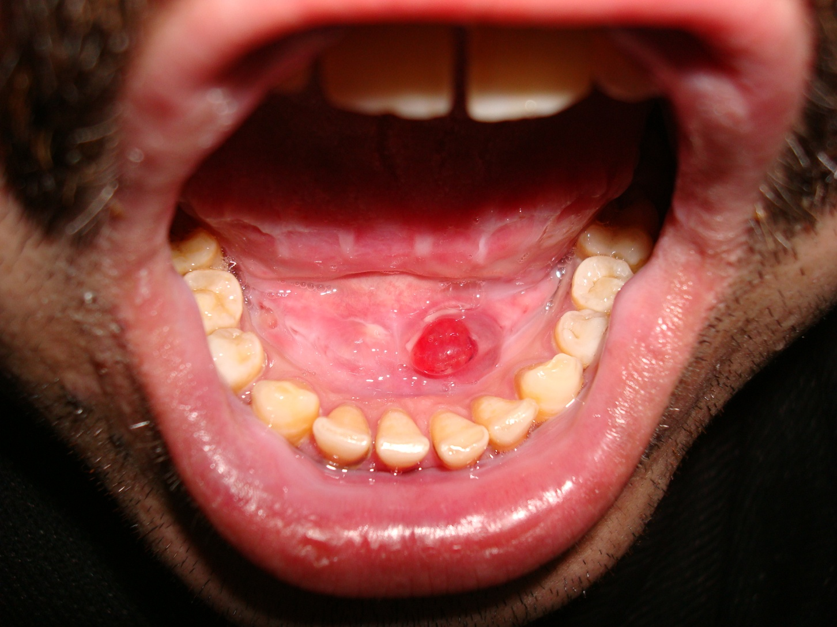
polypo
DIFFERENTIAL DIAGNOSIS?
Notes:
Polypoidal erythematous growth
D/D
Pyogenic granuloma
Hemangioma
Fibroma
Pleomorphic adenoma (must consider for mouth)
Malachoplakia
Verruciform xanthoma

Slide 18
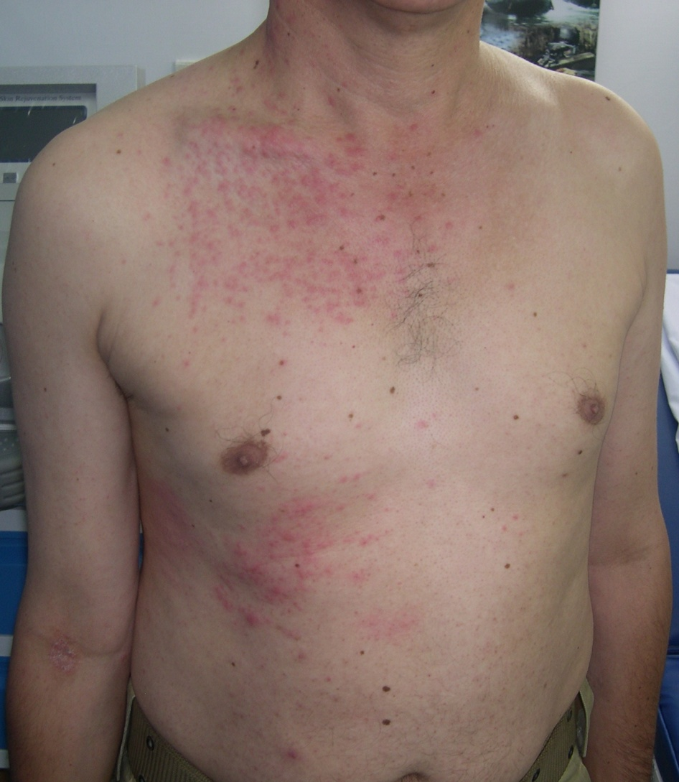
WHAT IS LIKELY DIAGNOSIS?
Notes:
Unilateral flexural exanthem

Slide 19
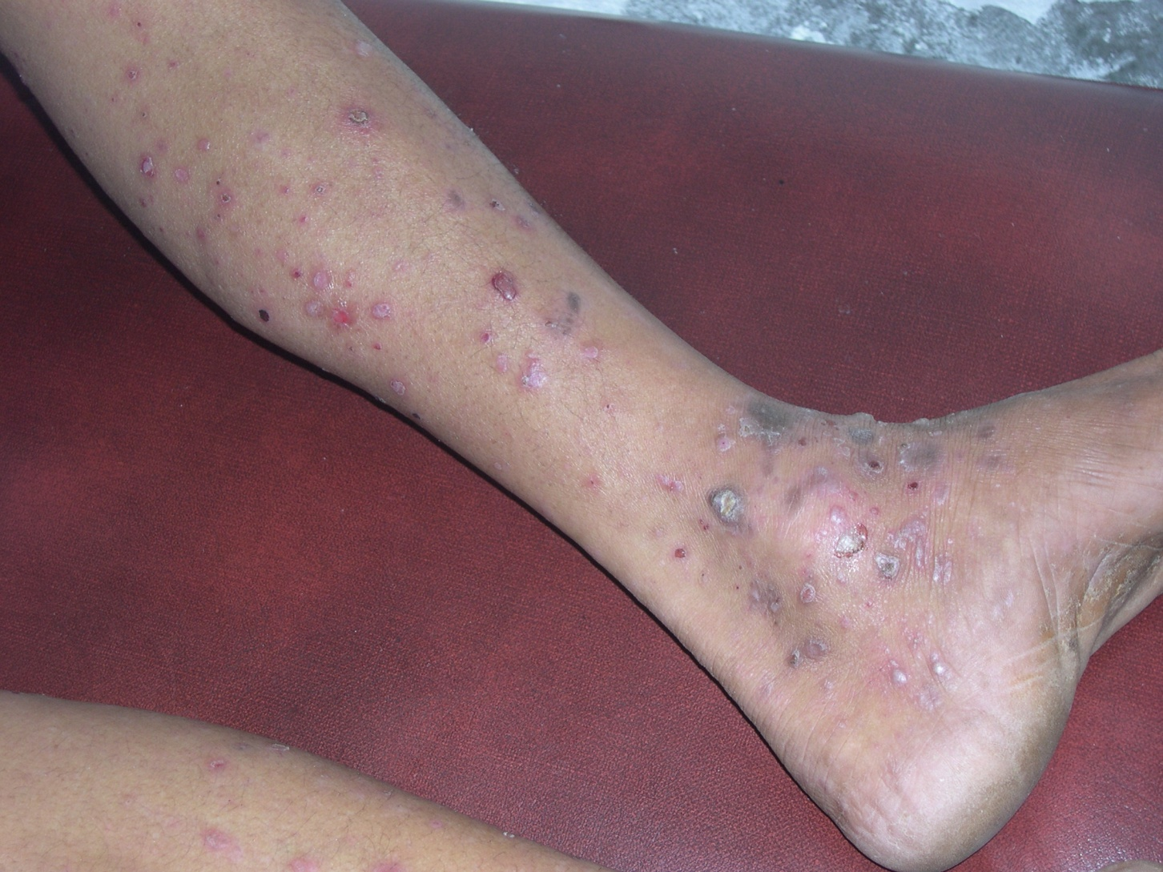
WHAT IS LIKELY DIAGNOSIS?
Notes:
Bullous lp

