Slide 1
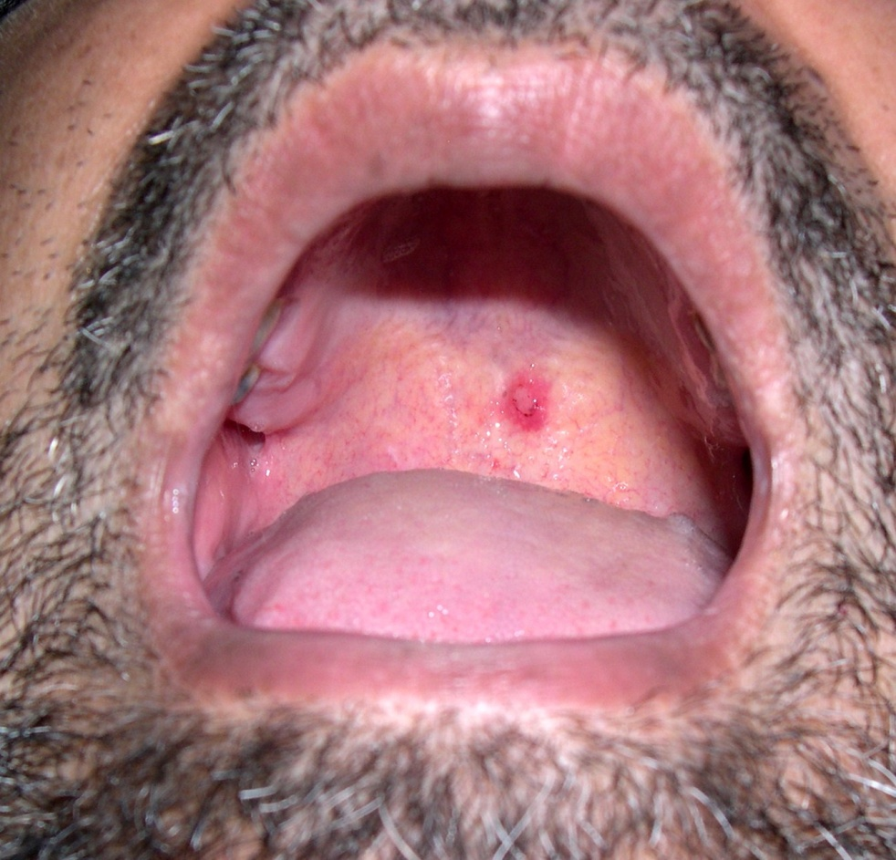
LIKELY DIAGNOSIS OF THIS RECURRENT LESION IN A
PATIENT OF BRONCHIAL ASTHMA
Notes:
Dx:Angina Bullosa haemorhagica
Repeated inhaler of steroid,trauma

Slide 2
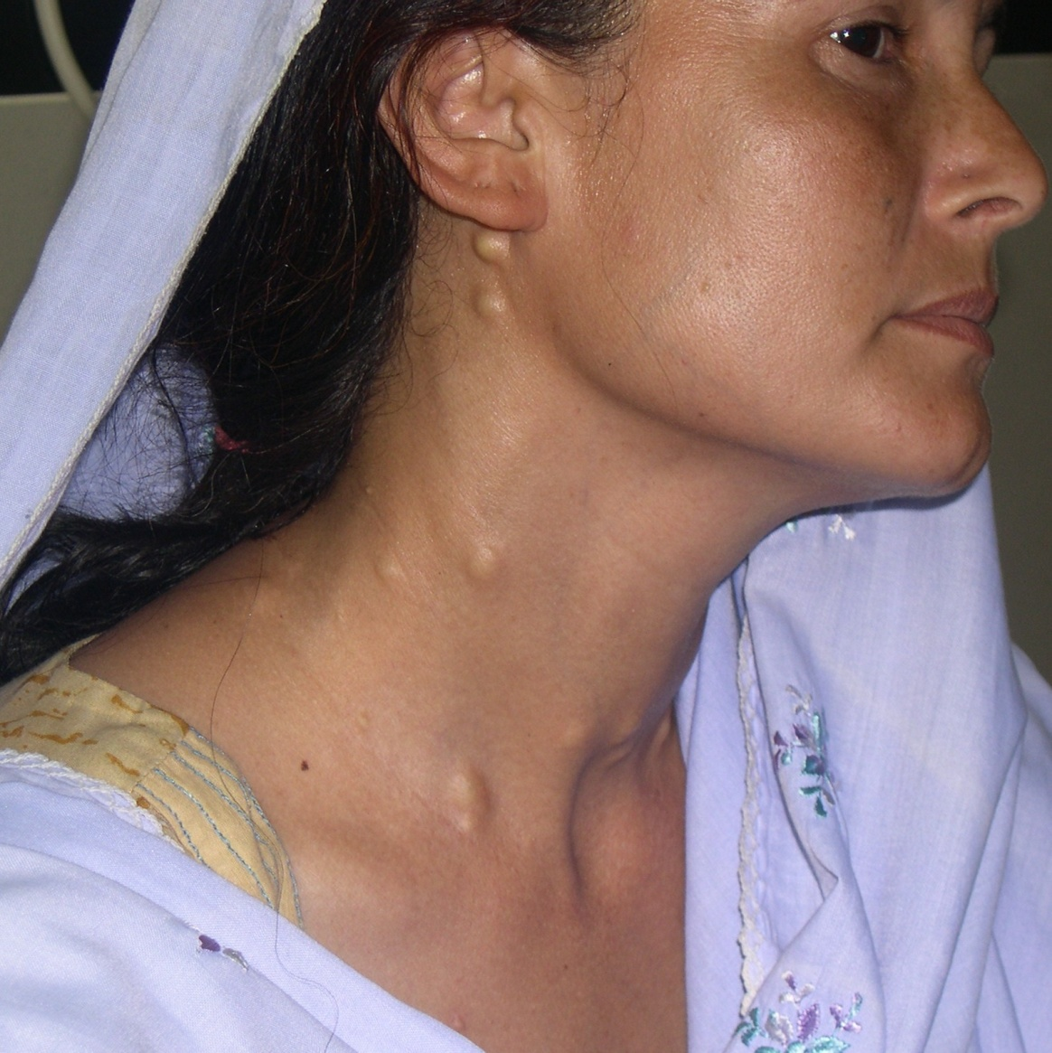
LIKELY DIAGNOSIS
Notes:
Steatocystoma multiplex

Slide 3
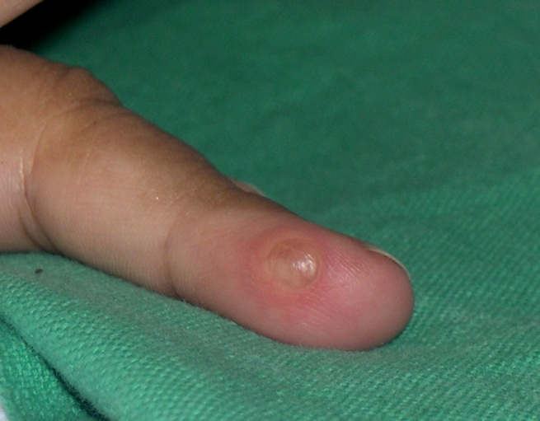
DIFFERENTIAL DIAGNOSIS
Notes:
Fibroma,Eccrine porma,epidermoid

Slide 4
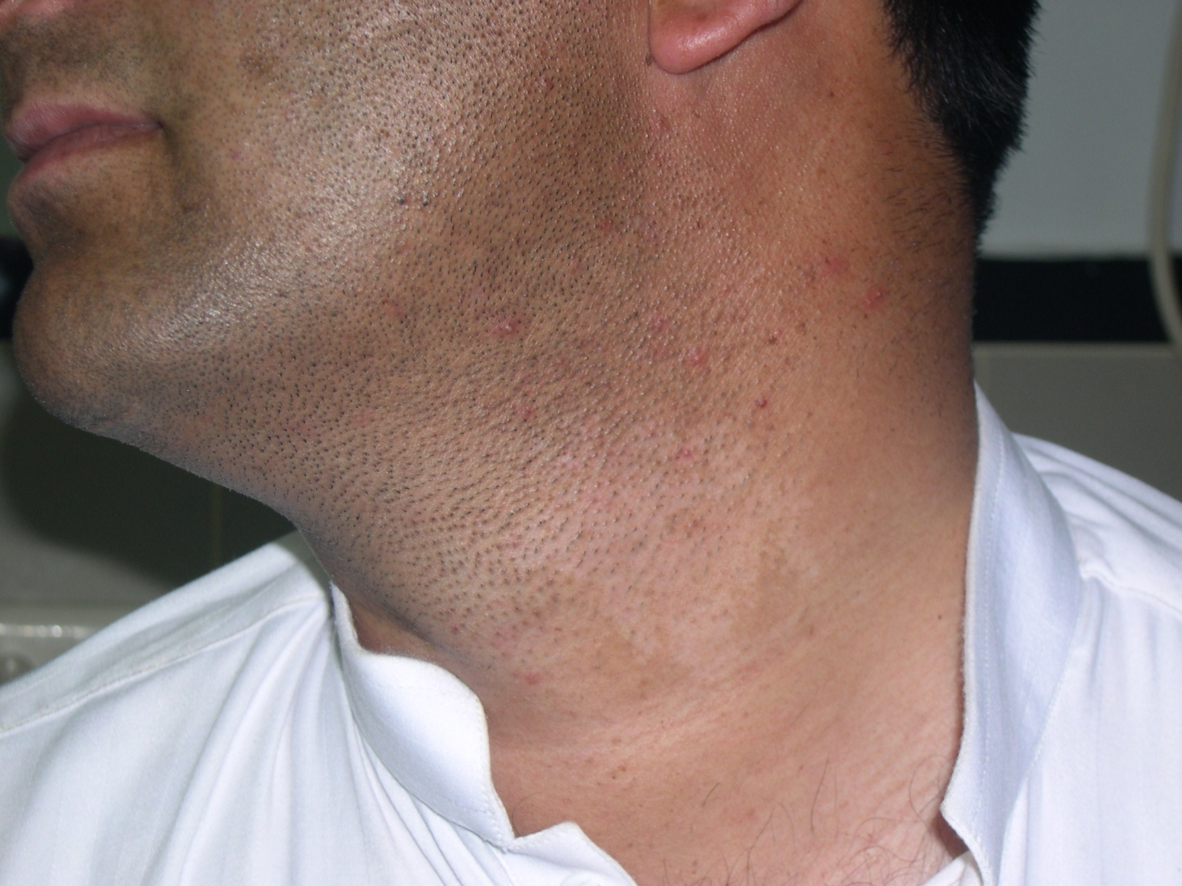
LIKELY DIAGNOSIS IN THIS PHARMACOLLOGICALLY MEDIATED LESION
Notes:
Nevus anemicus

Slide 5
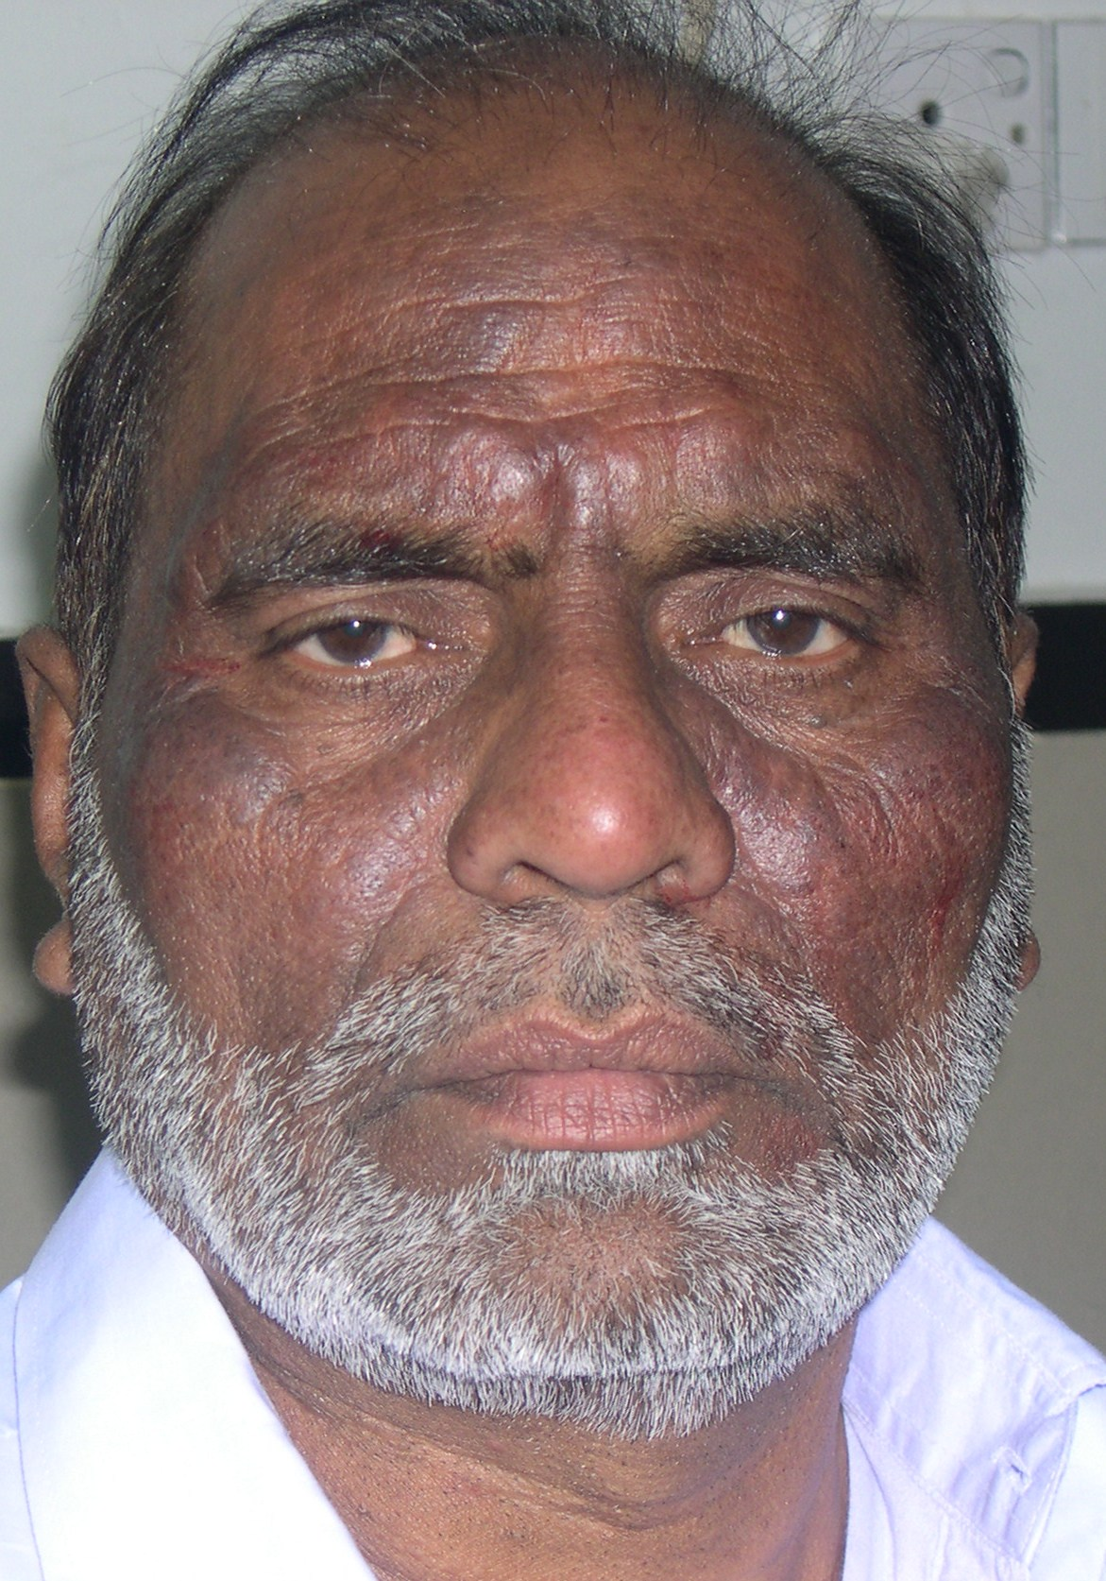
DIFFERENTIAL DIAGNOSIS
Notes:
CAD,Actinic reticculoids ,Psedolymphoma,

Slide 6
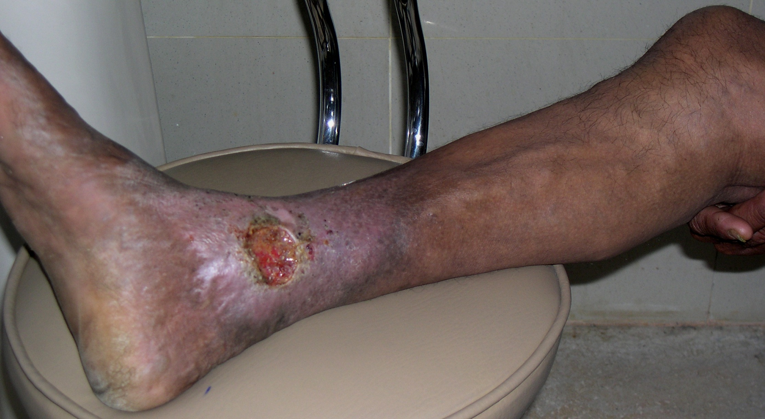
LIKELY DIAGNOSIS
Notes:
Venous ulcer

Slide 7
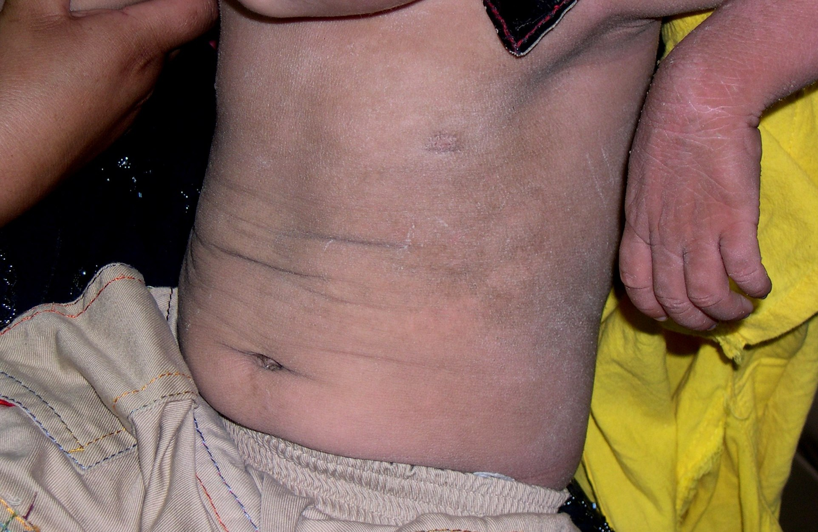
LIKELY DIAGNOSIS
Notes:
Epidermolytic Hyperkeratosis

Slide 8
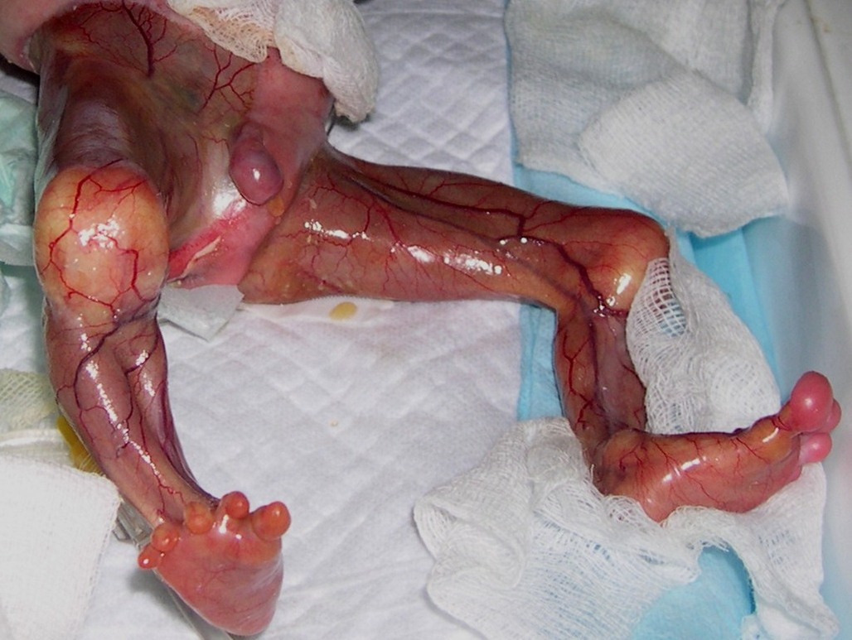
LIKELY DIAGNOSIS
Notes:
Aplasia cutis

Slide 9
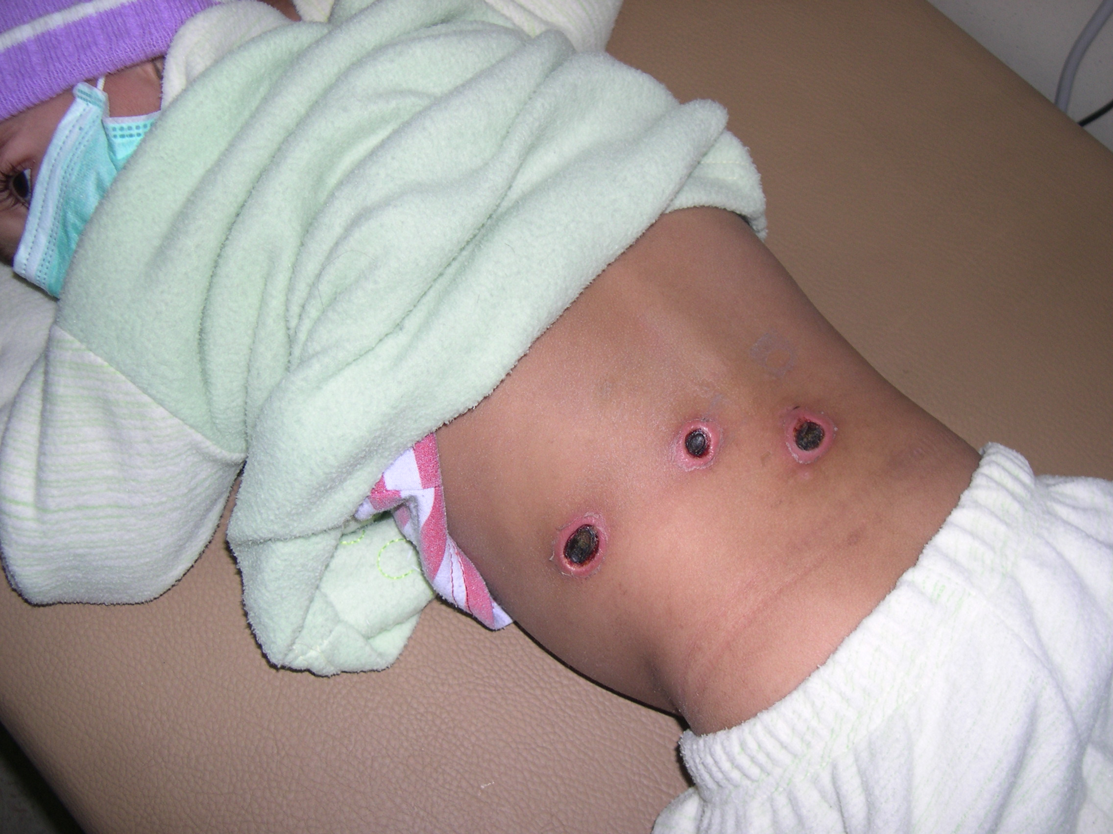
LIKELY DIAGNOSIS
Notes:
Hx brain tumor, Intrathecal metho

Slide 10
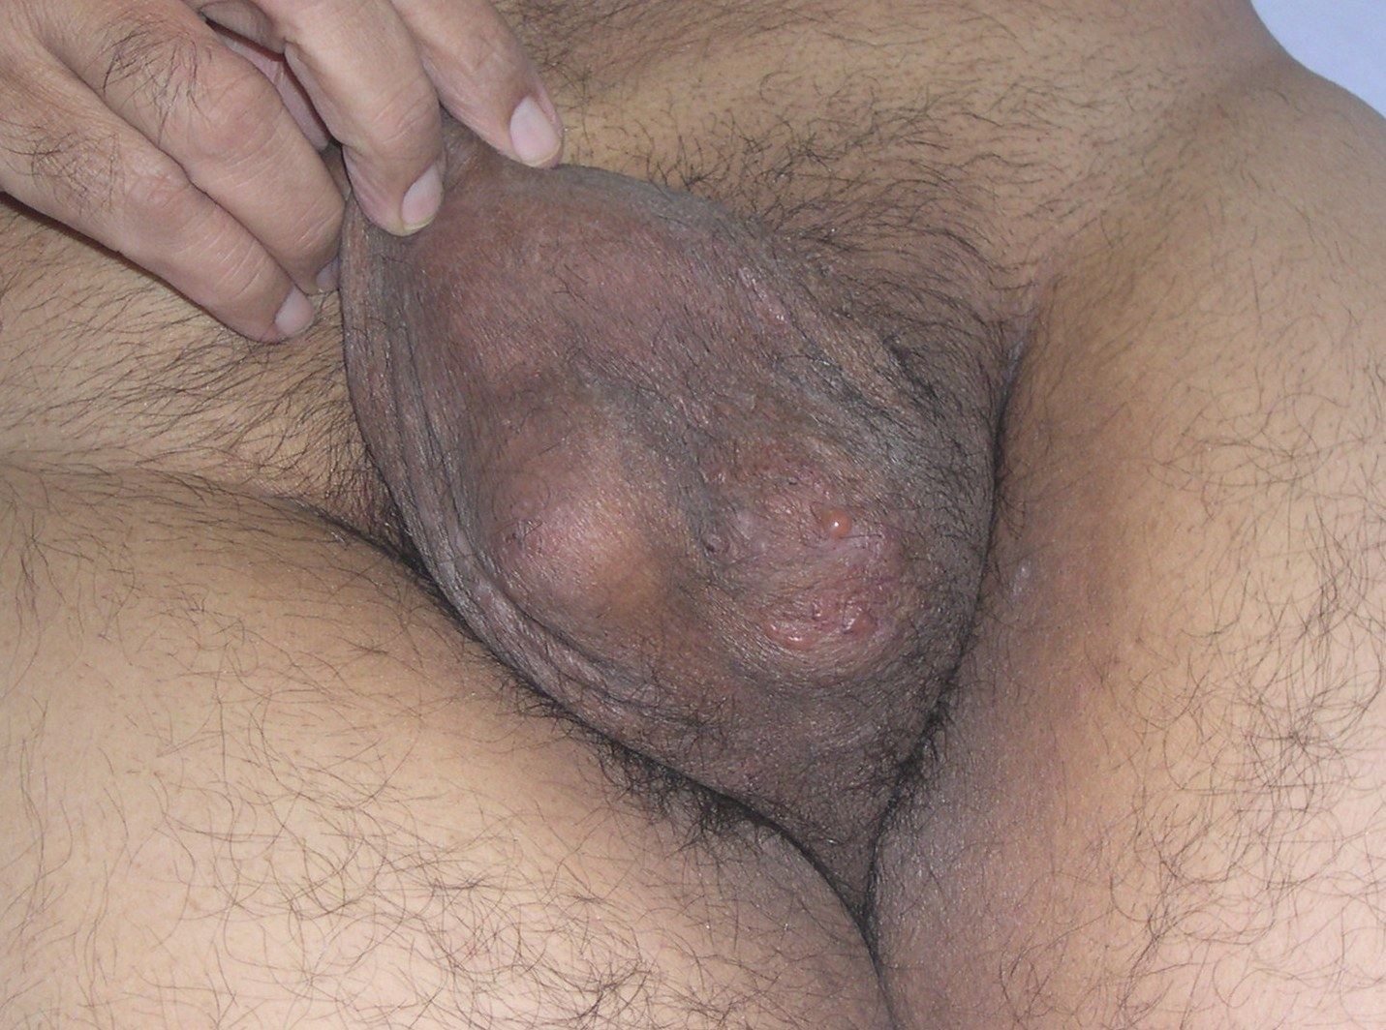
DIAGNOSIS
Notes:
HS

Slide 11
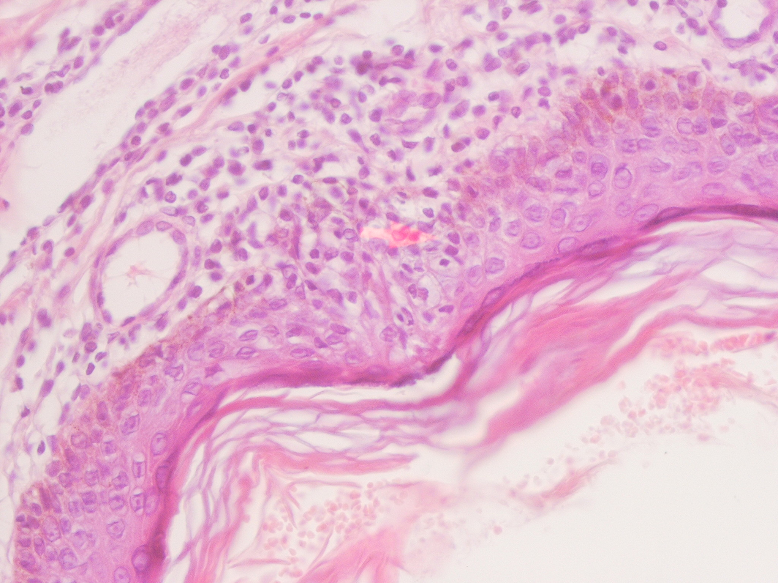
DIAGNOSIS
Notes:
MF

Slide 12
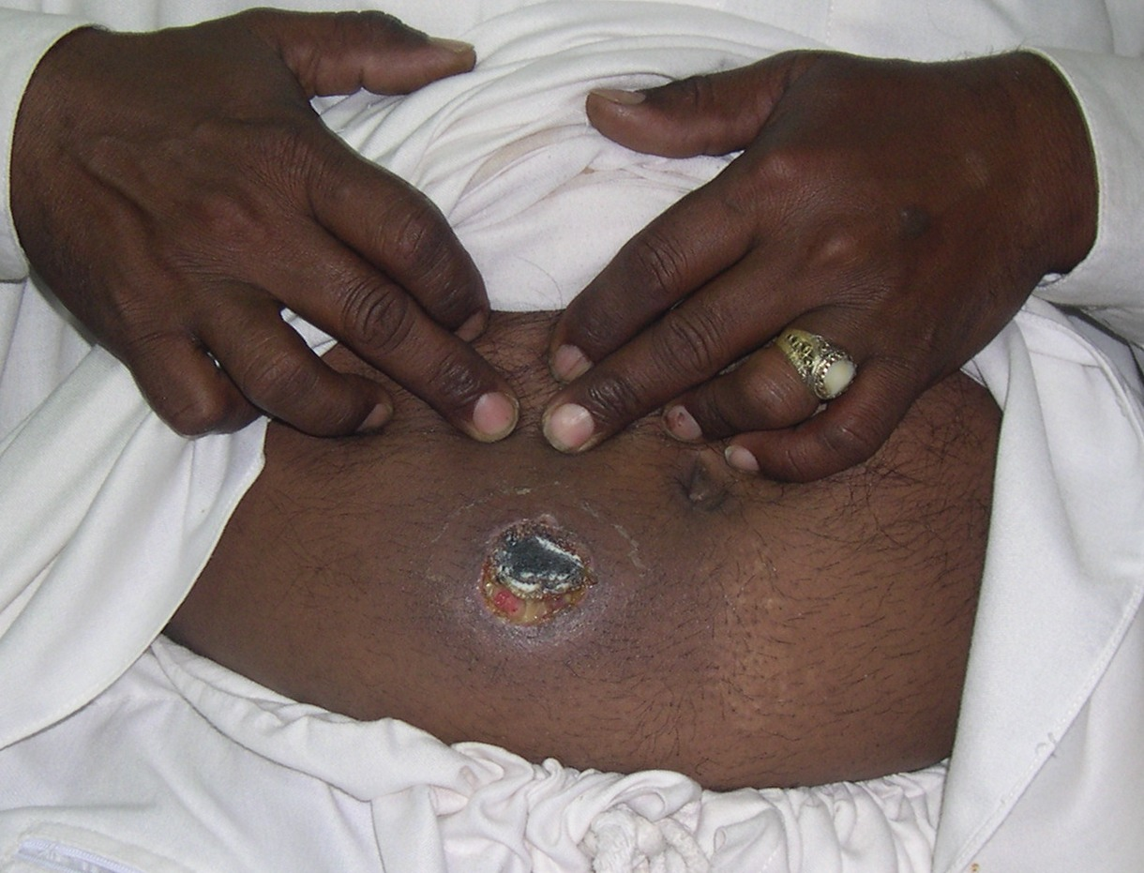
LIKELY DIAGNOSIS
Notes:
Icth gang

Slide 13
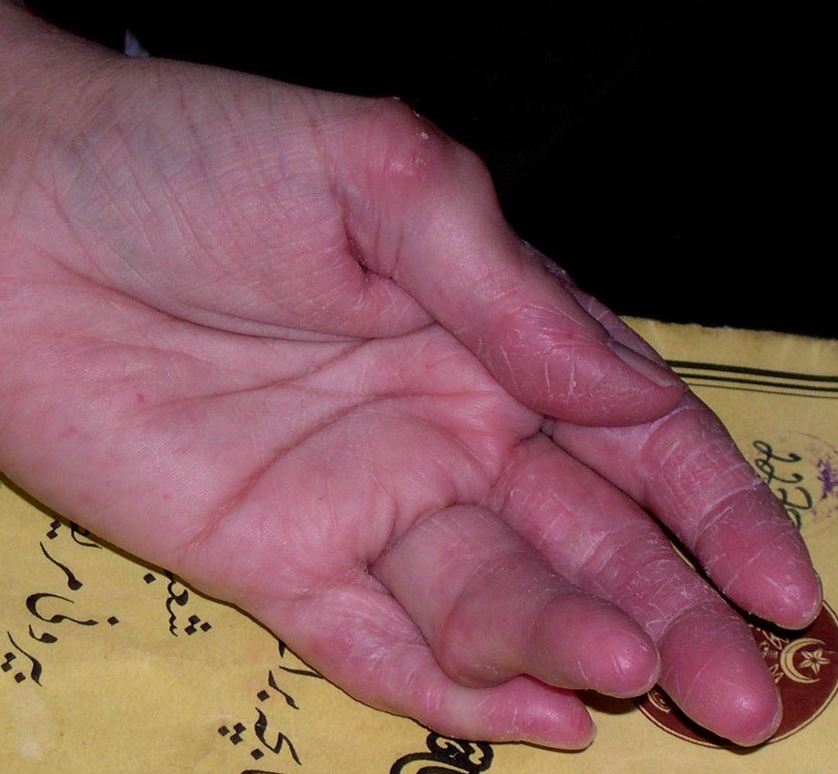
DIFFRENTIAL DIAGNOSIS
Notes:
Rh nodule,Gout

Slide 14
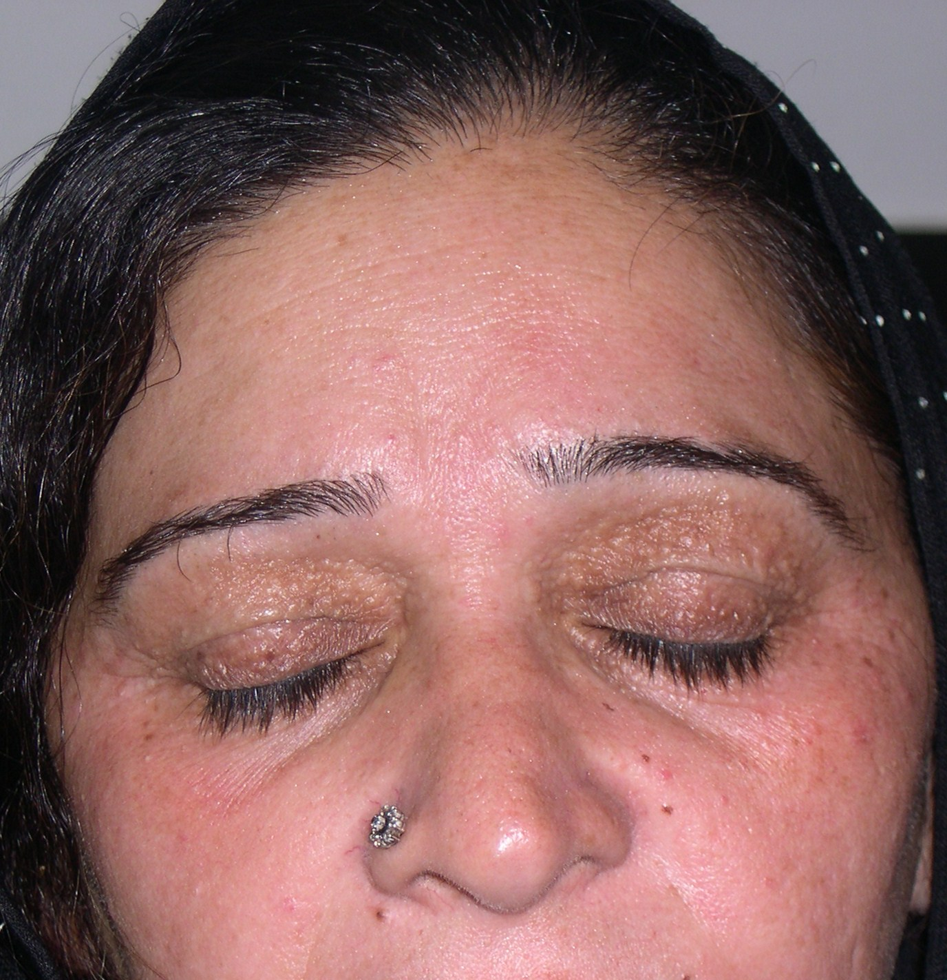
DIAGNOSIS
Notes:
syringoma

Slide 15
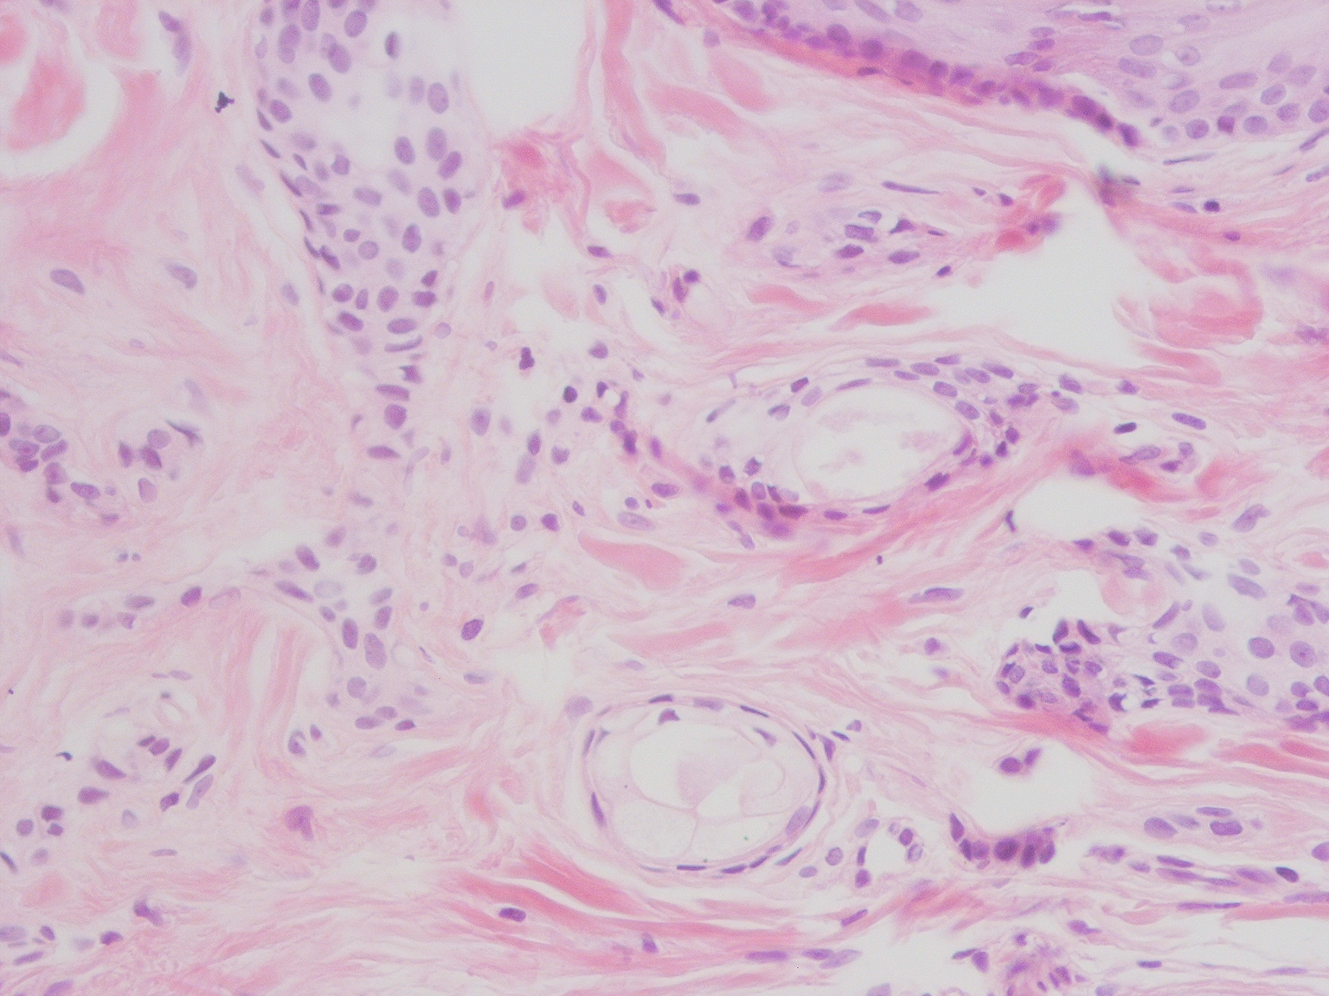
DIAGNOSIS
Notes:
syringoma

Slide 16
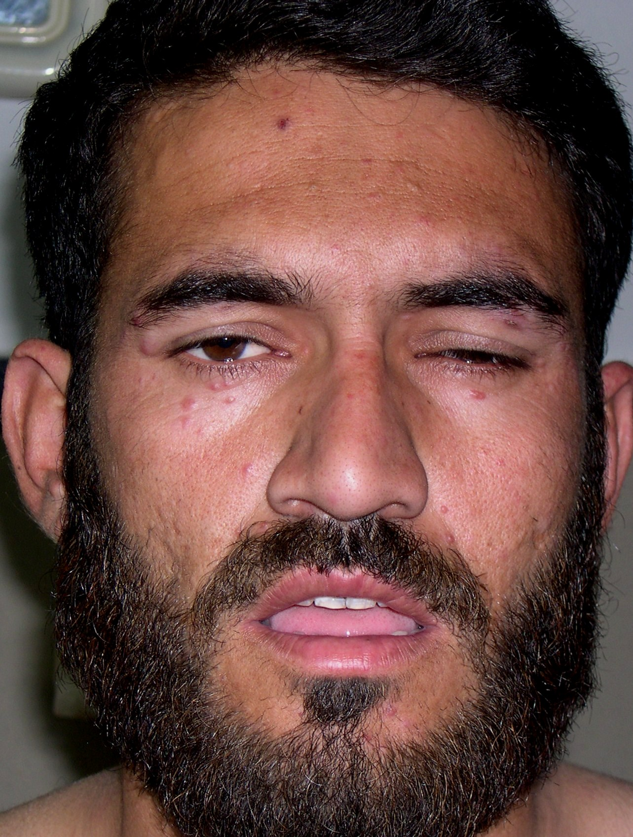
DIFFRENTIAL DIAGNOSIS
Notes:
Acne agminat,angiolupoid

Slide 17
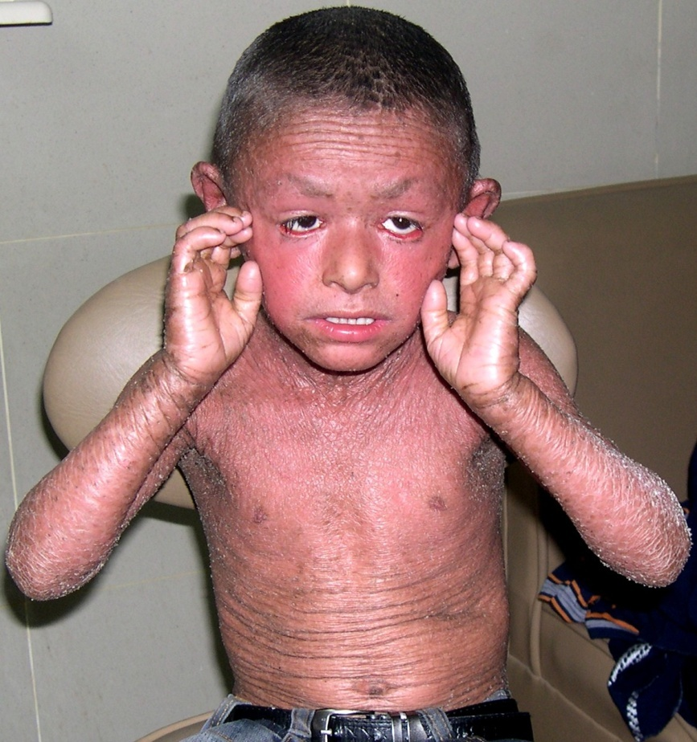
DIAGNOSIS
Notes:
NBIE

Slide 18
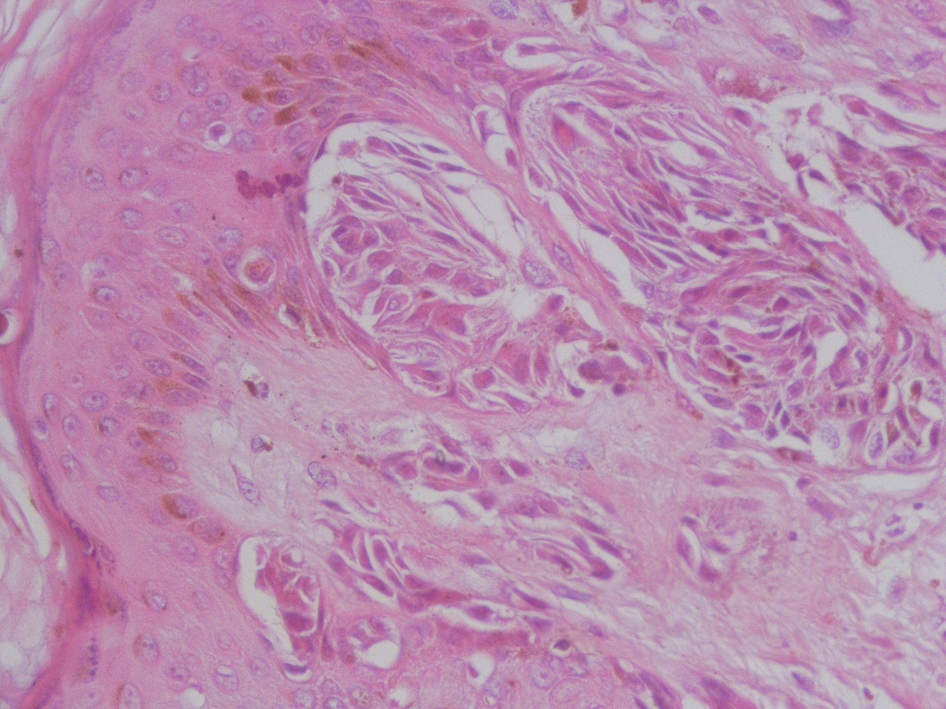
DIAGNOSIS
Notes:
Spitz nvus

