Slide 1
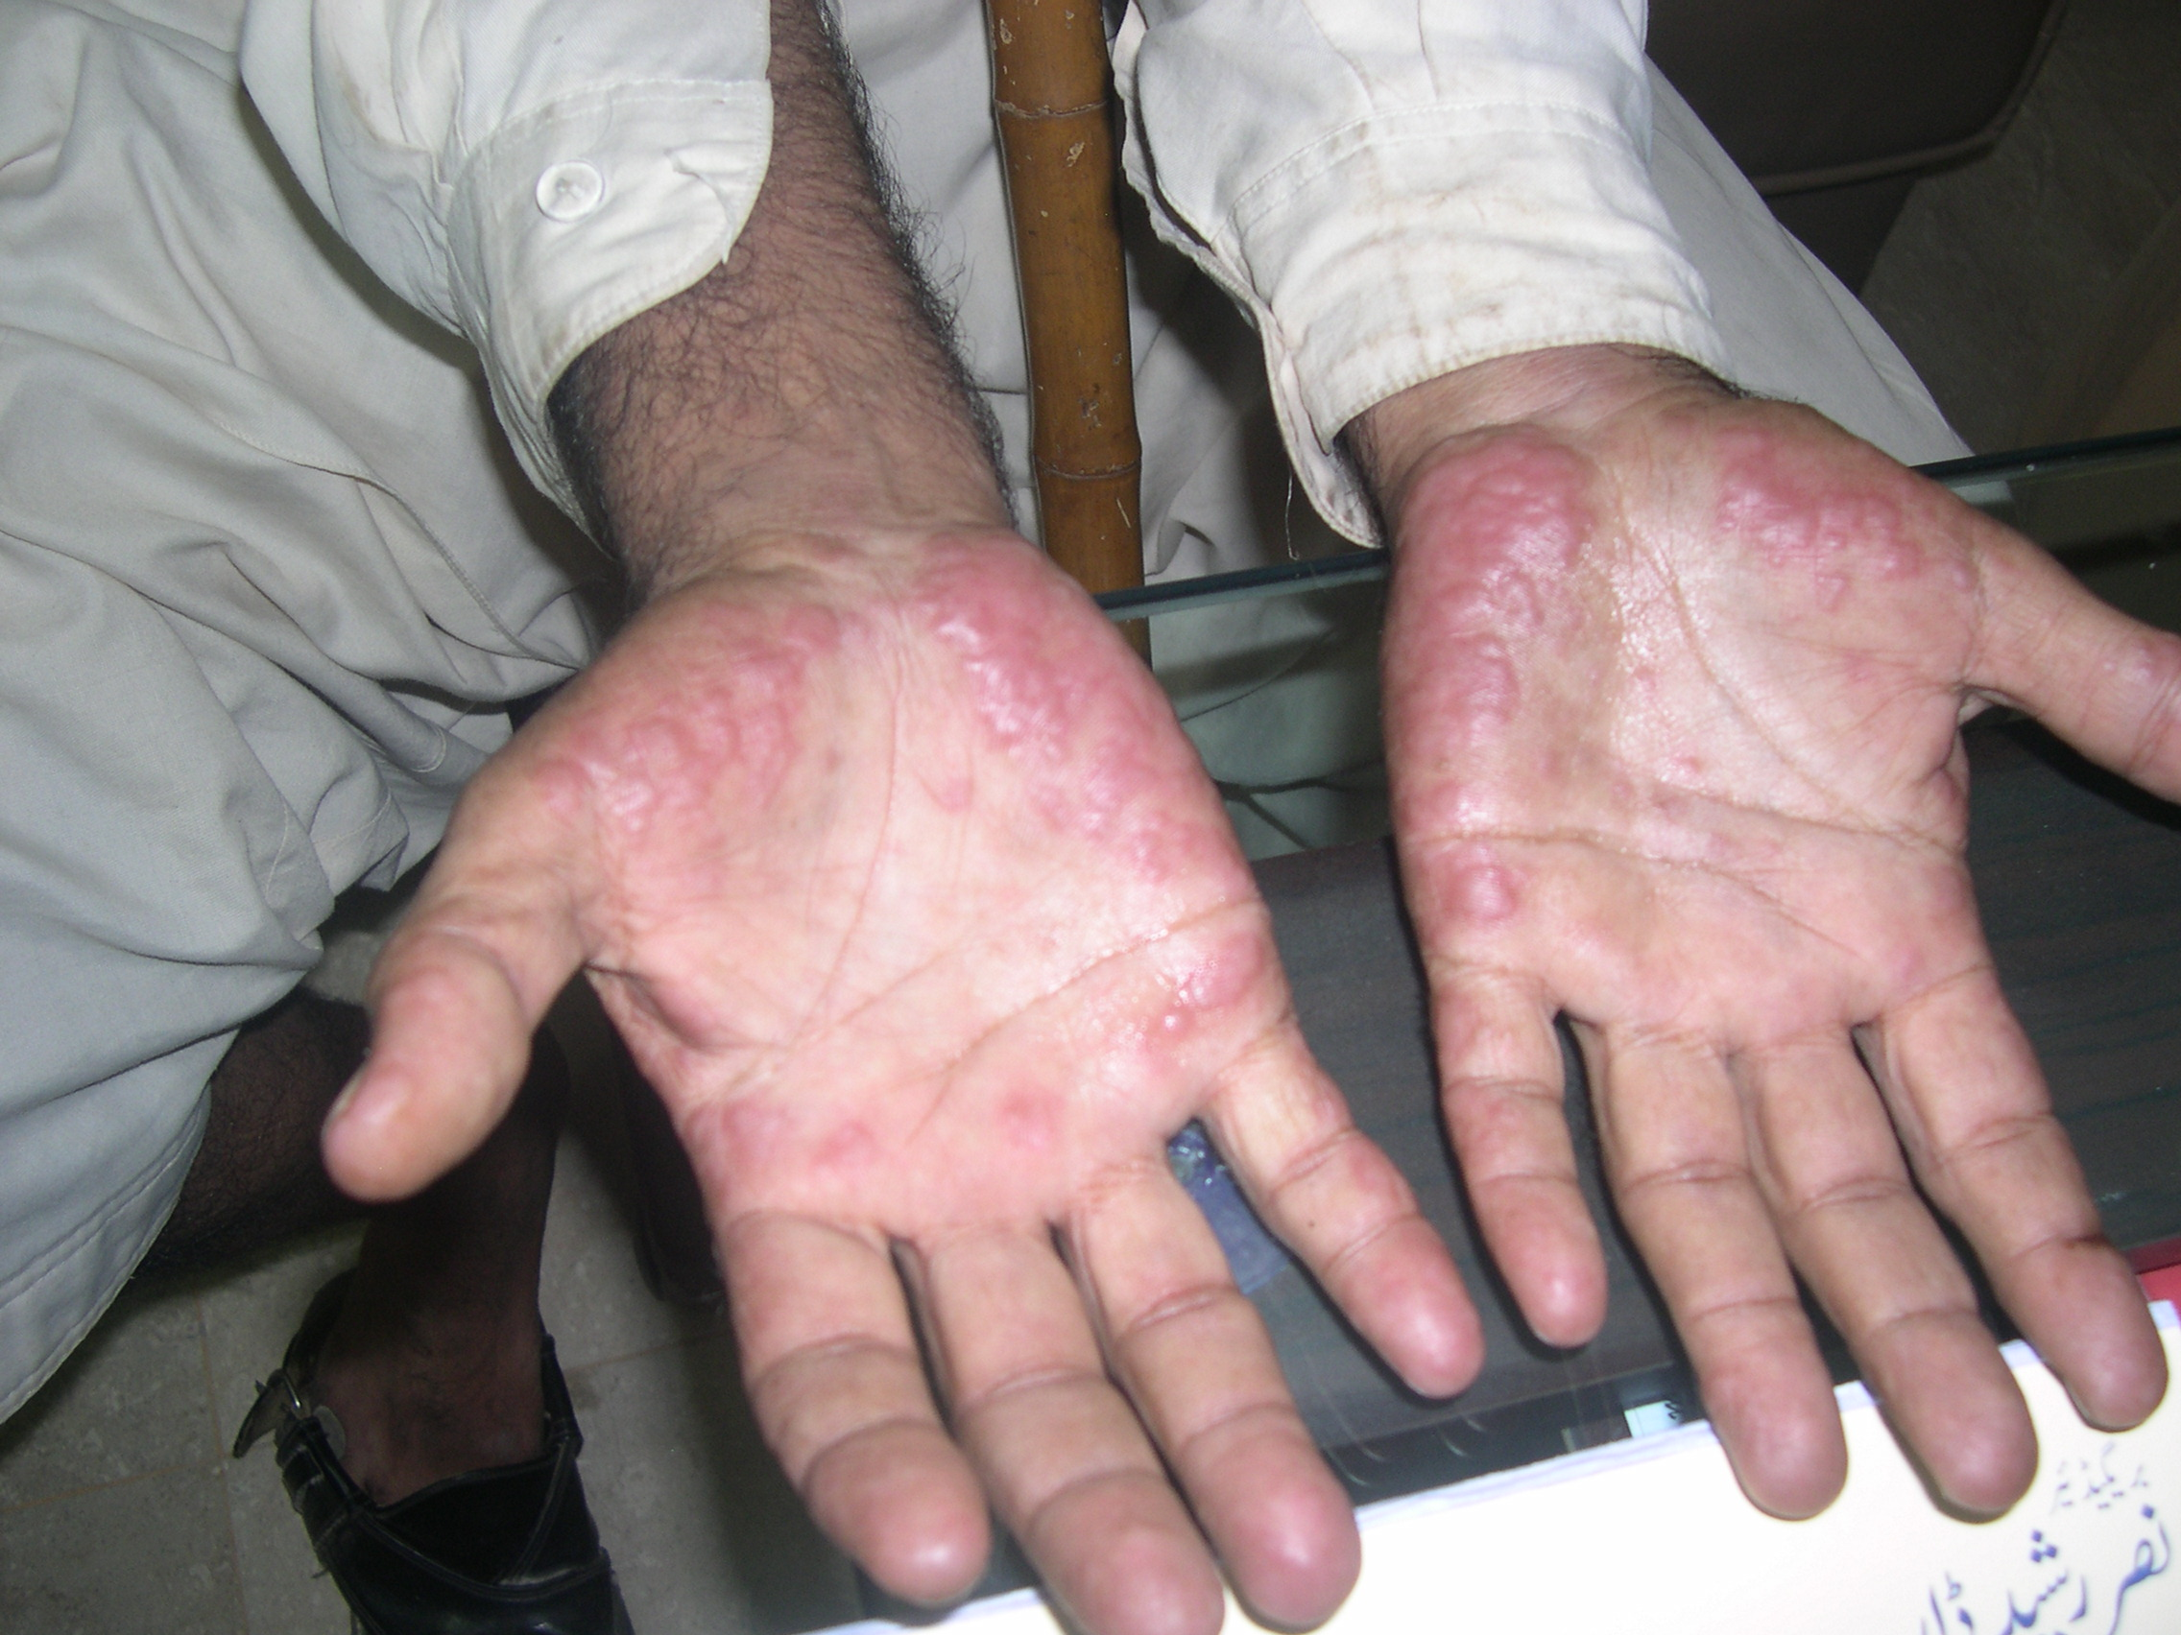
Notes:
Eccrine neutrophilic hidadenitis, EM, Acral sweets, lymphoma

Slide 2
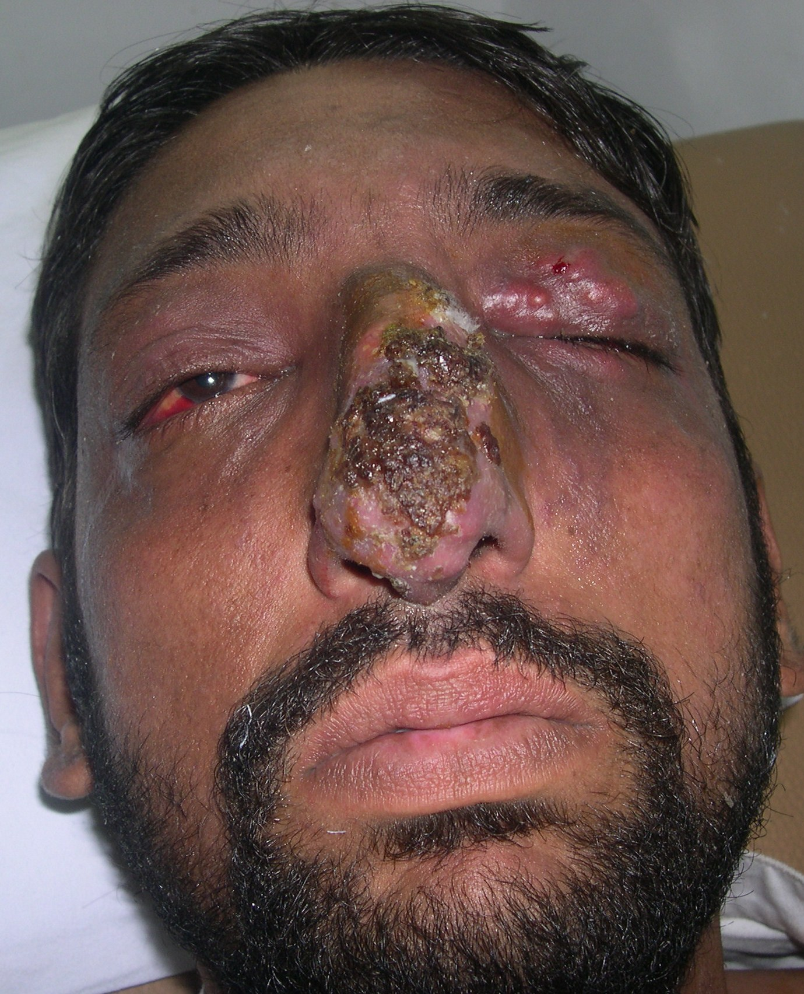
Notes:
Deep mycosis, cut.leishmaniasis, gumma, lymphoma, atypical mycobacterium

Slide 3
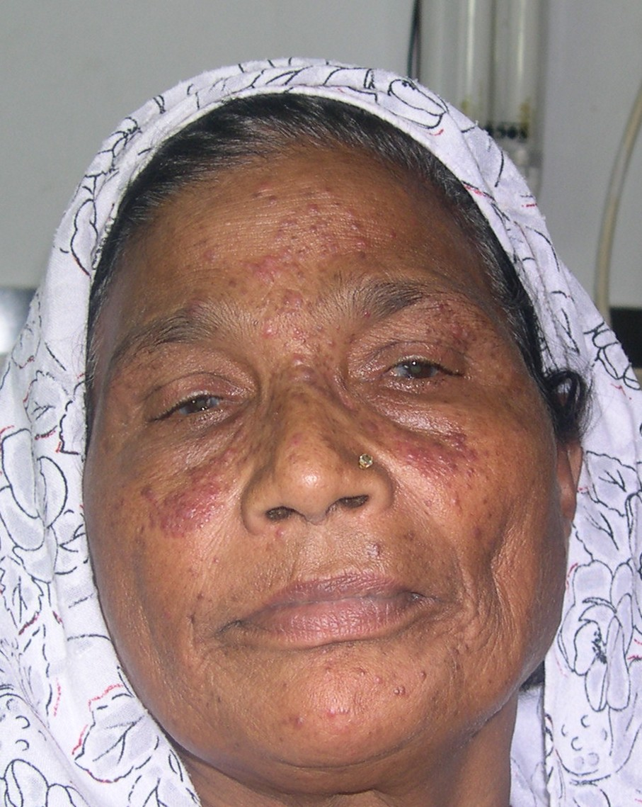
Notes:
Acne agminata, papular sarcoidosis, periorifacial dermatitis, B.cell lymphoma

Slide 4
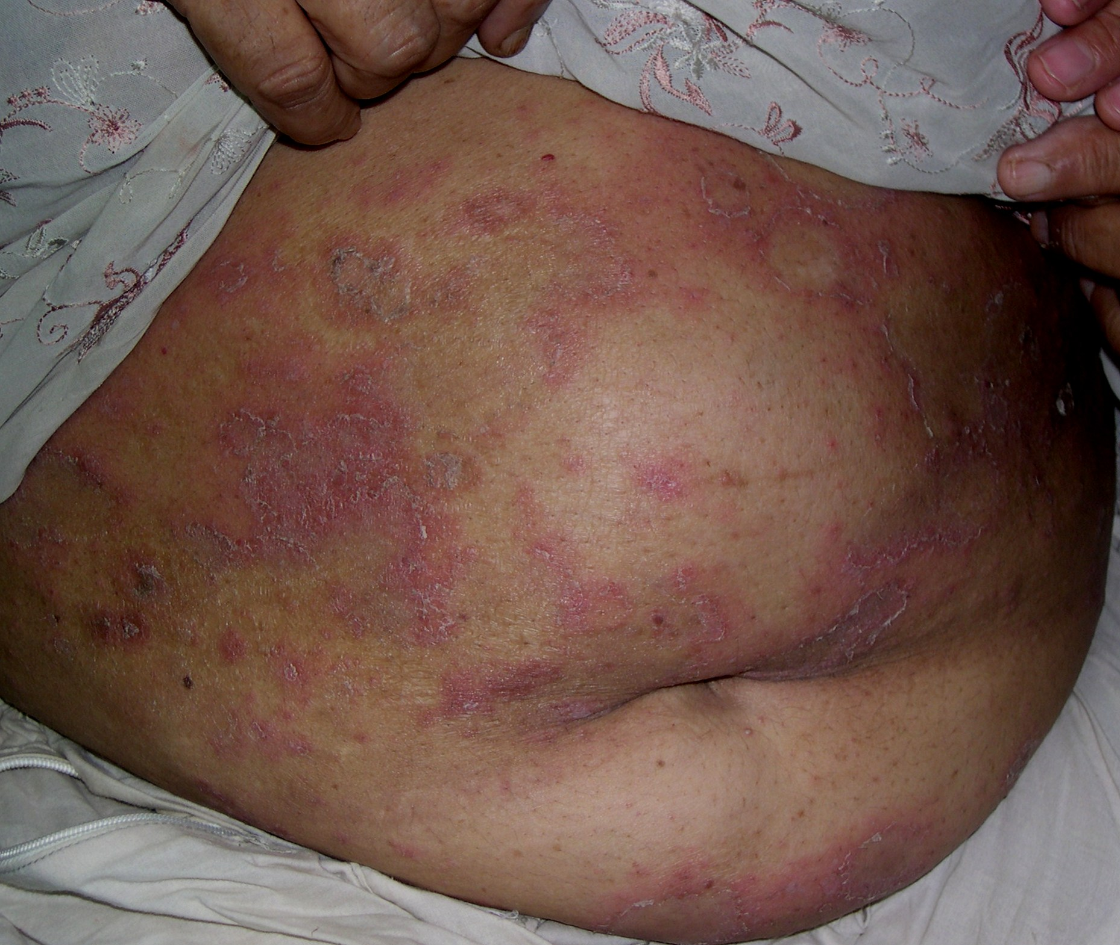
Notes:
EAC, SCLE, leprosy, healing pustular psoriasis,

Slide 5
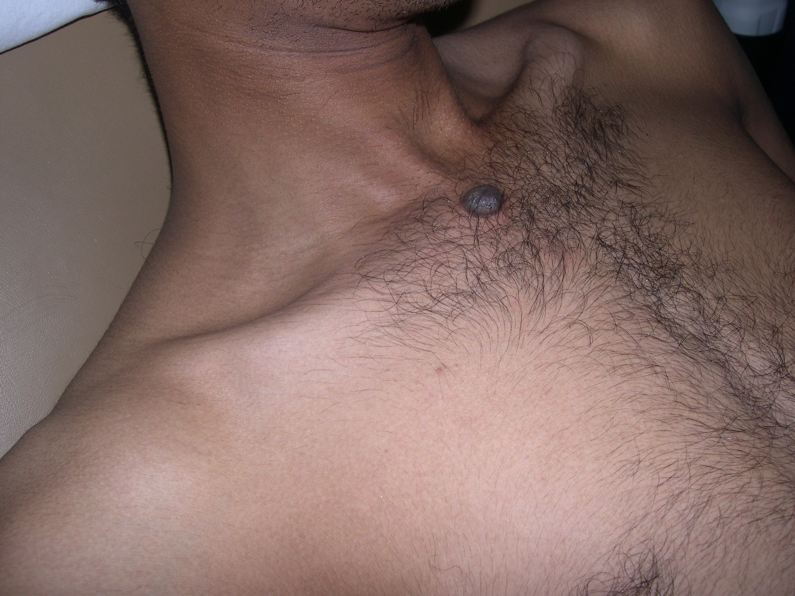
Notes:
COMPOUND melanocytic nevus, spitz nevus, appendegial tumour,dermatofibroma

Slide 6
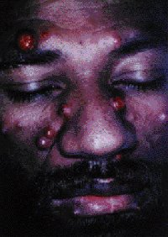
Notes:
Bacillary angiomatosis,coccidioidomycosis in aids

Slide 7
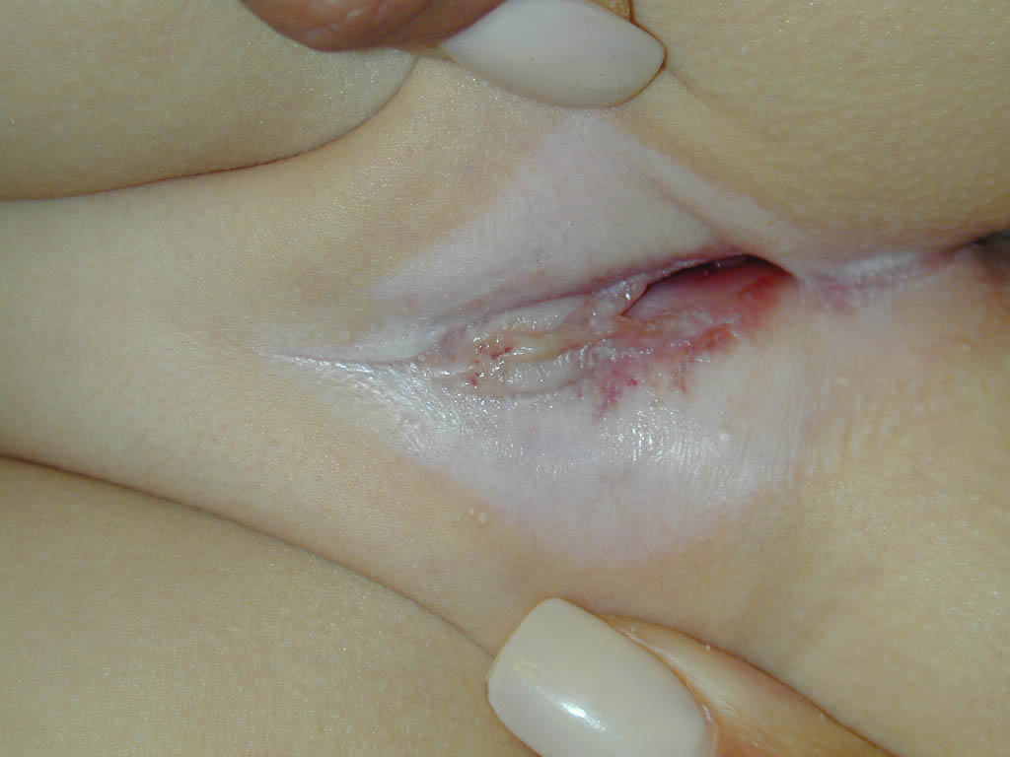
Notes:
LSA

Slide 8

WHAT IS THE DIAGNOSIS?
WHAT ARE THE HISTOPATHOLOGICAL FEATURES?
Notes:
Eccrine hidrocystomas

Slide 9
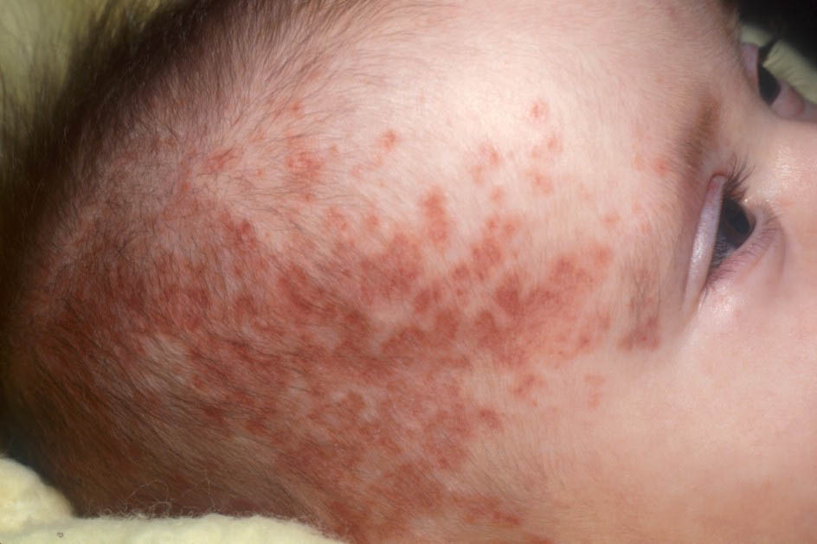
THIS PATIENT ALSO HAD THROMBOCYTOPENIA AND MILD CCF.
WHAT IS THE LIKELY DIAGNOSIS?
WHAT INVESTIGATIONS WILL BE HELPFUL IN CONFIRMING THE DIAGNOSIS?
WHAT COUNSELLING WILL YOU OFFER?
Notes:
NLE

Slide 10
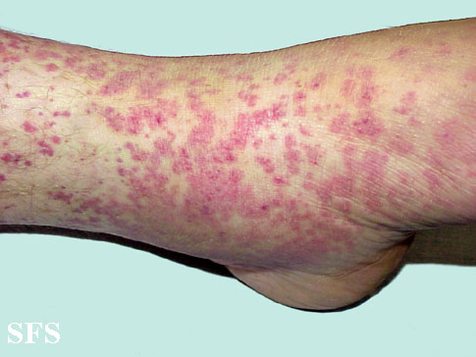
WHAT ARE YOUR FINDINGS?
WHAT IS THE LIKELY DIAGNOSIS?
Notes:
Vasculitis

Slide 11
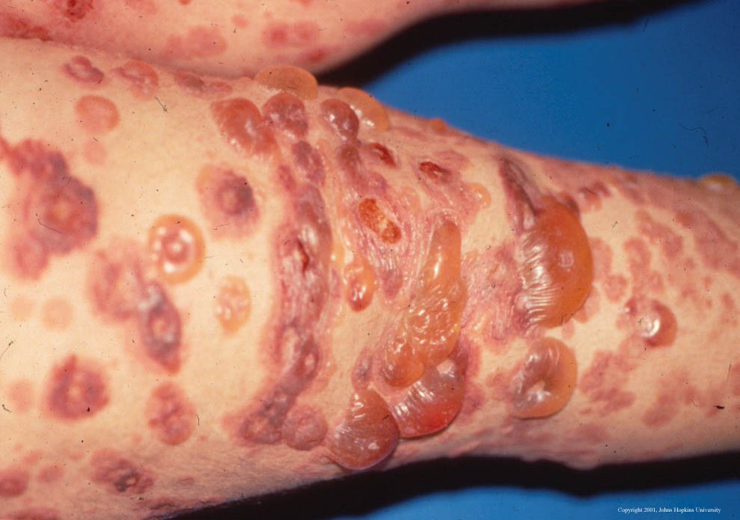
WHAT ARE YOUR FINDINGS?
WHAT IS THE LIKELY DIAGNOSIS?
WHAT IS THE PTHOGENESIS OF THIS DISEASE?
Notes:
Linear IgA

Slide 12
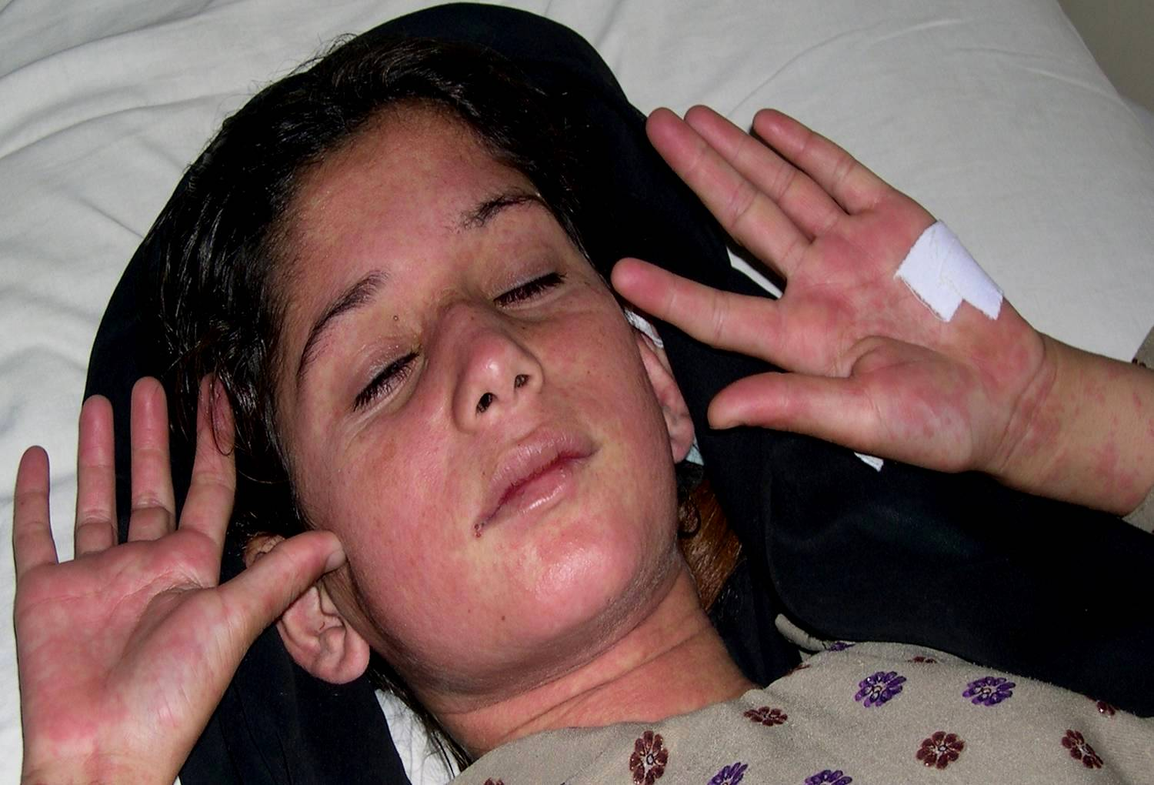
Differential diagnosis
Notes:
Kawasaki, scarlet fever, Viral exanthum, drug rash, TSS

Slide 13
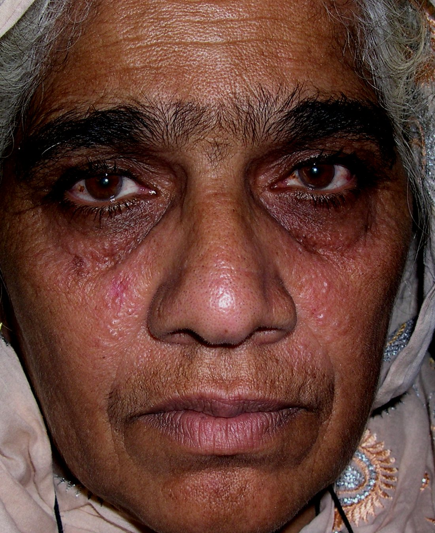
Notes:
Eccrine hidrocystomas, syringomas, colloid milium, sebaceous hyperplasia, Papular sarcoidosis, follicular mucinosis

Slide 14
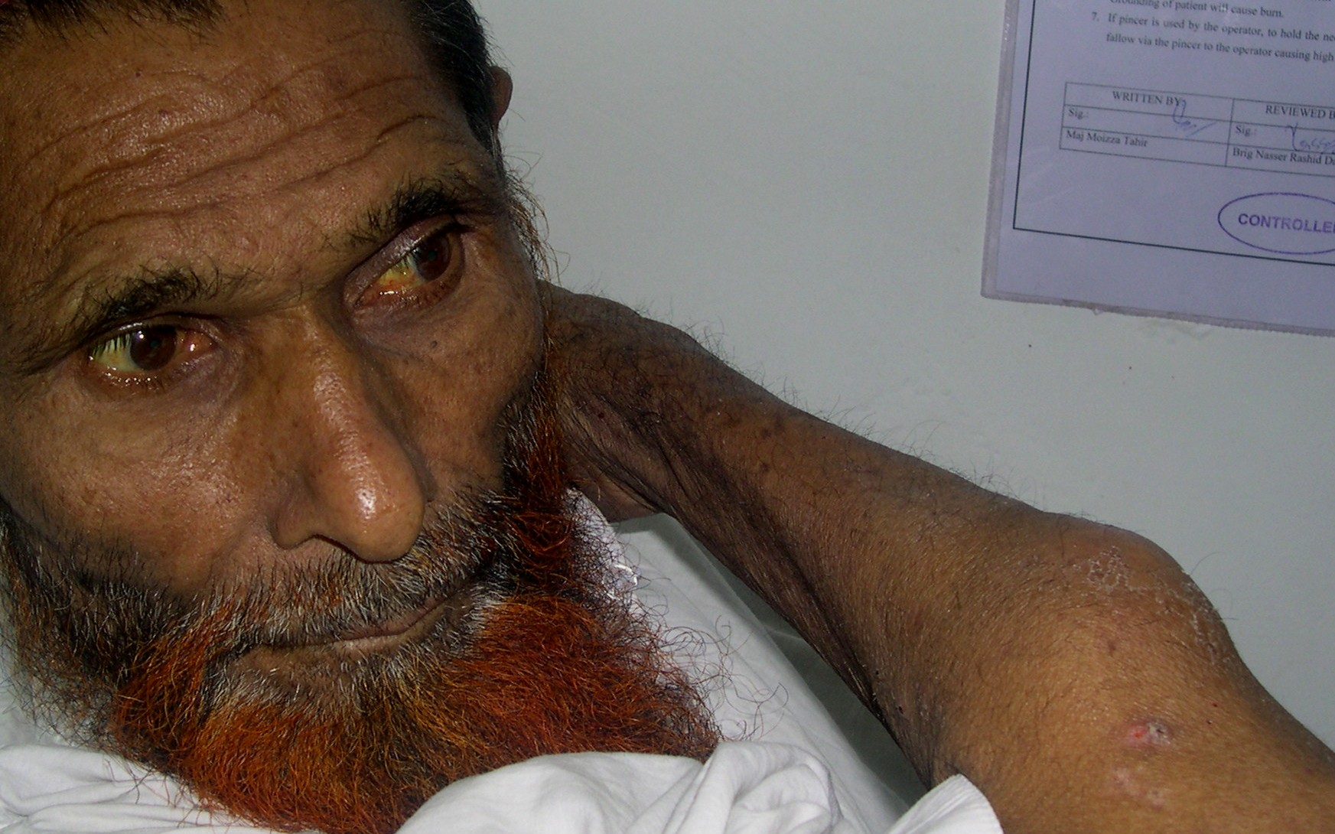
Notes:
Panniculitis-enzymatic with jaundice

Slide 15
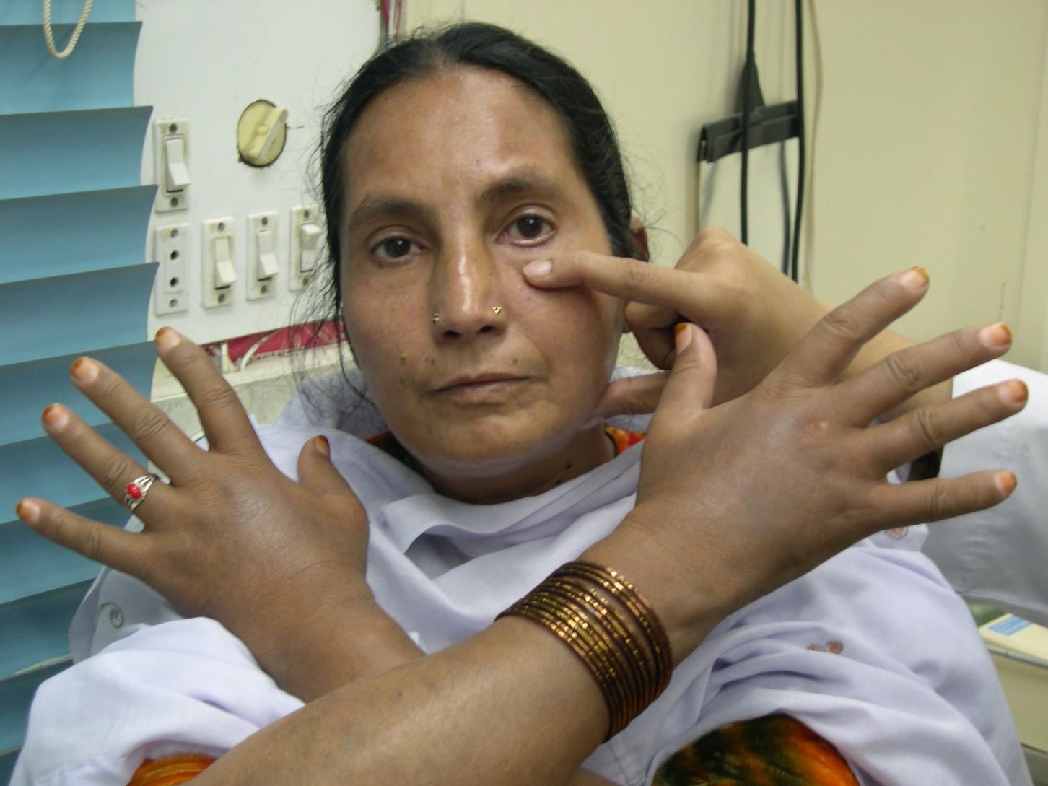
What are your findings?
What is the likely diagnosis?
What is the prognosis of this condition?

Slide 16
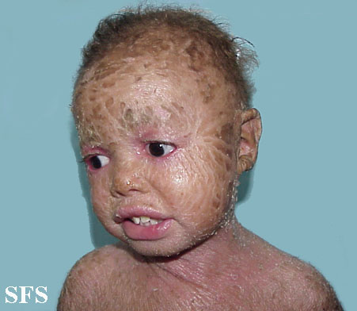
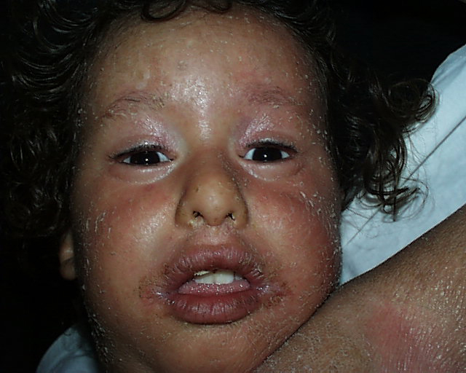
TWO TYPES OF ICTHYOSIS ARE SHOWN
WHAT IS YOUR DIAGNOSIS IN A AND B.
A
B
Notes:
A NBIE, B- Lamellar

