Slide 1
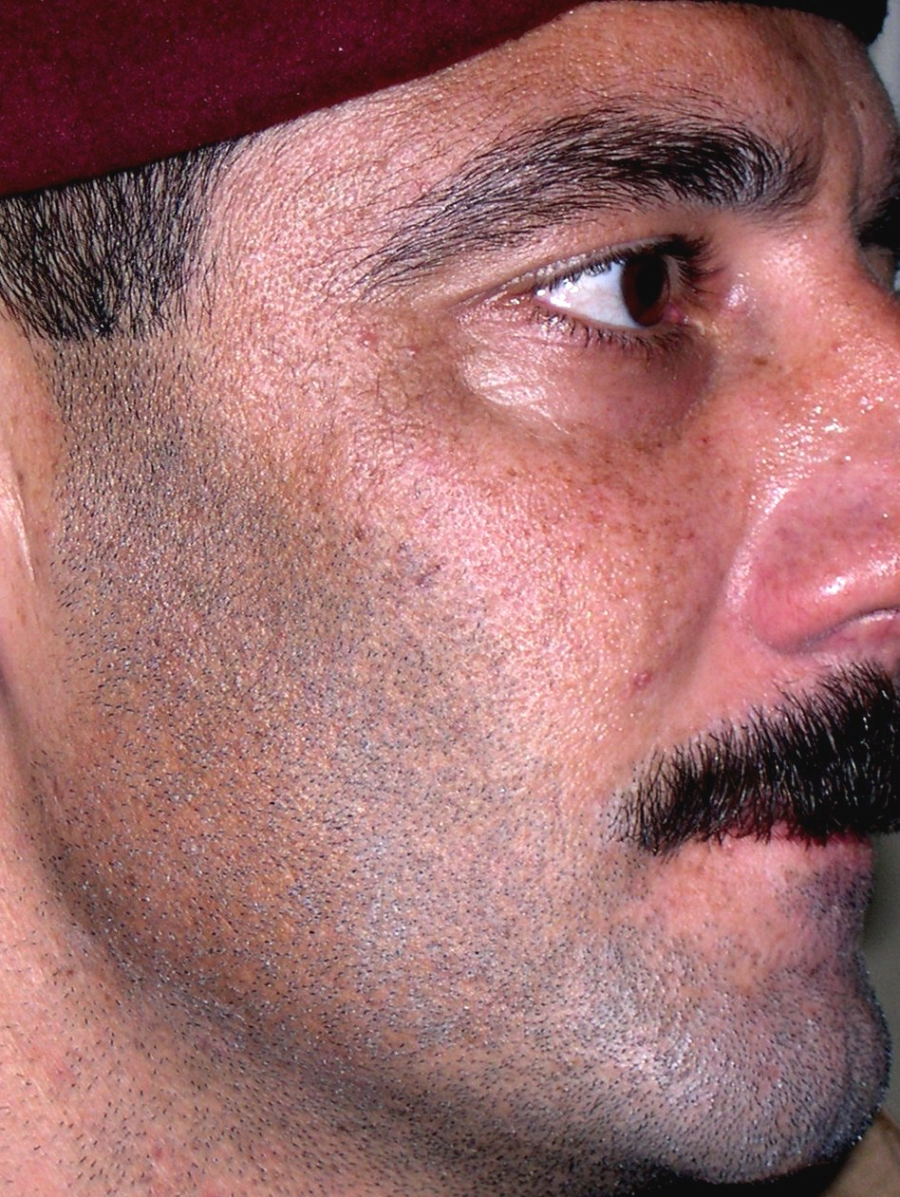
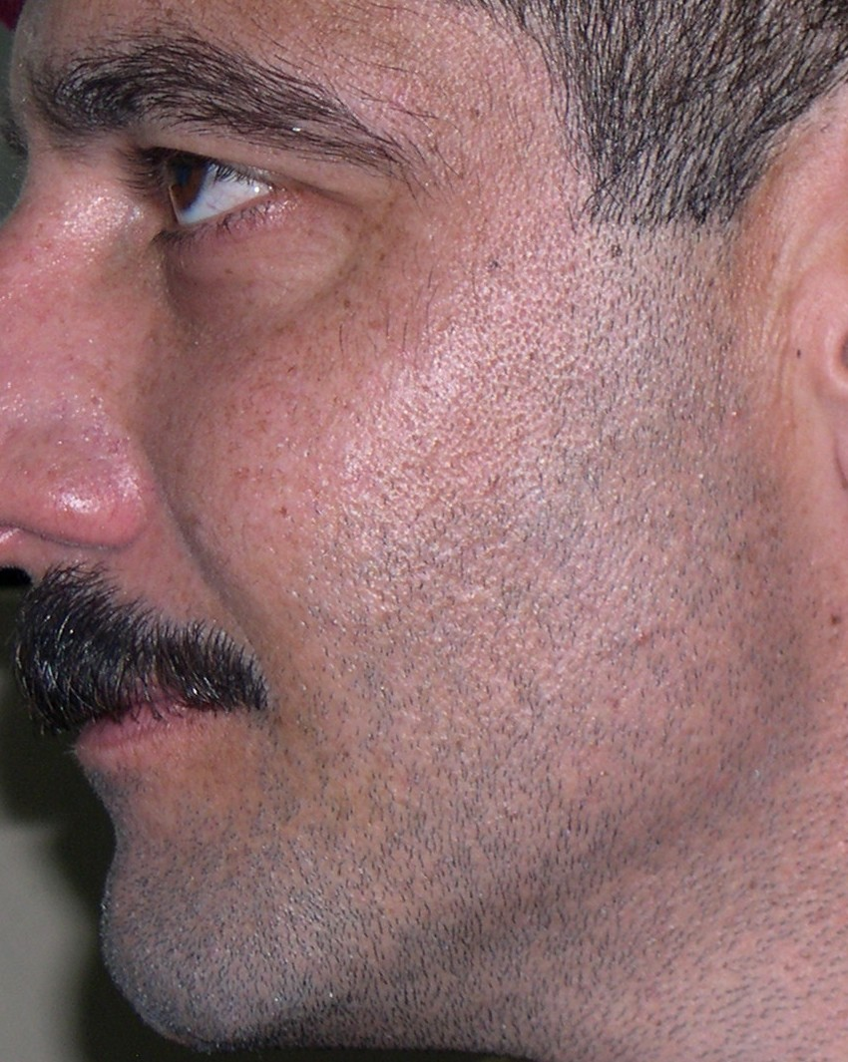
Likely diagnosis
Right side of face
Left side of face
Notes:
Becker nevus

Slide 2
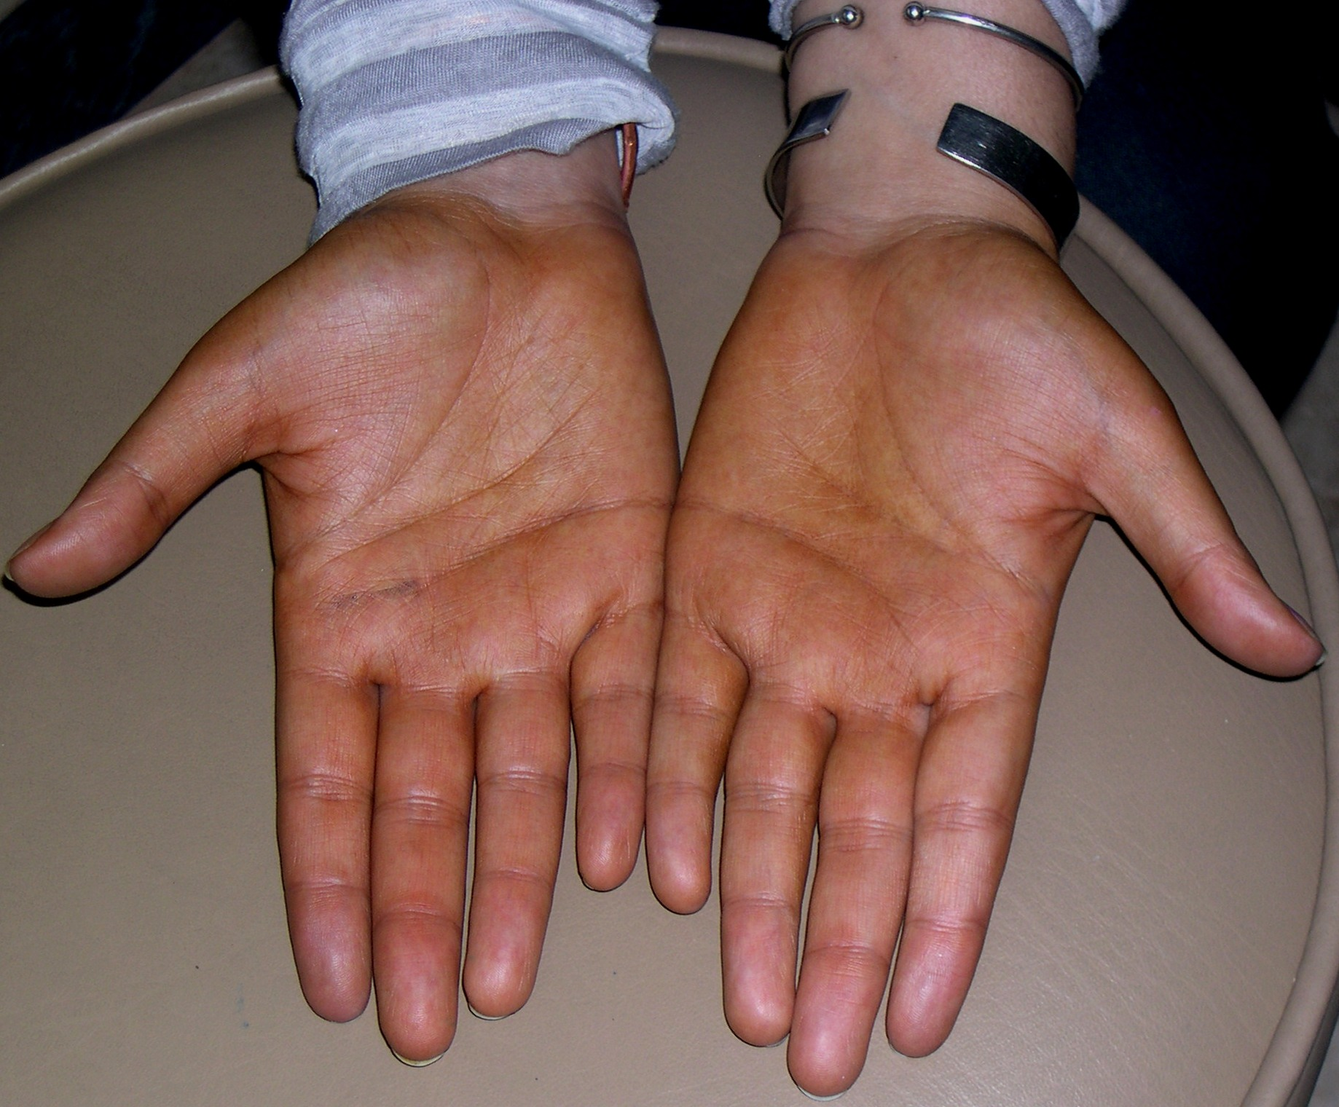
Likely diagnosis
Notes:
caretinoderma

Slide 3
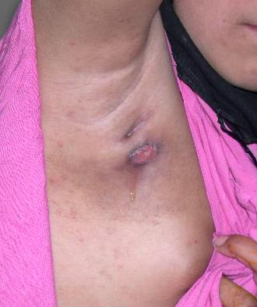
Differential diagnosis
Notes:
Scrofluderma
D/D
HIDERADENITIS SUPPURATIVA

Slide 4
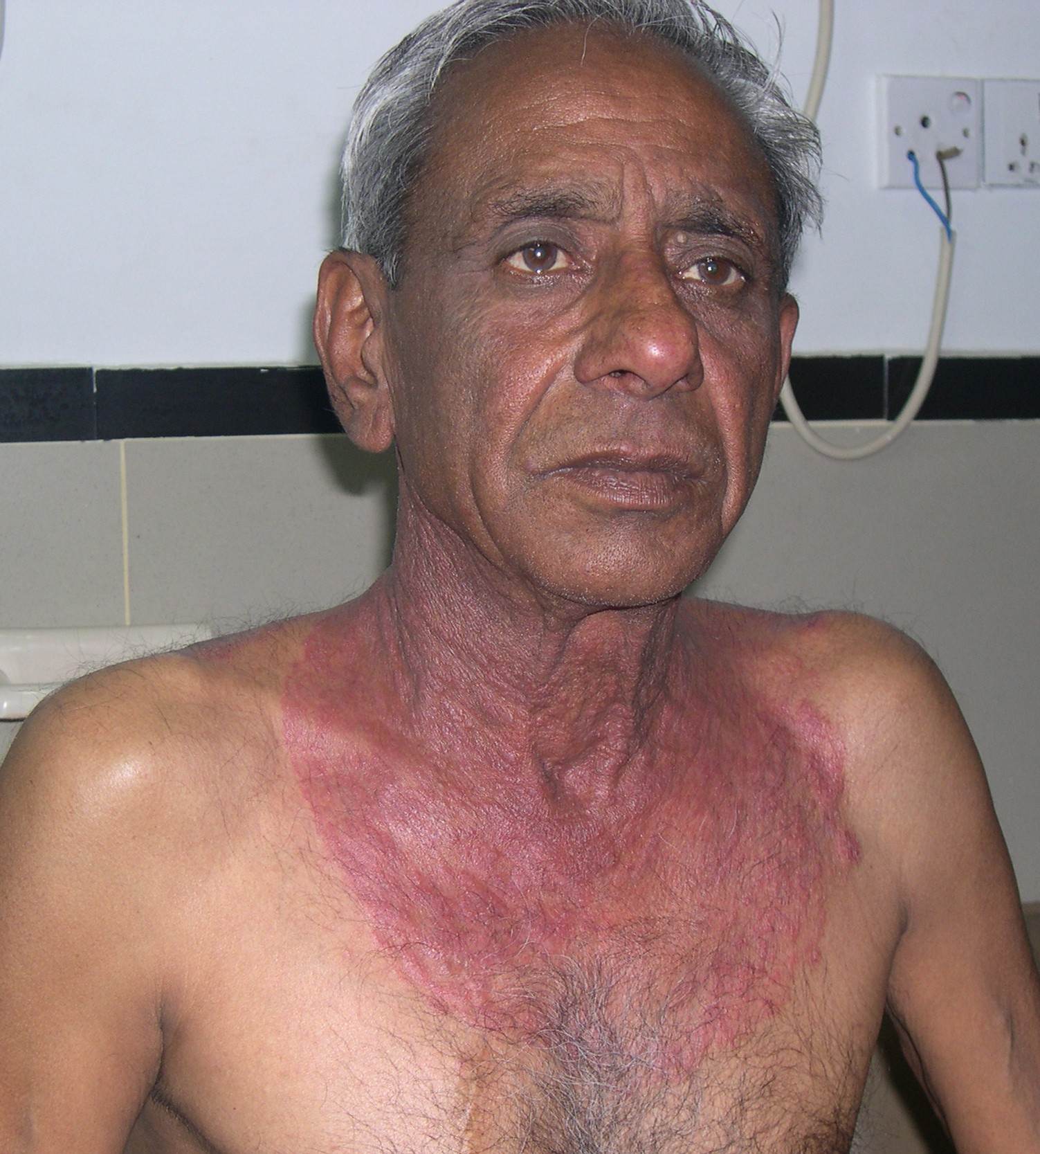
Likely diagnosis
Notes:
Tinea corporis

Slide 5
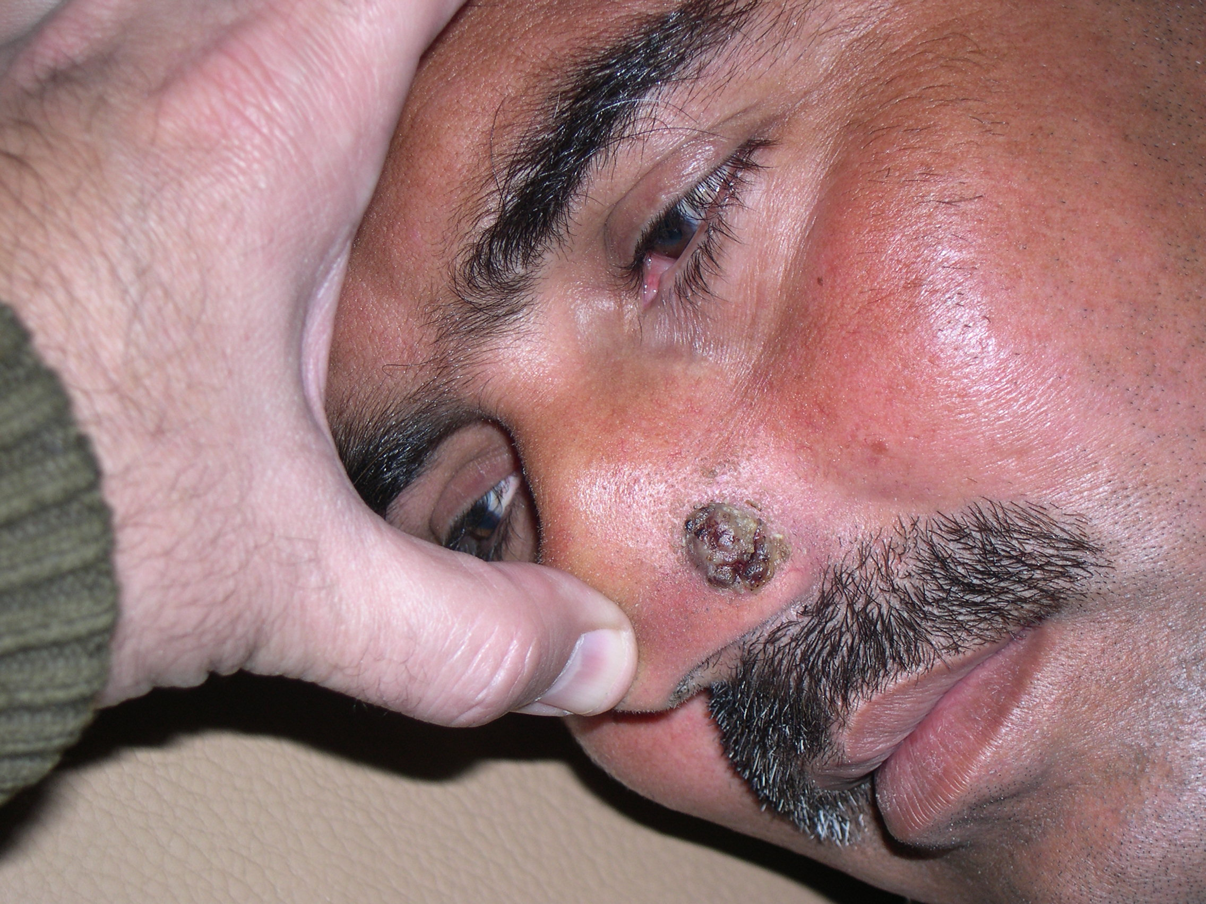
Differential diagnosis
Notes:
BCC
CL
DEEP MYCOSIS_botriomycosis

Slide 6
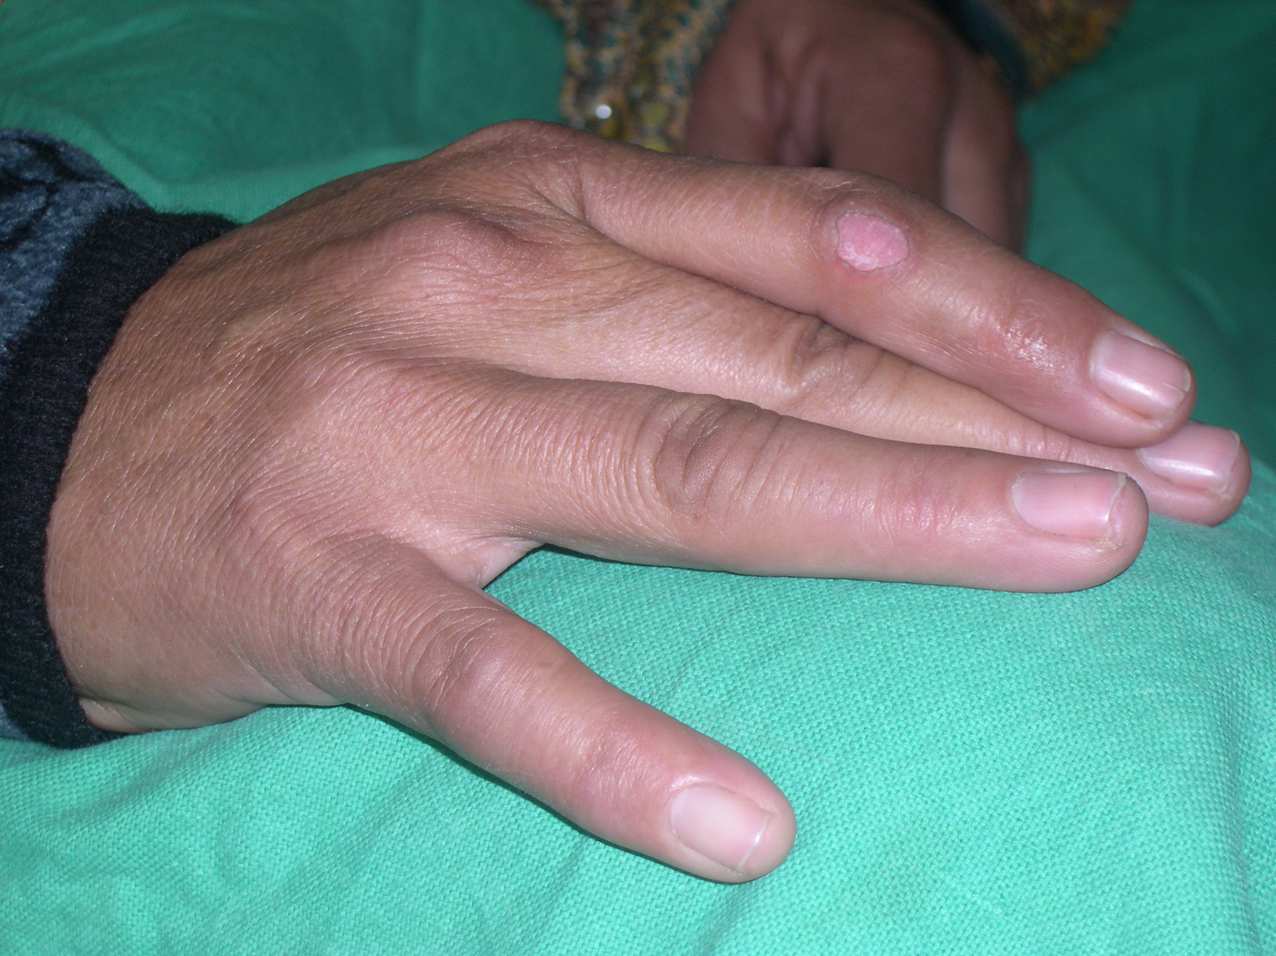
Likely diagnosis
Notes:
porokeratosis

Slide 7
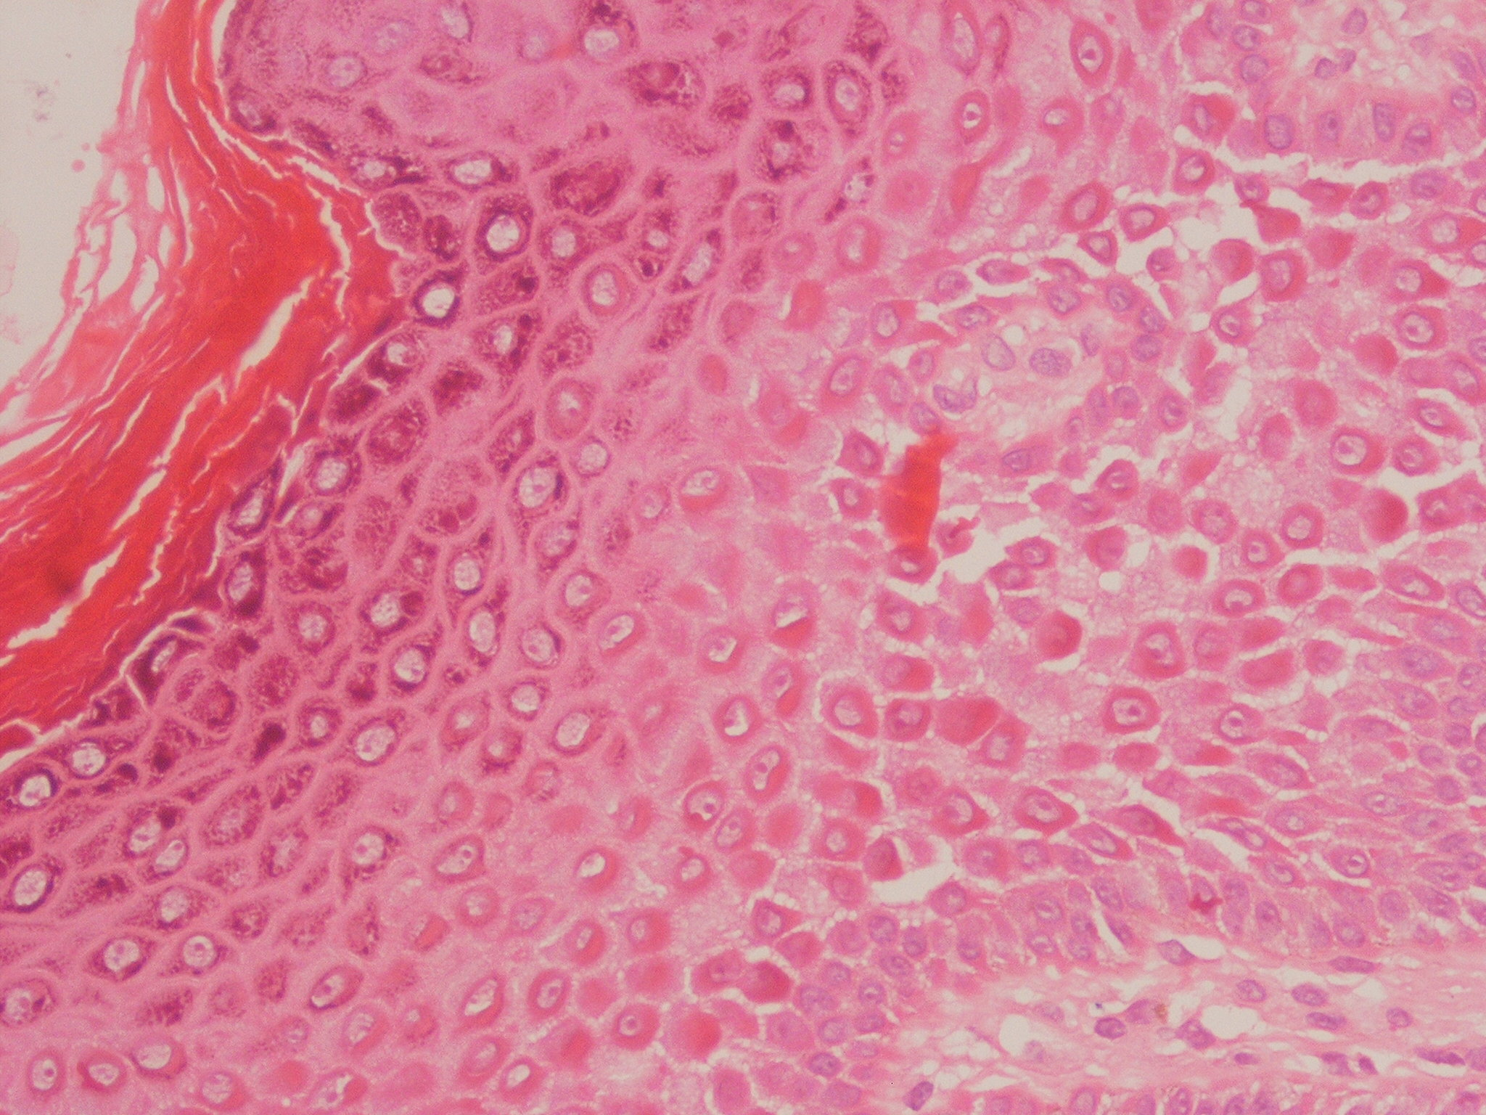
Likely diagnosis
Notes:
Dariers disease

Slide 8
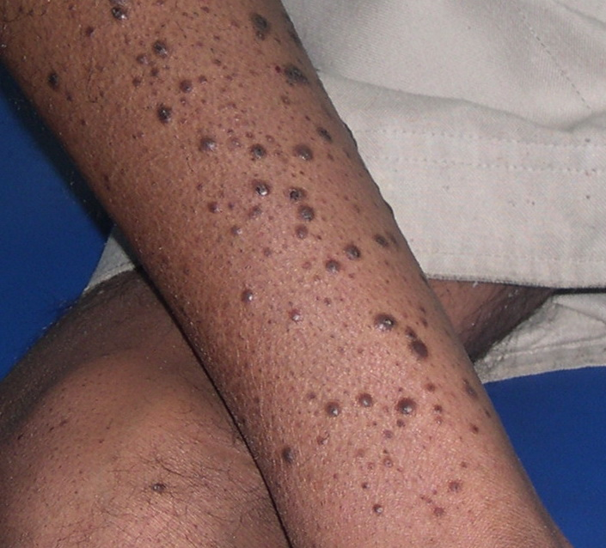
Likely diagnosis
Notes:
Kyrles disease
Flegels disease

Slide 9
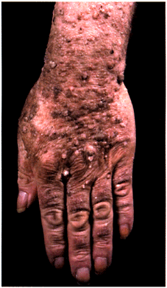
Patient developed explosive onset of this
eruption which was associated with haematemesis. Likely diagnosis
Notes:
Sign of lesser trelat

Slide 10
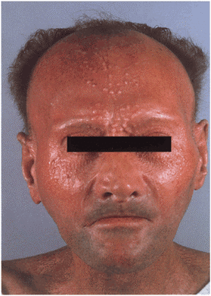
Likely diagnosis
Notes:
Lichen myxedematous

Slide 11
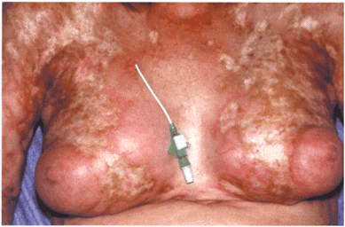
Likely diagnosis
Notes:
Graft versus host disease

