Slide 1
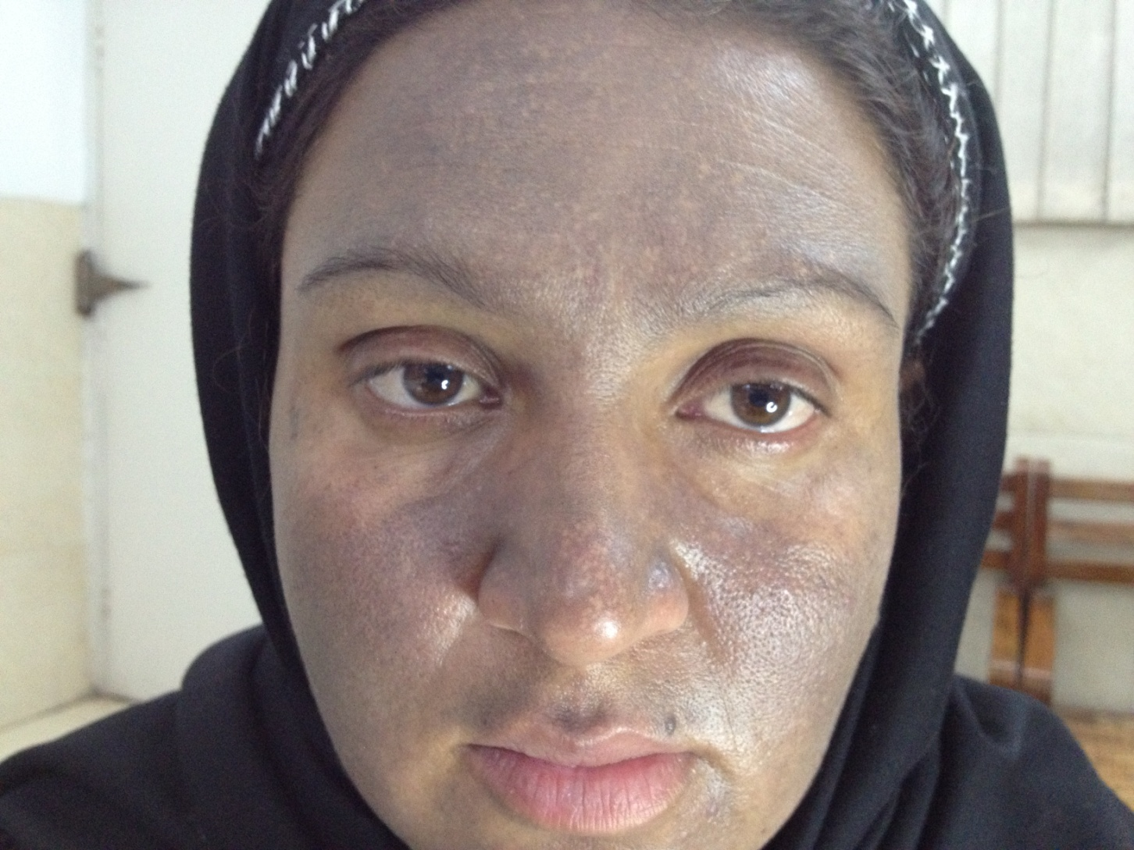
Notes:
DD: drug induced hyperpigmentation (minocycline, antimalarials, mepacrine, amiodarone, topical hydroquinone, argyria) , ashy dermatosis, LPP, ochronosis

Slide 2
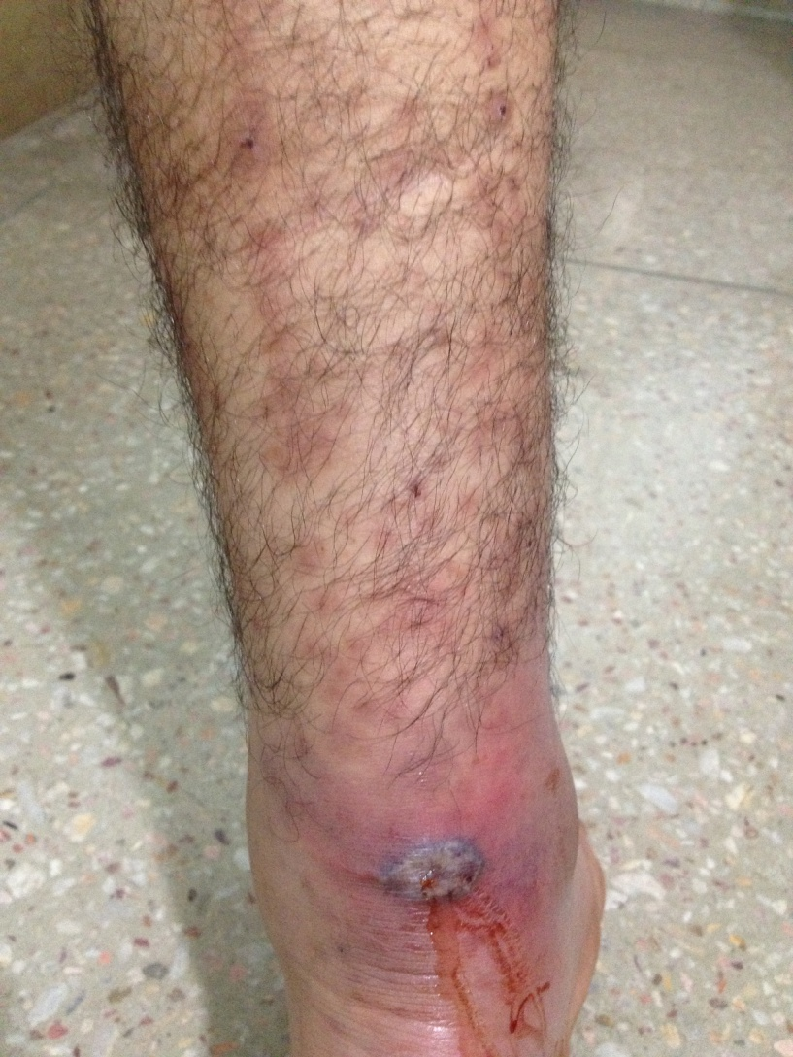
Notes:
Rickettsia (tache noir)
Q. Rx of choice ? Tetracyclines

Slide 3
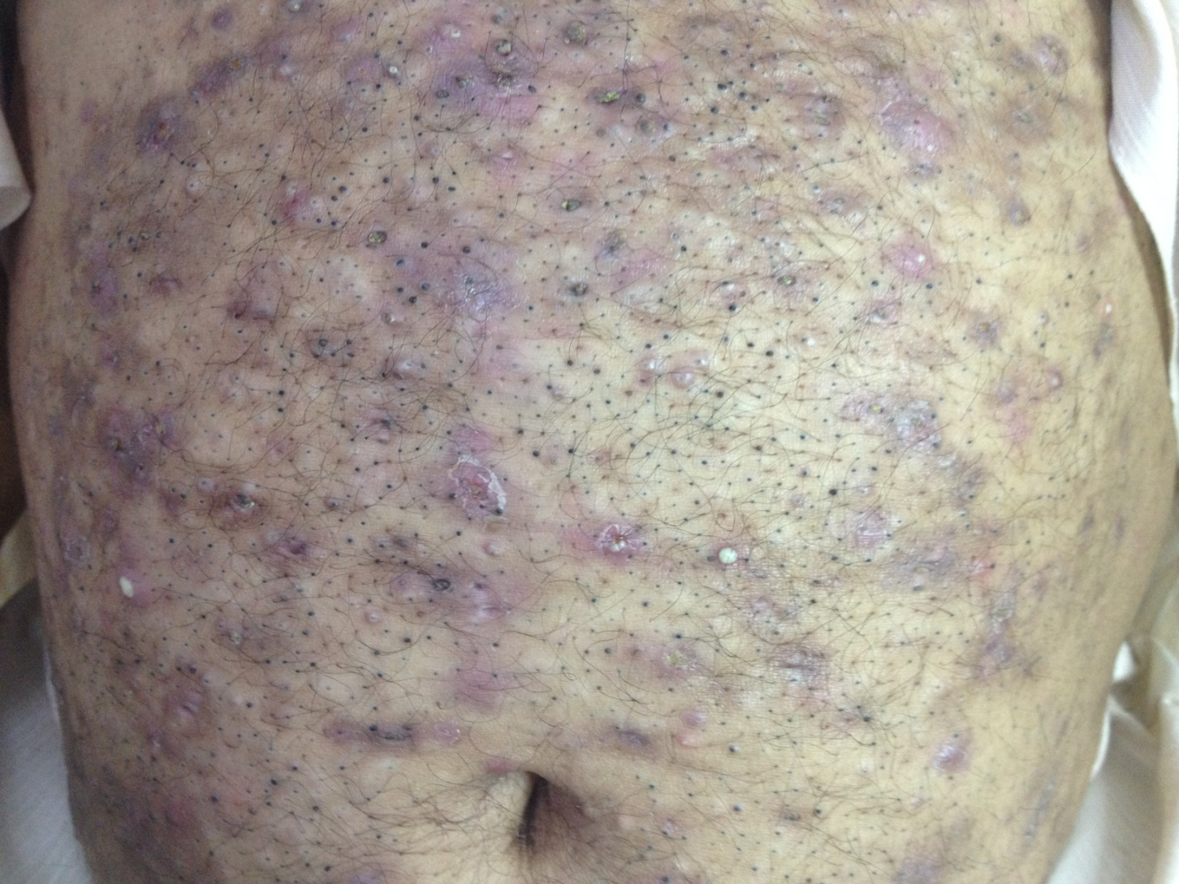
Notes:
Chloracne – Halogenoderma ( Hint: factory worker)
Q. Systemic evaluation? Hepatic profile (for HCC- 2ndry to hydrocarbon exposure)

Slide 4
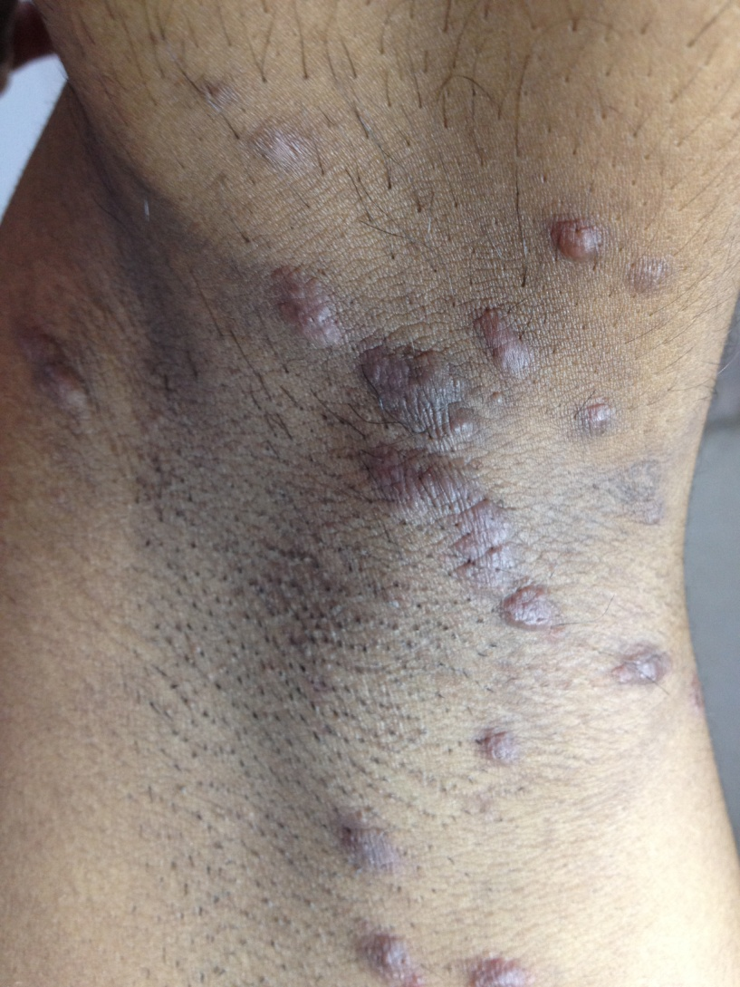
Notes:
Nodular scabies
DD: deep mycosis, B cell lymphoma, metastatic crohns, sarcoidosis, cut mets, pseudolymphoma, persistant insect bite reaction

Slide 5
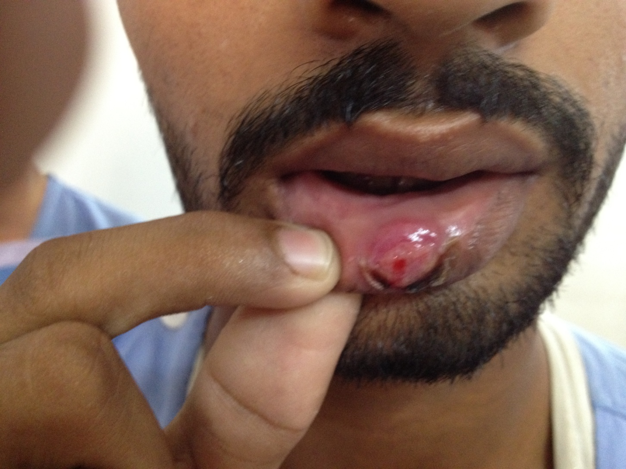
Notes:
Pyogenic granuloma
DD: Chancre, mucocoele

Slide 6
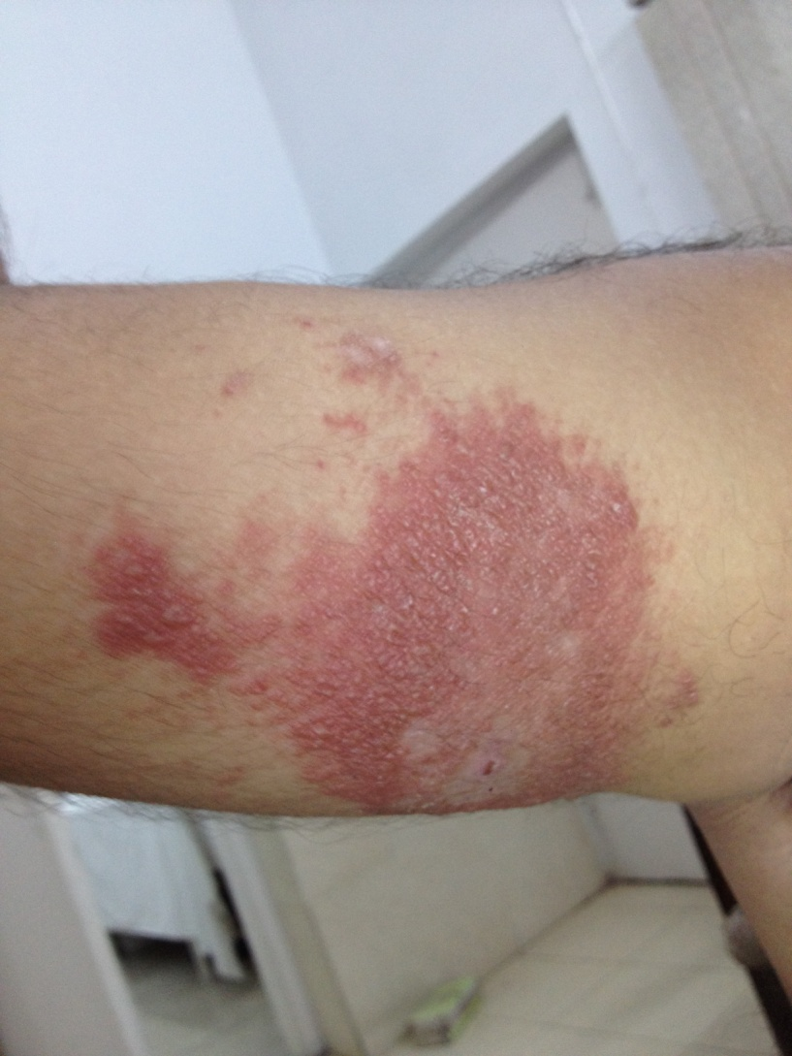
Notes:
Borderline leprosy

Slide 7
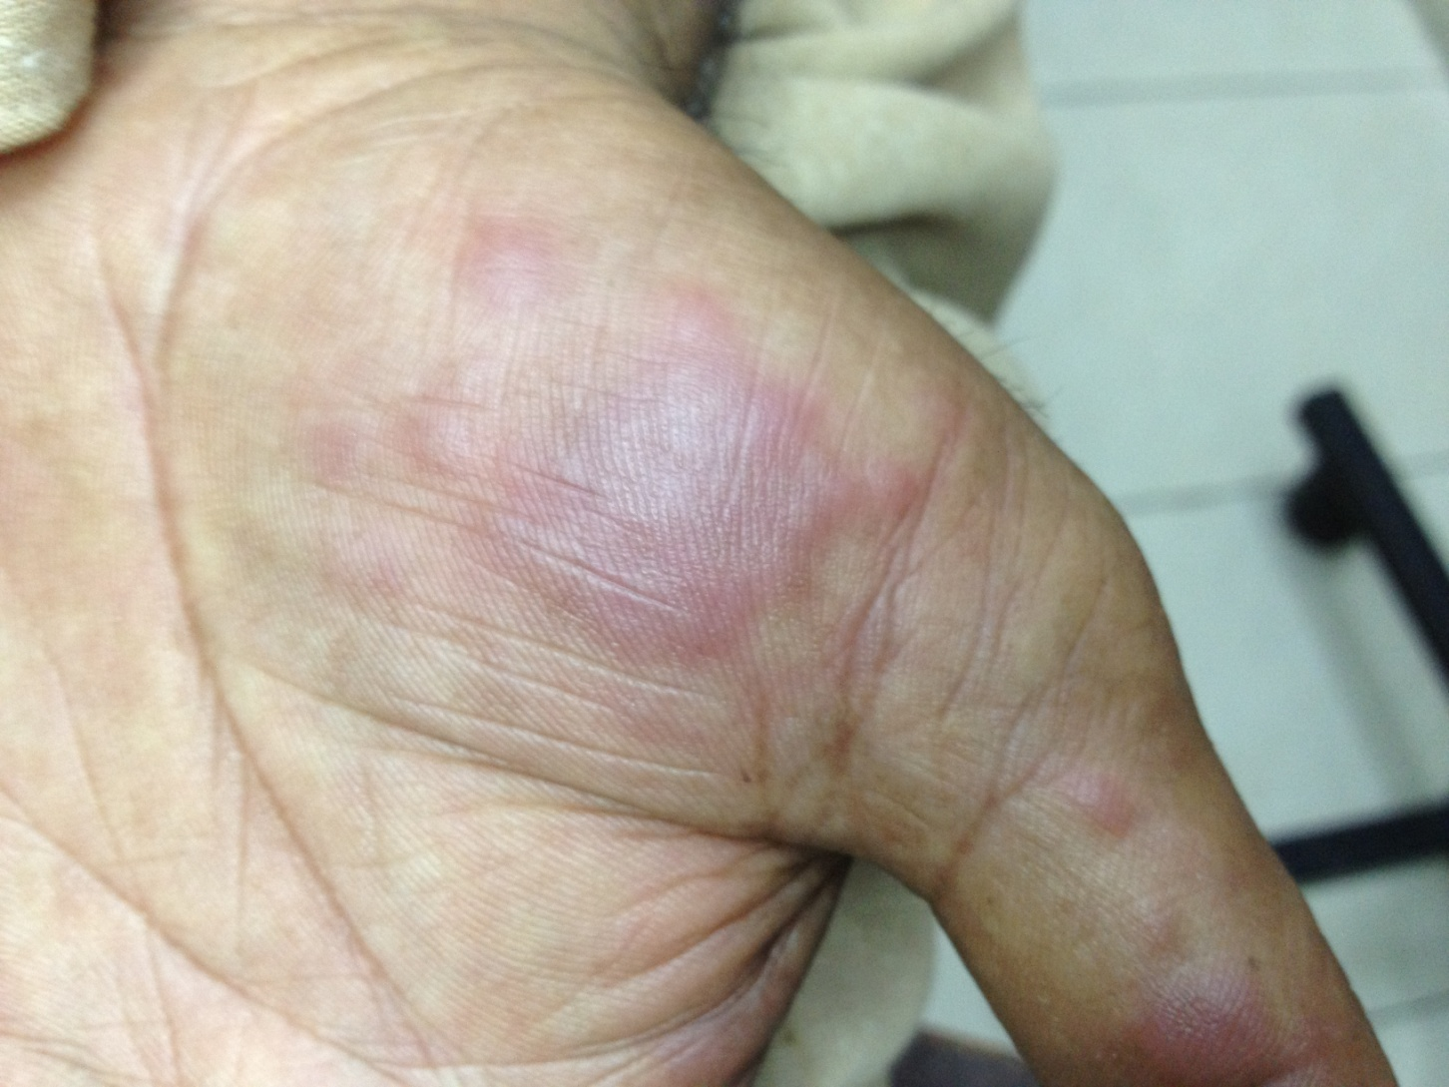
Notes:
Neutrophilic eccrine hidradenitis (Hint: pt has hematological malignancy)
DD: Sweets, EM, drug induced toxic erythemas
Q: types of NEH? (4types: chemo-induced, infections related, HIV ass, idiopathic in children)
Q: histopath findings?

Slide 8
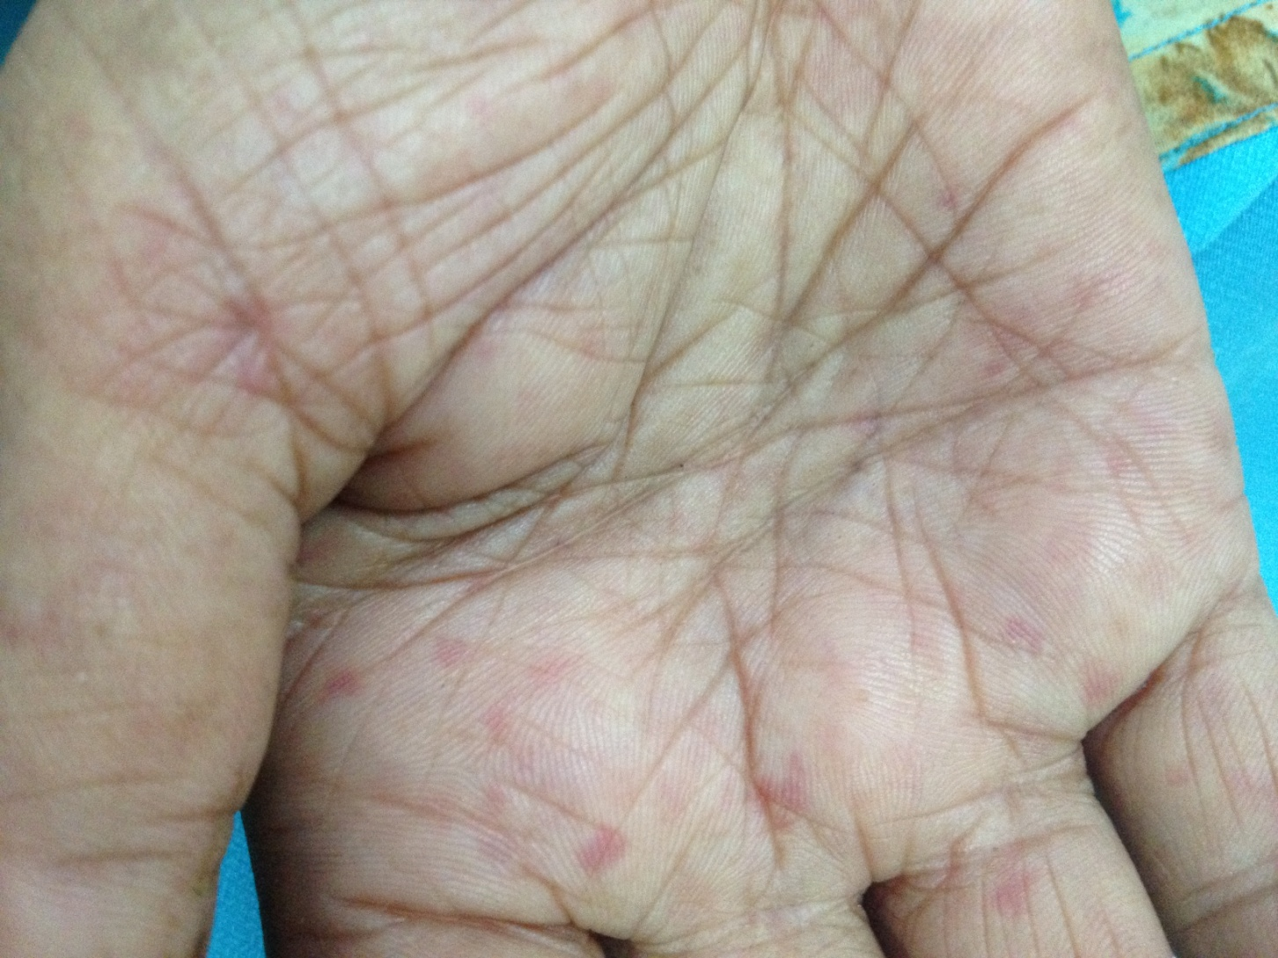
Notes:
Mat like telengiectasis of Syst sclerosis (Hint: similar lesions on face)

Slide 9
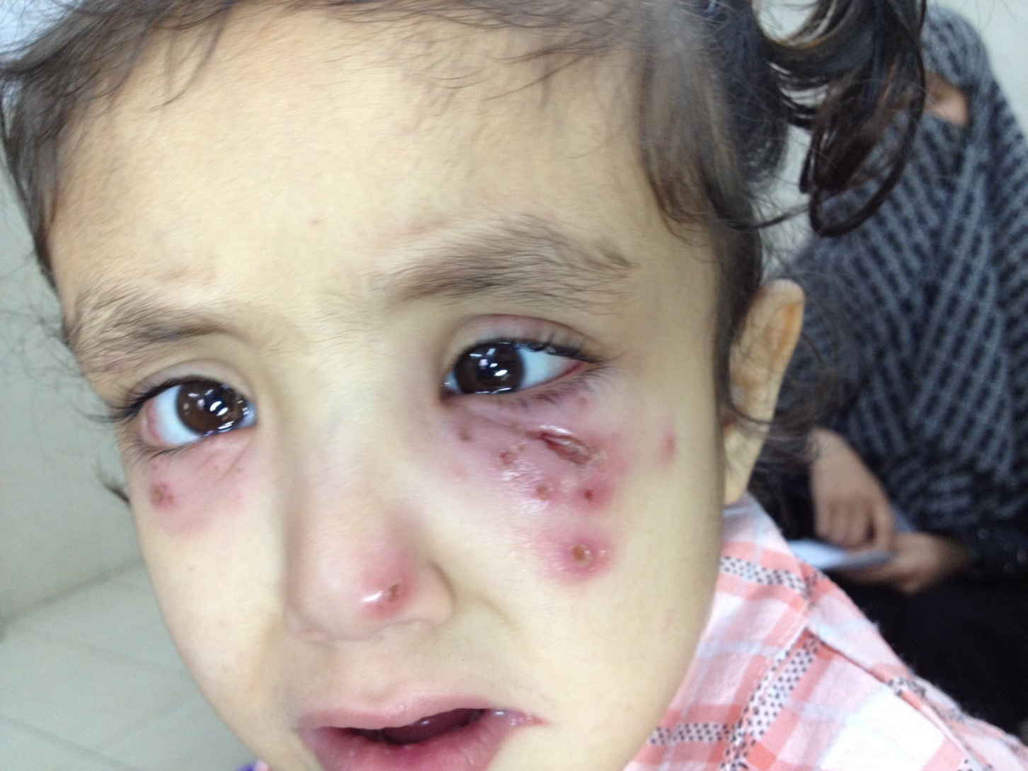
Notes:
Primary herpes

Slide 10
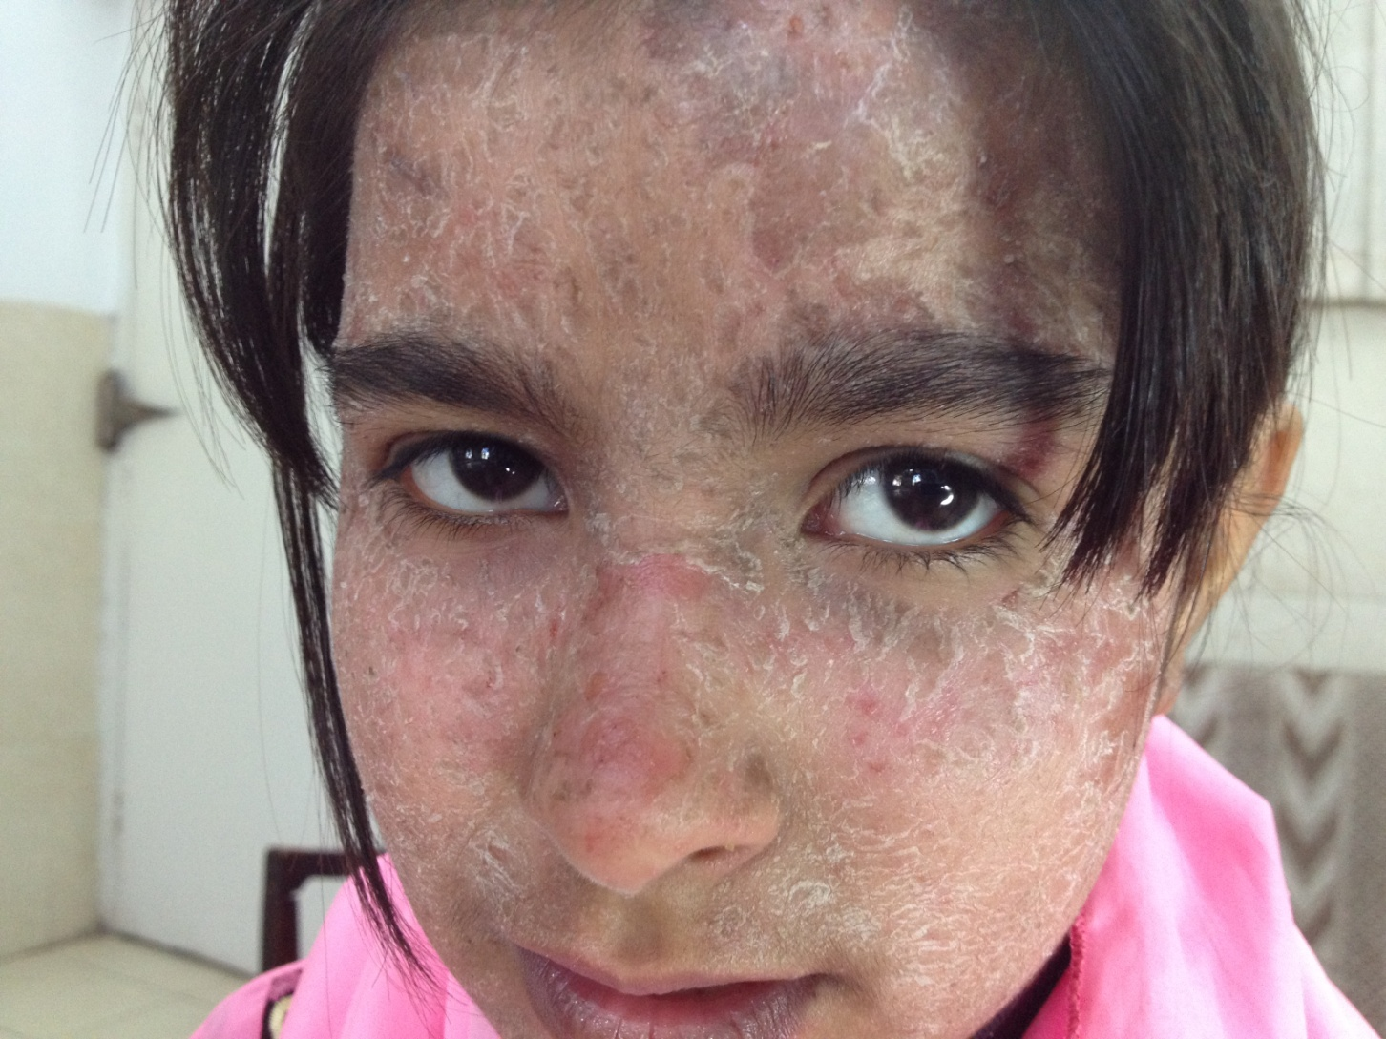
Notes:
DD: contact dermatitis, scaling after sunburn

Slide 11
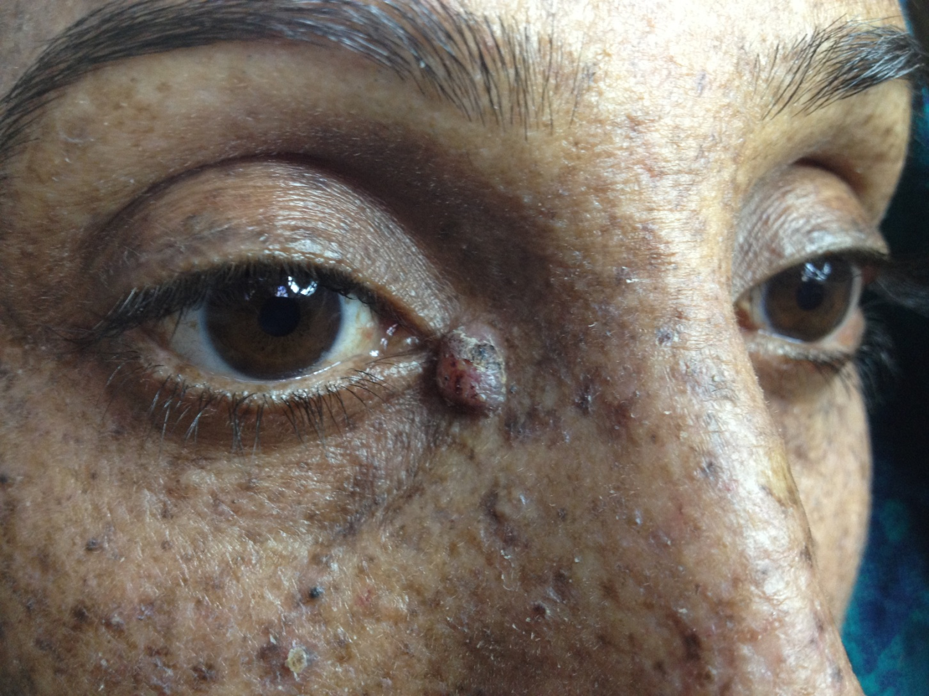
Notes:
XP with nodular BCC (but eye changes are absent)
DD: EDV

Slide 12
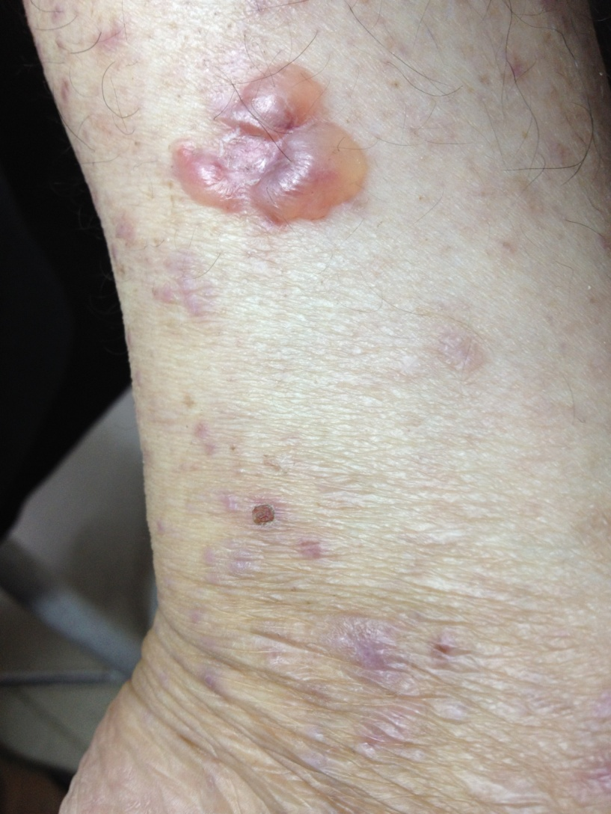
Notes:
LP pemphigoides / bullous LP

Slide 13
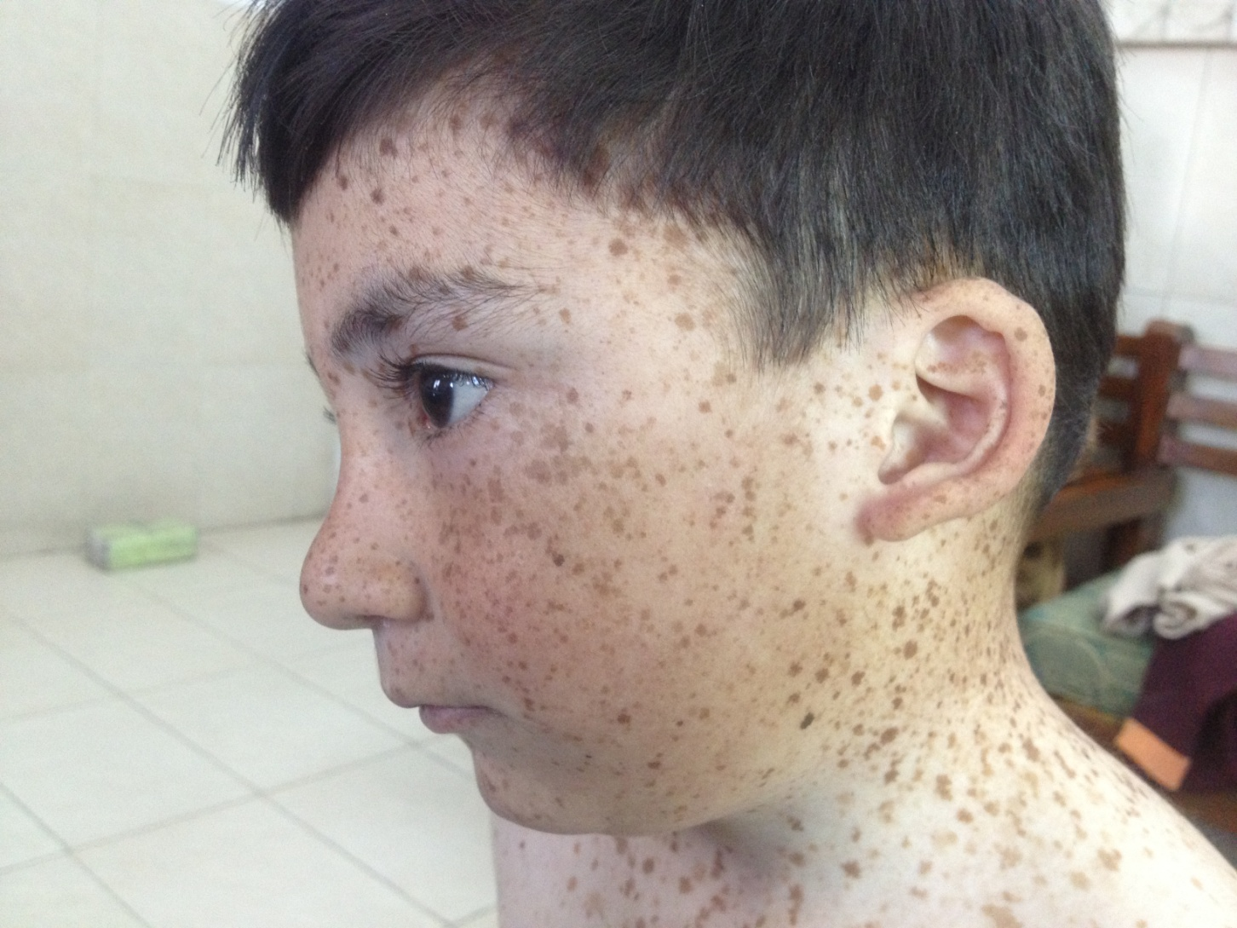
Notes:
Lentiginosis
DD: mastocytosis
Q: name lentiginosis synd?

Slide 14
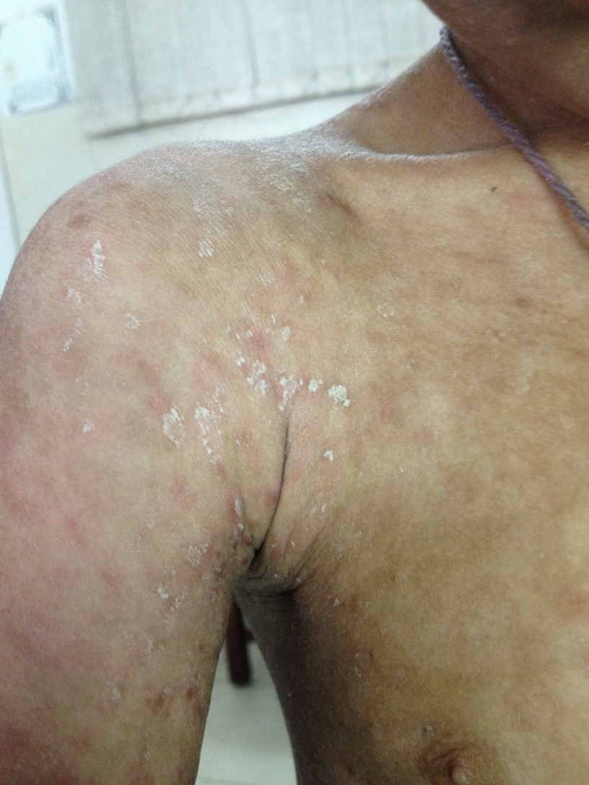
Notes:
Bullous icthyosiform erythroderma (mousse-ring lesions)

Slide 15
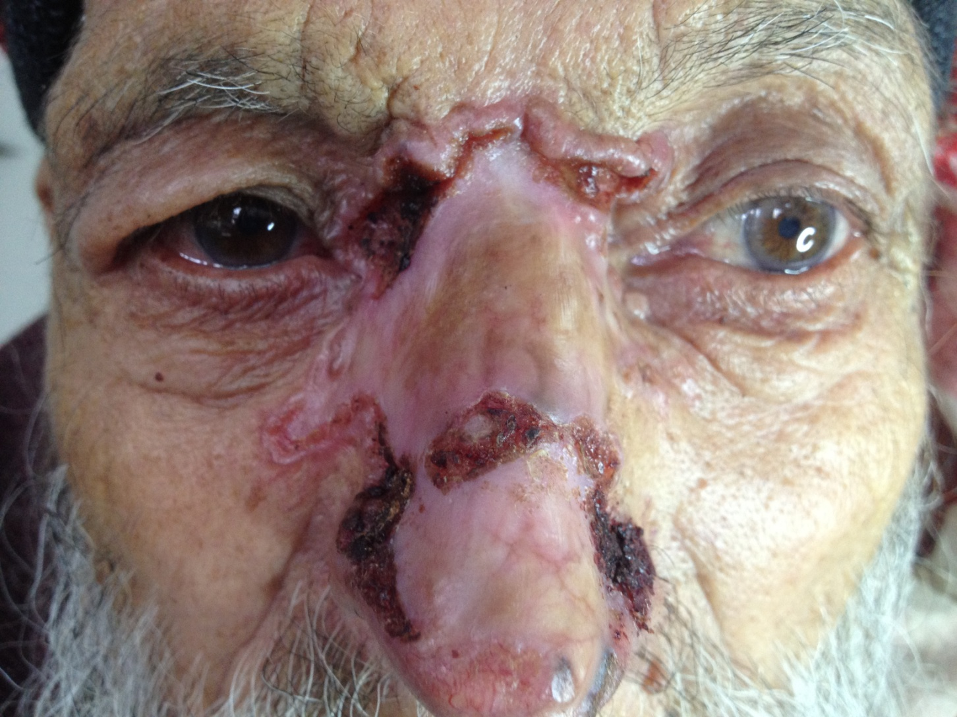
Notes:
BCC

Slide 16
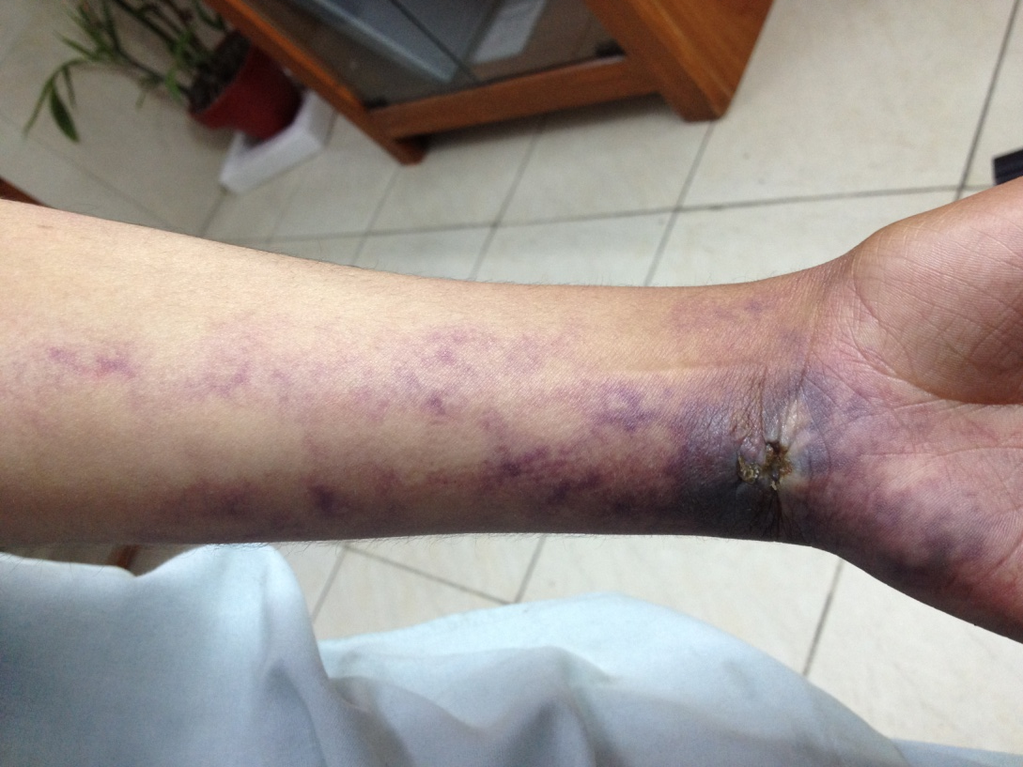

Slide 17
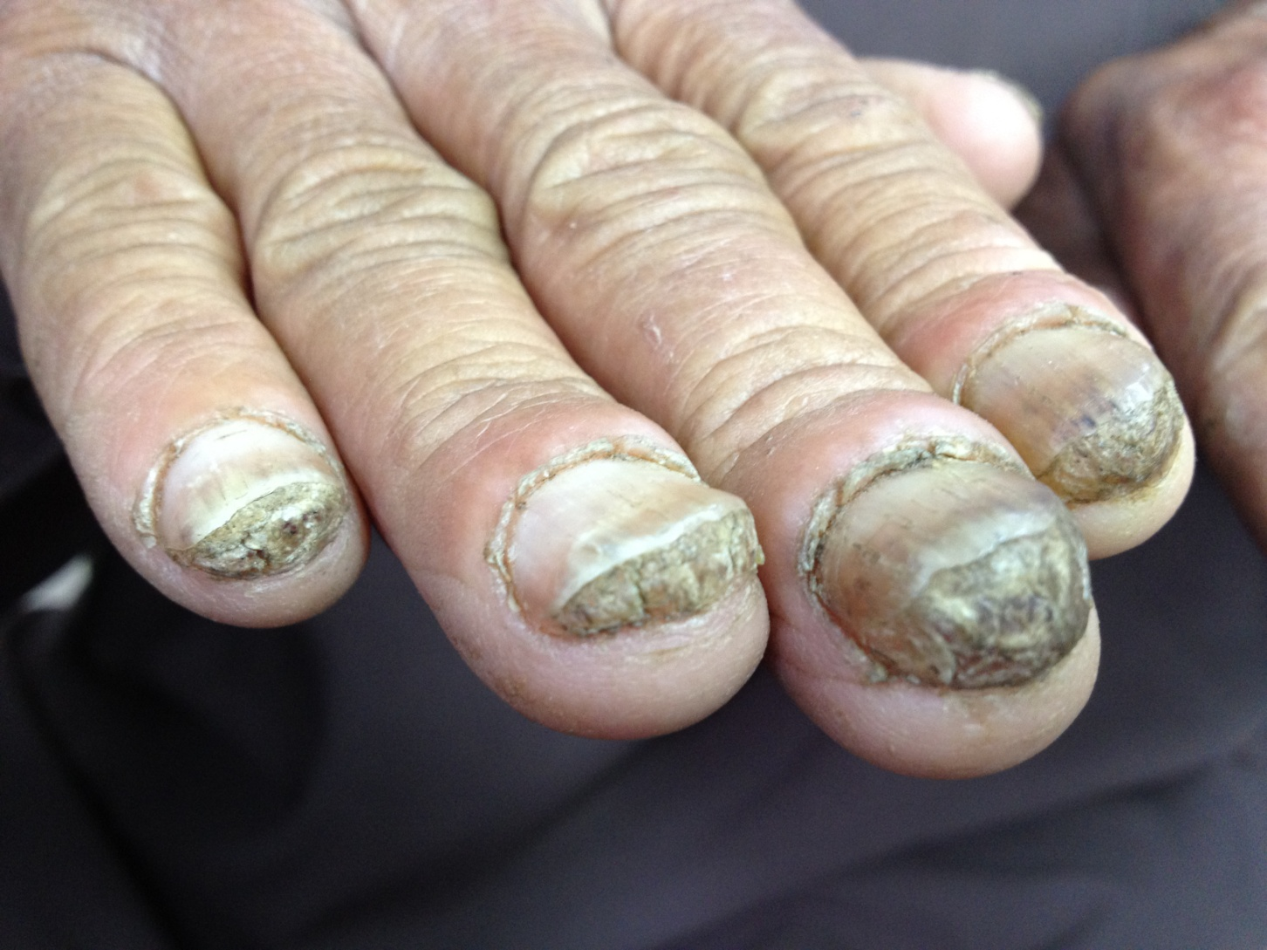
Notes:
Pachonychia congenita

Slide 18
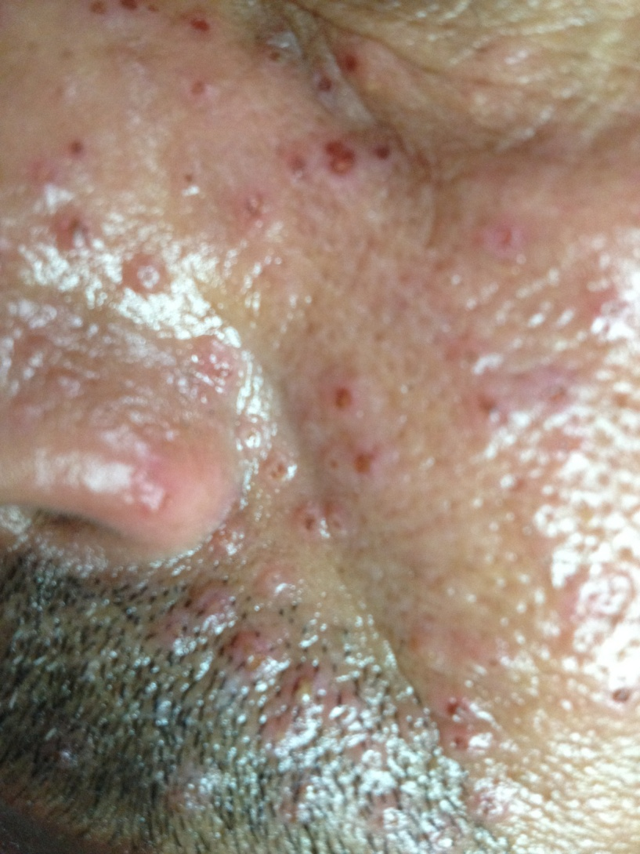
Notes:
Sebaceous hyperplasia

Slide 19
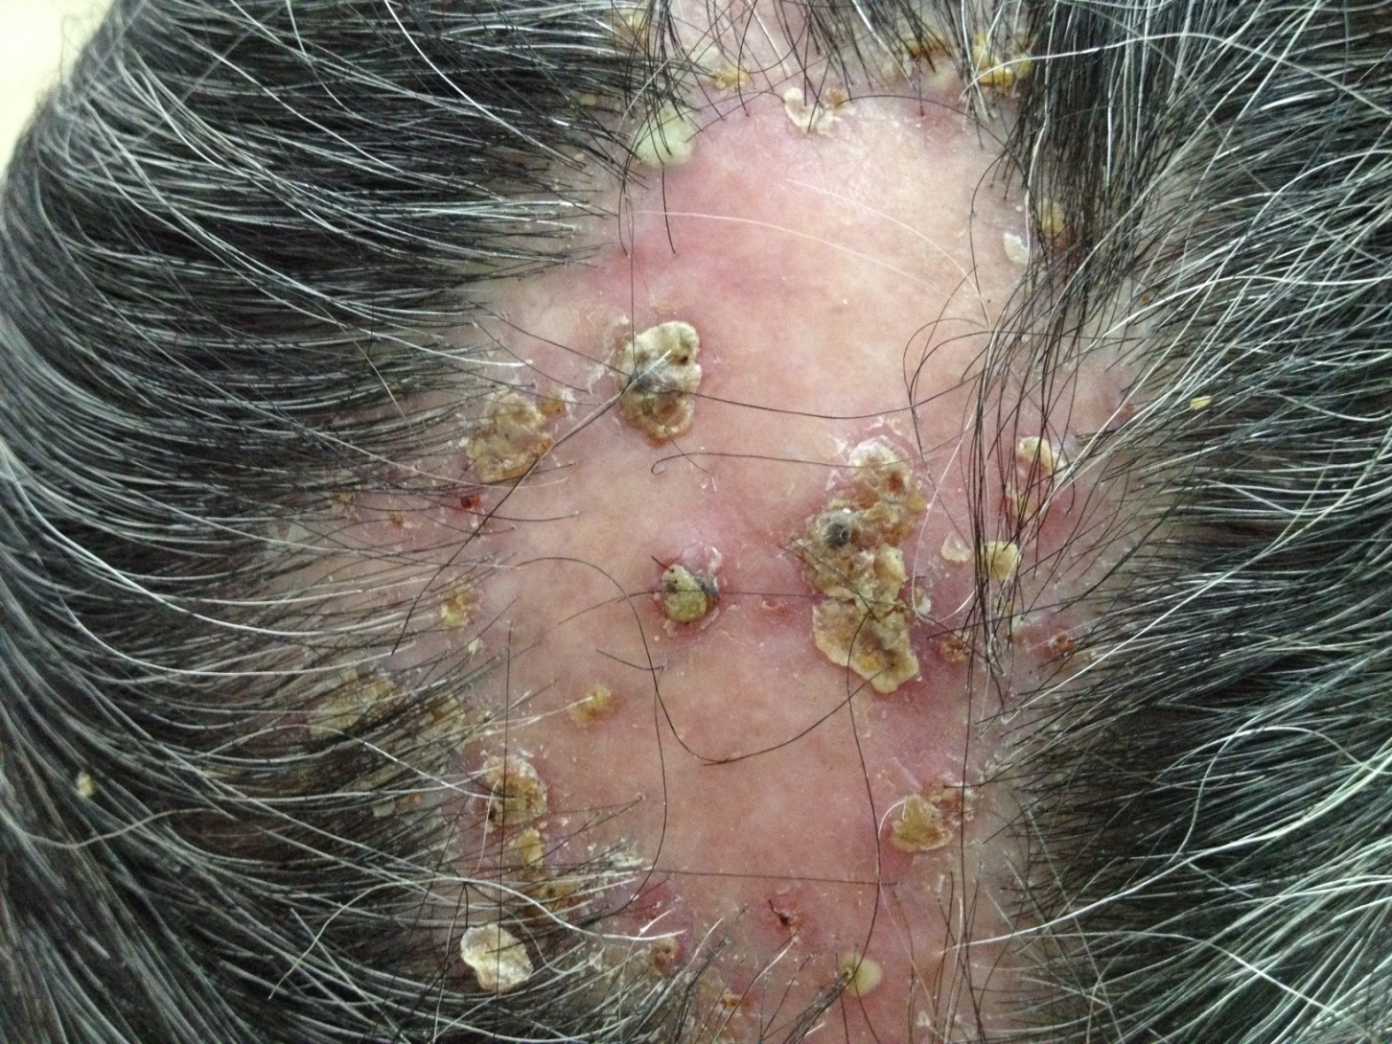
Notes:
Favus (scutula)
Q: features on hair microscopy? (air spaces)
Q: organism ? Schonlenii

