Slide 1
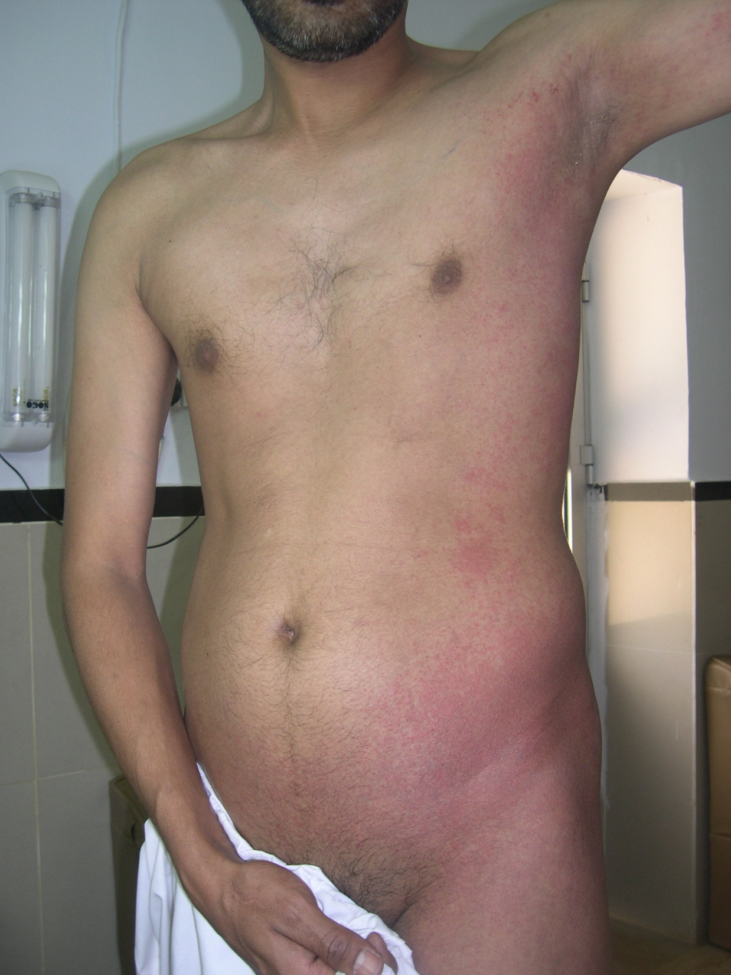
Notes:
Unilateral laterothoracic viral exanthem (of childhood)
(unusual thing here is that pt is adult)
Q. Etiology?

Slide 2
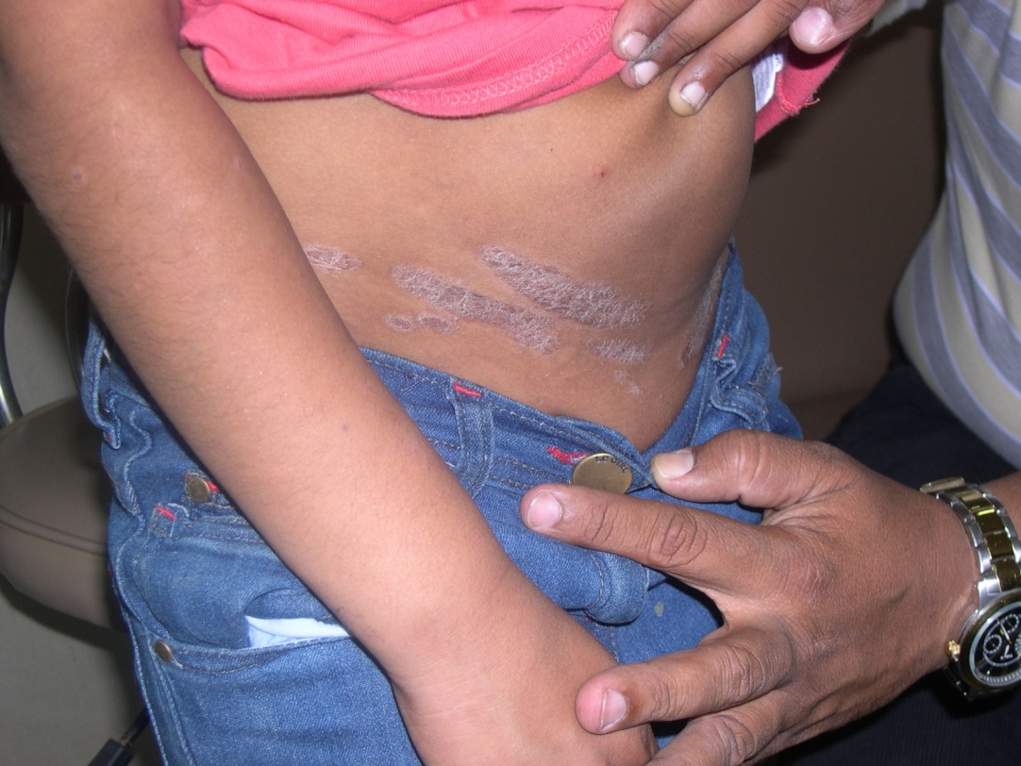
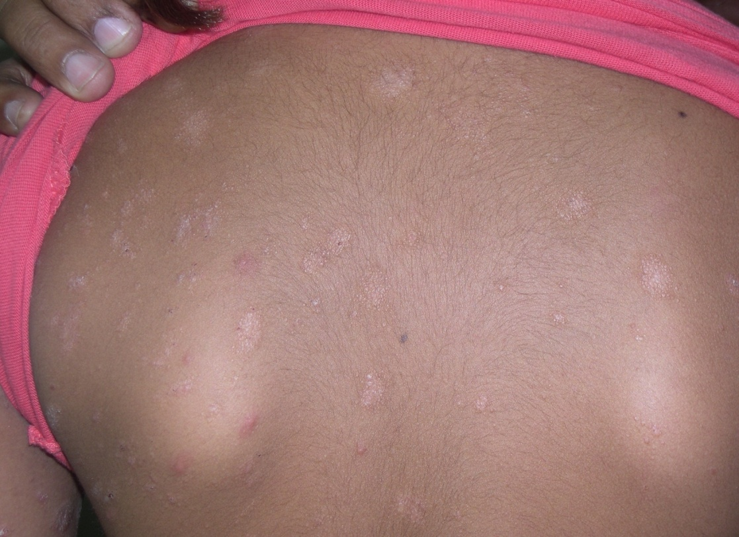
Notes:
DD : Lichen scrofulosorum, lichen nitidus

Slide 3
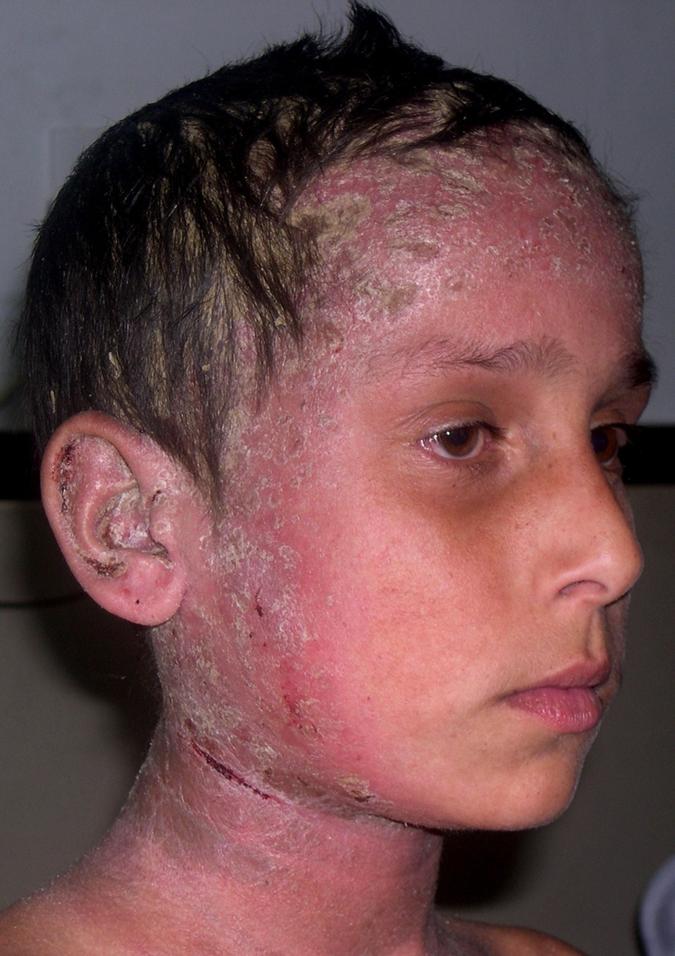
Notes:
DD: Sebopsoriasis, seb dermatitis, LCH, immunodef synd, nutritional def, drugs e.g. methyl dopa,

Slide 4
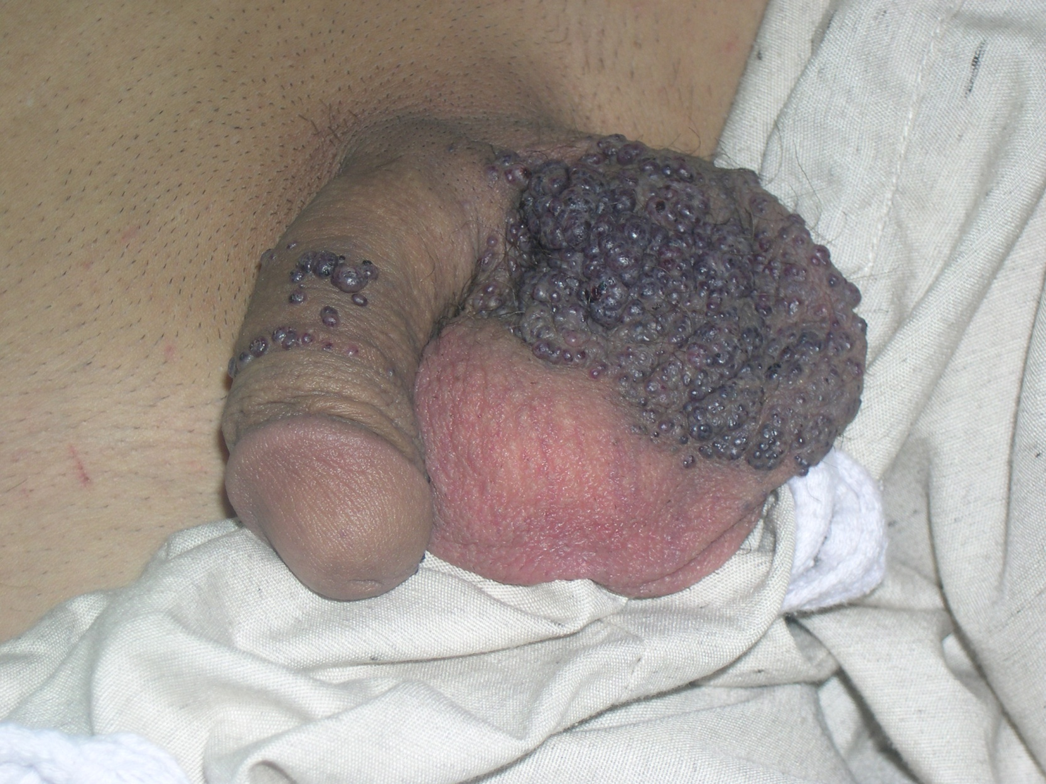
Notes:
angiokeratoma

Slide 5
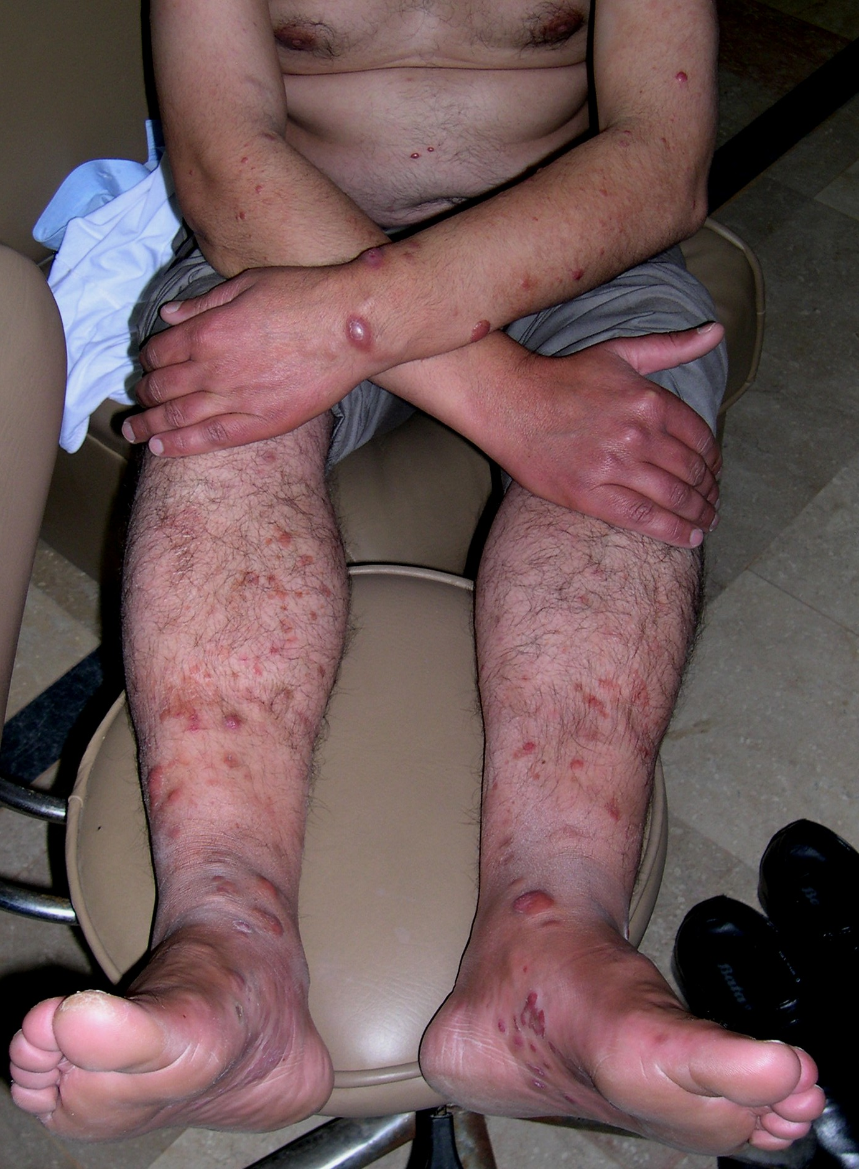
Notes:
DD: kaposi, cut mets, leukemia cutis, MCRH, cut B cell lymphoma, mastocytosis, sarcoidosis, leprosy

Slide 6
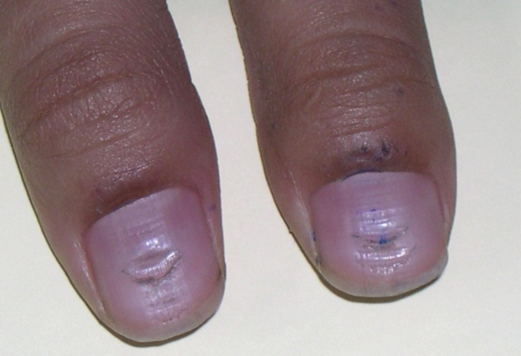
Notes:
Habit tic

Slide 7
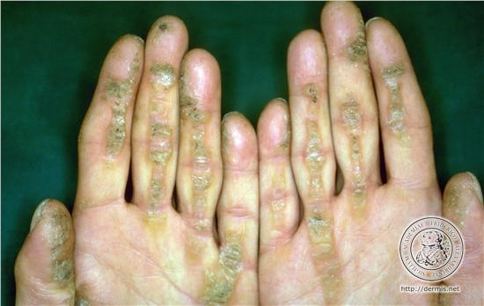
Notes:
Striate keratoderma
Q. associations

Slide 8
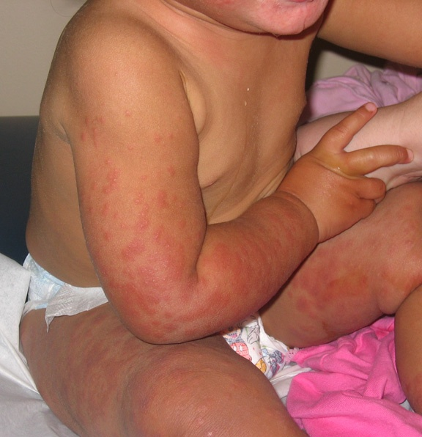
Diagnosis
Notes:
Gianotti crosti
Q. Etiology

Slide 9
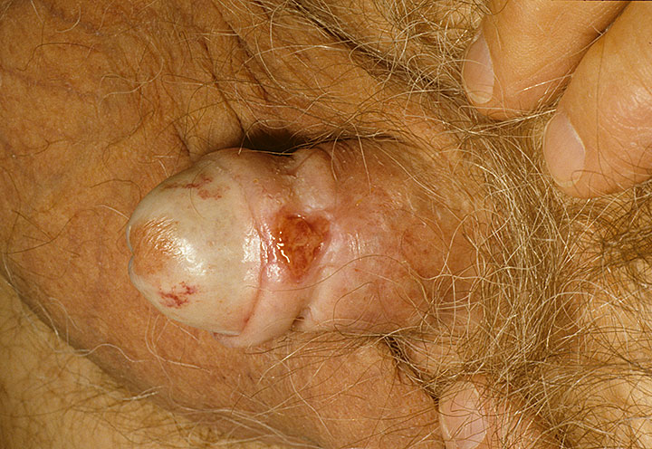
Diagnosis
Notes:
Balinitis xerotica obliterans (LSA with possibly SCC)

Slide 10
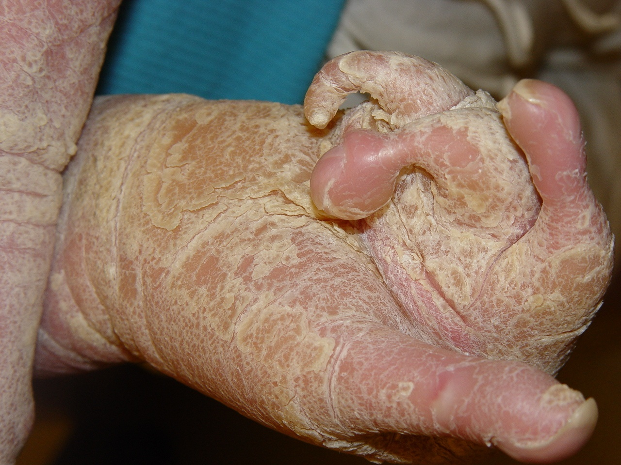
Notes:
Transgradiant keratoderma with pseudoainhem : DD mal de maleda, olmstead

Slide 11
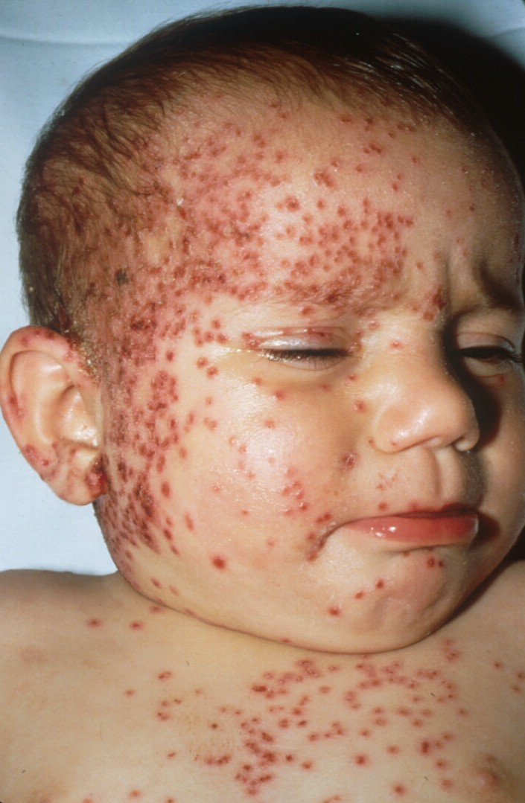
Notes:
Kaposi varicelliform eruption

Slide 12
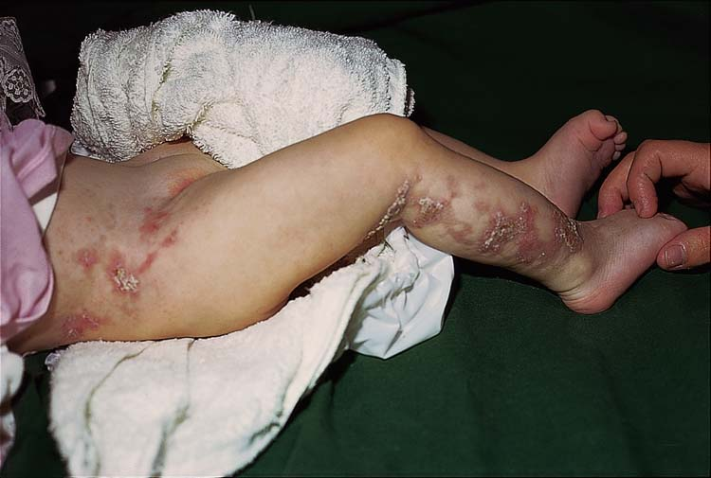
Notes:
Incont pigmenti

Slide 13
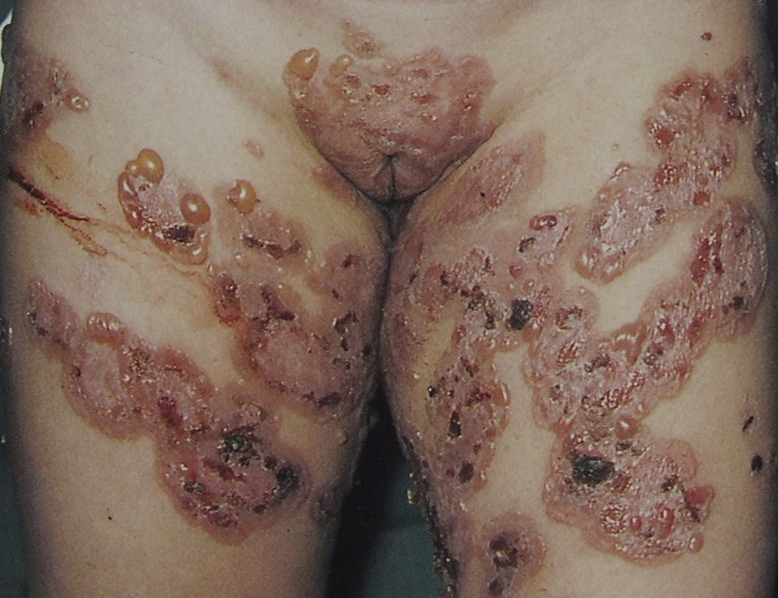
Notes:
CBDC

Slide 14
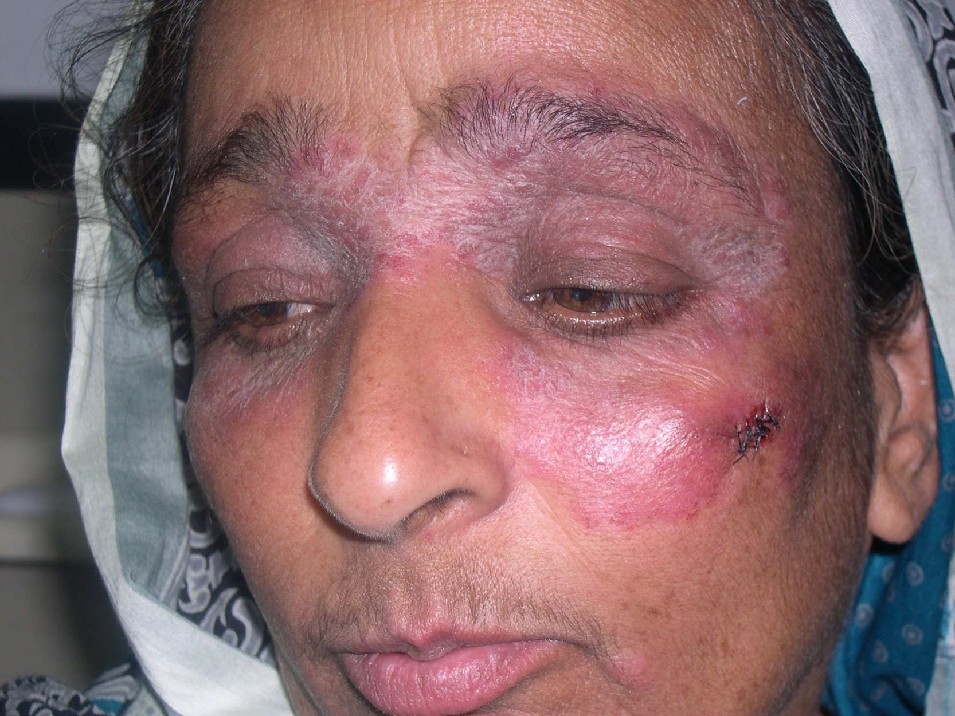
Notes:
DD : tinea, DLE

Slide 15
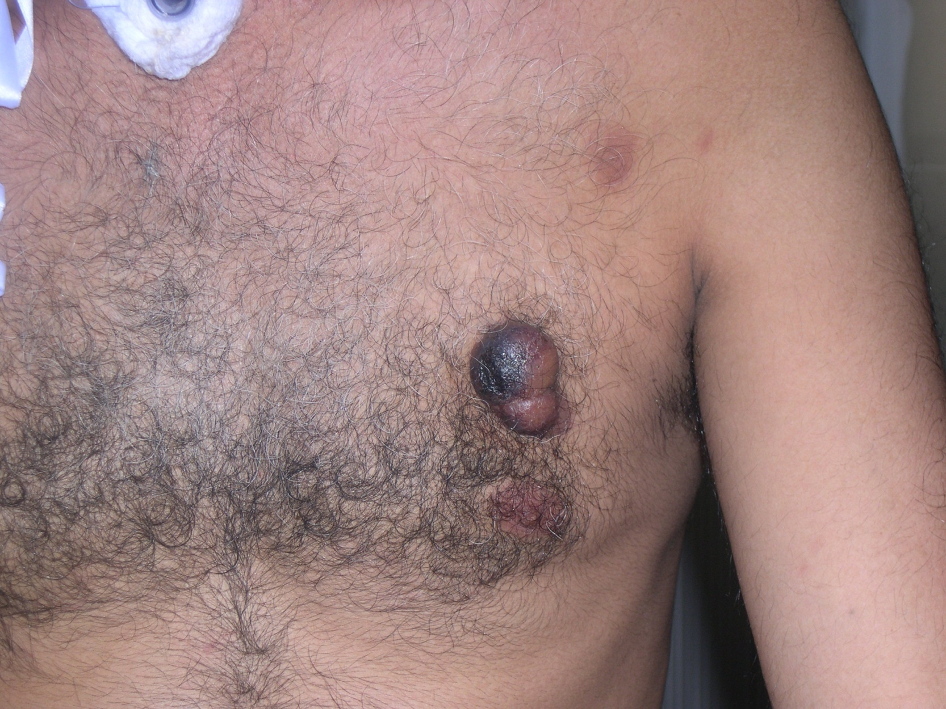
Notes:
Diagnosis: B cell lymphoma
DD: melanoma, DFSP, dermatofibroma, Cut mets

Slide 16
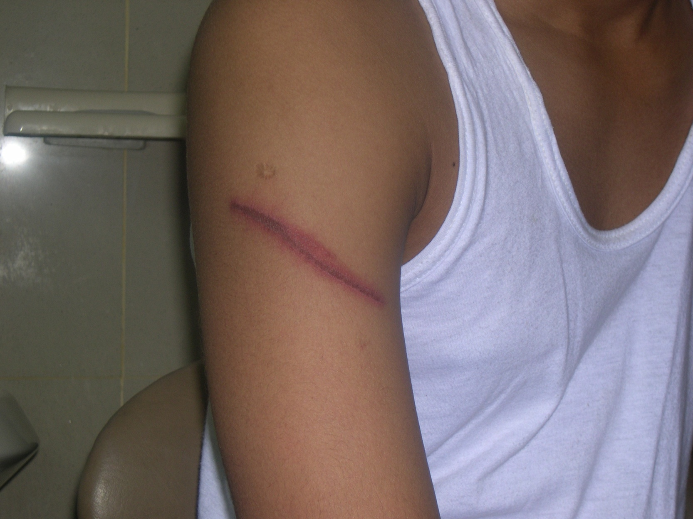
Notes:
Millipede burn
DD: irritant contact, DA

Slide 17
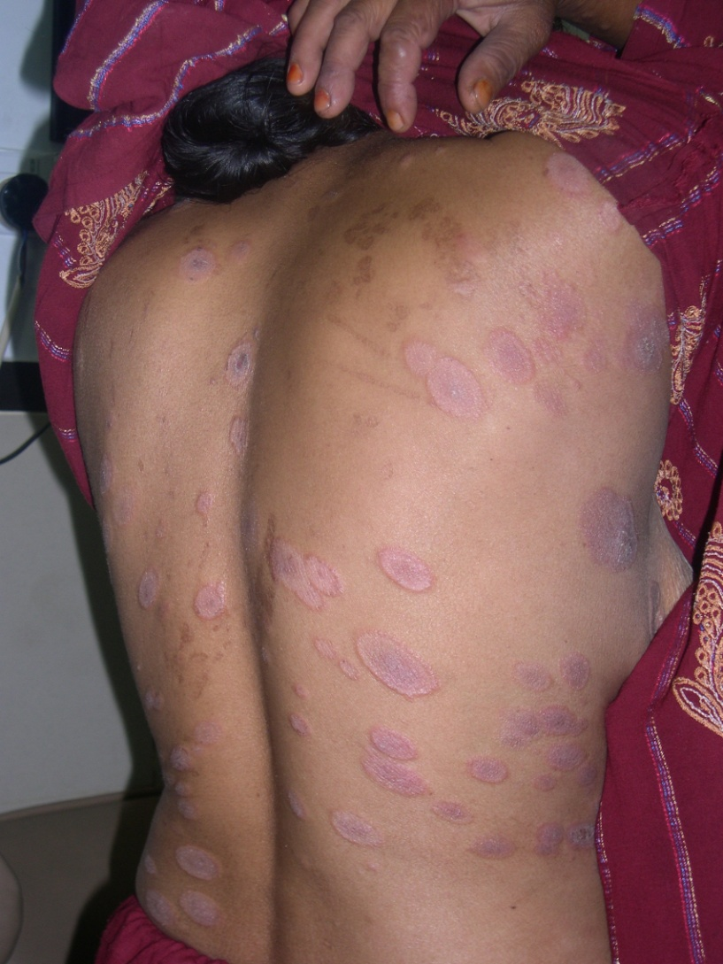
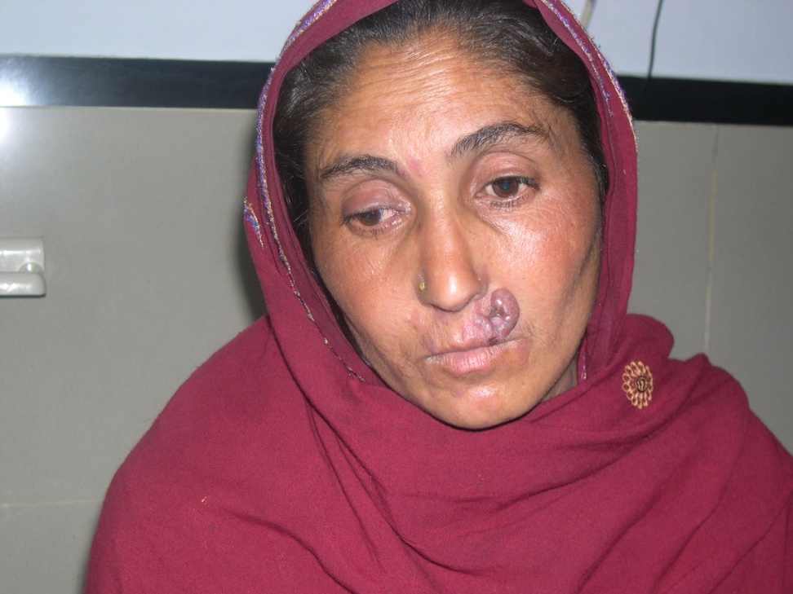

Slide 18
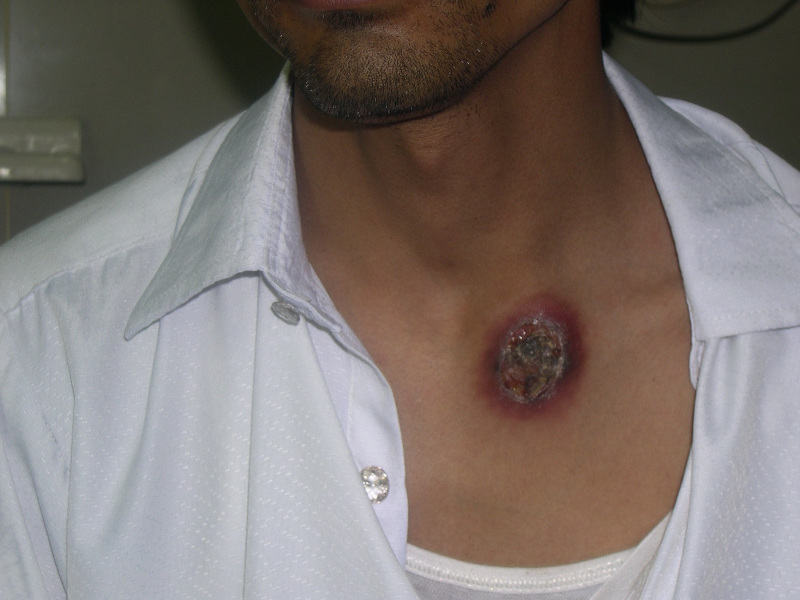
Notes:
Scrofuloderma (2ndry to sternoclavicular TB)

Slide 19
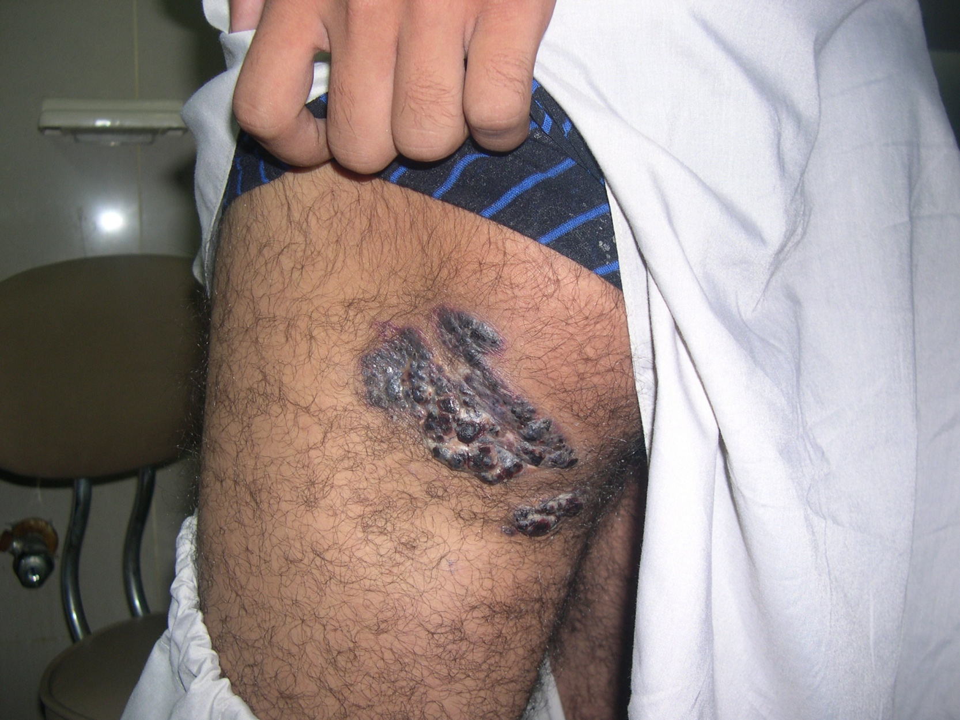
Notes:
angiokeratoma

