Slide 1
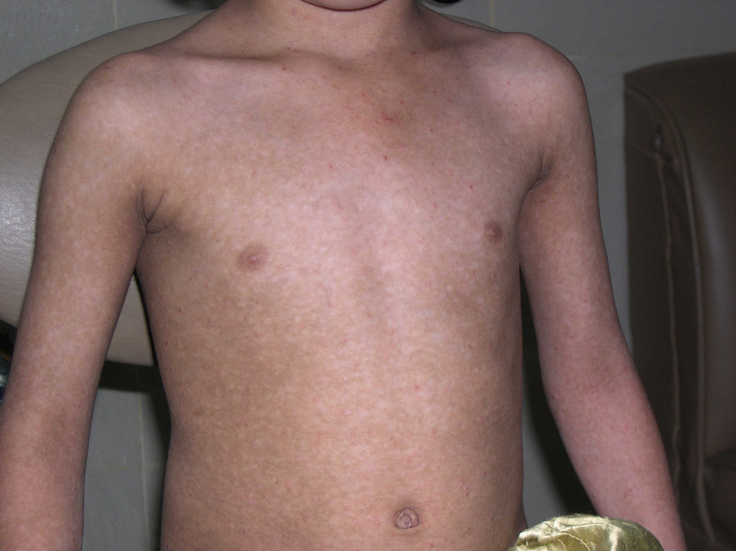
Notes:
Hypopigmented macules and scattered papules over trunk
Dx: PLC

Slide 2
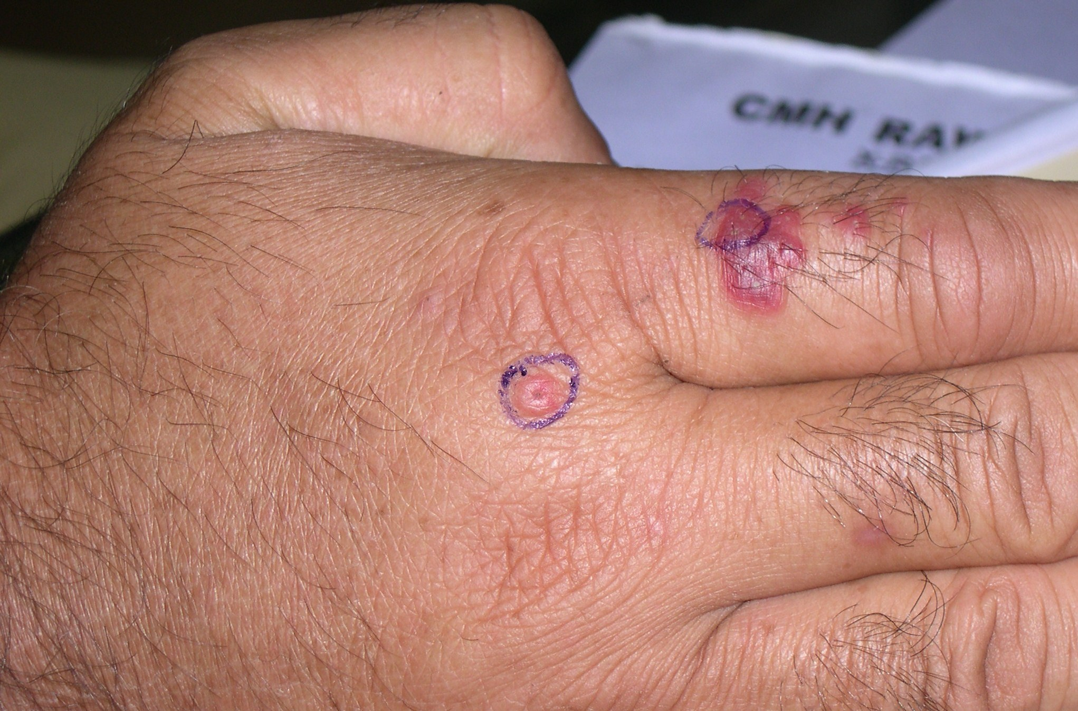
Notes:
D/D
Atypical mycobacterial infection
Sporotrichosis
Cut leishmaniasis
Persistent insect bite reaction
sarcoidosis

Slide 3
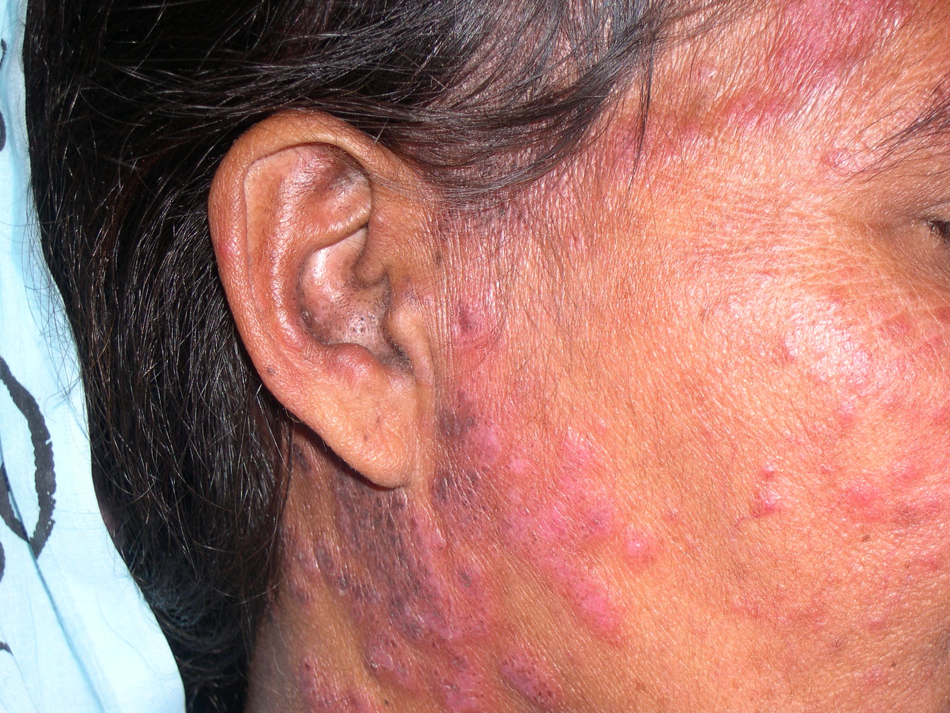
Notes:
DLE (follicular plugging in ear is seen)
D/D:
Pseudolymphoma
PMLE
LP
Hair dye dermatitis

Slide 4
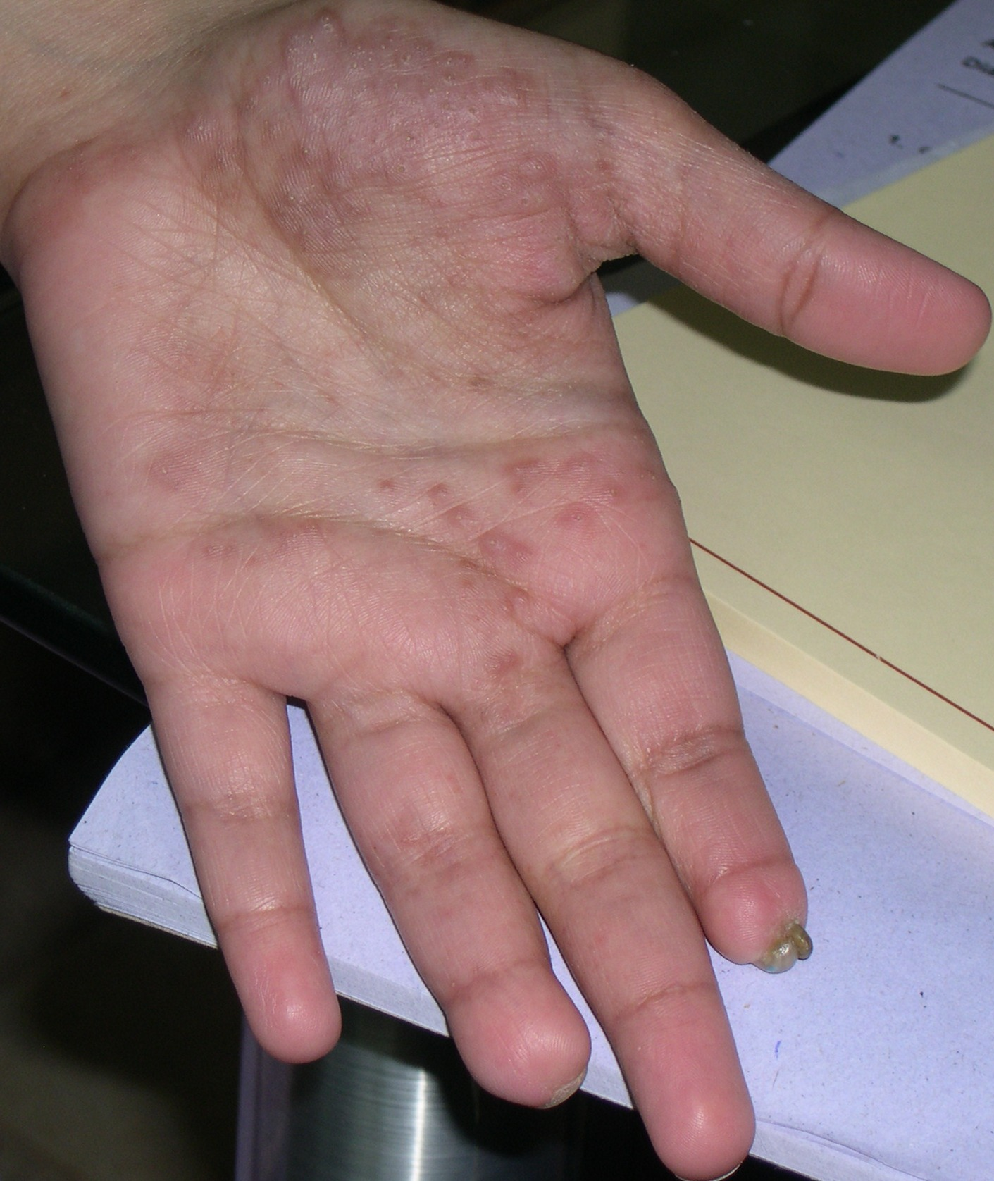
Notes:
Persistent for 6 months (papular lesions on hands and history of joint pains also)
Reiter’s
Sarcoidosis
Sec syphilis
Lepromatous leprosy
MCH
Psoriasis

Slide 5
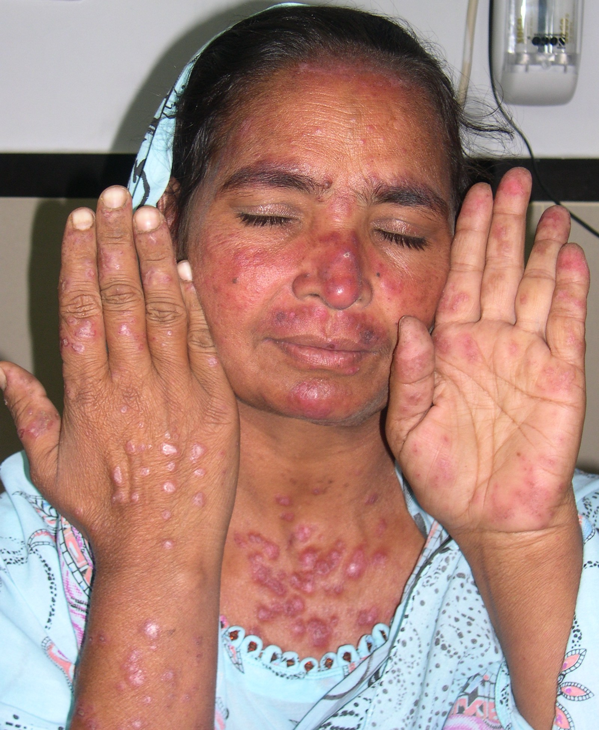
Notes:
SLE
D/D:
MCTD

Slide 6
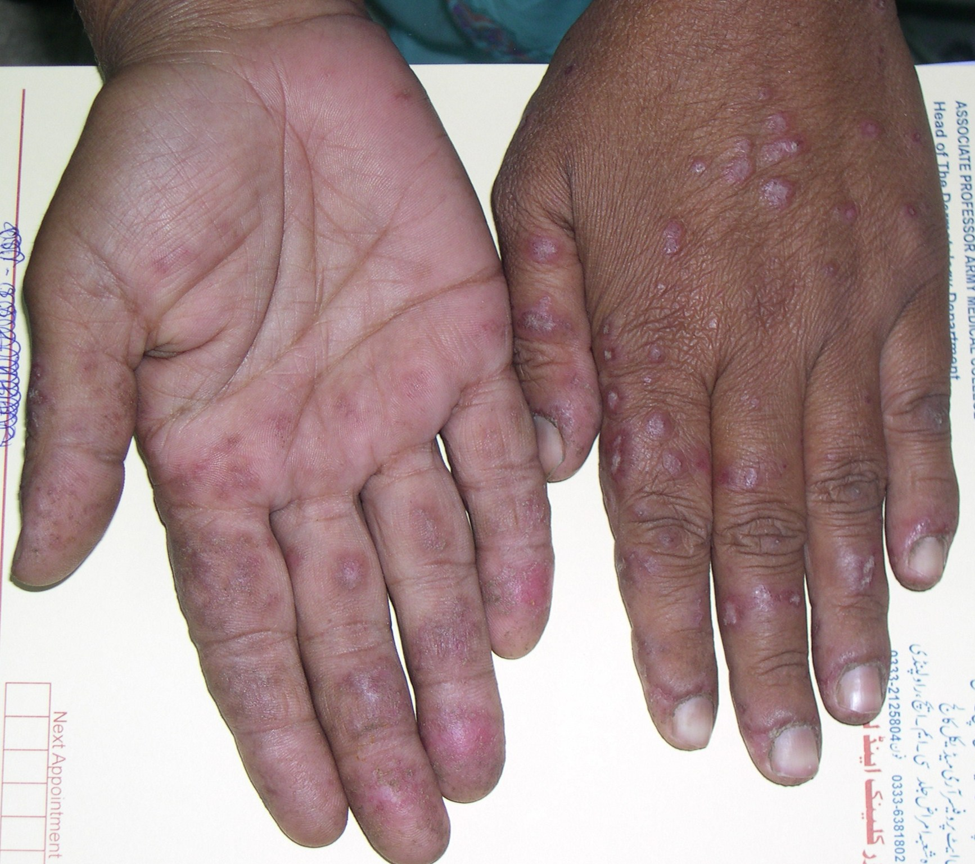
Notes:
Hands of previous SLE patient

Slide 7
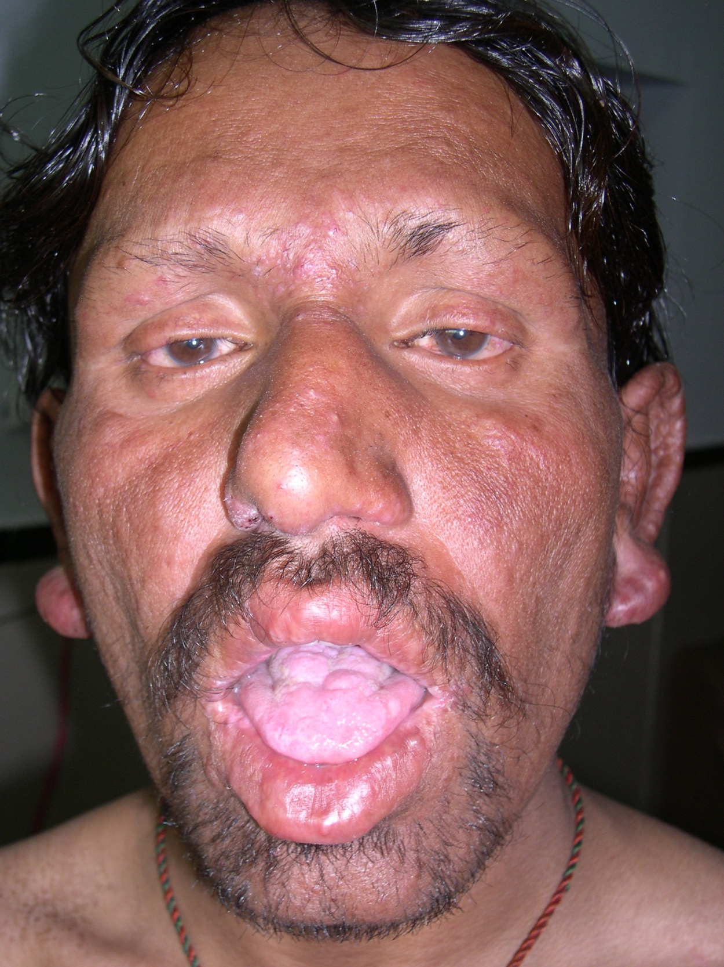
Notes:
Lepromatous leprosy
D/D
Amyloidosis
DCL
MCH

Slide 8
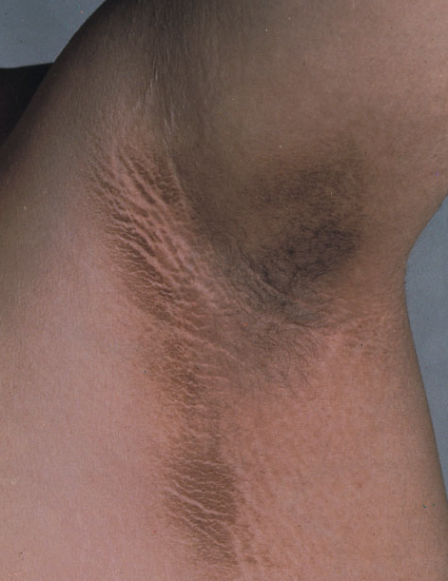
Notes:
Acanthosis nigricans (velvety plaque with accentuation of skin creases)

Slide 9
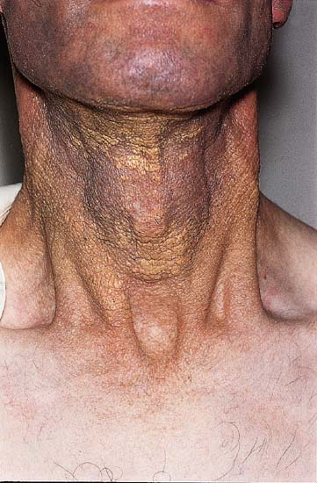
Notes:
Xanthoma planum (associated with paraproteinemia)
Inv: Serum protein electropharesis

Slide 10
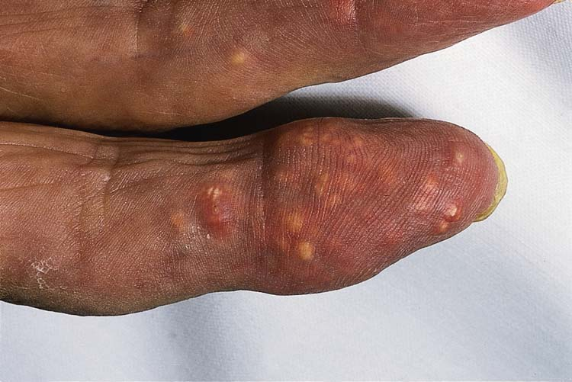
Notes:
D/D
Calcinosis cutis
Gouty tophi
pseudogout

Slide 11
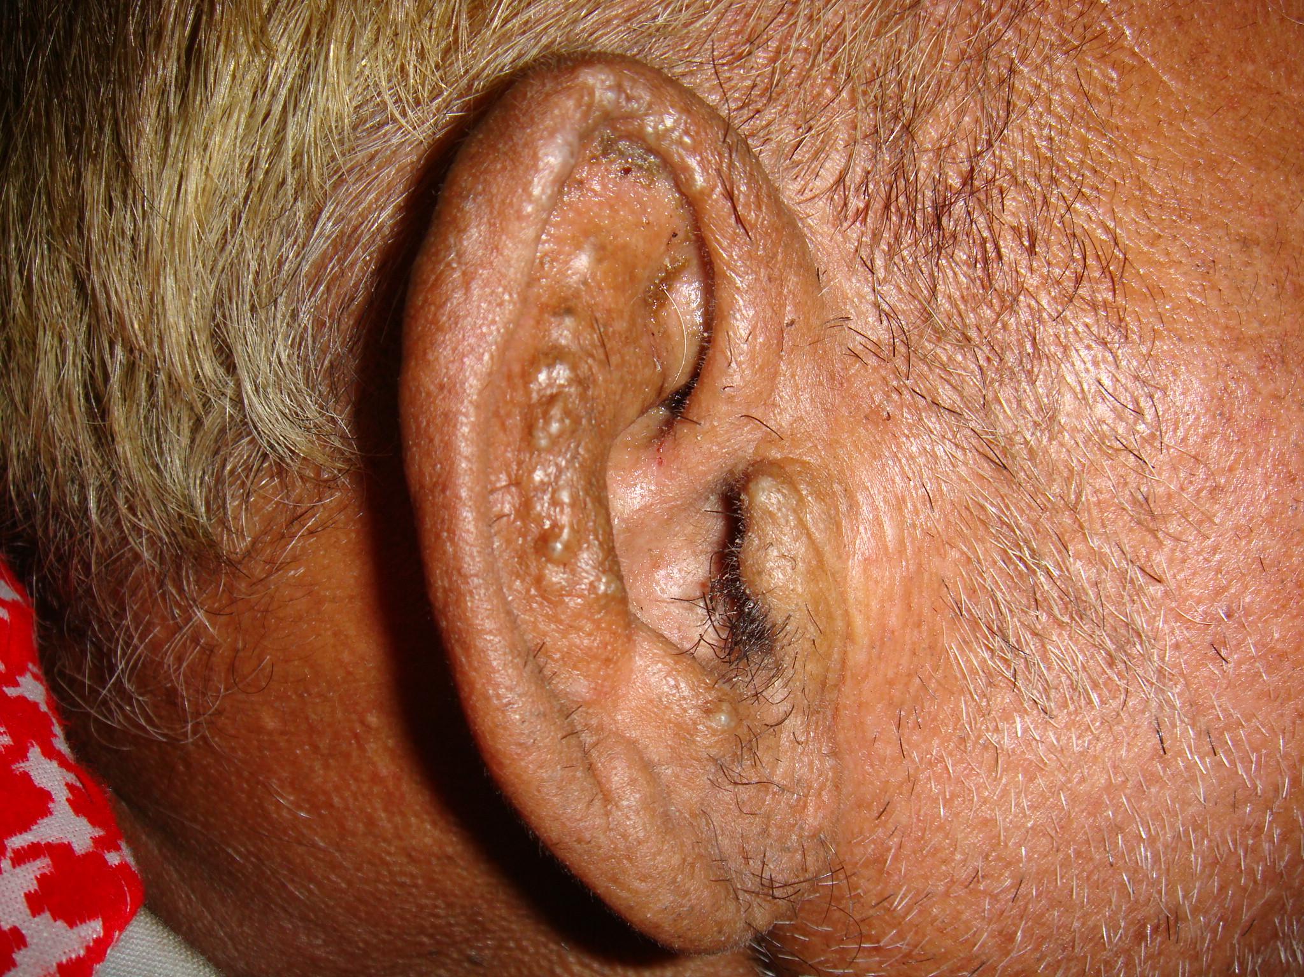
ALKAPTON URIA
OCHRONOSIS
Notes:
Papular lesions on ear
Dx: Ochronosis
D/D
Kimura
Gouty tophi
MCH

Slide 12
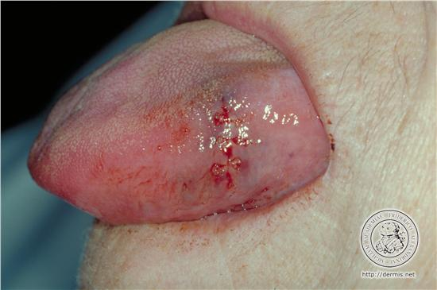
Notes:
amyloidosis

