Slide 1
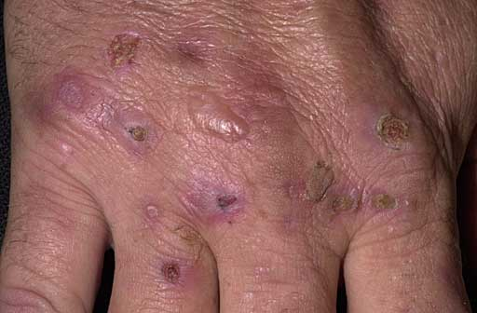
Notes:
D/D:
Porphyria
Pseudoporphyria

Slide 2
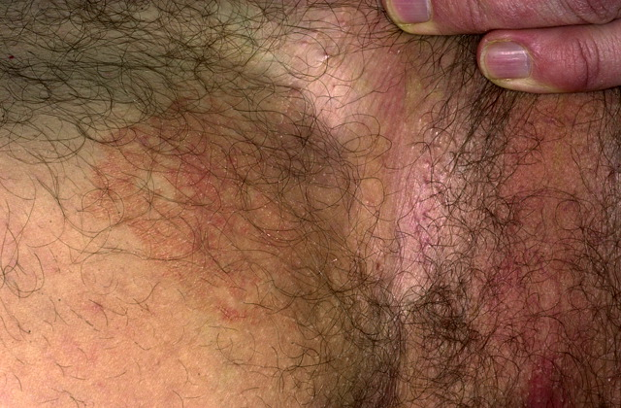
Notes:
Erythrasma
D/D:
Tinea
Irritant contact dermatitis

Slide 3
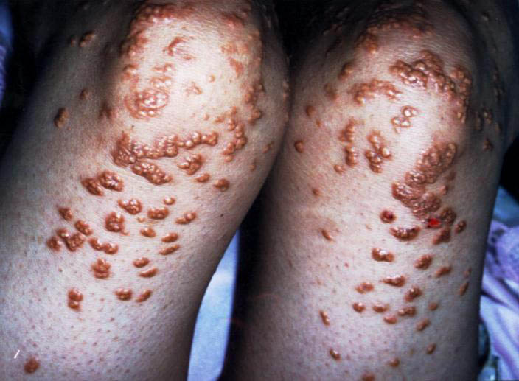
Notes:
Eruptive xanthomas
D/D:
Multicentric reticulohistiocytosis
Sarcoidosis

Slide 4
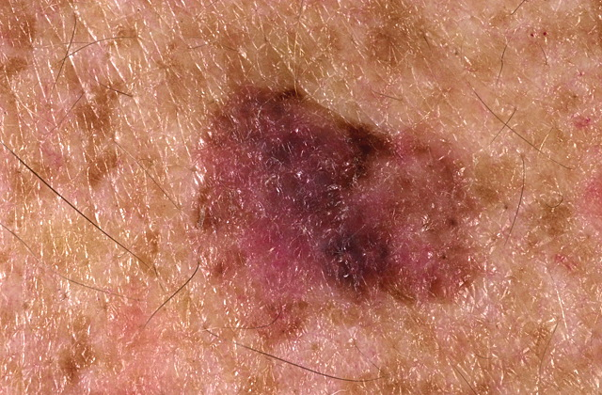
Notes:
D/D:
Sup spreading melanoma
Sup spreading BCC
Bowen dis

Slide 5
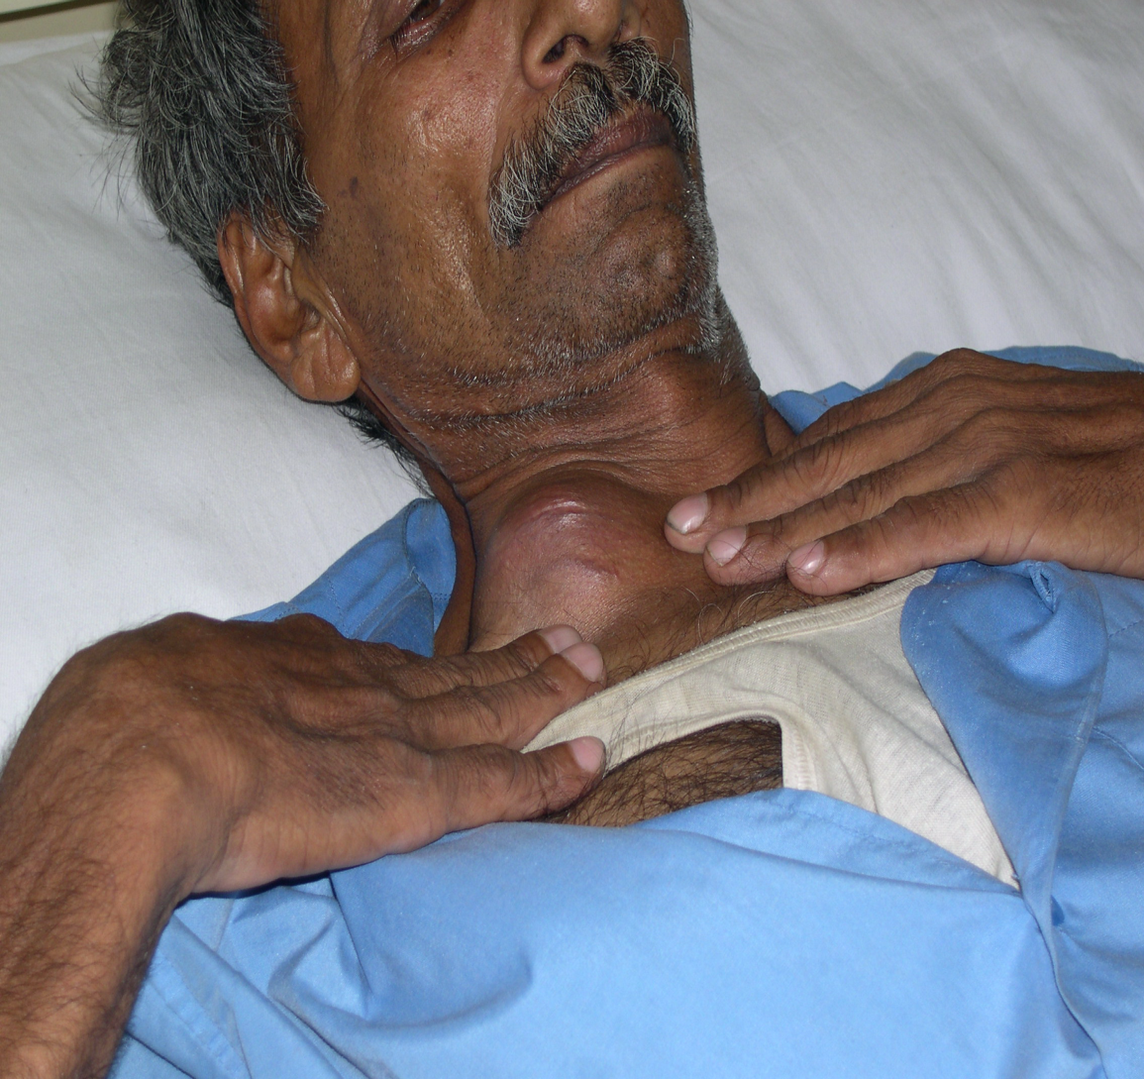
Notes:
D/D:
Lymphoma
Pancost Tumor
Supraclavicular mets

Slide 6
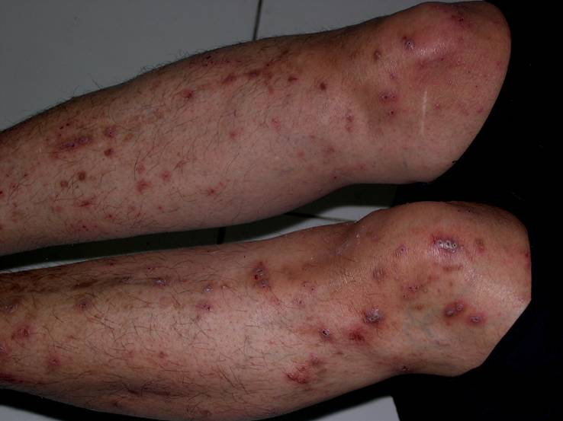
Notes:
D/D:
Perforating disorder
Papulonecrotic tuberculide
Prurigo nodularis

Slide 7
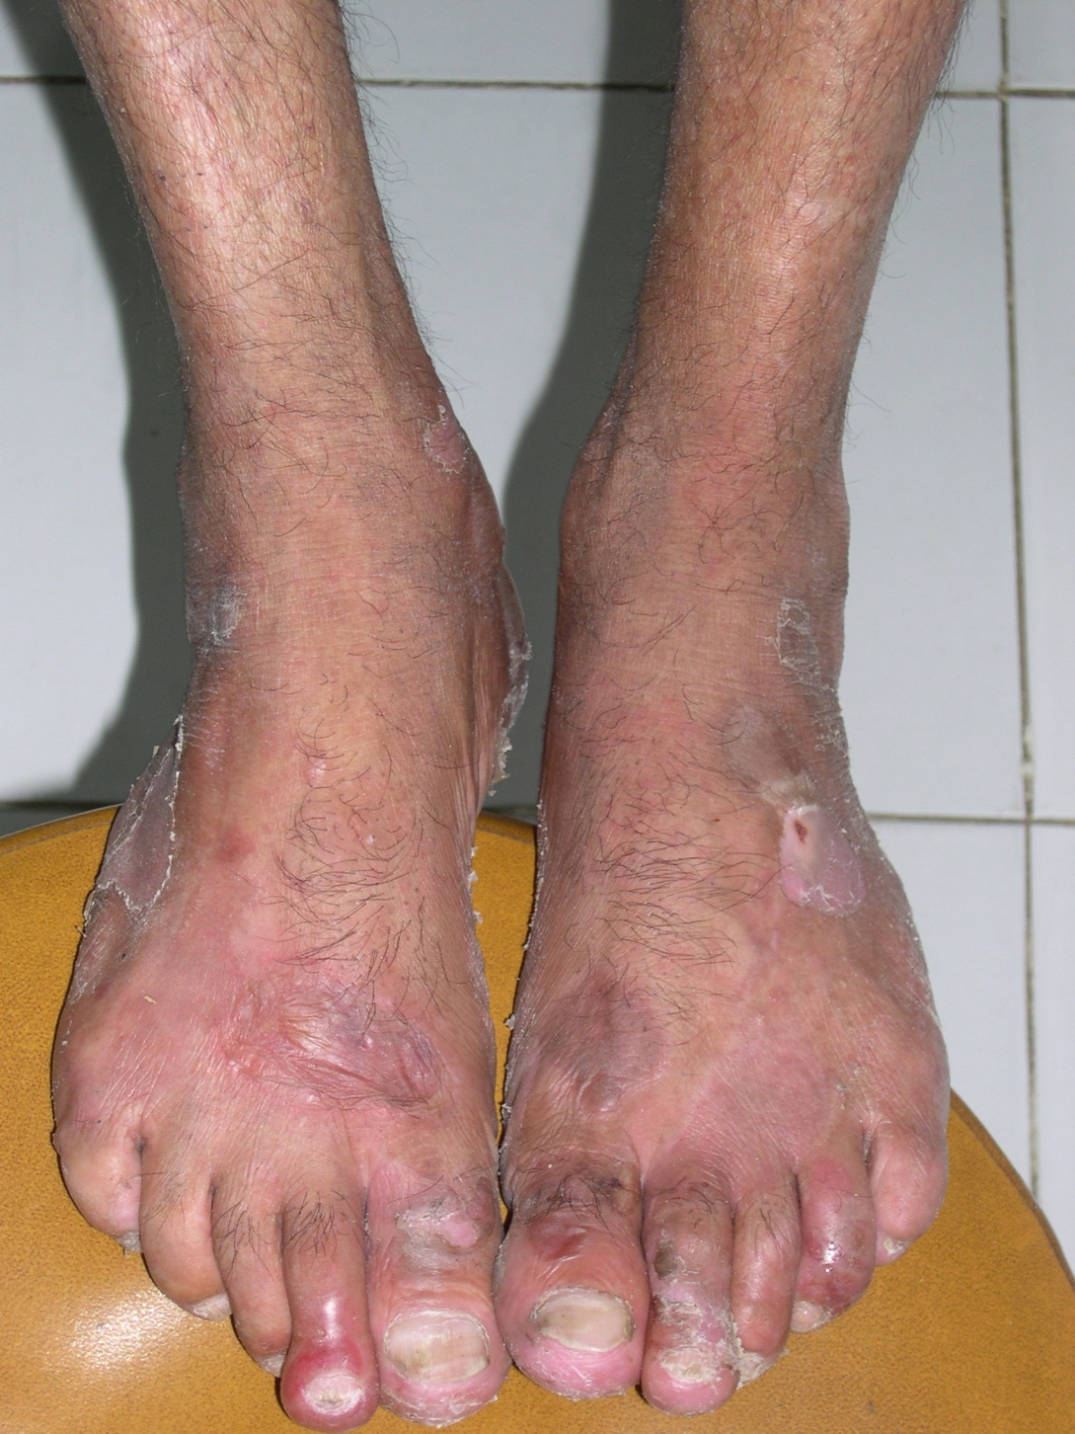
Notes:
Slide not discussed

Slide 8
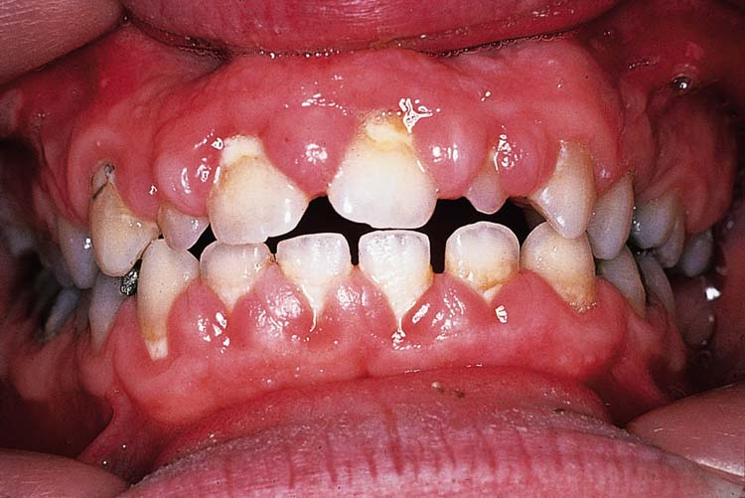
Notes:
Slide not discussed

Slide 9
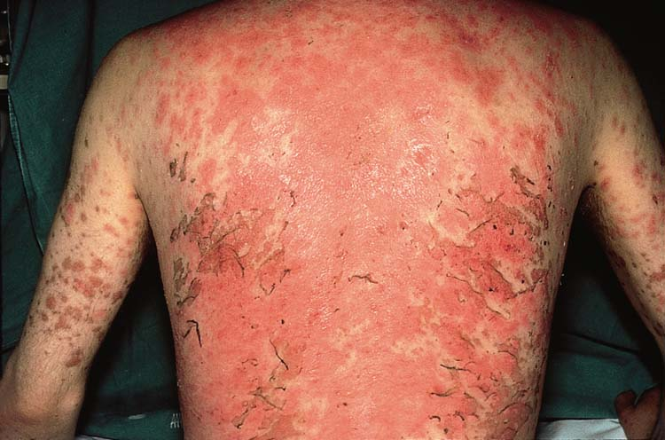
Notes:
Slide not discussed

Slide 10
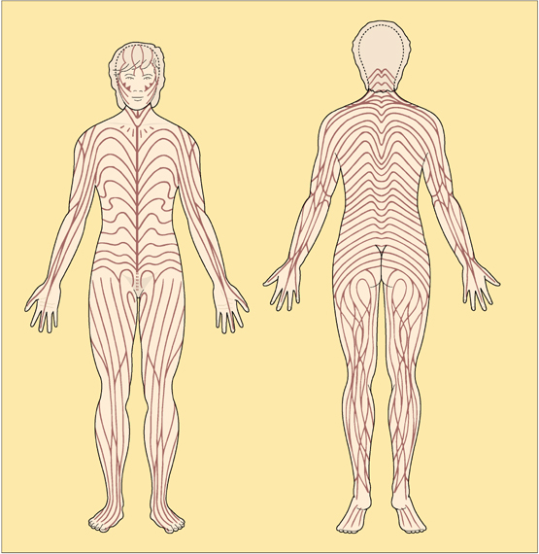

Slide 11
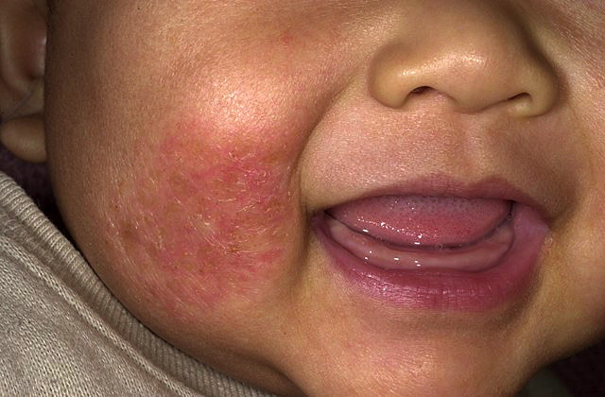

Slide 12
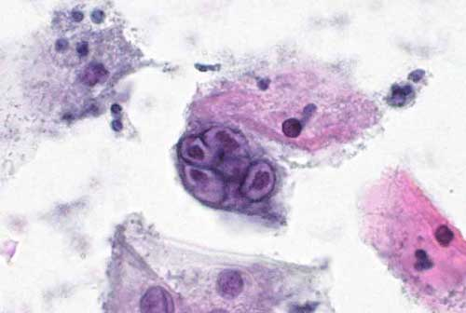

Slide 13
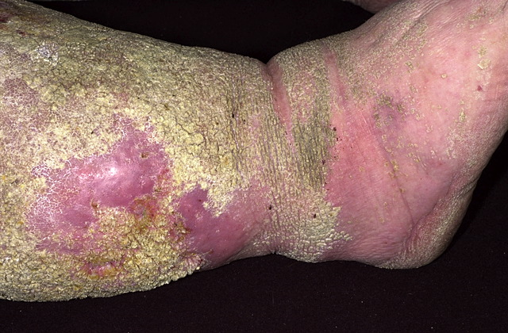

Slide 14
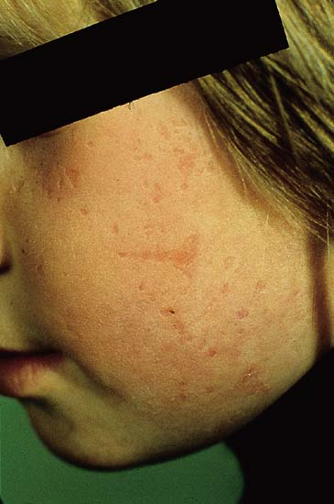
Notes:
Varioliform scarring shown
D/D:
EPP
Hydroa Vacciniformis
Vermiculate atrophoderma
Lipoid proteinosis

