Slide 1
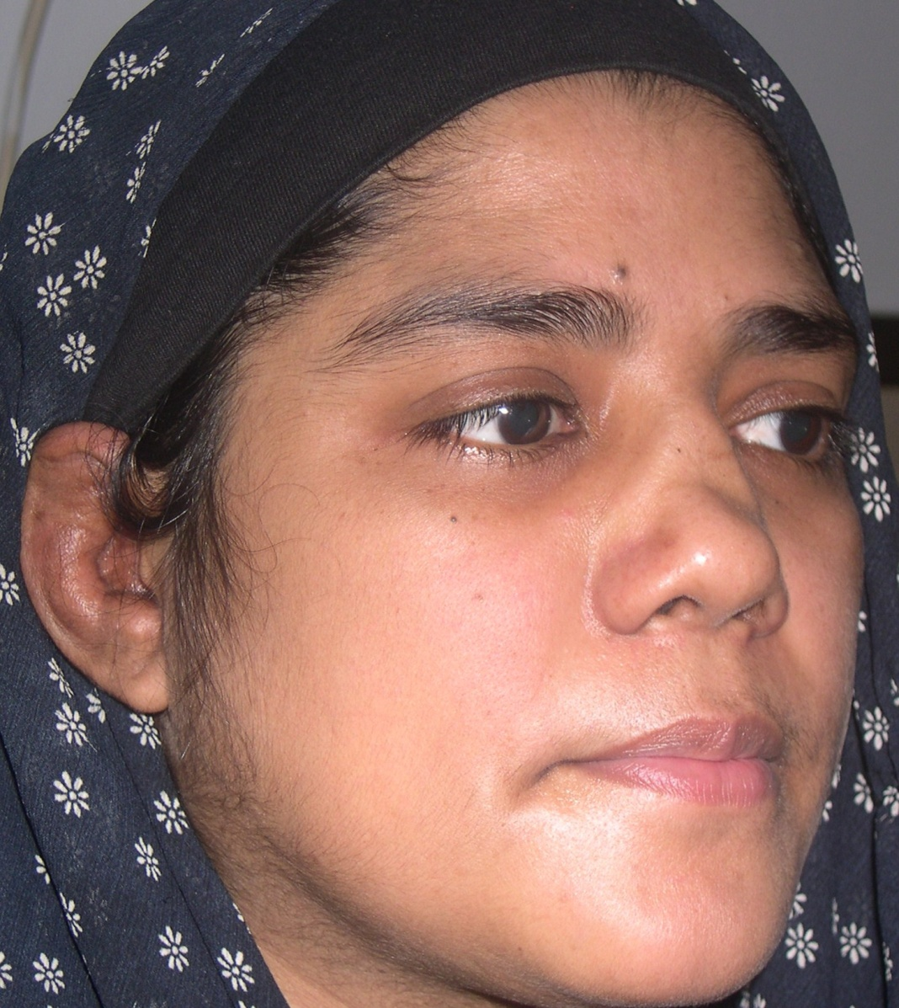
Notes:
Dx: Relapsing polychondritis ( depressed nose, ear cartilage involvement with sparing of ear lobe + hoarseness of voice on history)
Associations of relapsing polychondritis (Imp)
SLE, sjogren, dermatomyositis, Sweet, pyoderma gangrenosum

Slide 2
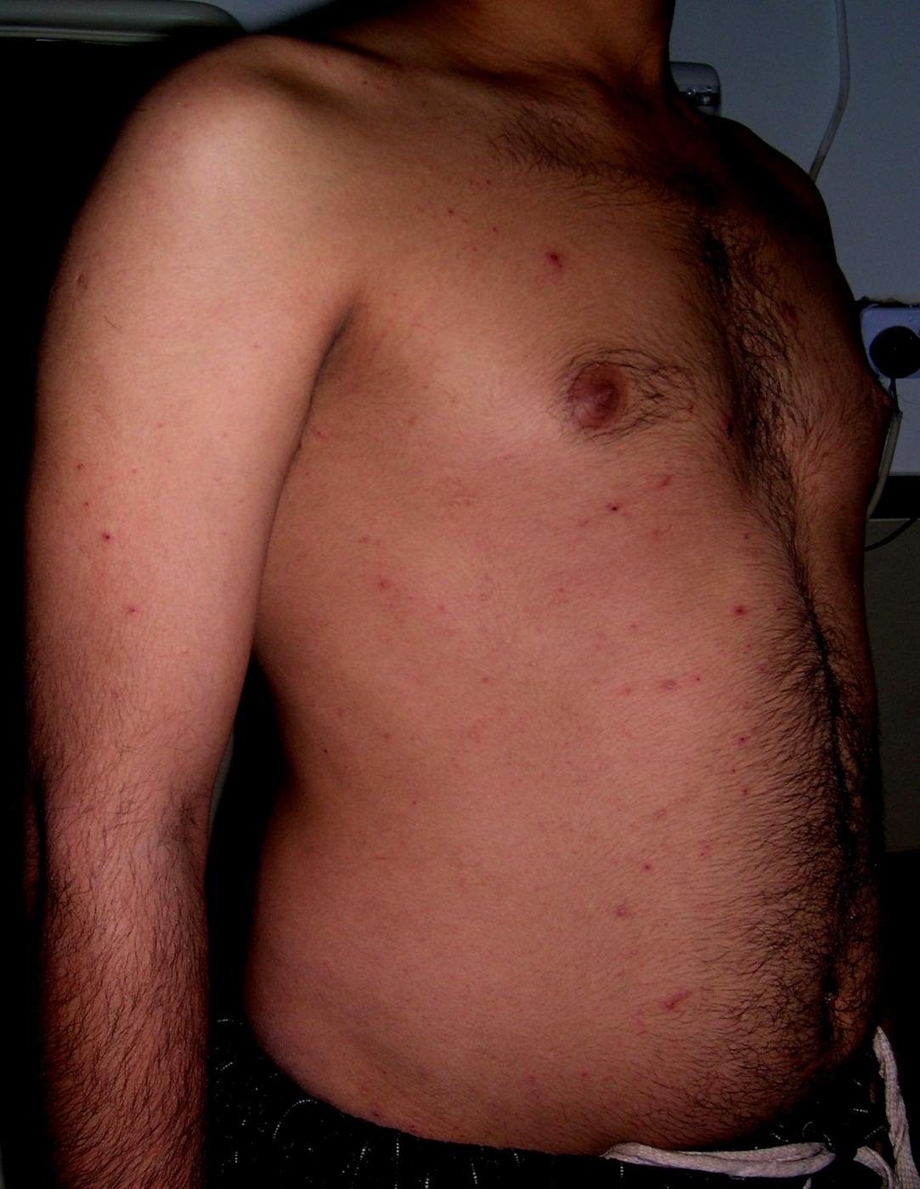
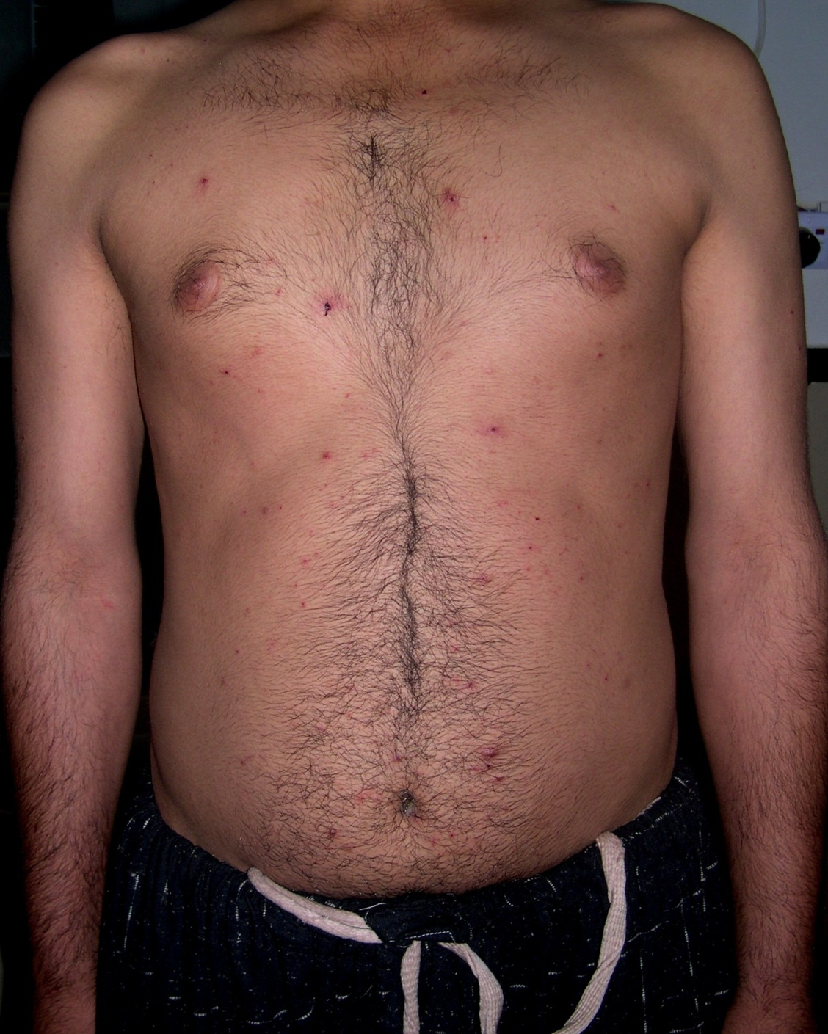
Notes:
D/D
PLEVA (mostly asymptomatic)
Papulonecrotic tuberclide (genital lesion is a sign of it)
Chicken pox
Lymphomatoid papulosis (itching is its sign)

Slide 3
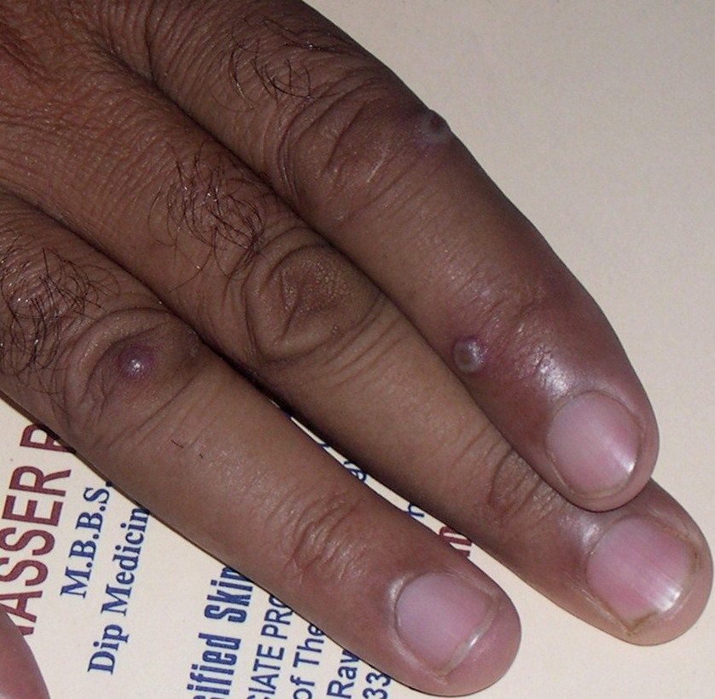
Notes:
Dx: Orf
D/D: Milker’s nodule, cow pox

Slide 4
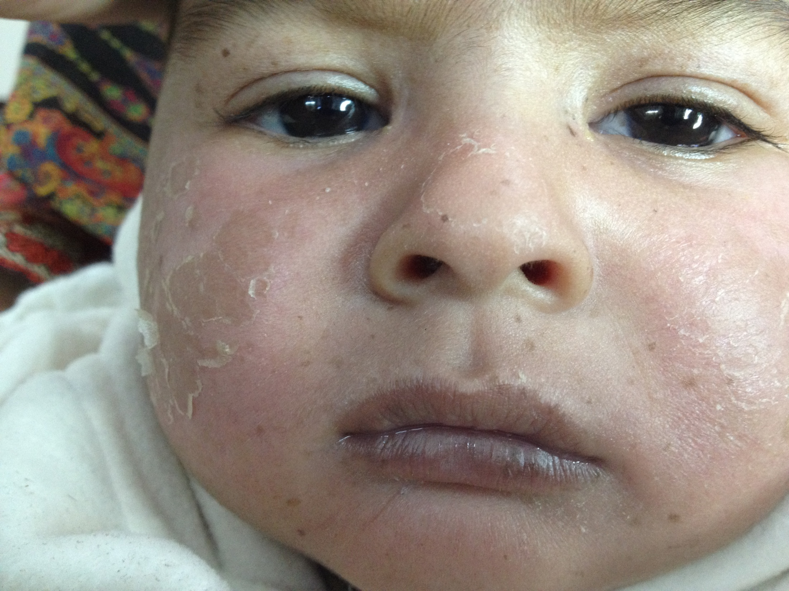
Notes:
Freckles, erythematous rash on cheeks and nose and peeling of skin (photosenitivity)
Dx: Early XP

Slide 5
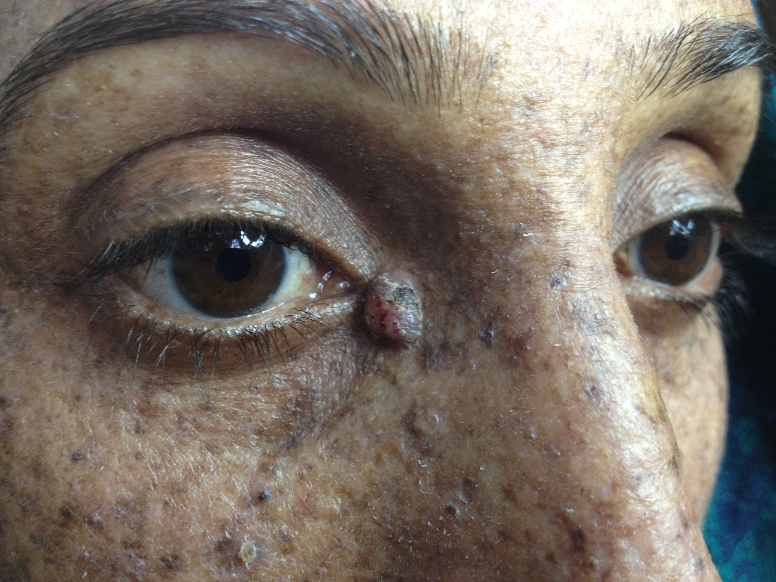
Notes:
Xeroderma pigmentosum with BCC

Slide 6
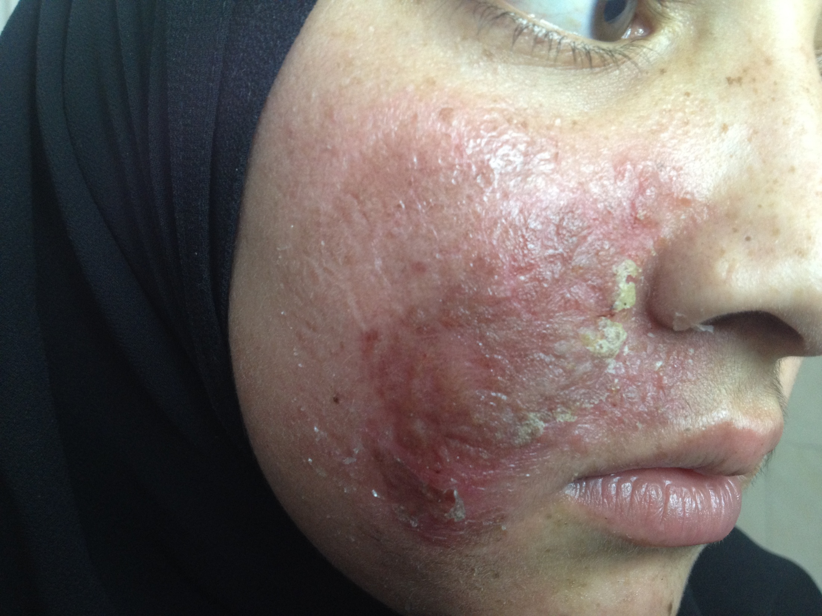
Notes:
D/D
Lupus vulgaris
Sarcoidosis
Cutaneous leishmaniasis
Tumid LE

Slide 7
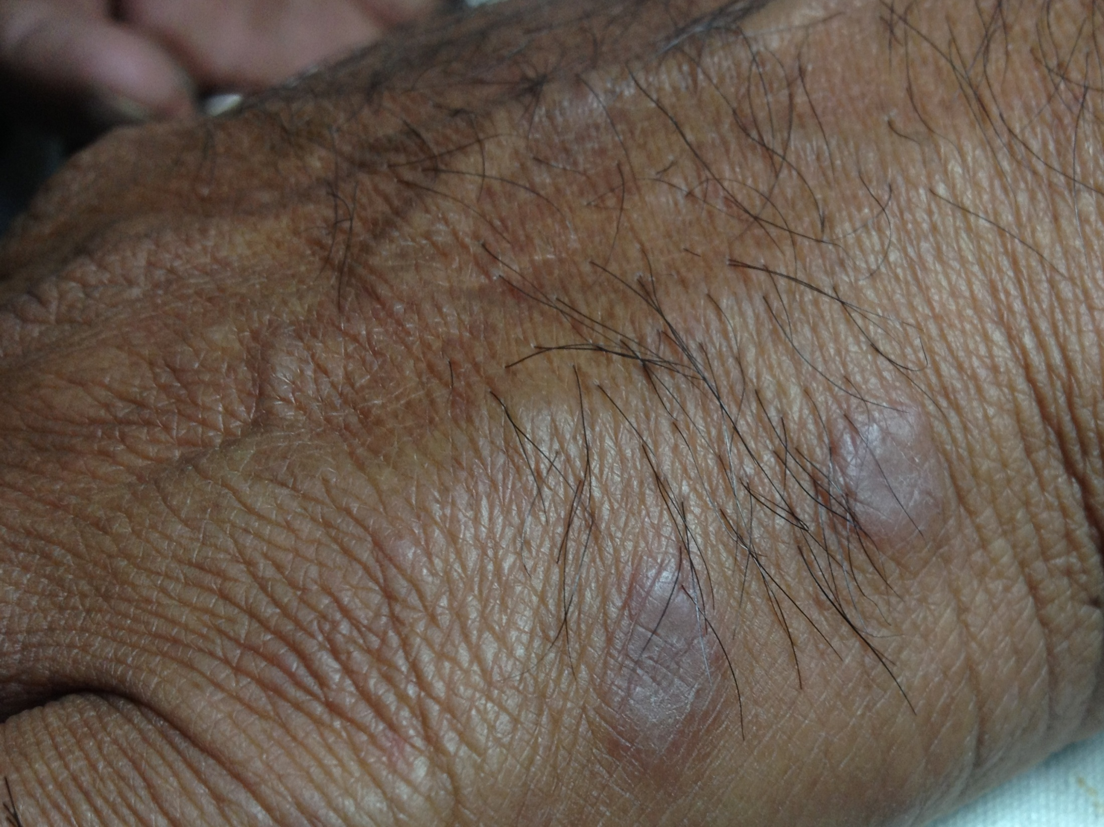
Notes:
Erythema elevatum diutinum

Slide 8
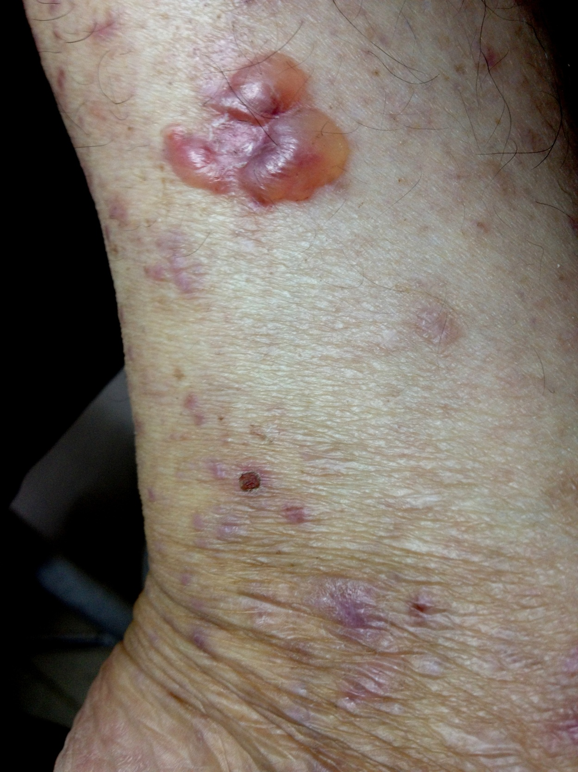
Notes:
Bullous LP

Slide 9
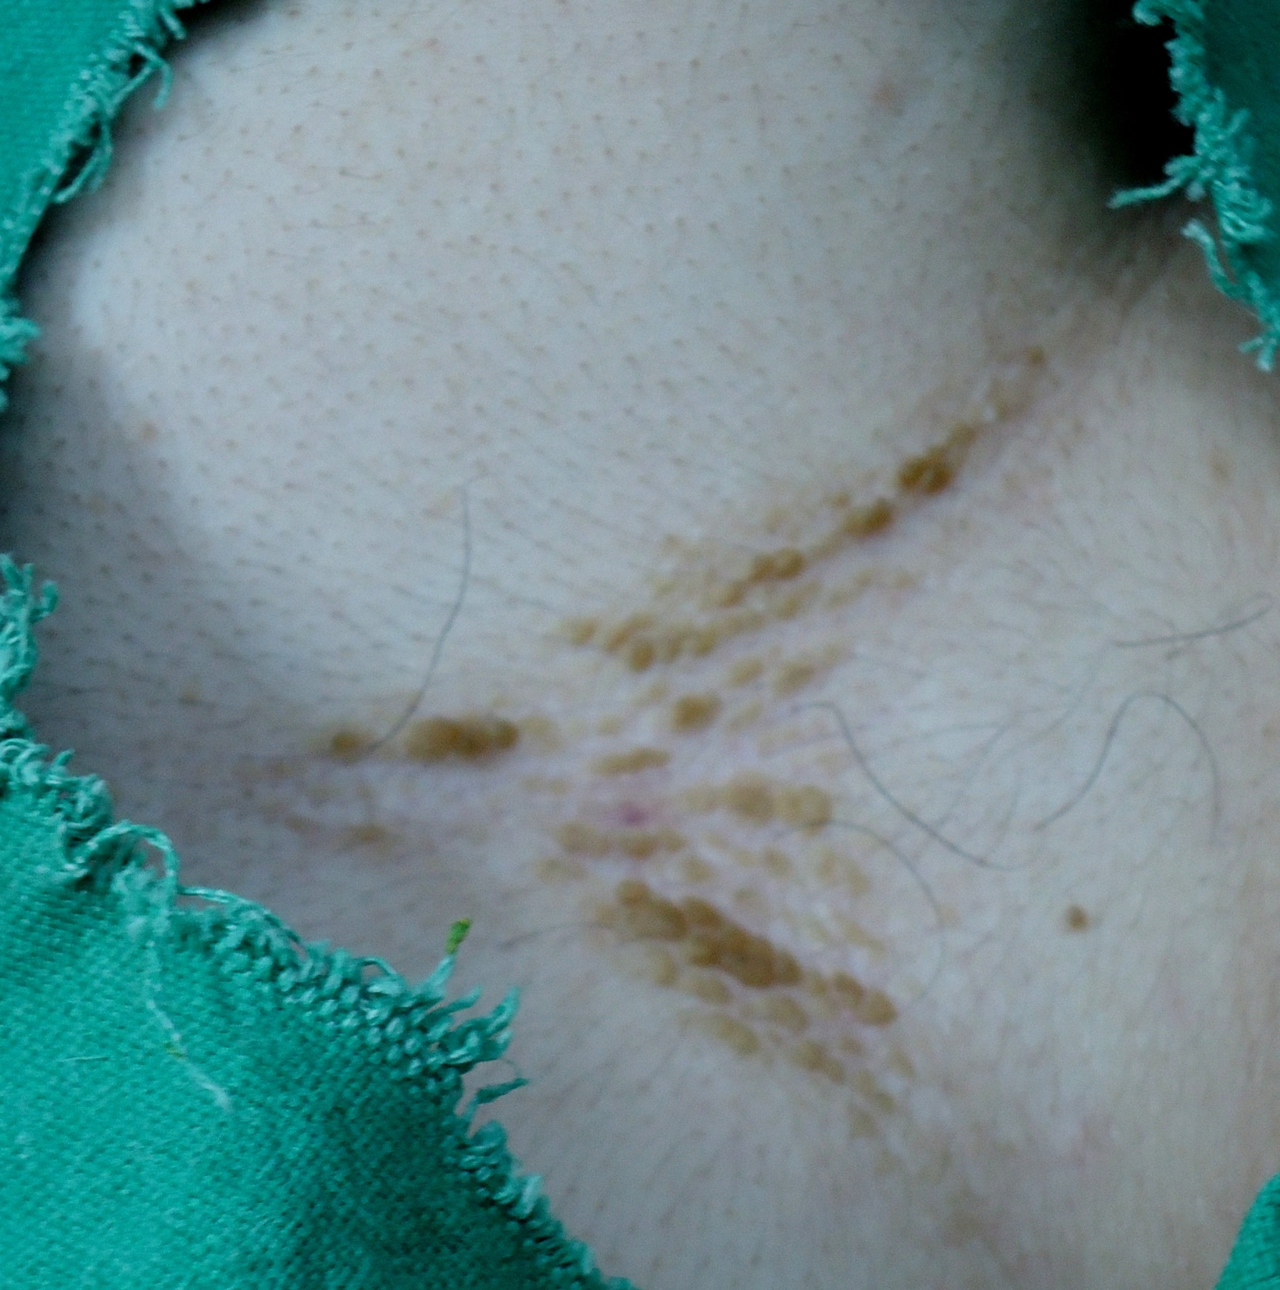
Notes:
Intramammary region shown
Dx: confluent and reticulate papillomatosis
D/D: Darier and Grover disease

Slide 10
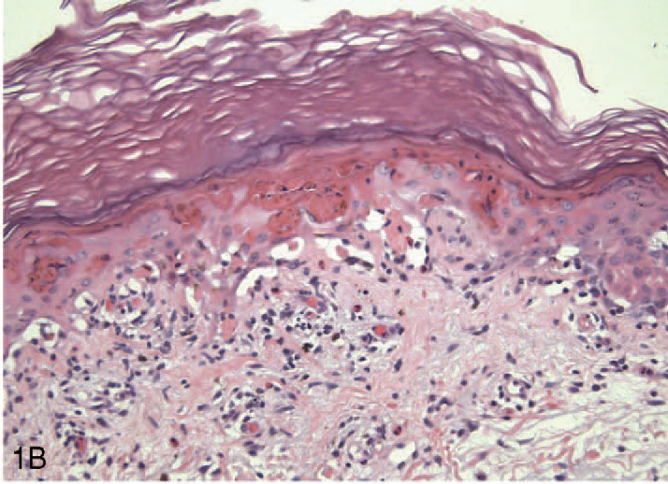
Notes:
Dx: EM
Interface dermatitis, less infiltrate with eosinophils, vacoular degeneration and epidermal necrosis

Slide 11
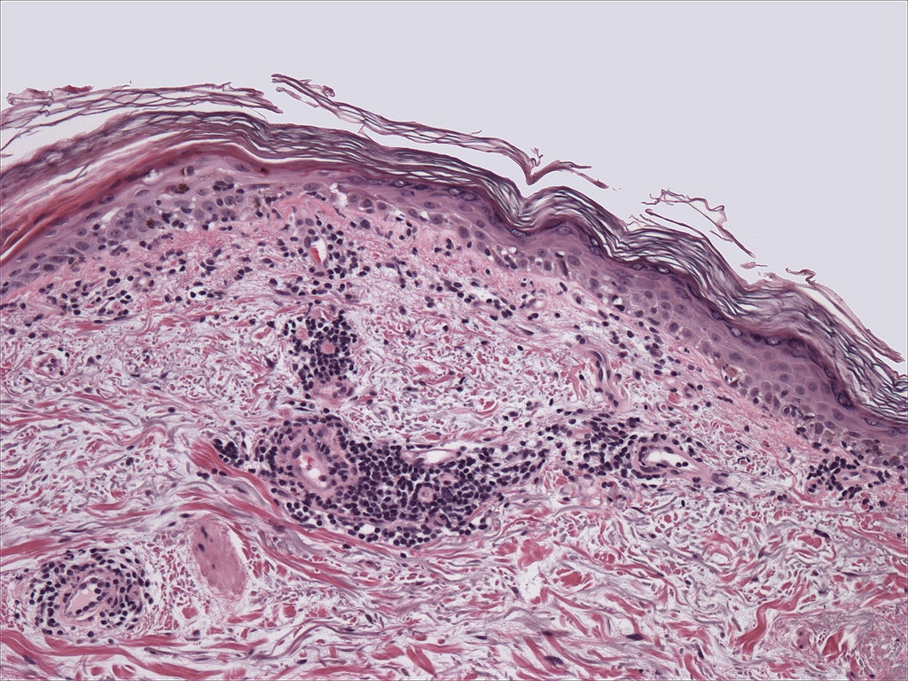
Notes:
Dx: SLE
Interface dermatitis, less infiltrate, separation of collagen bundles

Slide 12
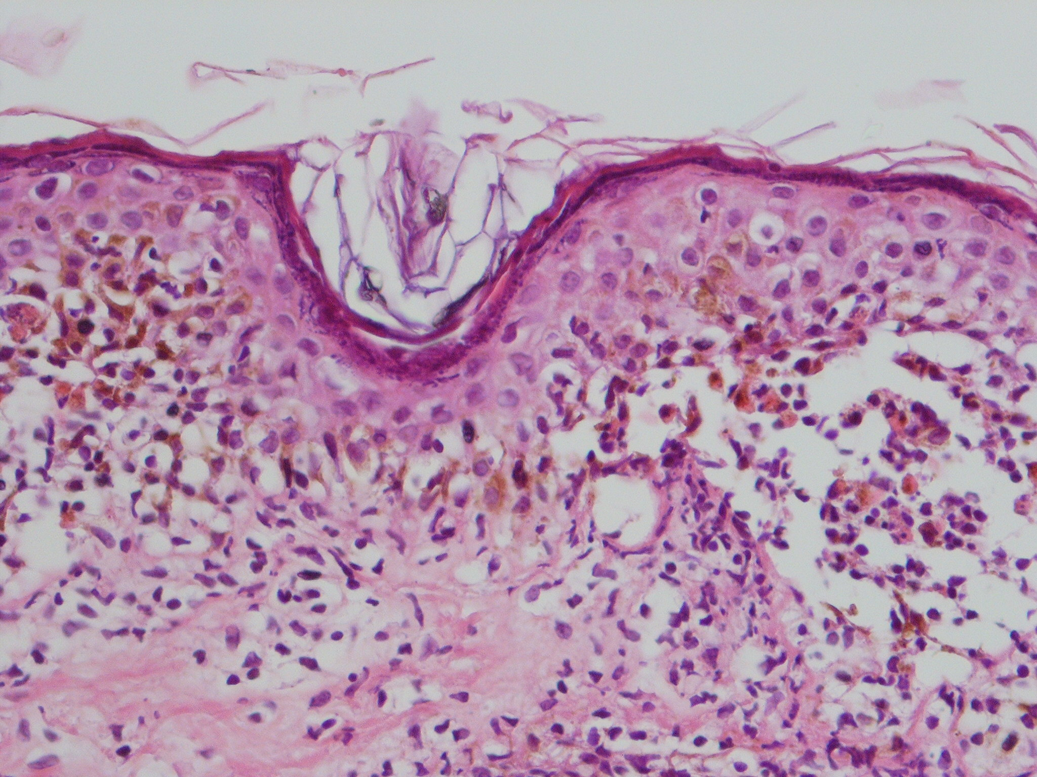
Notes:
Dx: DLE
Follicular plugging, hyperkeratosis, hypergranulosis, pigmentary incontinence, cell rich perivascular infiltrate

