Slide 1
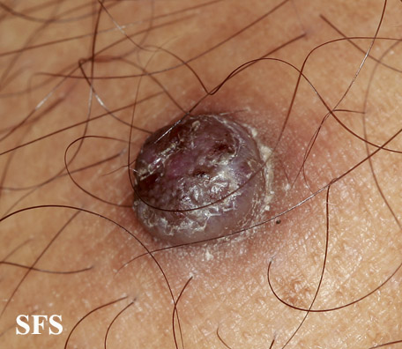
DIFFRENTIAL DIAGNOSIS
Notes:
D/D
Pyogenic granuloma
Eccrine poroma
Clear cell acanthoma
Irritated mole
Nodular BCC

Slide 2
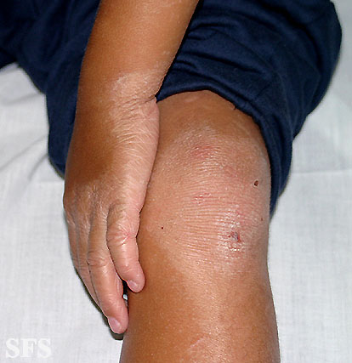
DIAGNOSIS
Notes:
Erythrokeratoderma variabalis

Slide 3
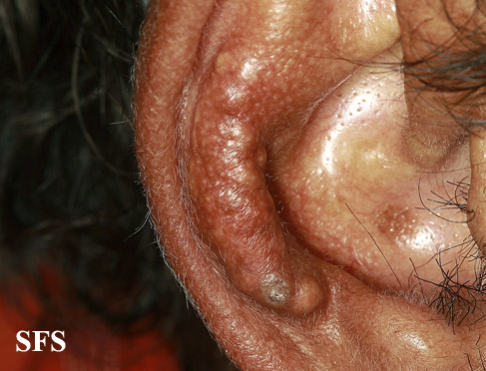
LIKELY DIAGNOSIS
Notes:
D/D
Gouty tophi
RA nodules
Calcinosis
Sarcoidosis
DLE

Slide 4
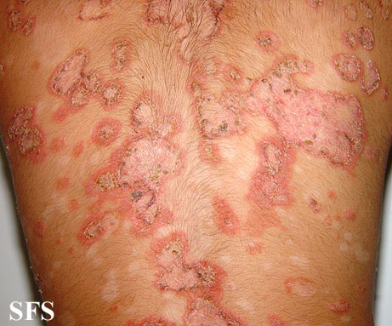
DIFFRENTIAL DIAGNOSIS
Notes:
D/D
Healing pustular psoriasis
Tinea corporis
Pemphigus foliaceus
SCLE

Slide 5
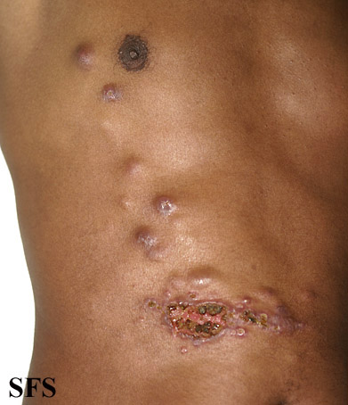
DIFFRENTIAL DIAGNOSIS
Notes:
Sporotrichosis
Lymphatic spread of leishmaniasis
Cat scratch dis
Tularemia
Nocardiosis

Slide 6
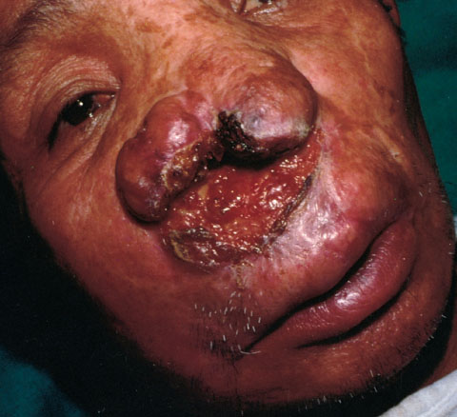
DIFFRENTIAL DIAGNOSIS
Notes:
Mucocutaneous leishmaniasis
SCC
Syphlitic gumma
Rhinoscleroma
Wegner’s granulomatosis

Slide 7
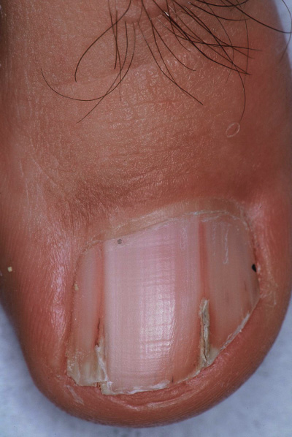
LIKELY DIAGNOSIS
Notes:
Darier Disease

Slide 8
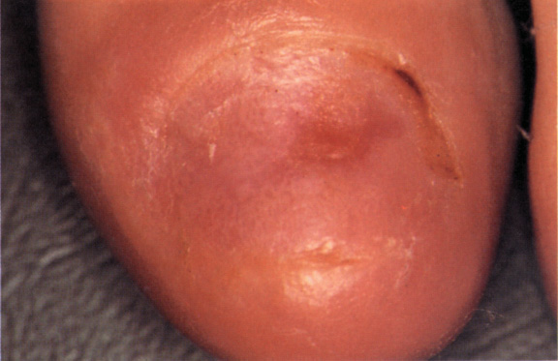
DIFFRENTIAL DIAGNOSIS
Notes:
Anonychia
Congenital
Trauma
LP
EB
Peripheral vascular disorders

Slide 9
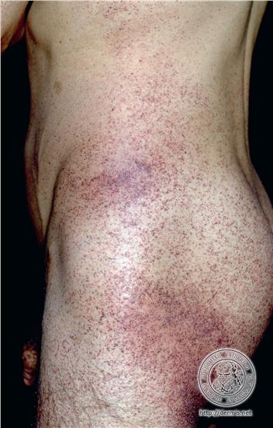
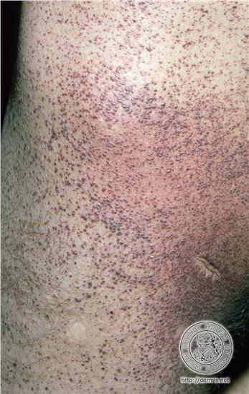
LIKELY DIAGNOSIS
Notes:
Angiokeratoma of corporis diffusum

Slide 10
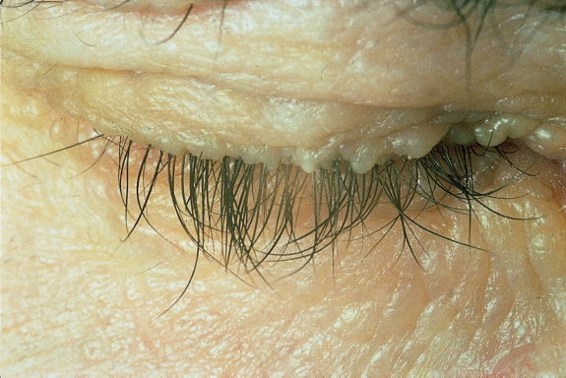
DIAGNOSIS
Notes:
Lipoid proteinosis

Slide 11
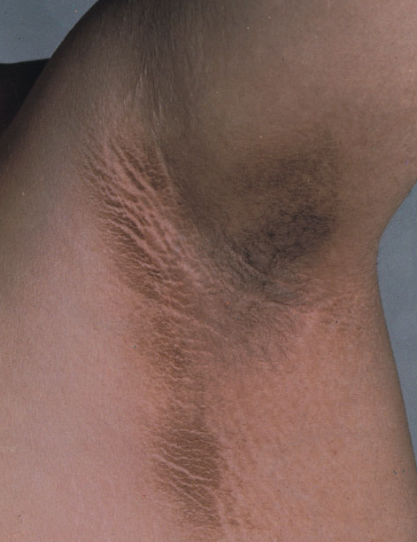
DIAGNOSIS AND ASSOCIATED CONDITIONS
Notes:
Acanthosis nigricans
Associations
Idiopathic, DM, obesity, malignancy, drugs (niacin, insulin, OCP, corticosteroids)

Slide 12
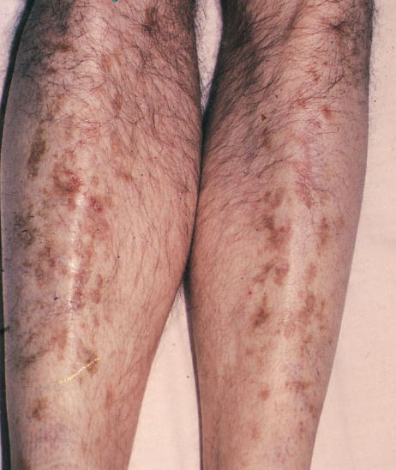
LIKELY DIAGNOSIS
Notes:
Diabetic dermopathy
(Brownish black patches on legs)
Pathogenesis: microangiopathies

Slide 13
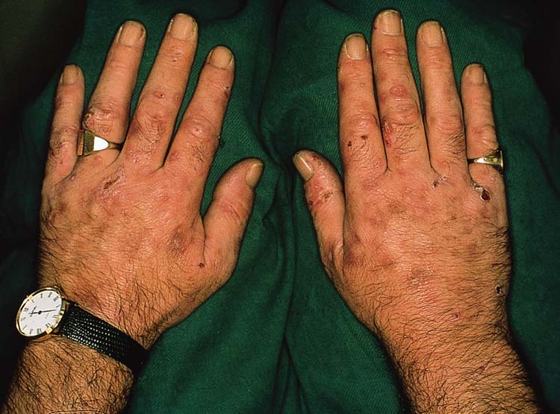
LIKELY DIAGNOSIS
Notes:
PCT

Slide 14
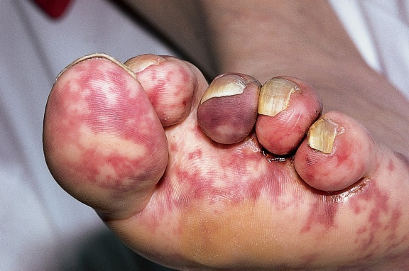
PATHOGENETIC MECHANISM AND UNDRLYING CAUSES
Notes:
Pathogenetic mech: embolic phenomenon
Causes: atherosclerosis

Slide 15
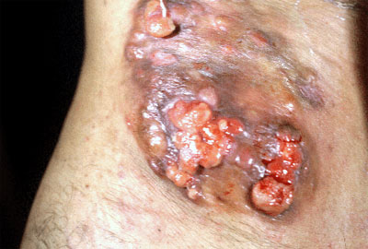
DIFFERENTIAL DIAGNOSIS
Notes:
Dermatofibrosarcoma protubernas
Syringocystadenoma papilleferum (if from early age)
Deep mycosis

Slide 16
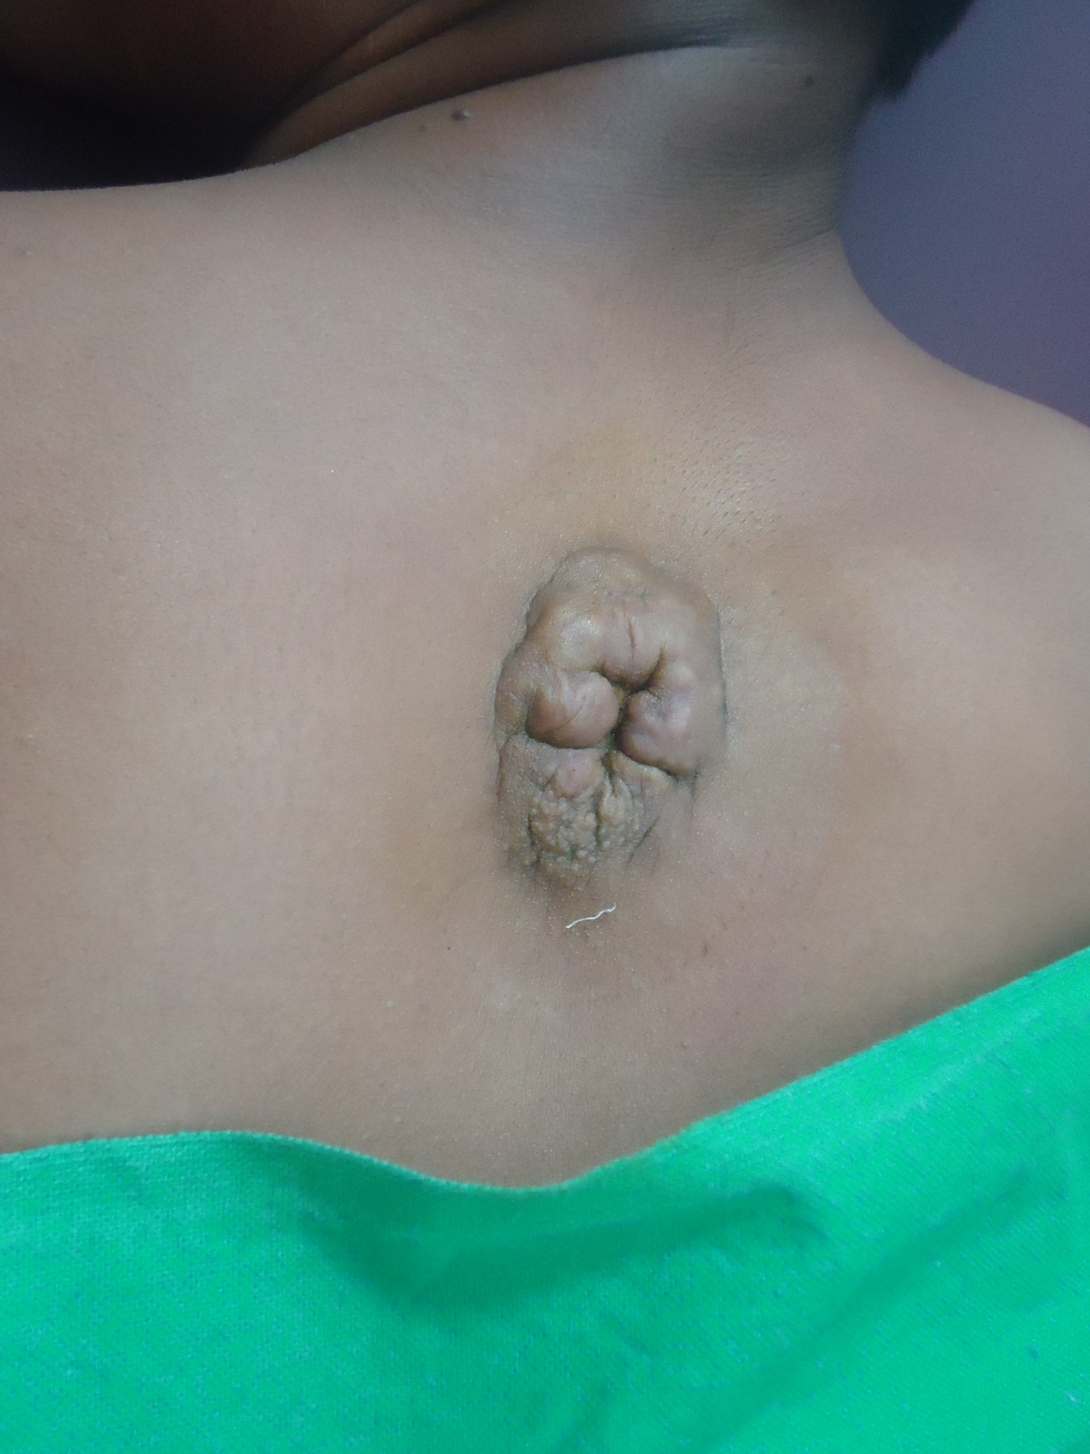
DIFFERENTIAL DIAGNOSI AND IMPLICATIONS
Notes:
D/D
Fibroma
Plexiform neurofibroma
Implications: spina bifida occulta

Slide 17
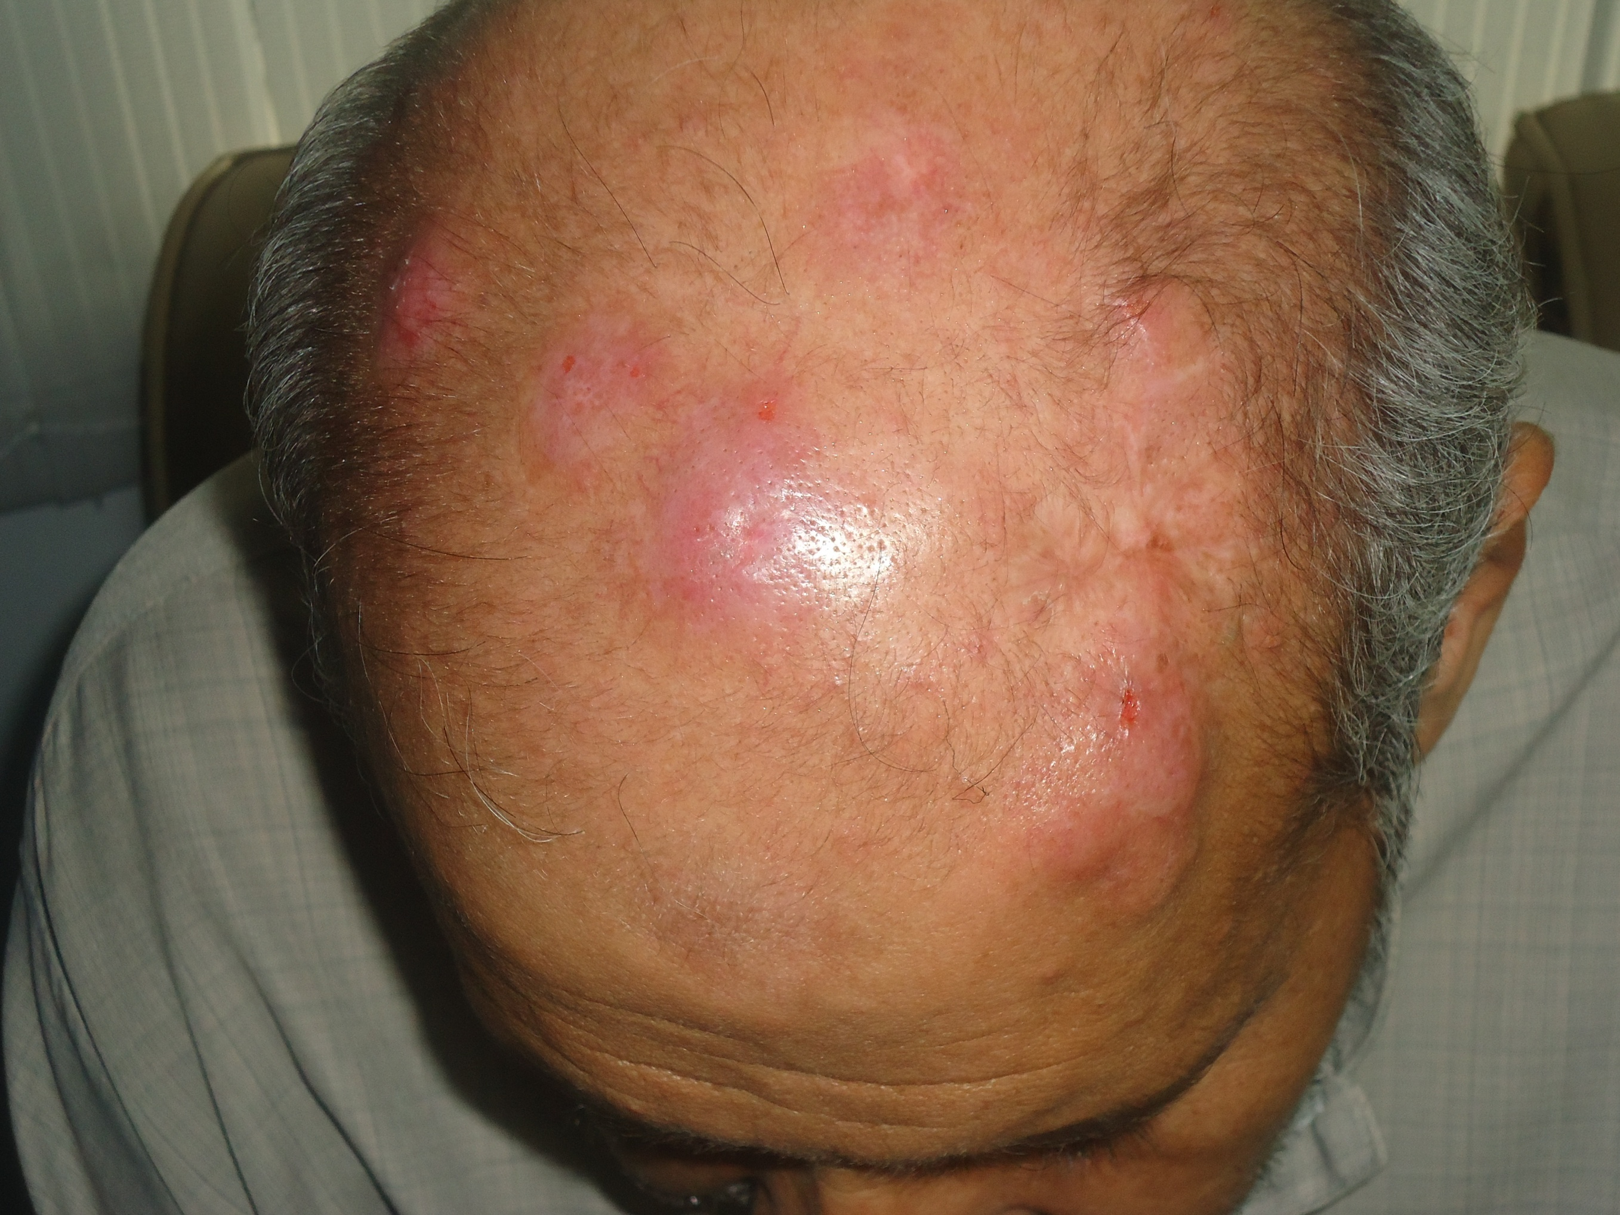
DIFFERENTIAL DIAGNOSIS
Notes:
Multiple nodules over scalp for 6 months
Pseudolymphoma
B-cell lymphoma
Follicular mucinosis
DLE
Hypernephroma
mets

Slide 18
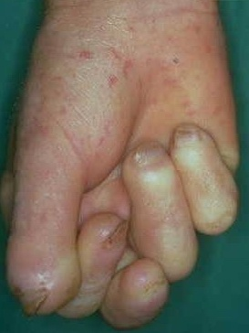
FINDINGS AND DIAGNOSIS
Notes:
Findings
Skin sclerosis
Dystrophic nails
Mat-like telengiectasias
Dx: Scleroderma

Slide 19
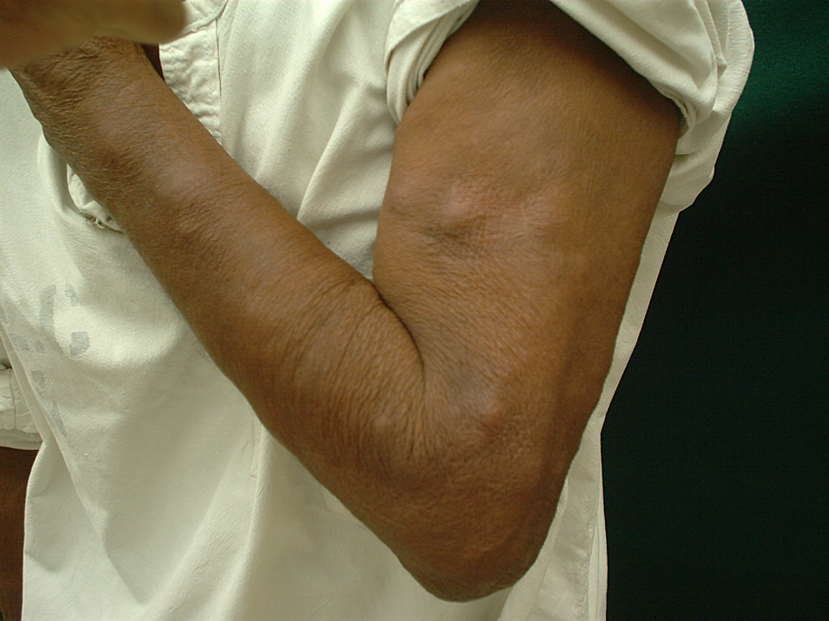
PAINFUL TENDER NODULES DURING COURSE OF
TREATMENT FOR A CHRONIC DISEASE
Notes:
ENL

Slide 20
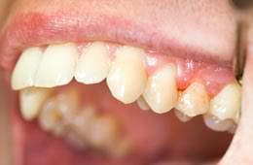
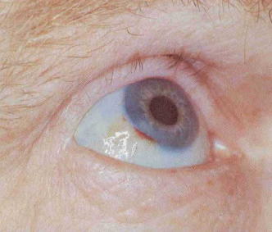
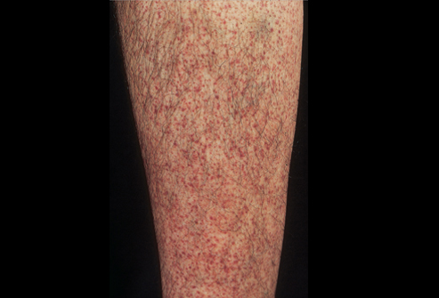
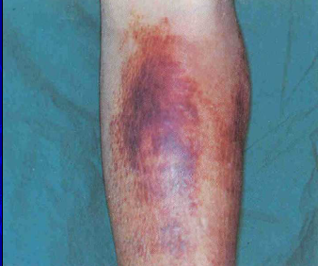
Notes:
Scurvy

