Slide 1
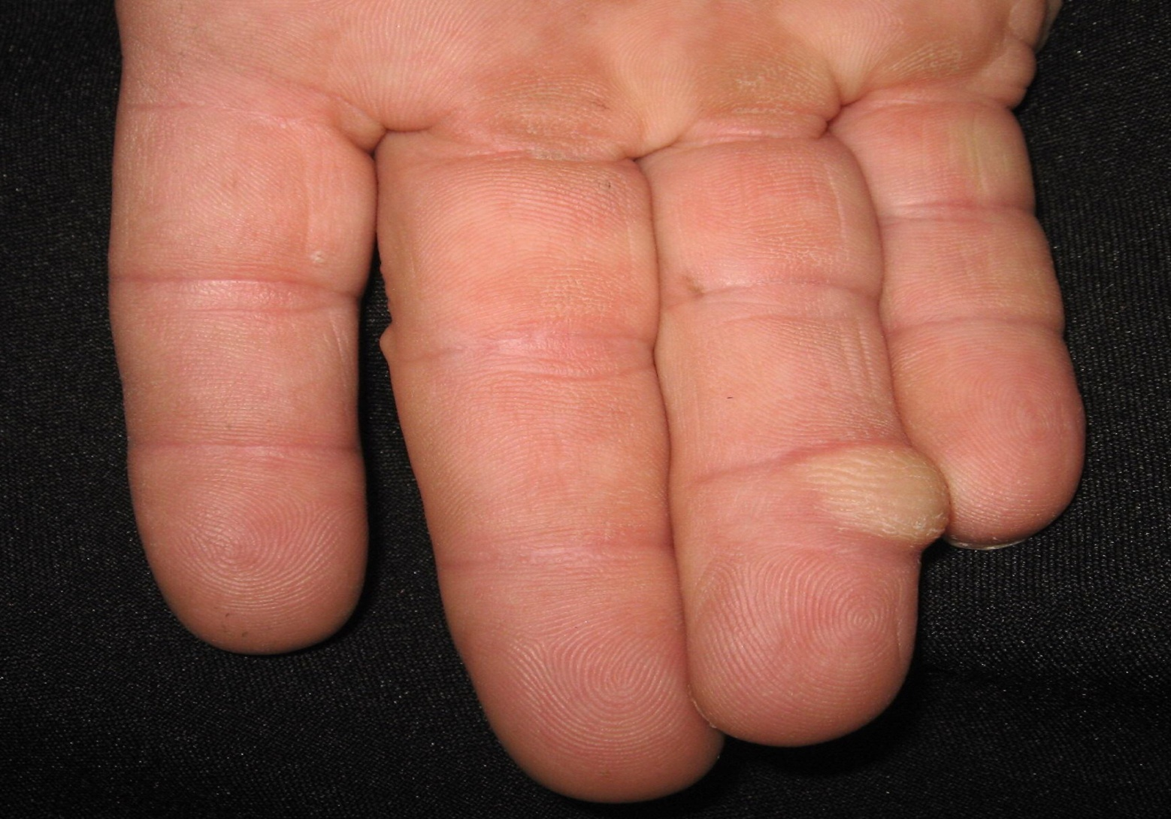
Notes:
D/D
Implantation dermoid cyst
Fibroma
Collagenoma
Giant cell tumor of tendon sheath
Calcinosis cutis
Foreign body

Slide 2
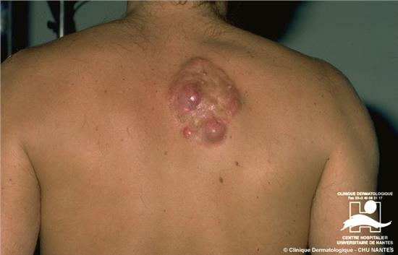
Notes:
D/D
Cutaneous B-cell lymphoma
Sarcoidosis
Deep mycosis
Dermatofibrosarcoma protuberans
Cutaneous mets

Slide 3
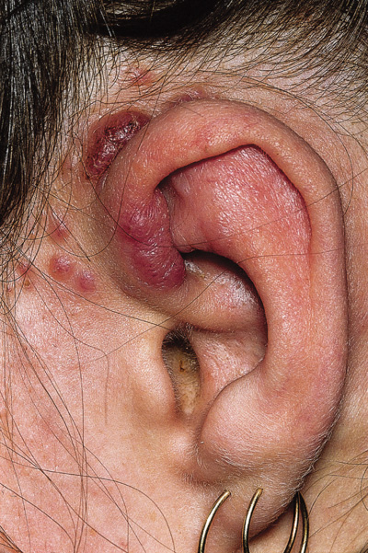
Notes:
Kimura
D/D
Angiolymphoid sarcoidosis
Angiosarcoma
Kaposi sarcoma
Bacillary angiomatosis
Pseudolymphoma

Slide 4
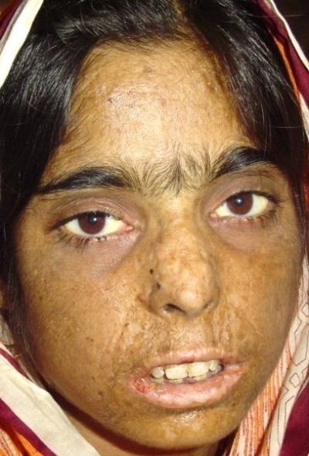
Notes:
Porphyria

Slide 5
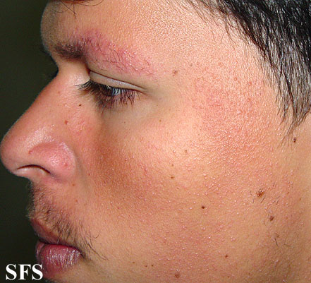
Notes:
ulerythema ophryogenes

Slide 6
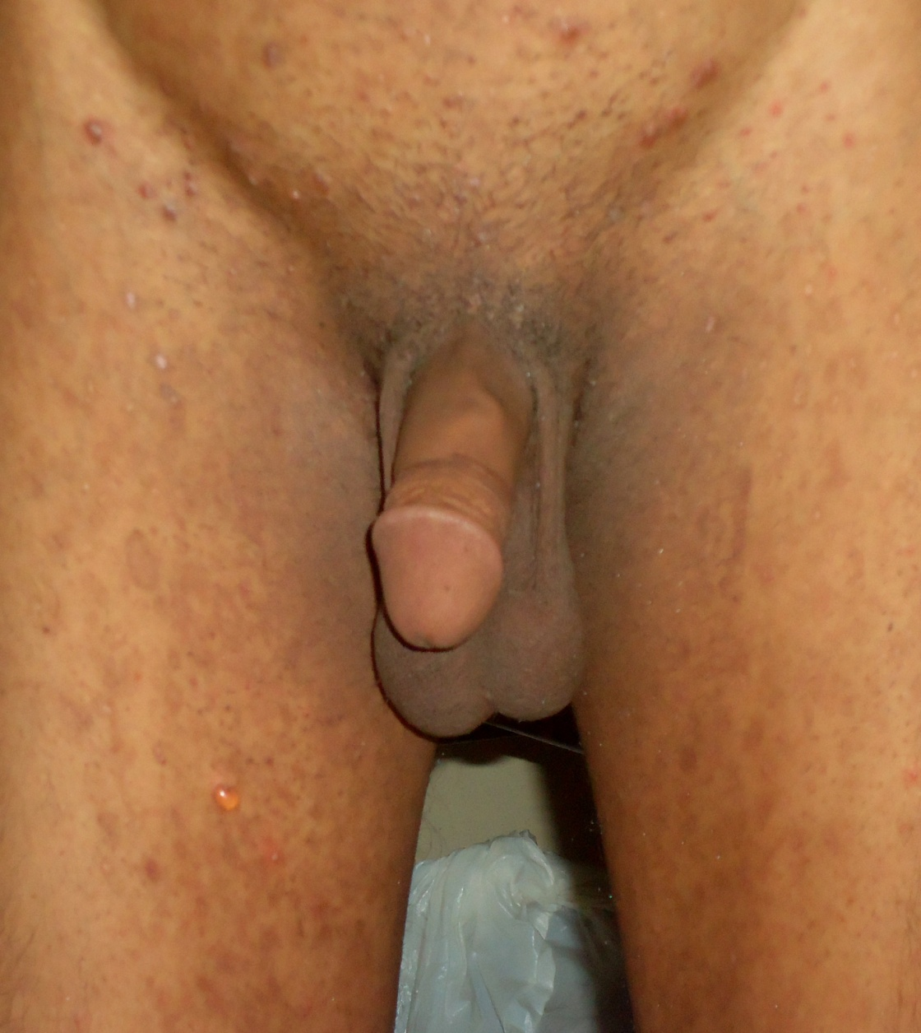
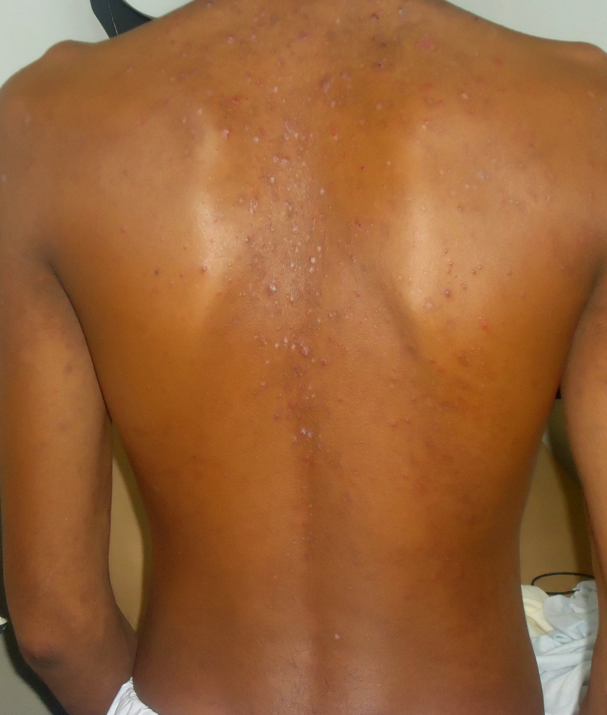
Notes:
Bullous LP

Slide 7
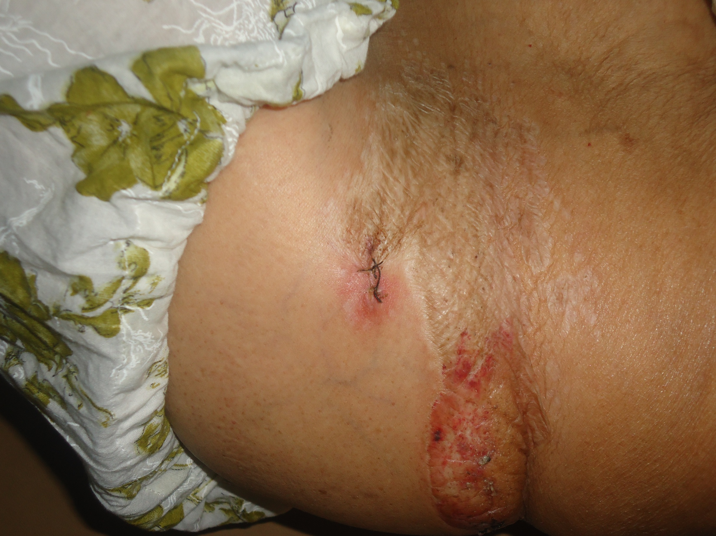
Notes:
LSA (with inflammation seen after trauma). Follicular plugging is present

Slide 8
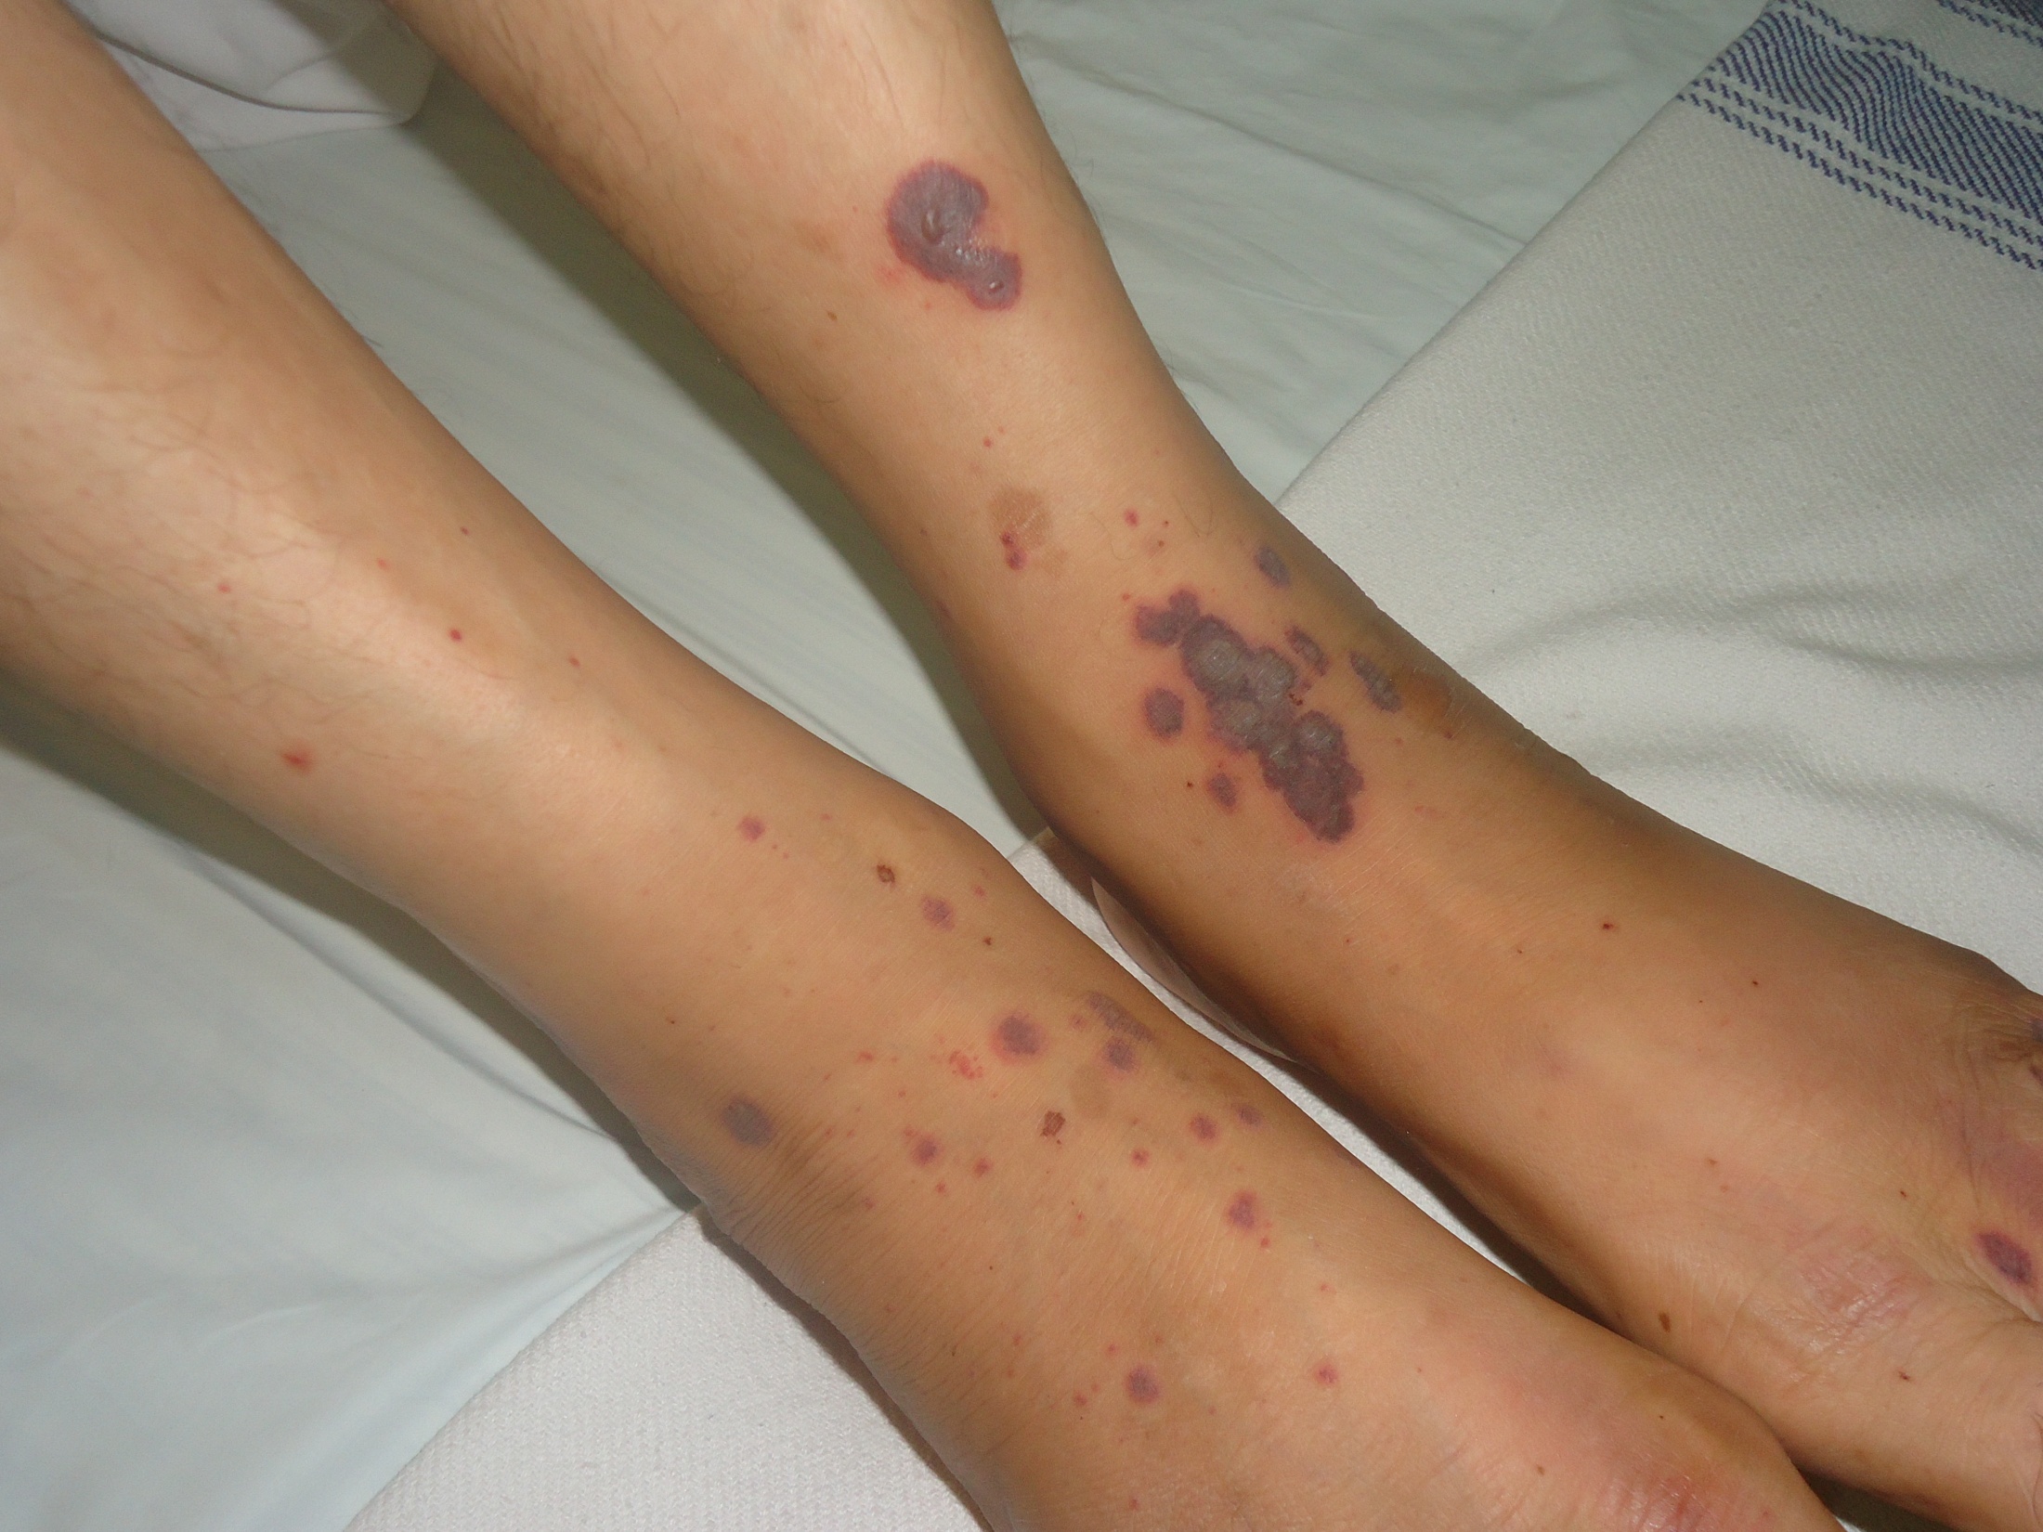
Notes:
Vasculitis

Slide 9
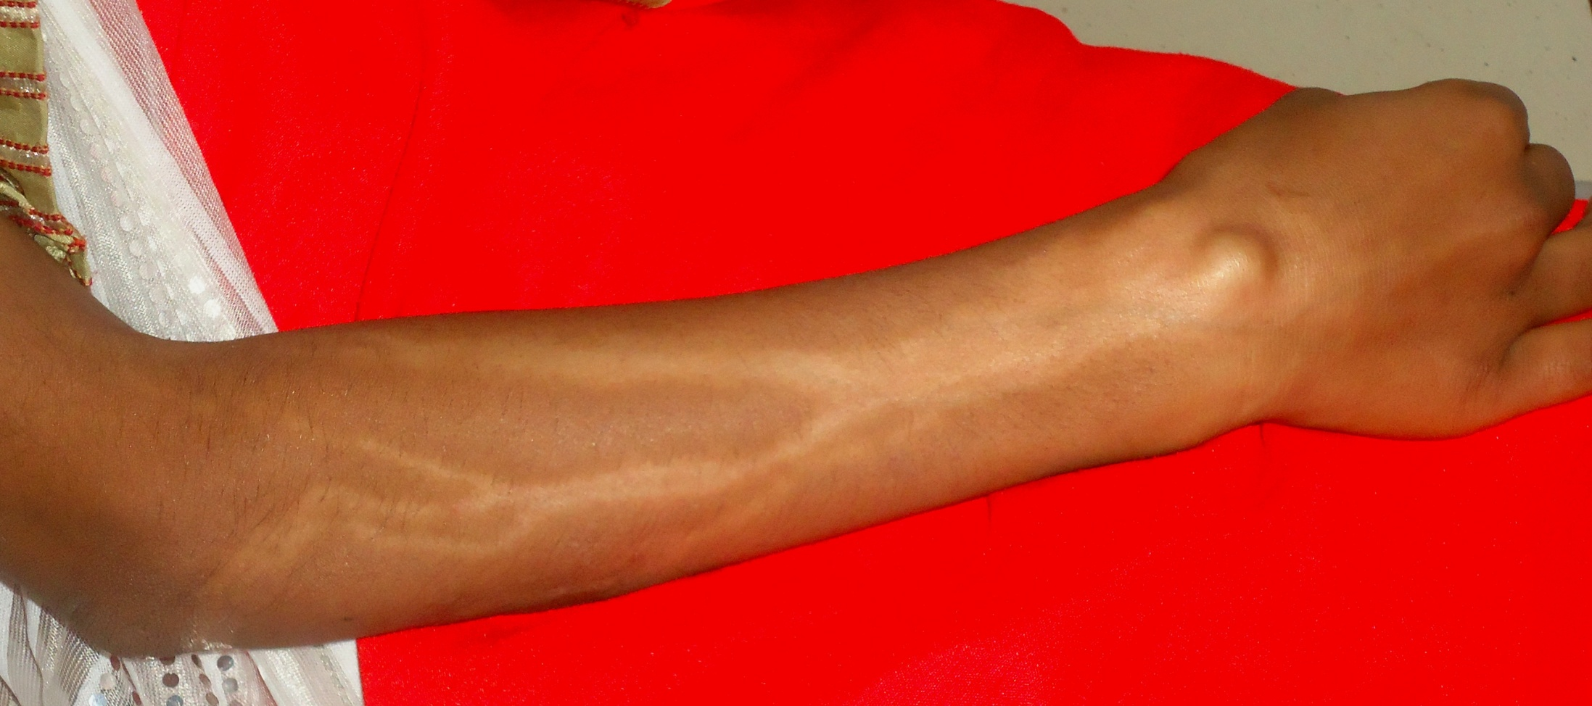
Notes:
Steroid induced lymphangitis (after I/L steroid treatment of ganglion)

