Slide 1
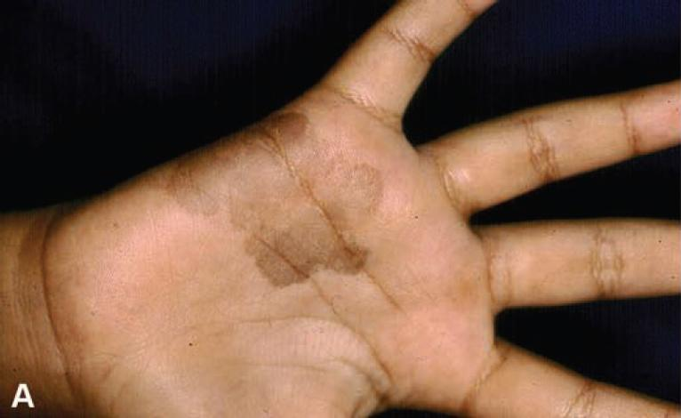
Likely Diagnosis
Notes:
Tinea nigra

Slide 2
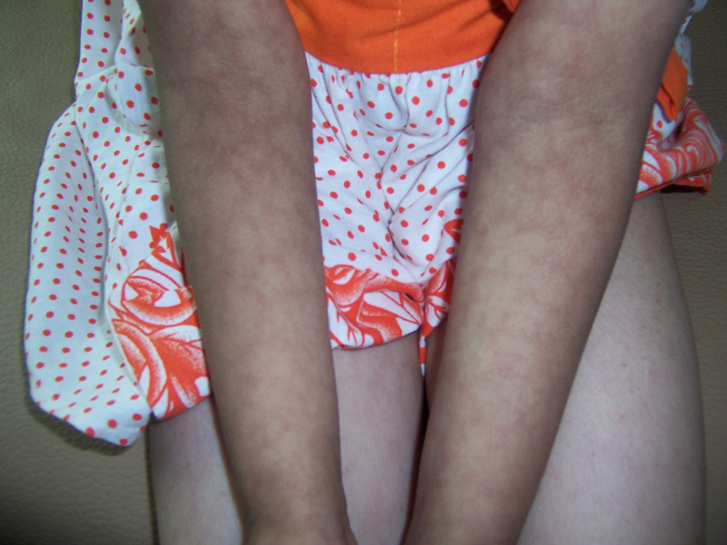
Diagnosis
Likely systemic complications
Notes:
Livedo reticularis
Complications:
Polyneuropathy
Mononeuritis multiplex
Glomerulonephritis
Abdominal pain
Rectal bleeding
HTN
Stroke
Peripheral vascular dis
Orchitis
Cardiomyopathy
Pericarditis

Slide 3
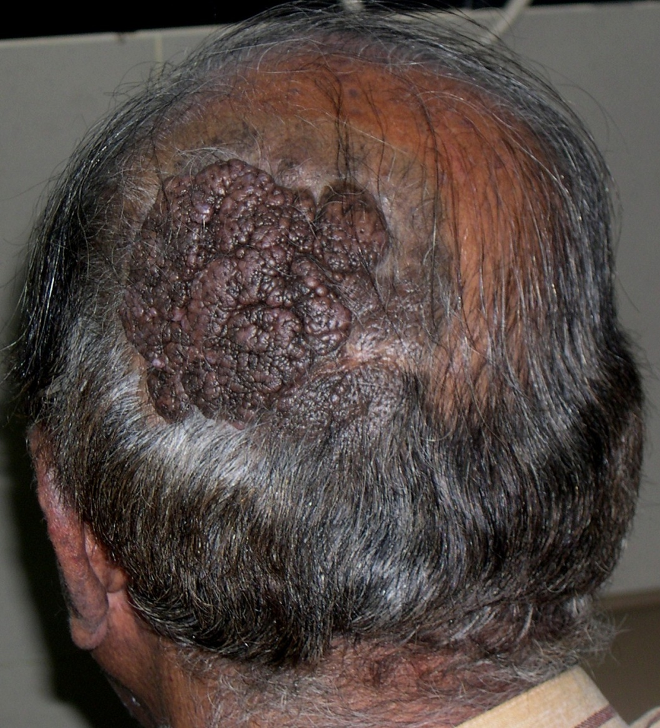
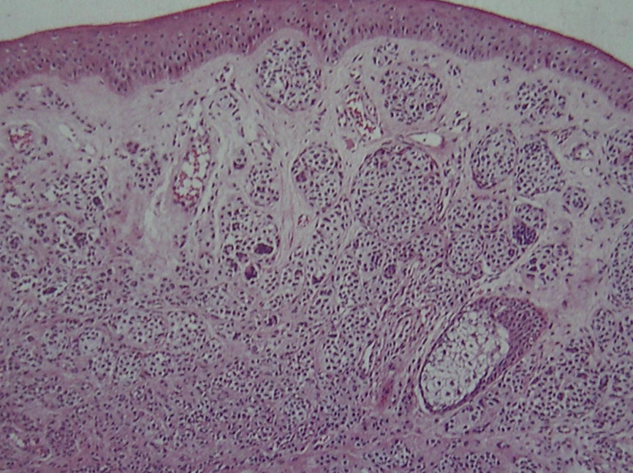
Present since birth. Diagnosis
Notes:
Congenital nevomelanocytic nevus

Slide 4
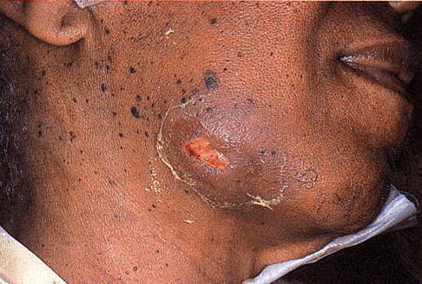
Differential Diagnosis
Notes:
Dental sinus
Scrofuloderma
Actinomycosis

Slide 5
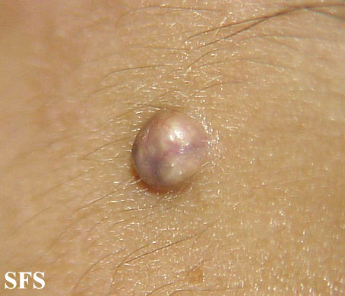
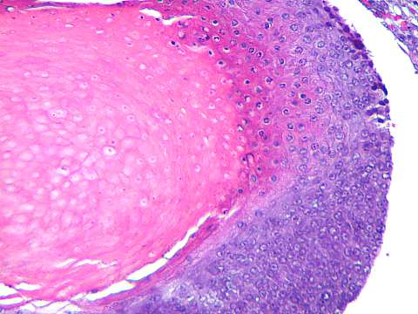
Diagnosis
Notes:
Pilomatricoma

Slide 6
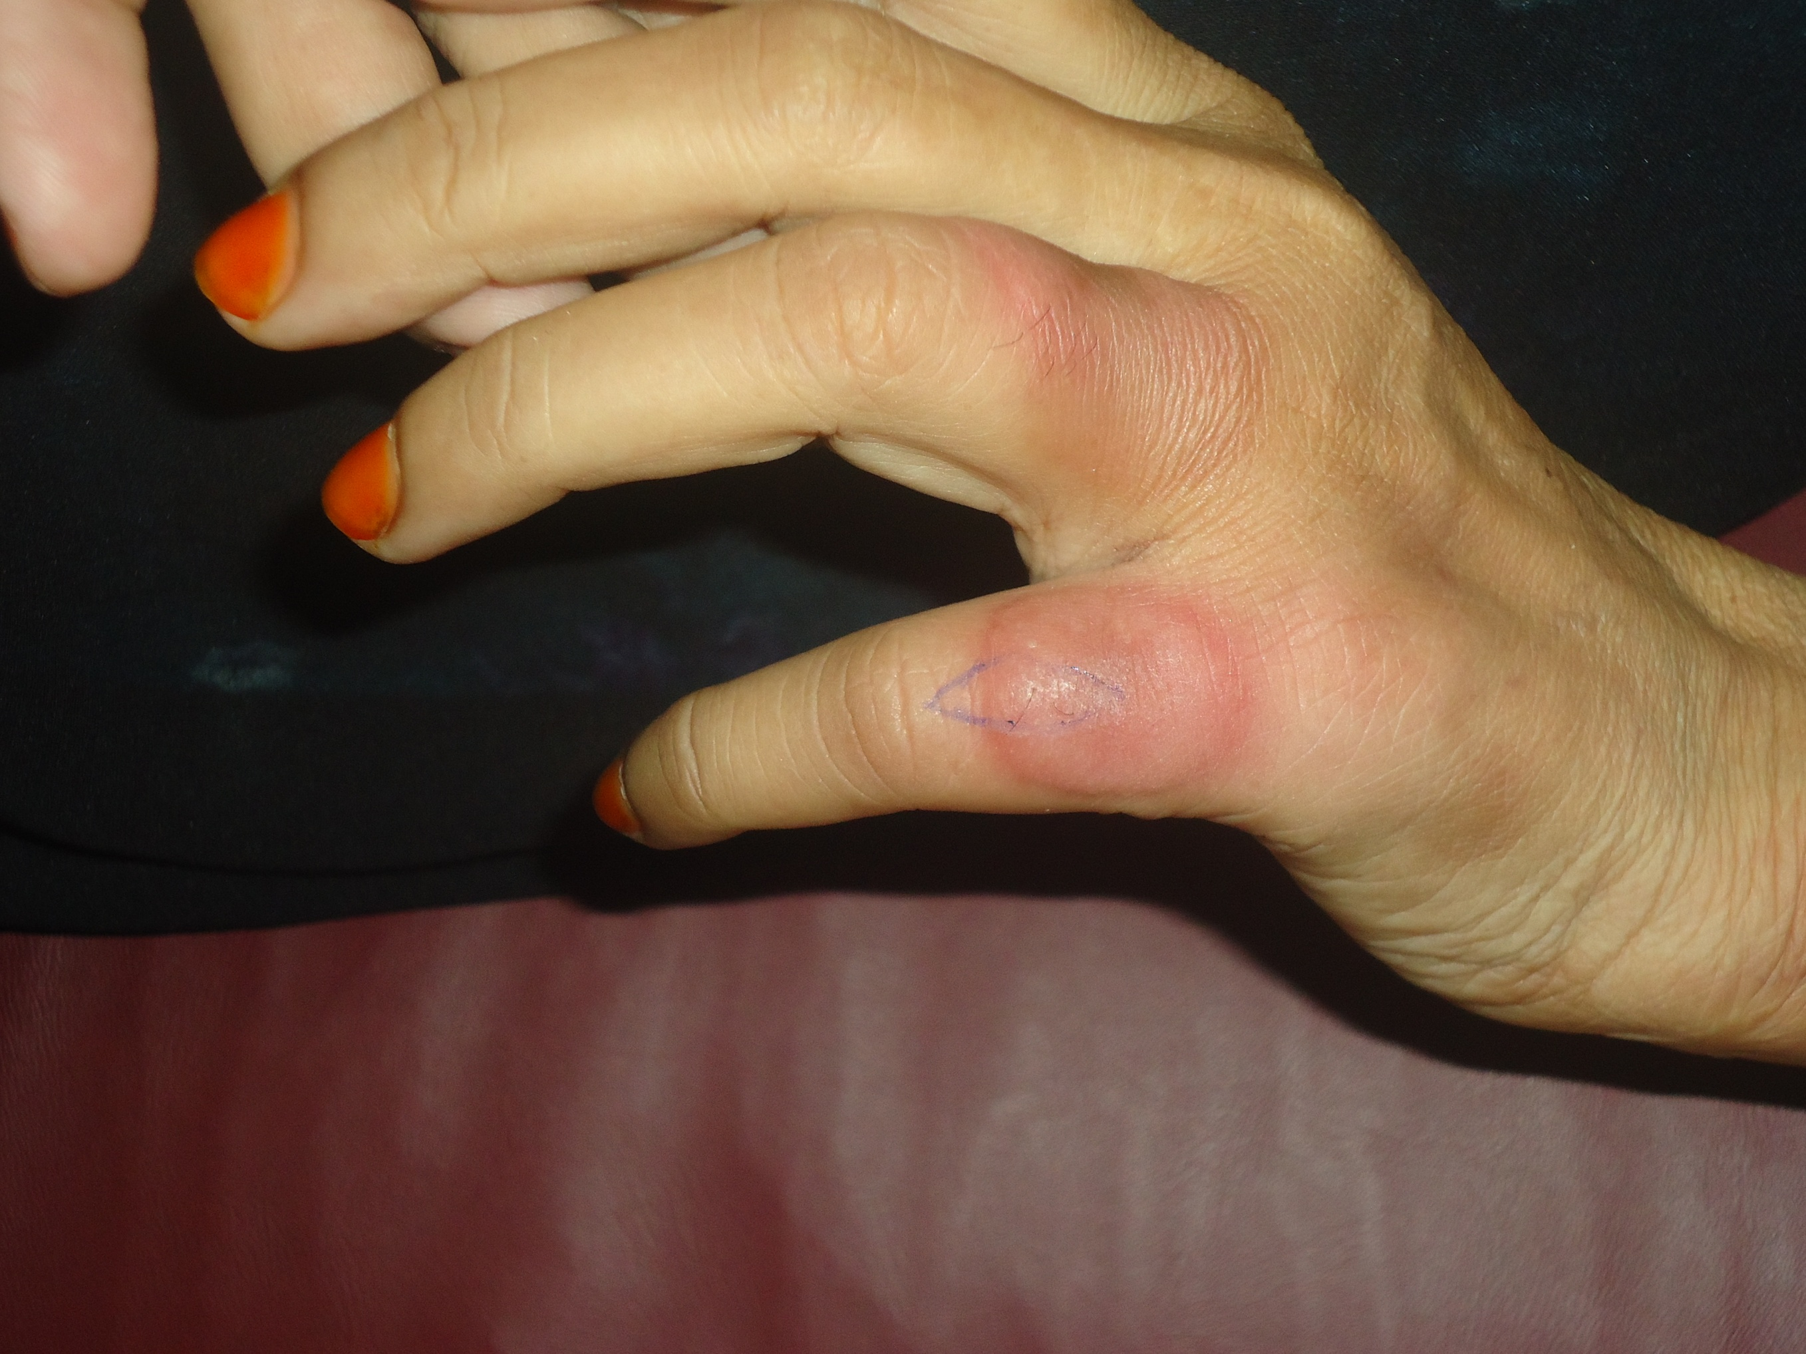
Likely Diagnosis
Notes:
D/D:
EM
Sweet
Urticarial vasculitis
GA
Orf

Slide 7
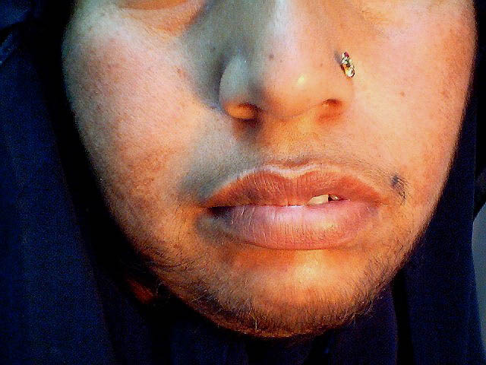
Investigations
Notes:
FSH, LH, testosterone, DHEAS, prolactin, sex hormone binding globulin, USG pelvis and TFTs.
If all the above tests are normal then think any paraneoplastic condition, 5 alpha reductase levels are low or end organ sensitivity

Slide 8
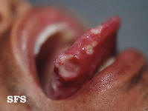
Differential Diagnosis
Notes:
Aphthous ulcers shown
Behcet
Crohn’s dis
Celiac dis
Nutritional deficiencies
HIV
SLE
Idiopathic recurrent aphthae

Slide 9
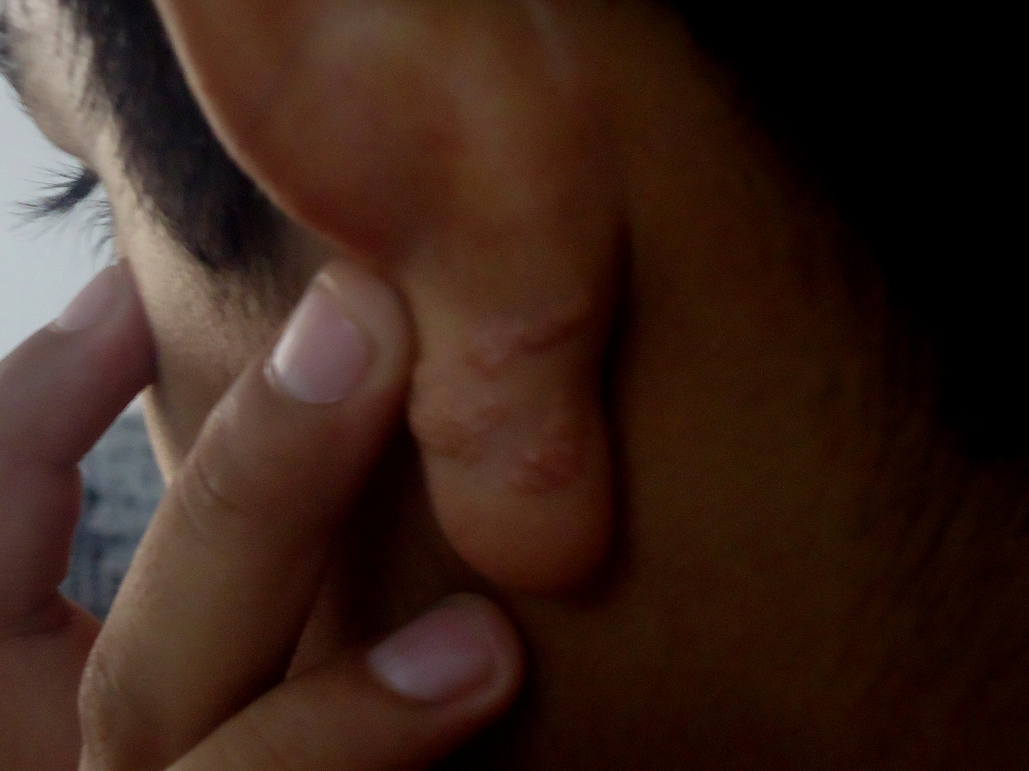
Diagnosis
Notes:
D/D
Nevus sebaceous
GA
Nevus elastosis serpenginosum
Angiolymphoid hyperplasia with eosinophilia
Lymphangioma
Sarcoidosis

Slide 10
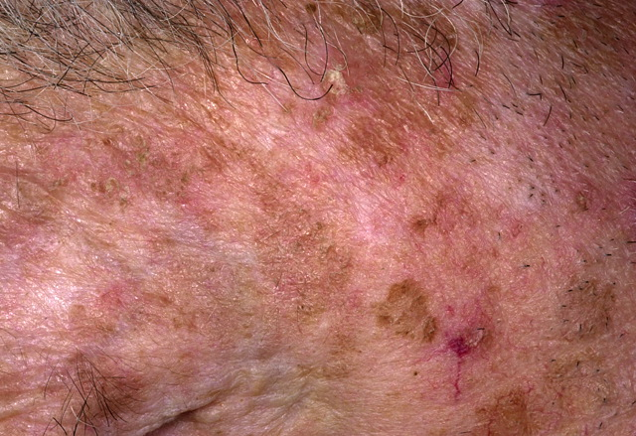
Likely Diagnosis
Notes:
Actinic keratosis
D/D: SK

Slide 11
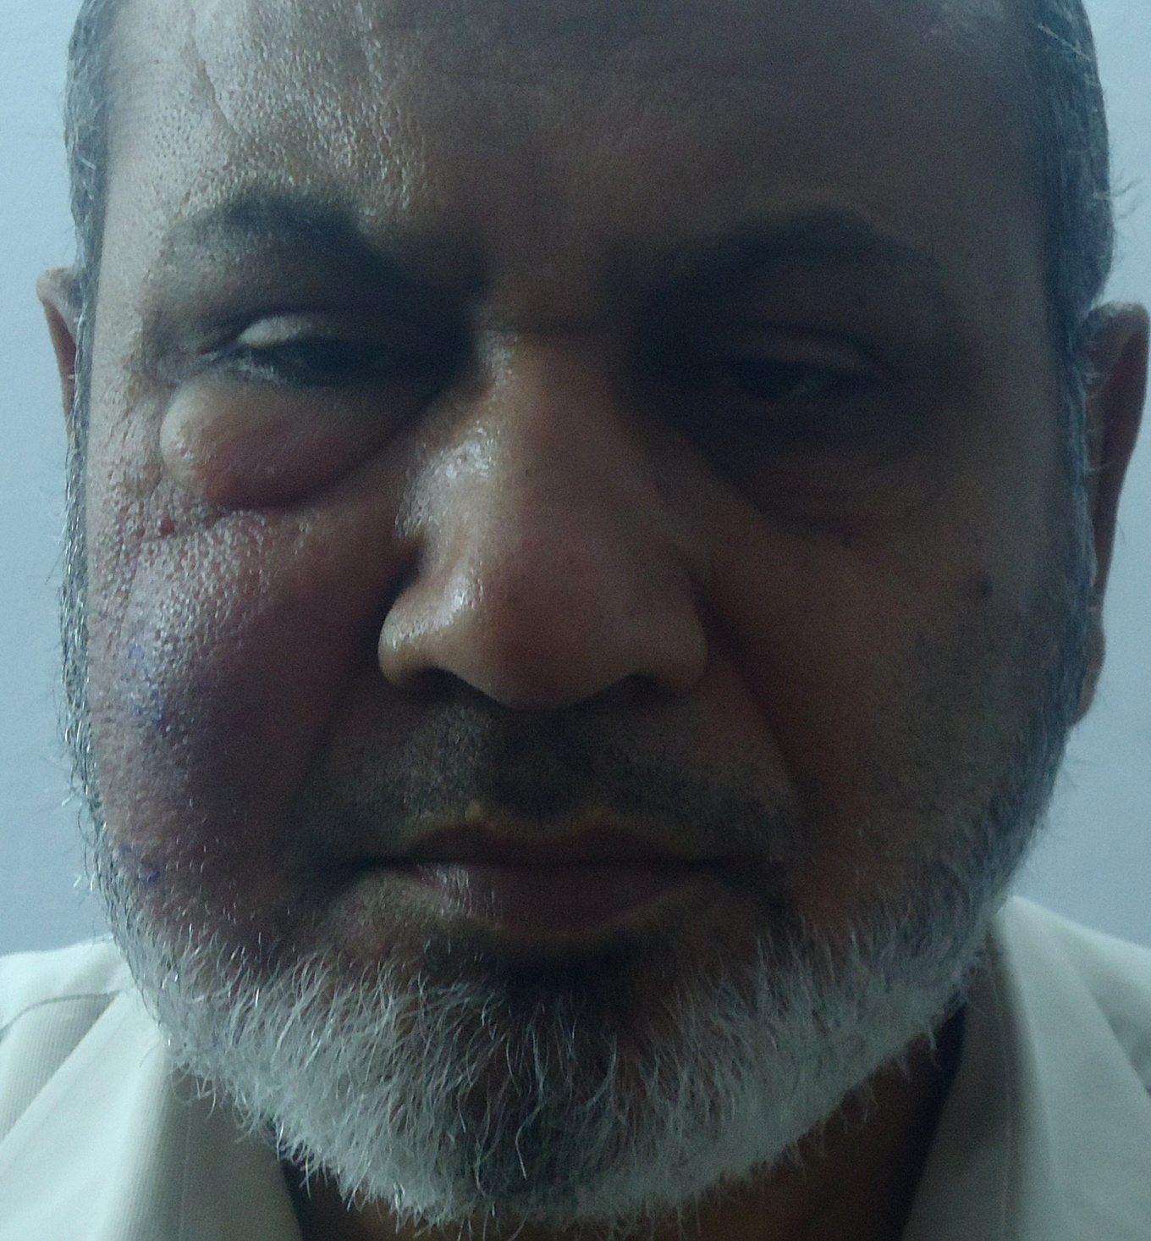
GIVE YOUR DIFFERENTIAL DIAGNOSIS

Slide 12
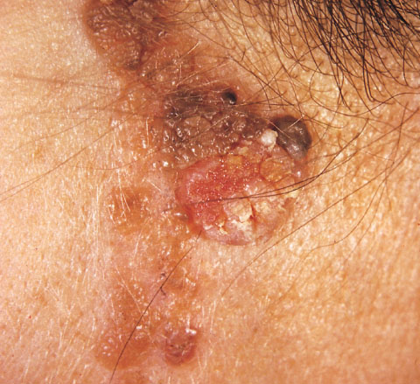
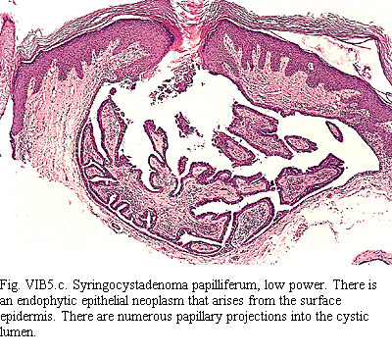
Likely Diagnosis
Notes:
Syringocystadenoma papilleferum
D/D
Nevus sebaceous
Elastosis perforans serpenginosa

Slide 13
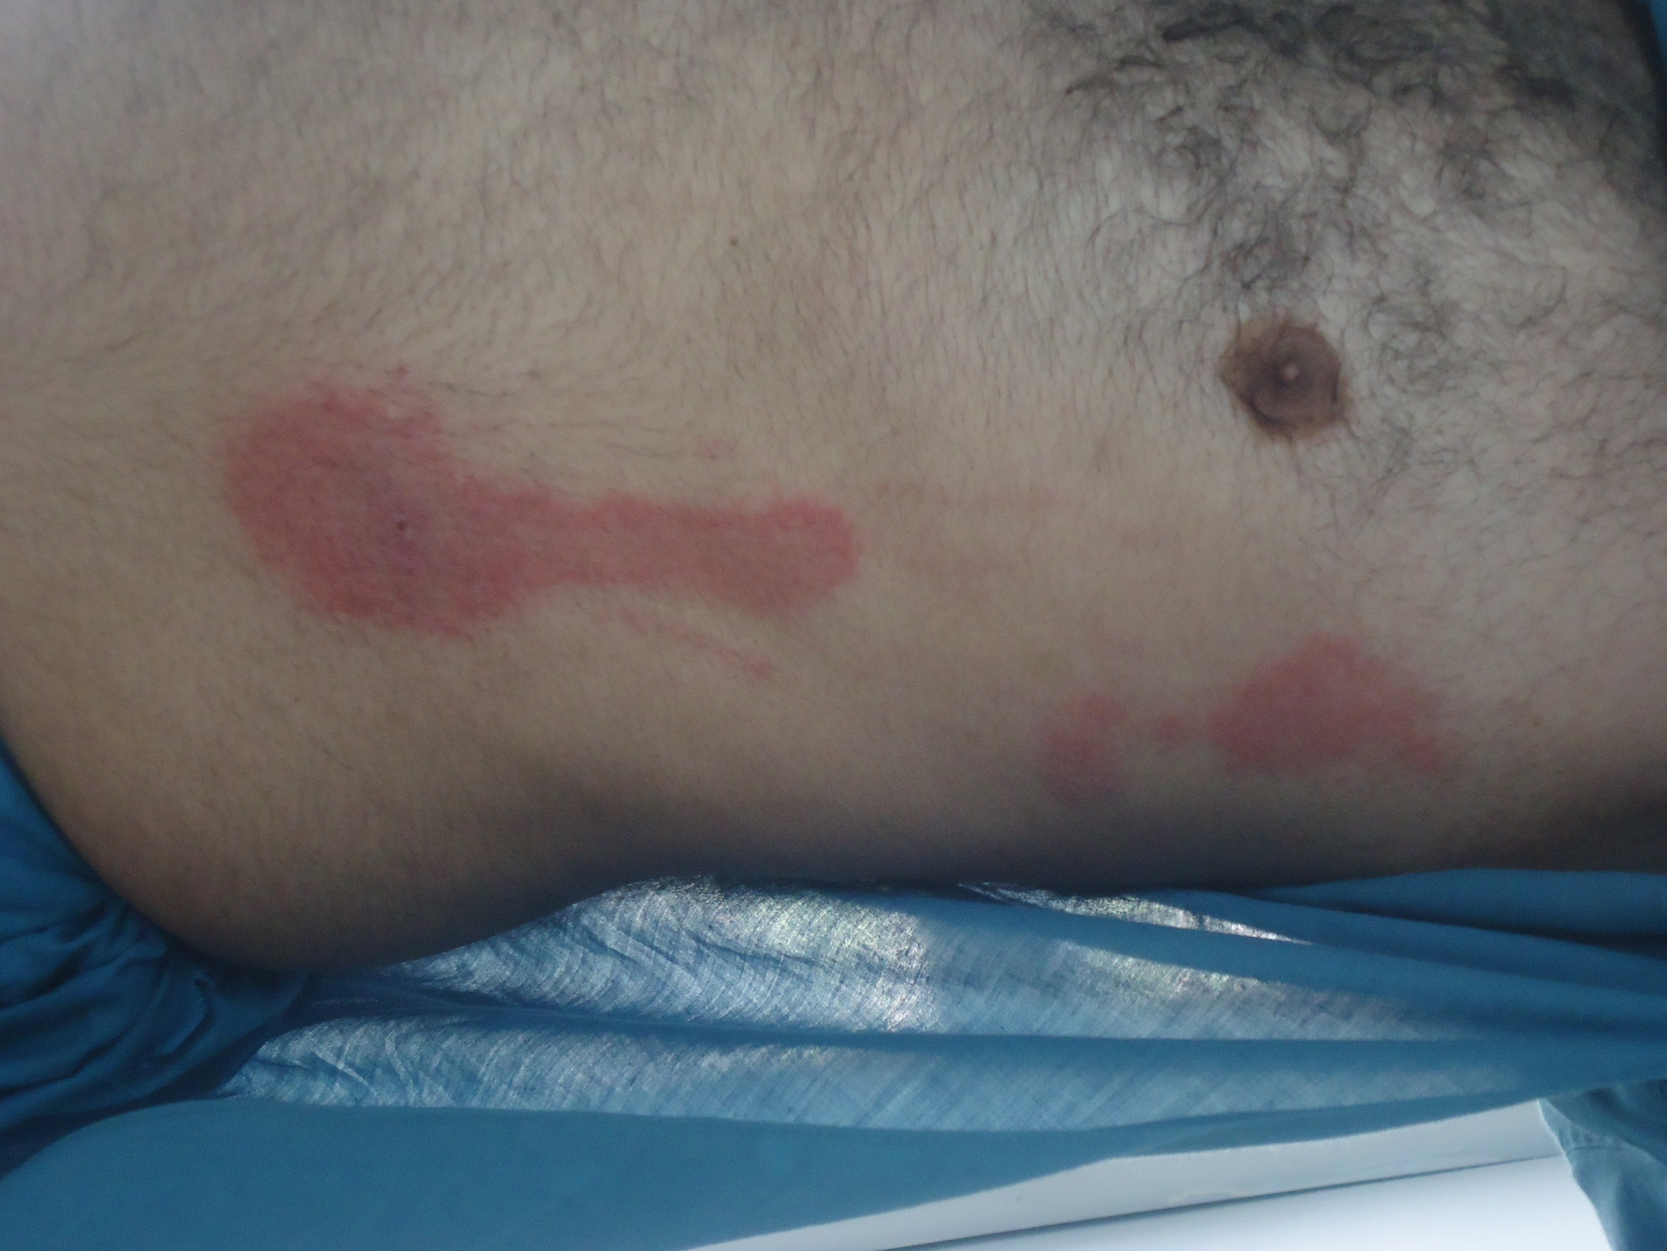
Notes:
Insect bite with lymphangitis

Slide 14
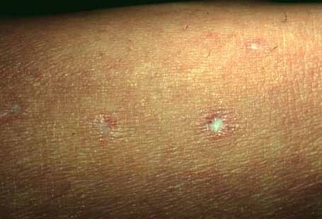
THIS PATIENT HAD EPISODES OF RECURRENT ABDOMINAL PAIN.
WHAT IS THE MOST LIKELY DIAGNOSIS?
Notes:
Degos dis

Slide 15
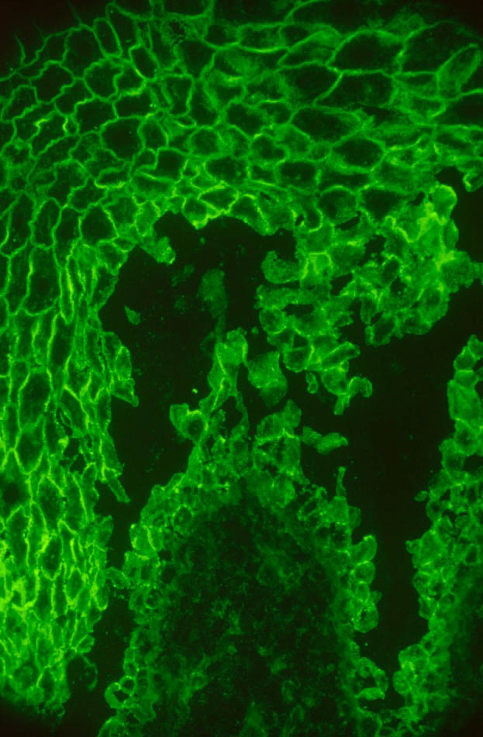
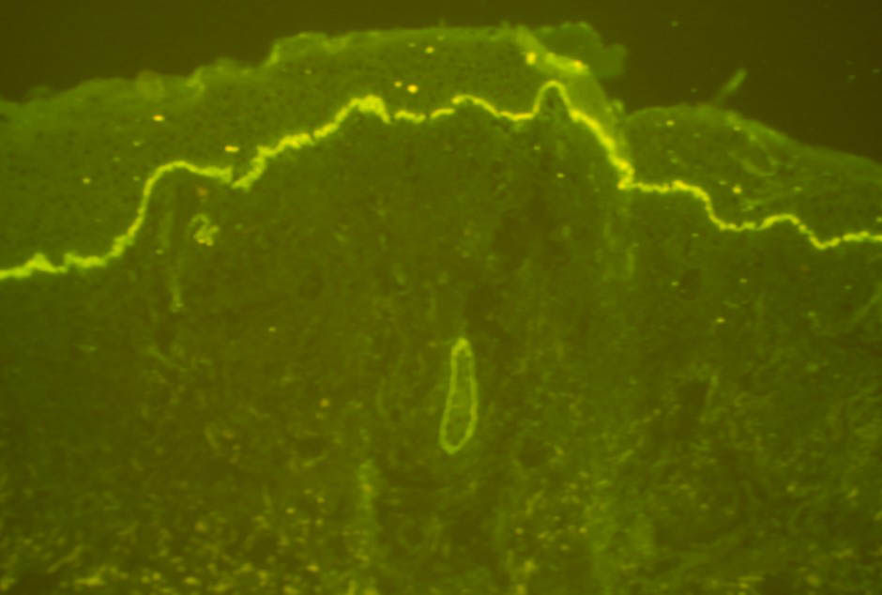
WHAT IS THE SIGNIFICANCE OF THE FOLLOWING PICTURES?
A
A
B
B
Notes:
Fish net pattern
Linear IgA deposits

Slide 16
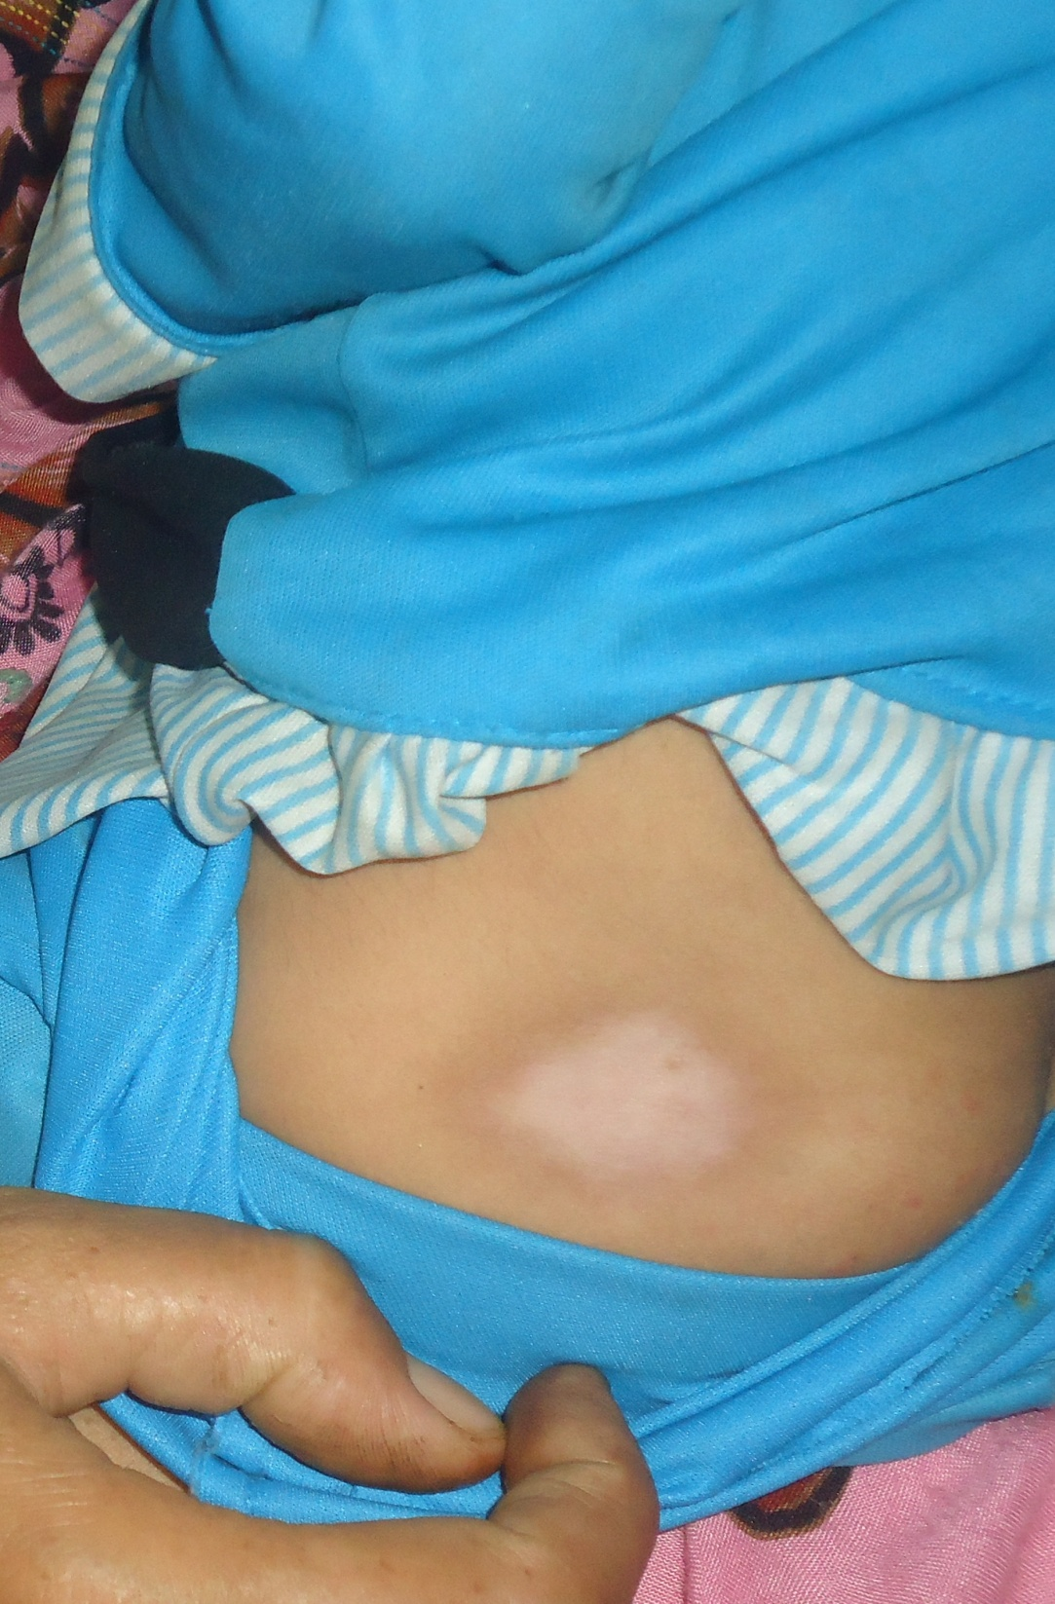
Notes:
Present since birth ; Atrophoderma

Slide 17
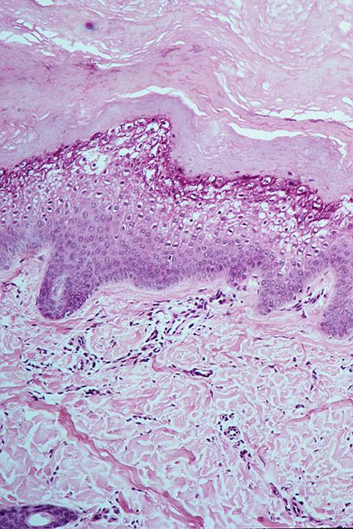
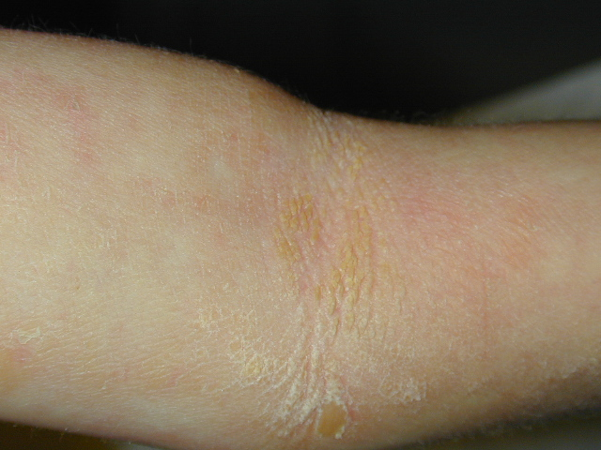
Diagnosis
Notes:
Epidermolytic hyperkeratosis

Slide 18
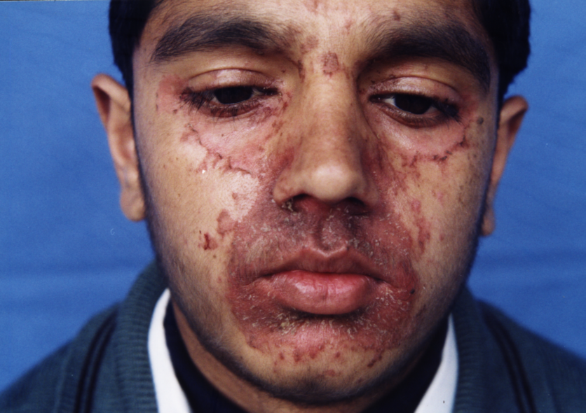
Likely Diagnosis
Notes:
Acrodermatitis enteropathica

Slide 19
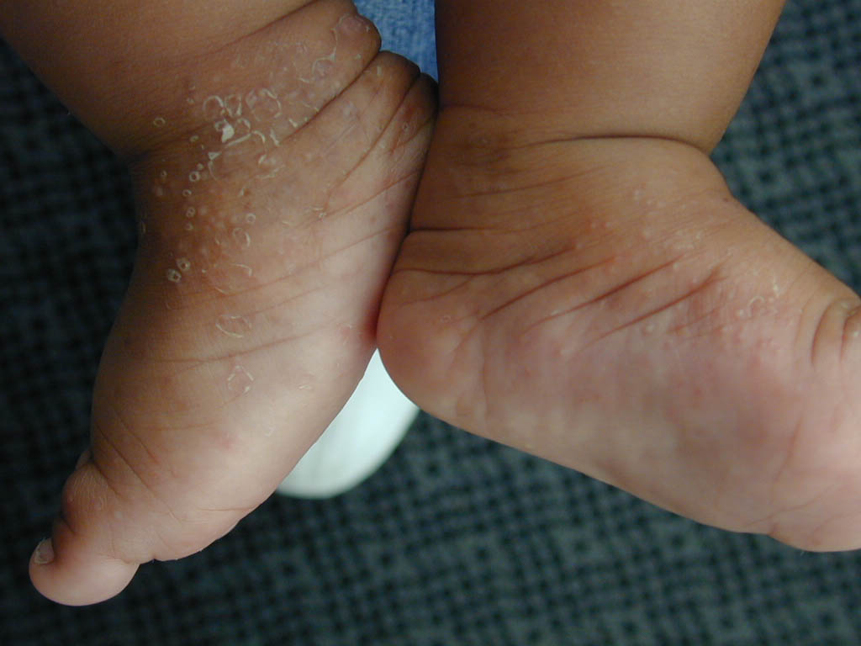
THIS SIX MONTHS OLD RASH WAS NON RESPONSIVE TO STEROIDS/antiscabies.
WHAT IS LIKELY DIAGNOSIS?
HOW WILL YOU CONFIRM THE DIAGNOSIS?
WHAT IS THE TREATMENT OF THIS CONDITION?
Notes:
Infantile acropustulosis
H/p and pus c/s
Dapsone is treatment

Slide 20
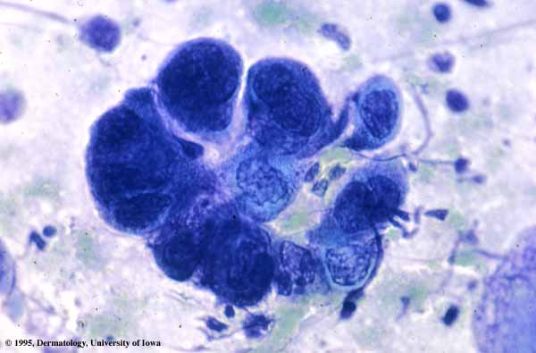
What is shown in this slide?
Name three disorders which can have this feature?
Notes:
Tzanck smear (epithelial giant cells seen)
Herpes simplex
Herpes zoster
Chicken pox

