Slide 1
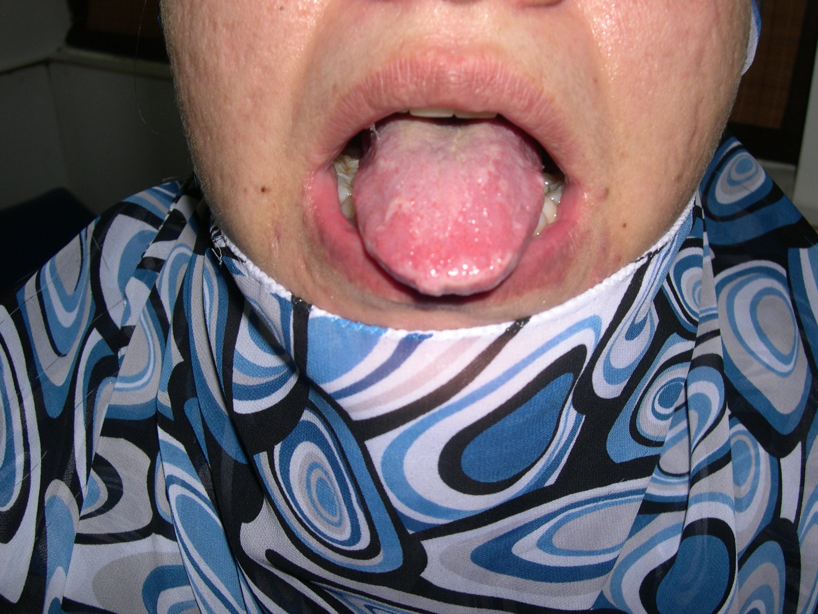
Notes:
Dx: Lipoid proteinosis
Macroglossia with teeth indentations, difficulty in opening the mouth and waxy scars on face are shown

Slide 2
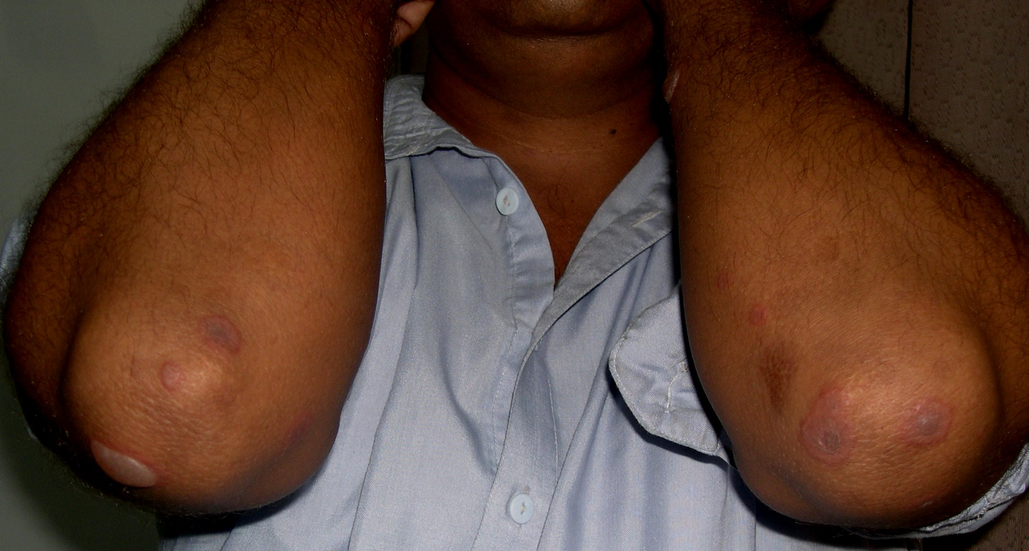
Notes:
D/D
EM
Bullous FDE
Bullous LP

Slide 3
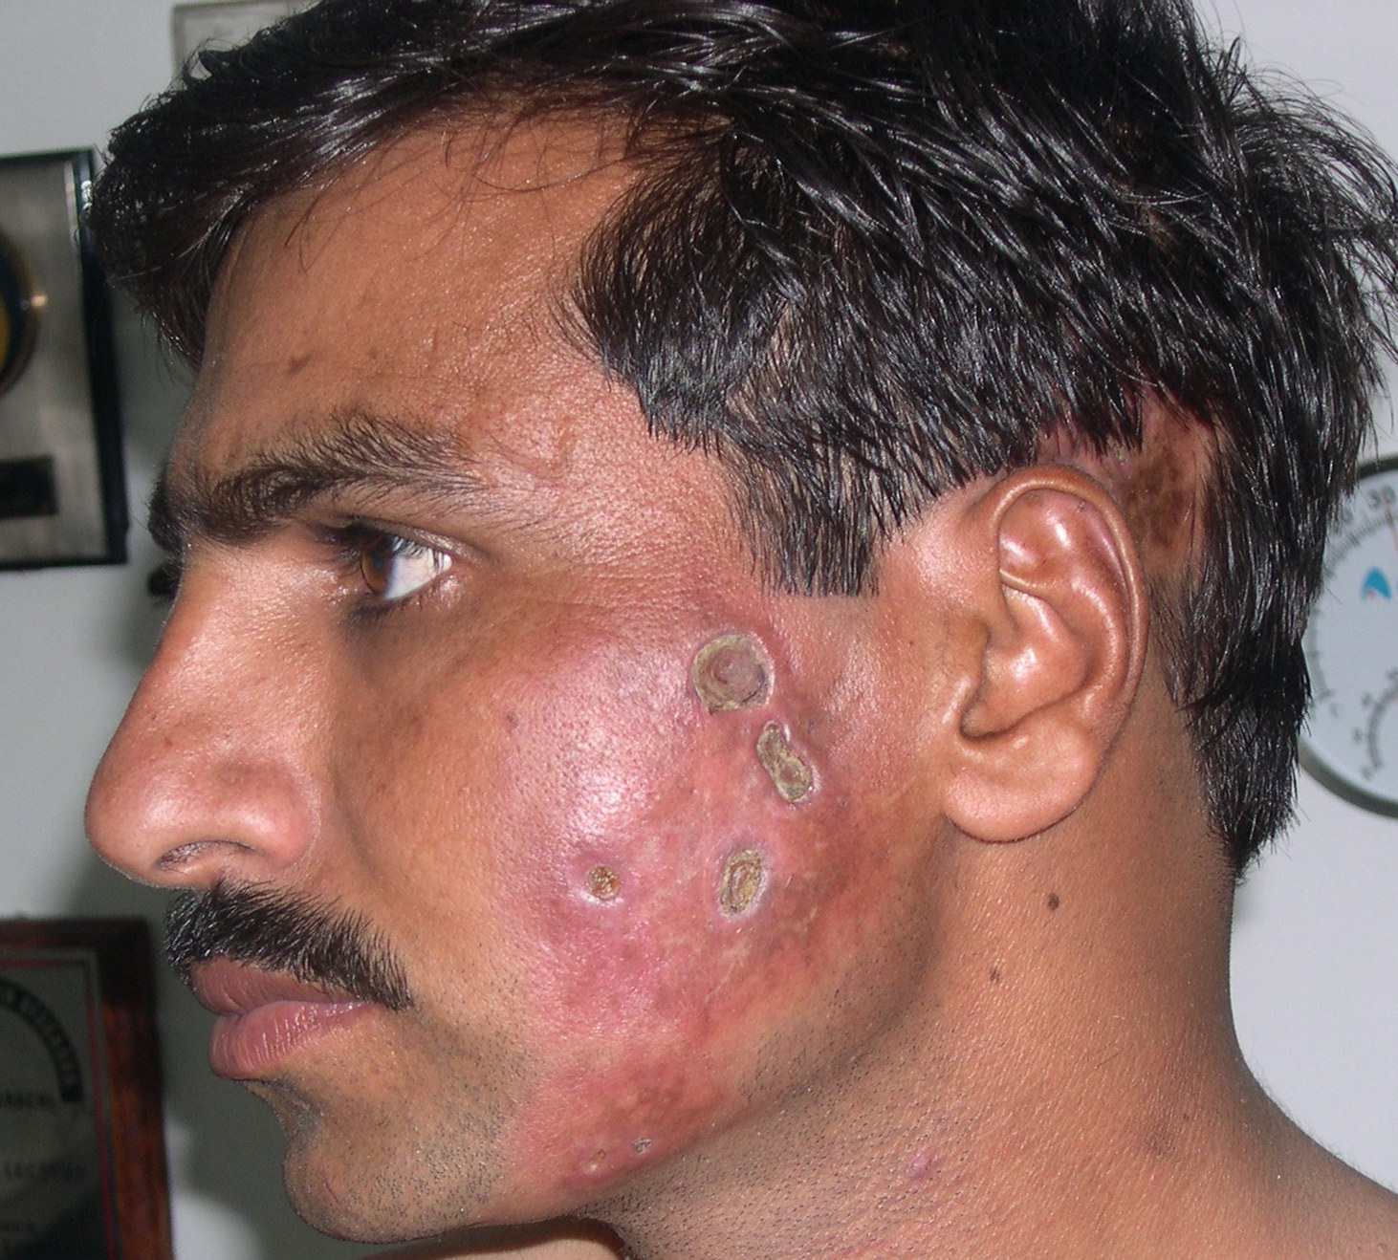
Notes:
D/D
Panniculitis
Deep mycosis
Syphilitic gummas

Slide 4
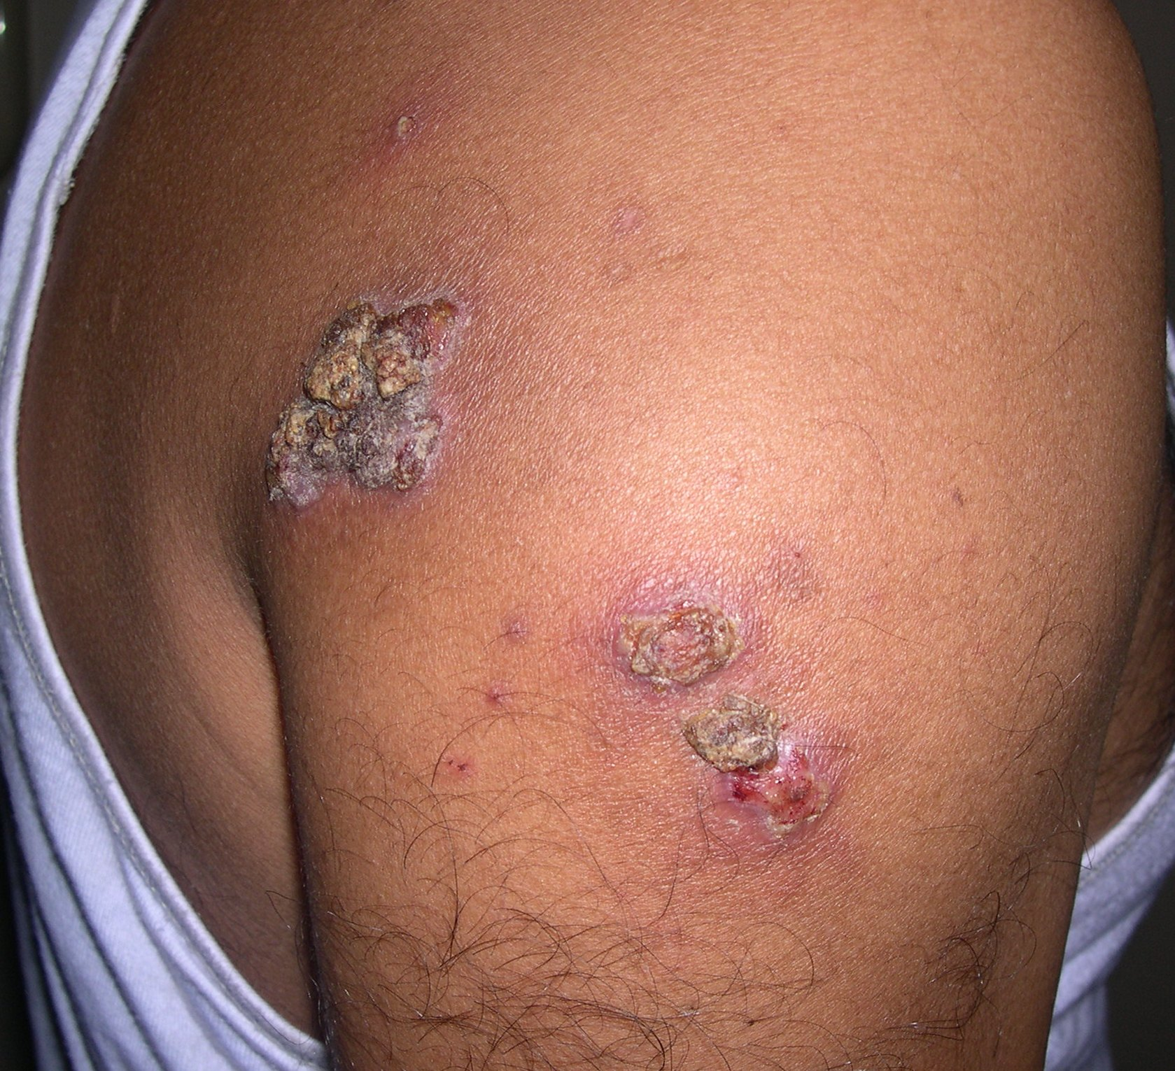
Notes:
D/D
Deep mycosis
Leishmaniasis
Sporotrichosis
Syringocystadenoma papilleferum

Slide 5
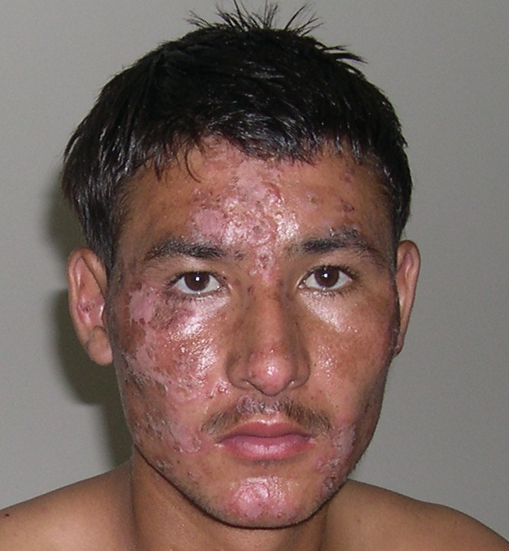
Notes:
Irritant contact dermatitis

Slide 6
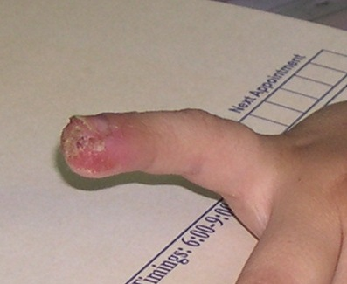
Notes:
D/D
Acrodermatitis continus of hallopeau
Herpetic whitlow
Parakeratosis pustulosa
Eczema

Slide 7
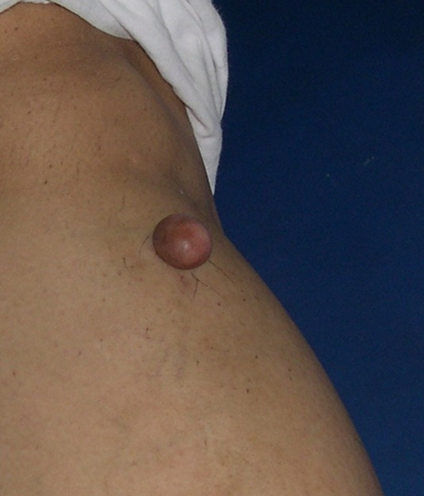
Notes:
D/D
Fibroma
Dermatofibroma
Neurofibroma
Neuromas
Adnexal tumors

Slide 8
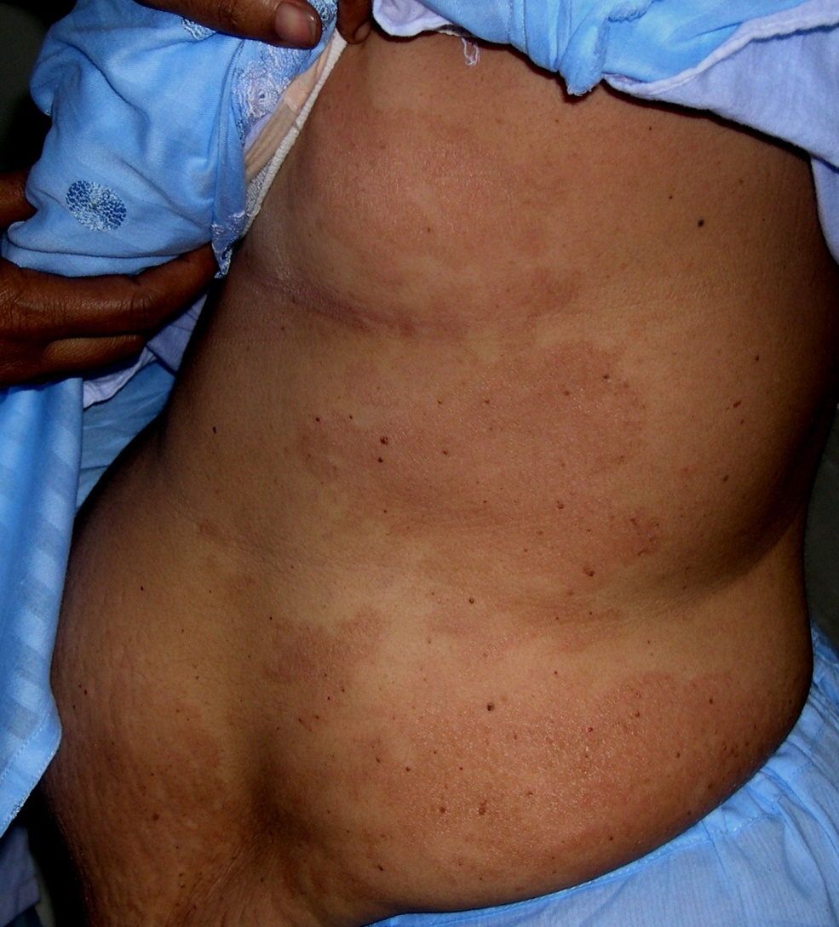
Notes:
D/D
Large plaque parapsoriasis
MF
Tinea corporis
Eczematous drug eruptions
Carcinoma eryspiloides

Slide 9
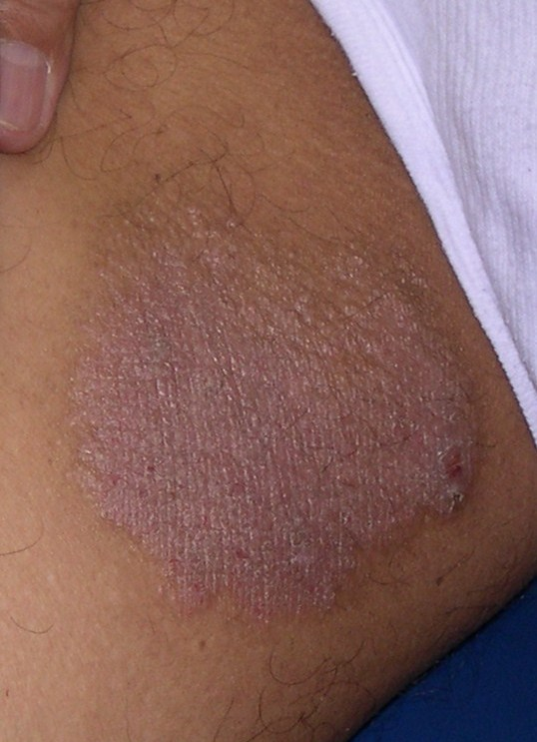
Notes:
Lichen simplex chronicus
It causes nerve thickening and this is how we differentiate it from simple eczema

Slide 10
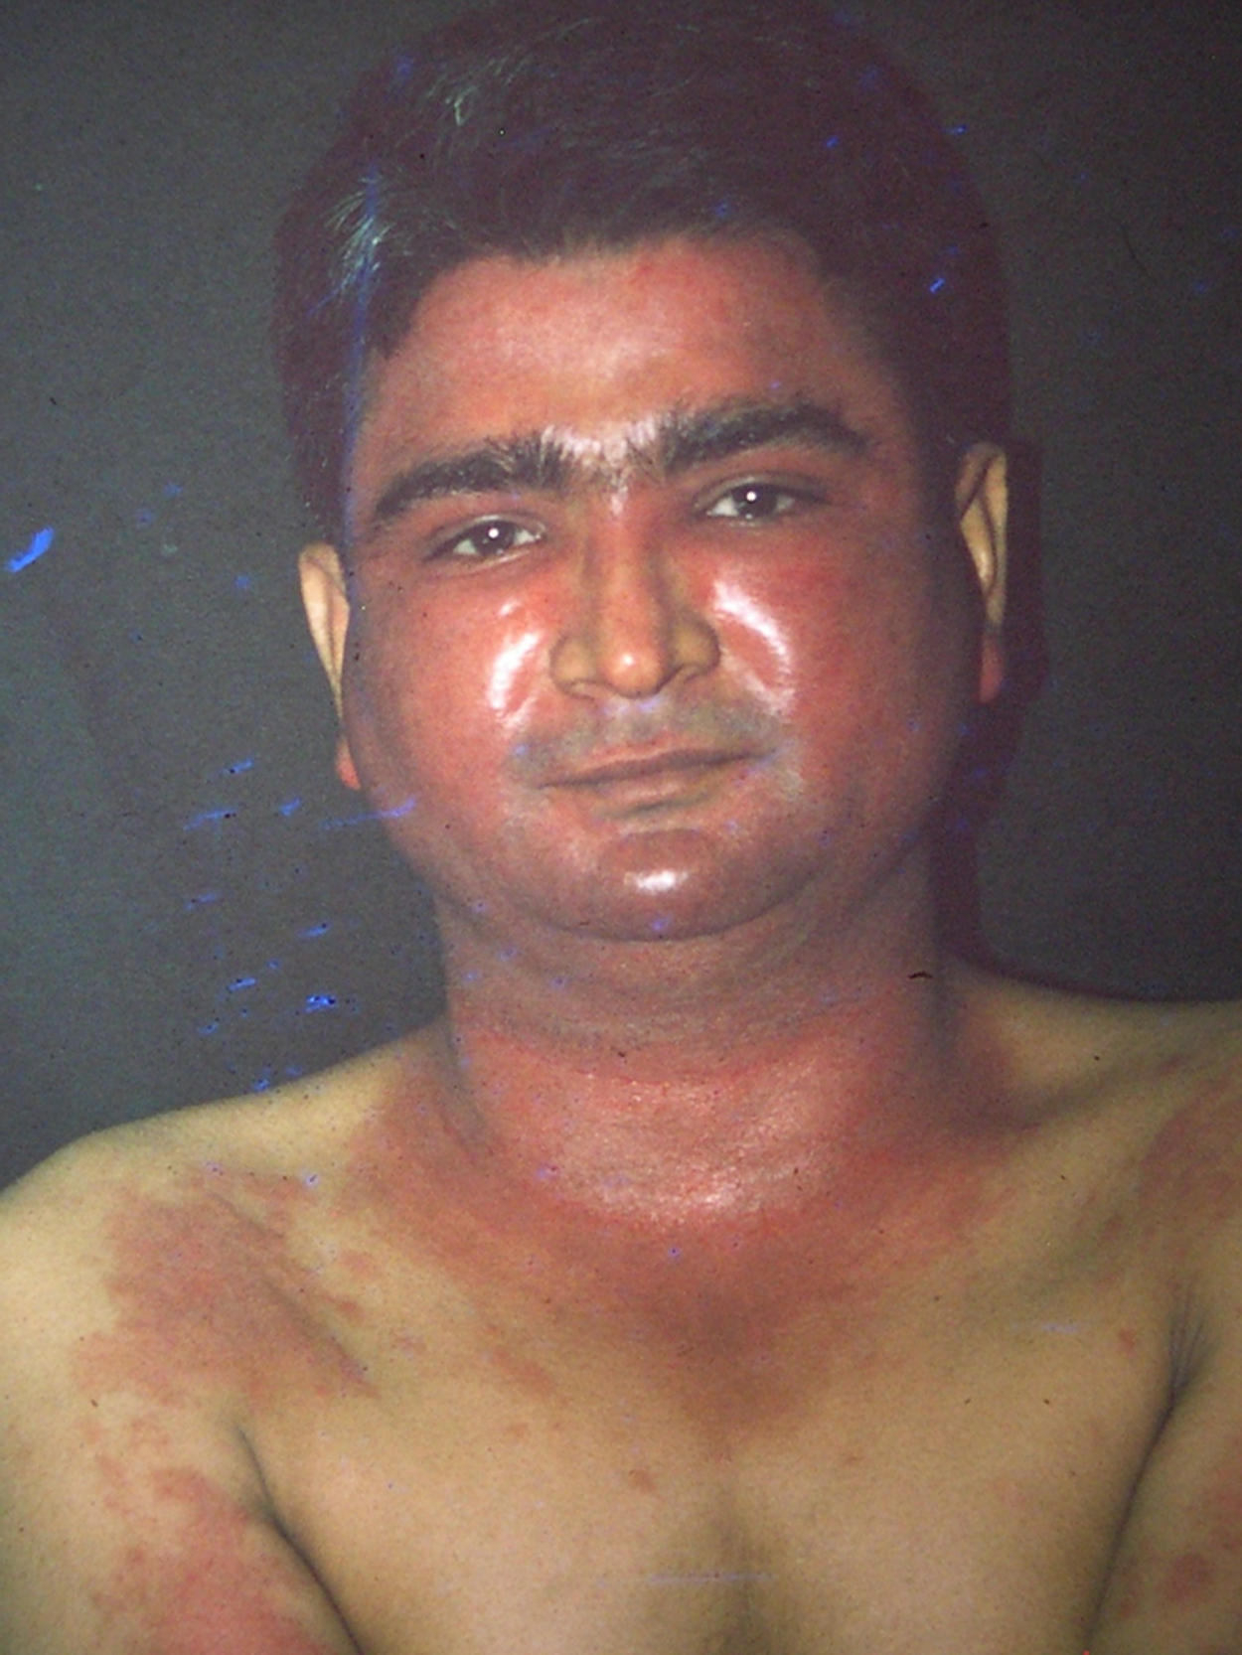
Notes:
Acute sunburn reaction
D/D: Photocontact dermatitis

Slide 11
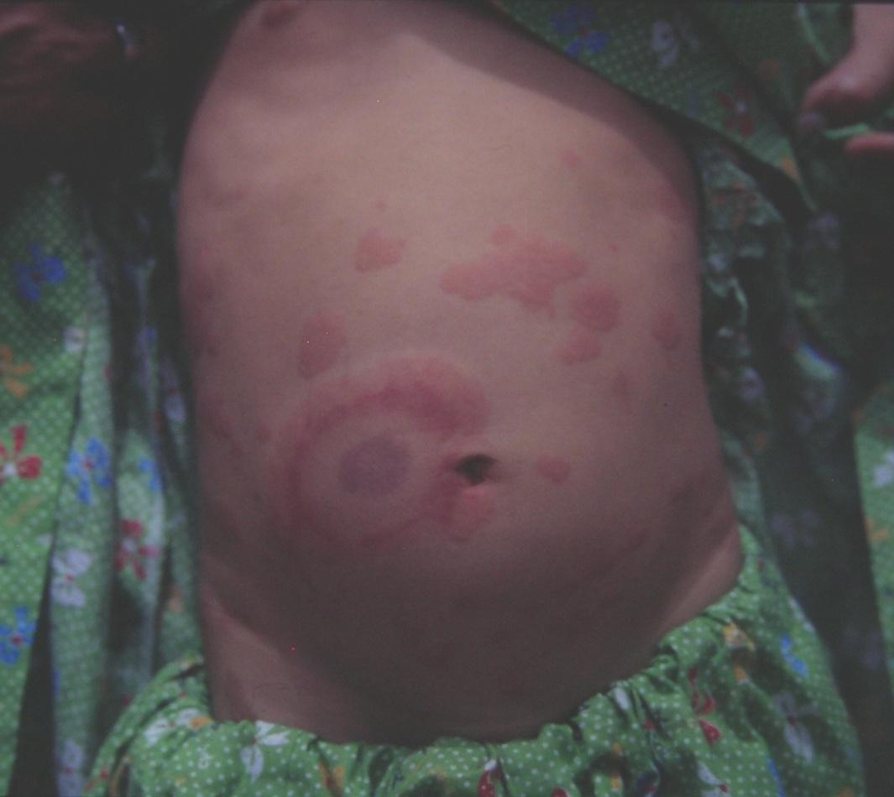
Notes:
Acute hemorrhagic edema (rosette like lesions – ecchymotic center is seen)..it has better prognosis than HSP and no relapses and no renal involvement
D/D
HSP (there is renal involvement and relapses occurs)

Slide 12
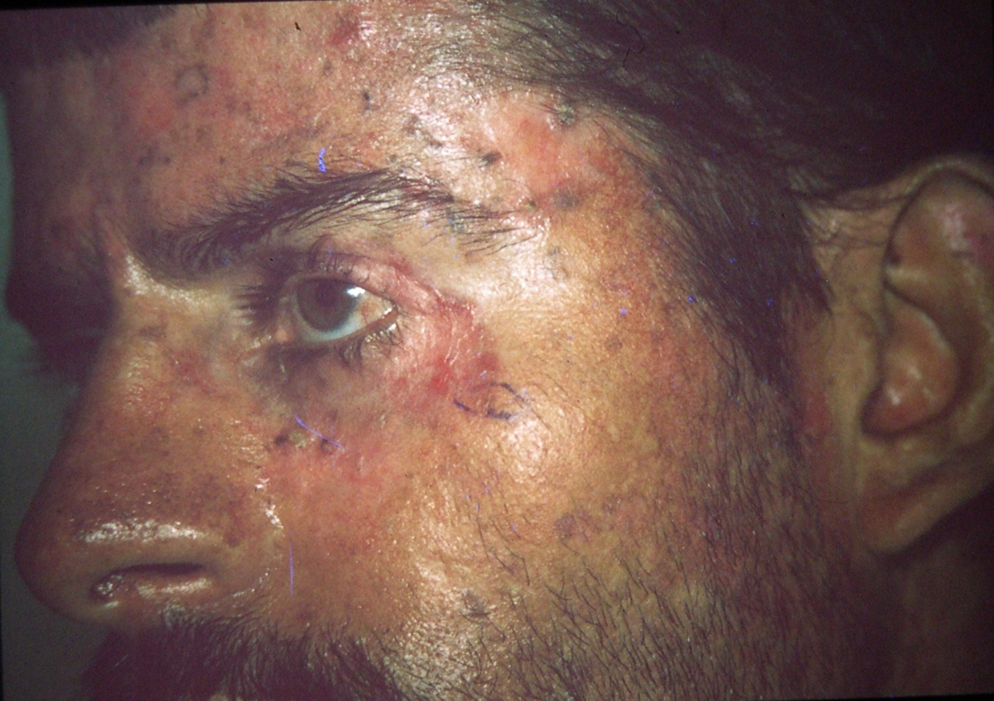
Notes:
PCT (scleromalacia, hypertrichosis and waxy scars shown)

Slide 13
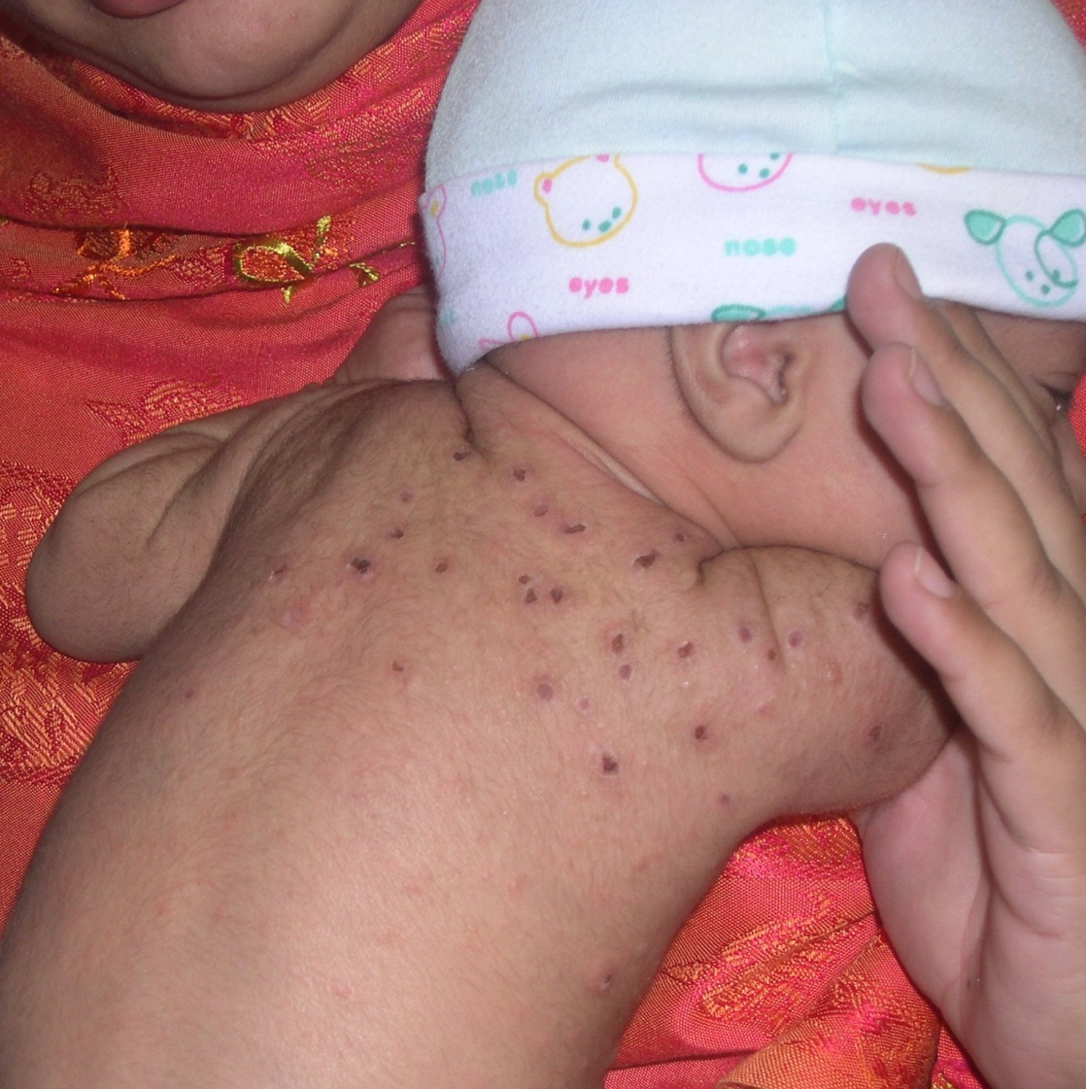
Notes:
On H/P there are calcium deposits
Dx: subcutaneous fat necrosis of newborn
Newborn subcutaneous fat disorders
Subcutaneous fat necrosis
Cold panniculitis
Neonatal cold injury
Sclerema neonatorum

Slide 14
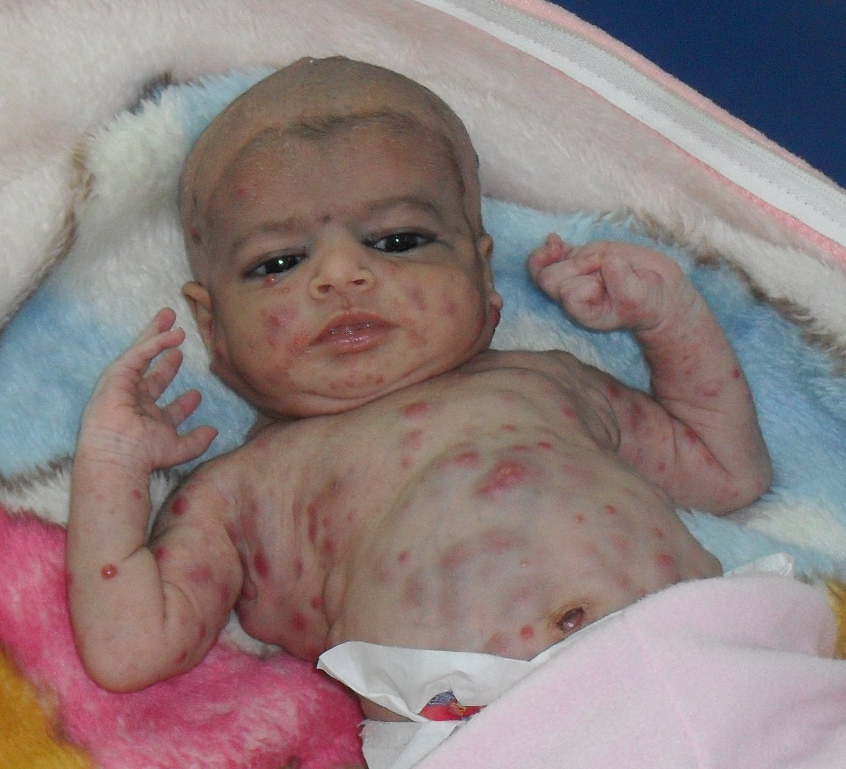
Notes:
D/D
Multiple hemangiomas
Blueberry muffins

Slide 15
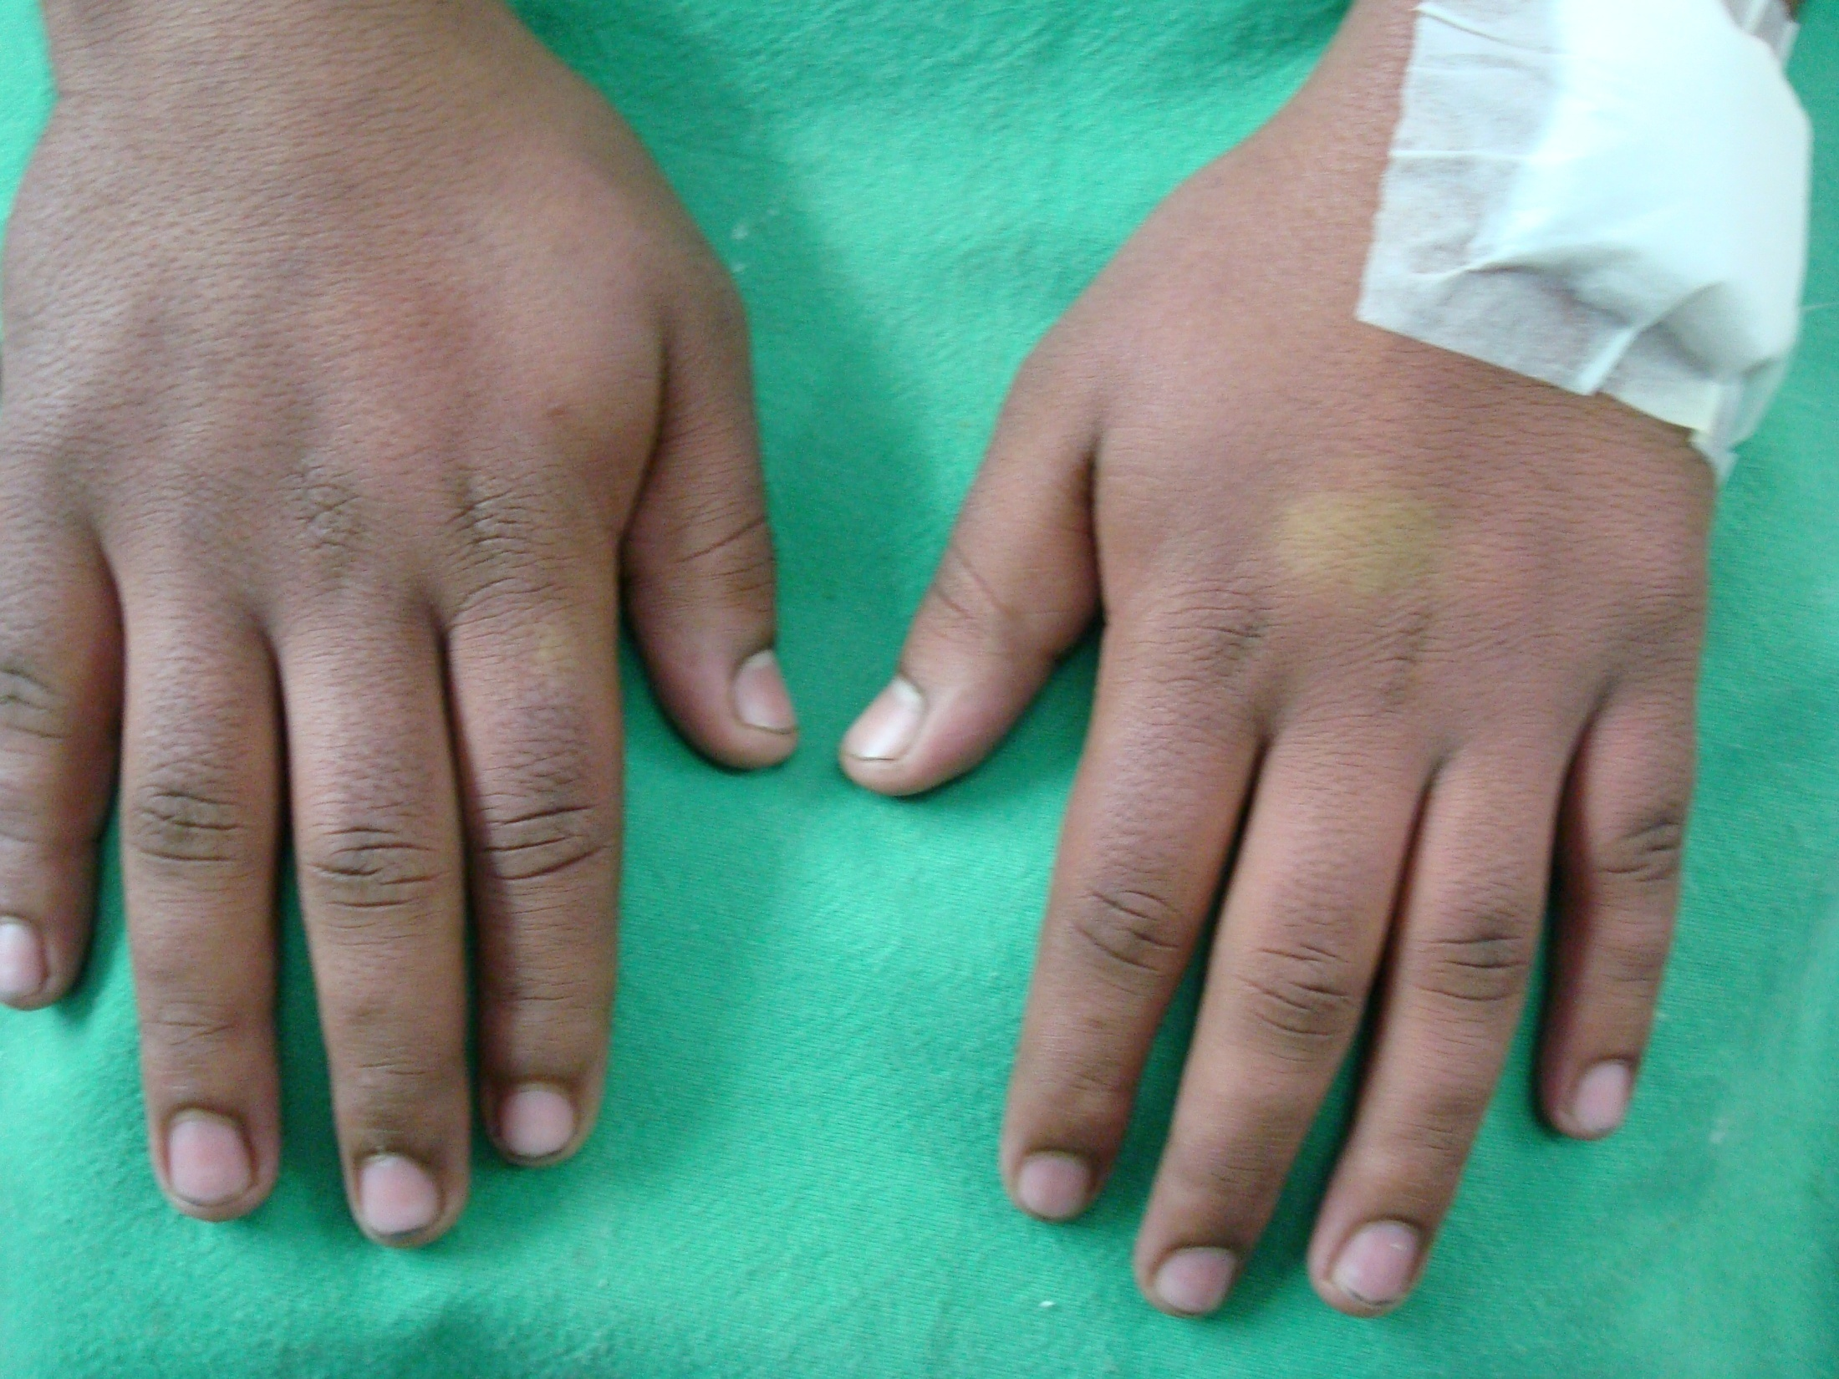
Notes:
Hand edema with symmetrical and persistent blanchable erythema shown
Dx: Erythrocyanosis (has association with myeloproliferative disorders)
Idiopathic reactions to cold
Chillblains
Raynaud’s
Acrocyanosis
Erythrocyanosis

Slide 16
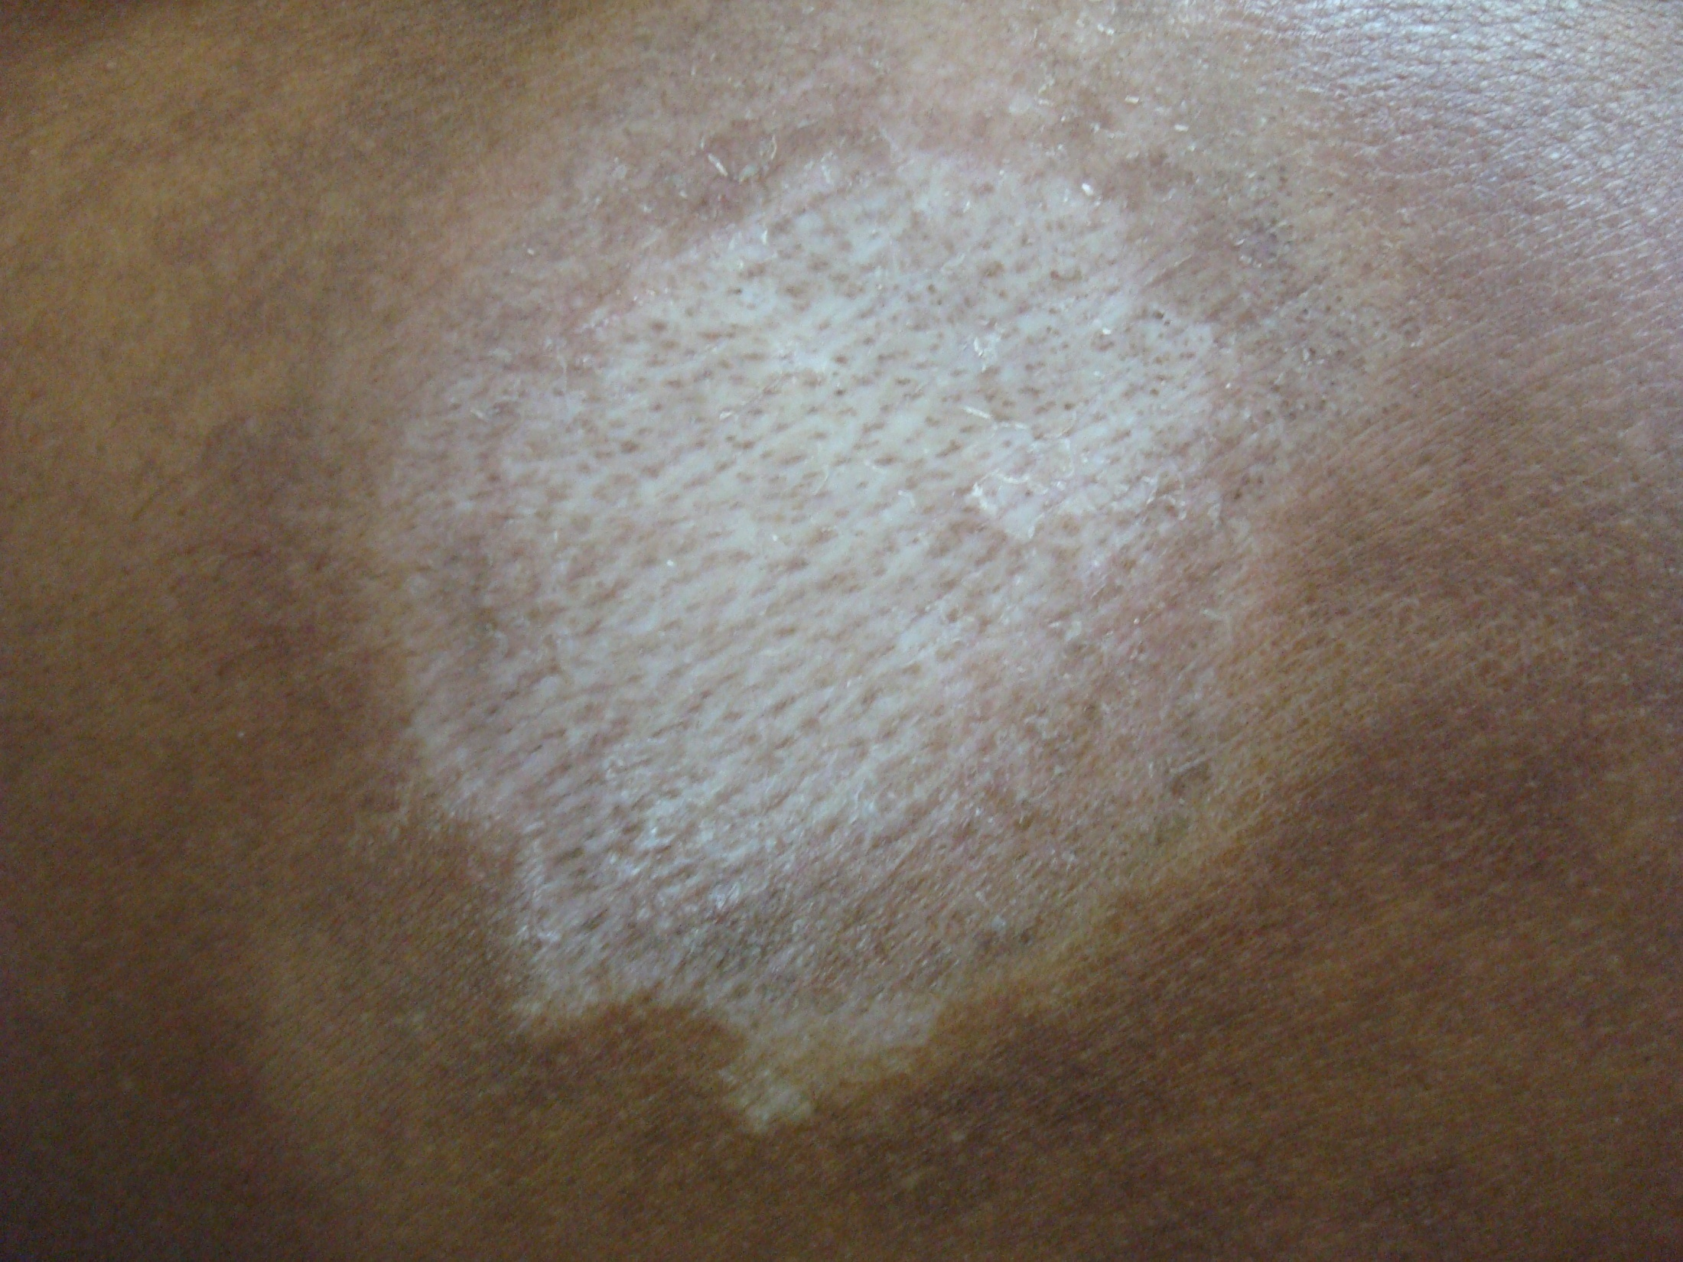
Notes:
LSA

Slide 17
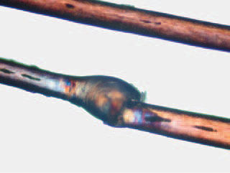
Notes:
Trichorrhehxis invaginata

Slide 18
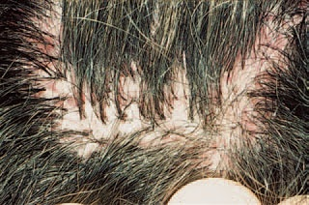
Notes:
Tufted folliculitis

Slide 19
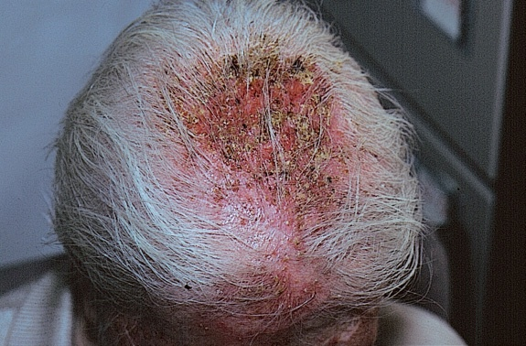
Notes:
D/D
Brunsting-Perry syndrome
Pemphigus vegetans
SCC
Erosive pustular dermatosis of scalp- imp diagnosis especially in an elderly female with androgenic alopecia

Slide 20
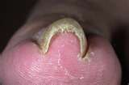
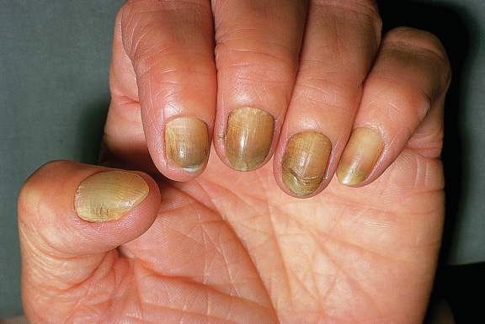
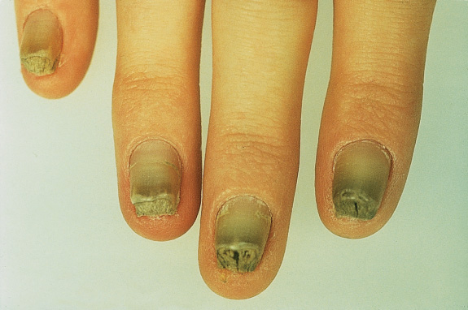
A
B
C
Notes:
A: Pincer nail
B: Yellow nail syndrome
C: Pachonychia congenita (wedge shaped subungual hyperkeratosis)
Associations of pincer nail
Bronchiectasis
Lymphedema
Pincer nail is either idiopathic or acquired – (trauma in acquired causes)

