Slide 1
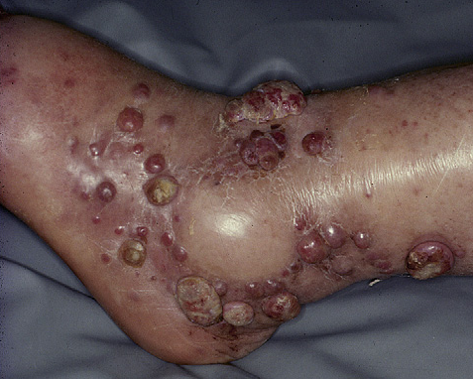
DIFFERENTIAL DIAGNOSIS
Notes:
Kaposi (likely diagnosis)
Bacillary angiomatosis
Deep mycosis
B-cell lymphoma

Slide 2
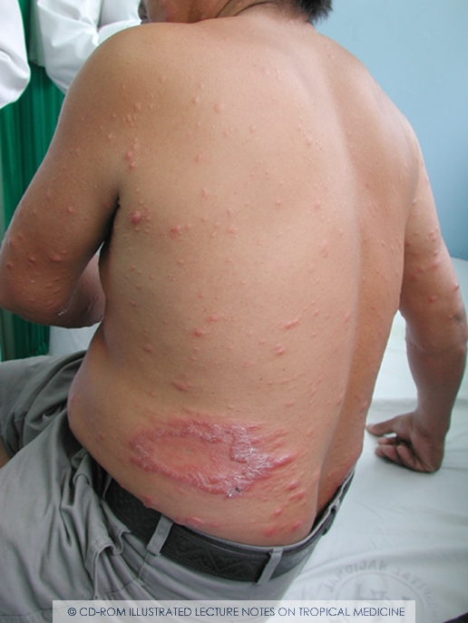
DIAGNOSIS
Notes:
Borderline leprosy downgrading to lepromatous leprosy (subpolar leproamtous leprosy)

Slide 3
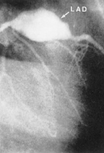
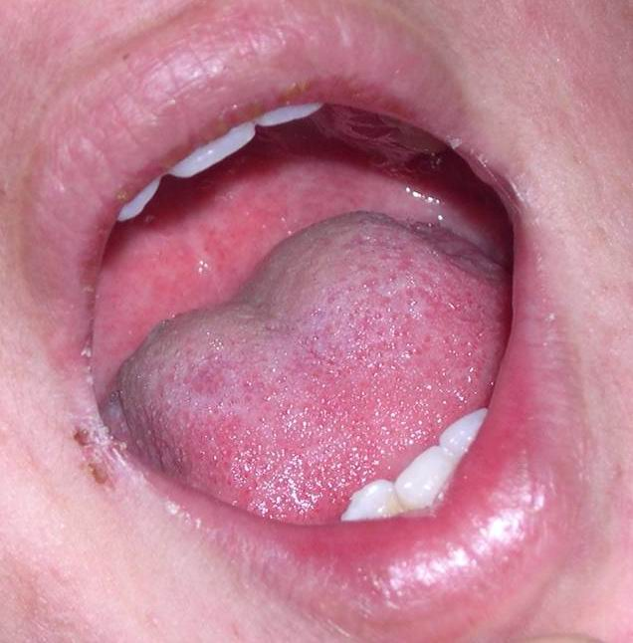
DIAGNOSIS
Notes:
Kawasaki disease (strawberry tongue and aneurysm in LAD is shown)
If untreated 25% develop aneurysms
Criteria of Kawasaki
Strawberry tongue
Fever of more than 5 days duration
Lymphadenopathy
Polymorphus rash
Treatment: immunoglobulins 2g/day I/V for 3 days + aspirin 100 mg/kg

Slide 4
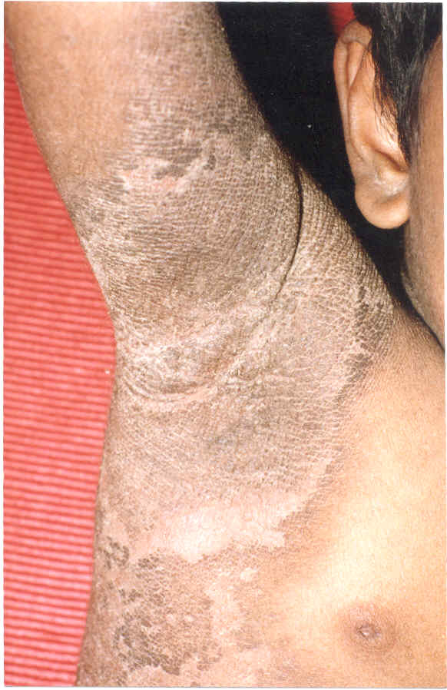
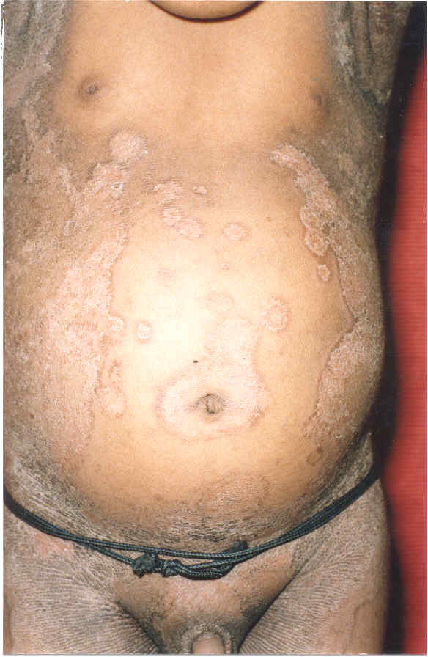
DIAGNOSIS
Notes:
Epidermolytic hyperkeratosis

Slide 5
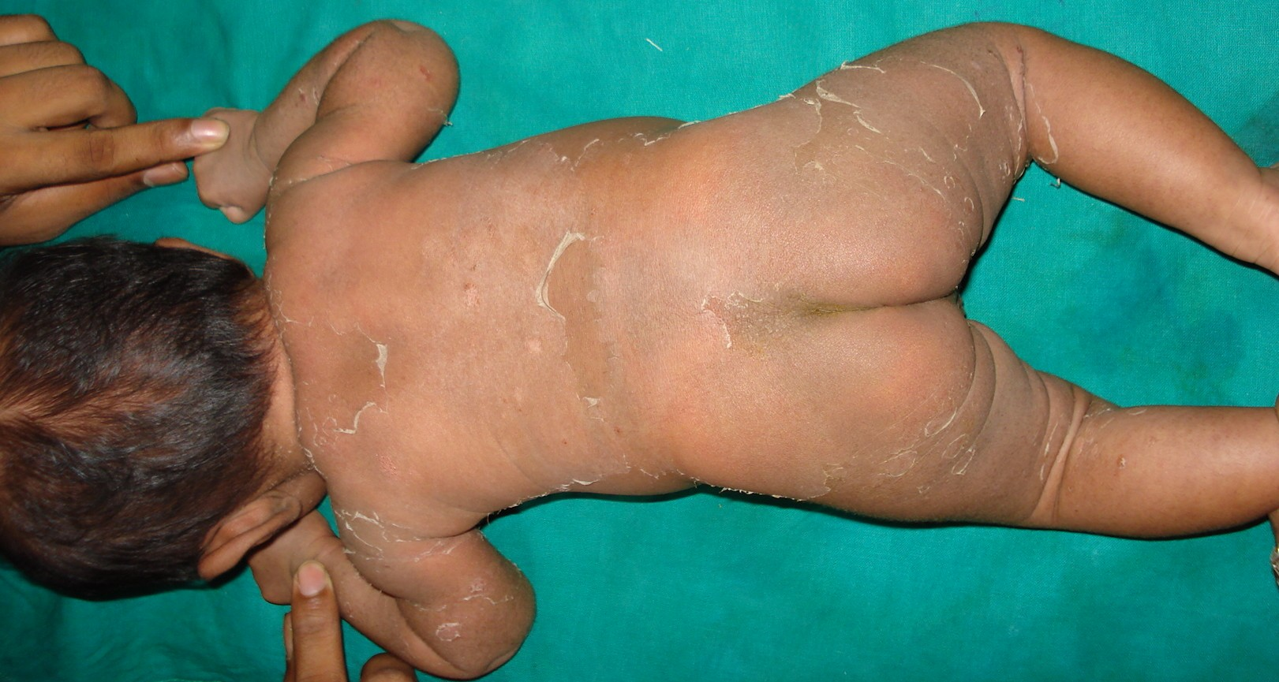
PRESENT SINCE BIRTH. DIAGNOSIS
Notes:
Skin peeling syndrome

Slide 6
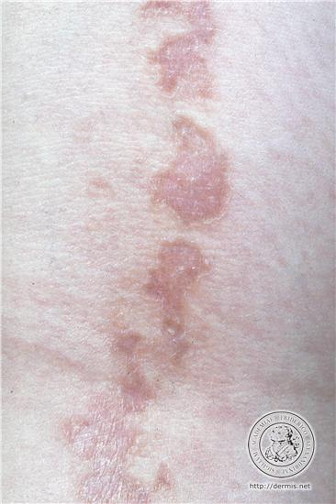
DIAGNOSIS
Notes:
Linear Porokeratosis

Slide 7
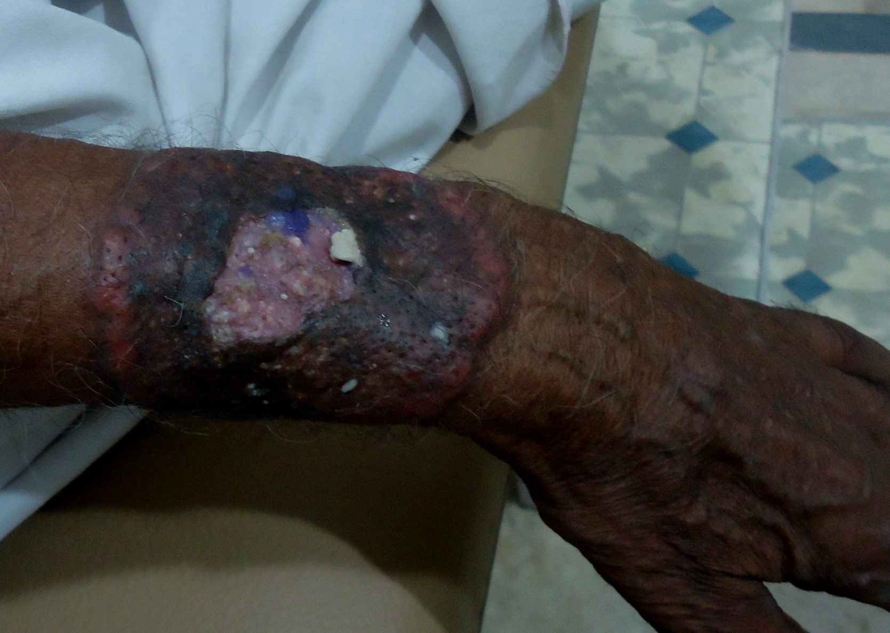
DIFFERENTIAL DIAGNOSIS
Notes:
Broad yellowish brown margin with hypertrophy and ulceration (xanthogranulomatous appearance)
Sebaceous CA
Necrobiotic xanthogranulomas
Atypical necrobiosis lipoidica
Trichoadenoma
Treatment of necrobiotic xanthogranuloma
1. Rule out paraproteinemia and treat it

Slide 8
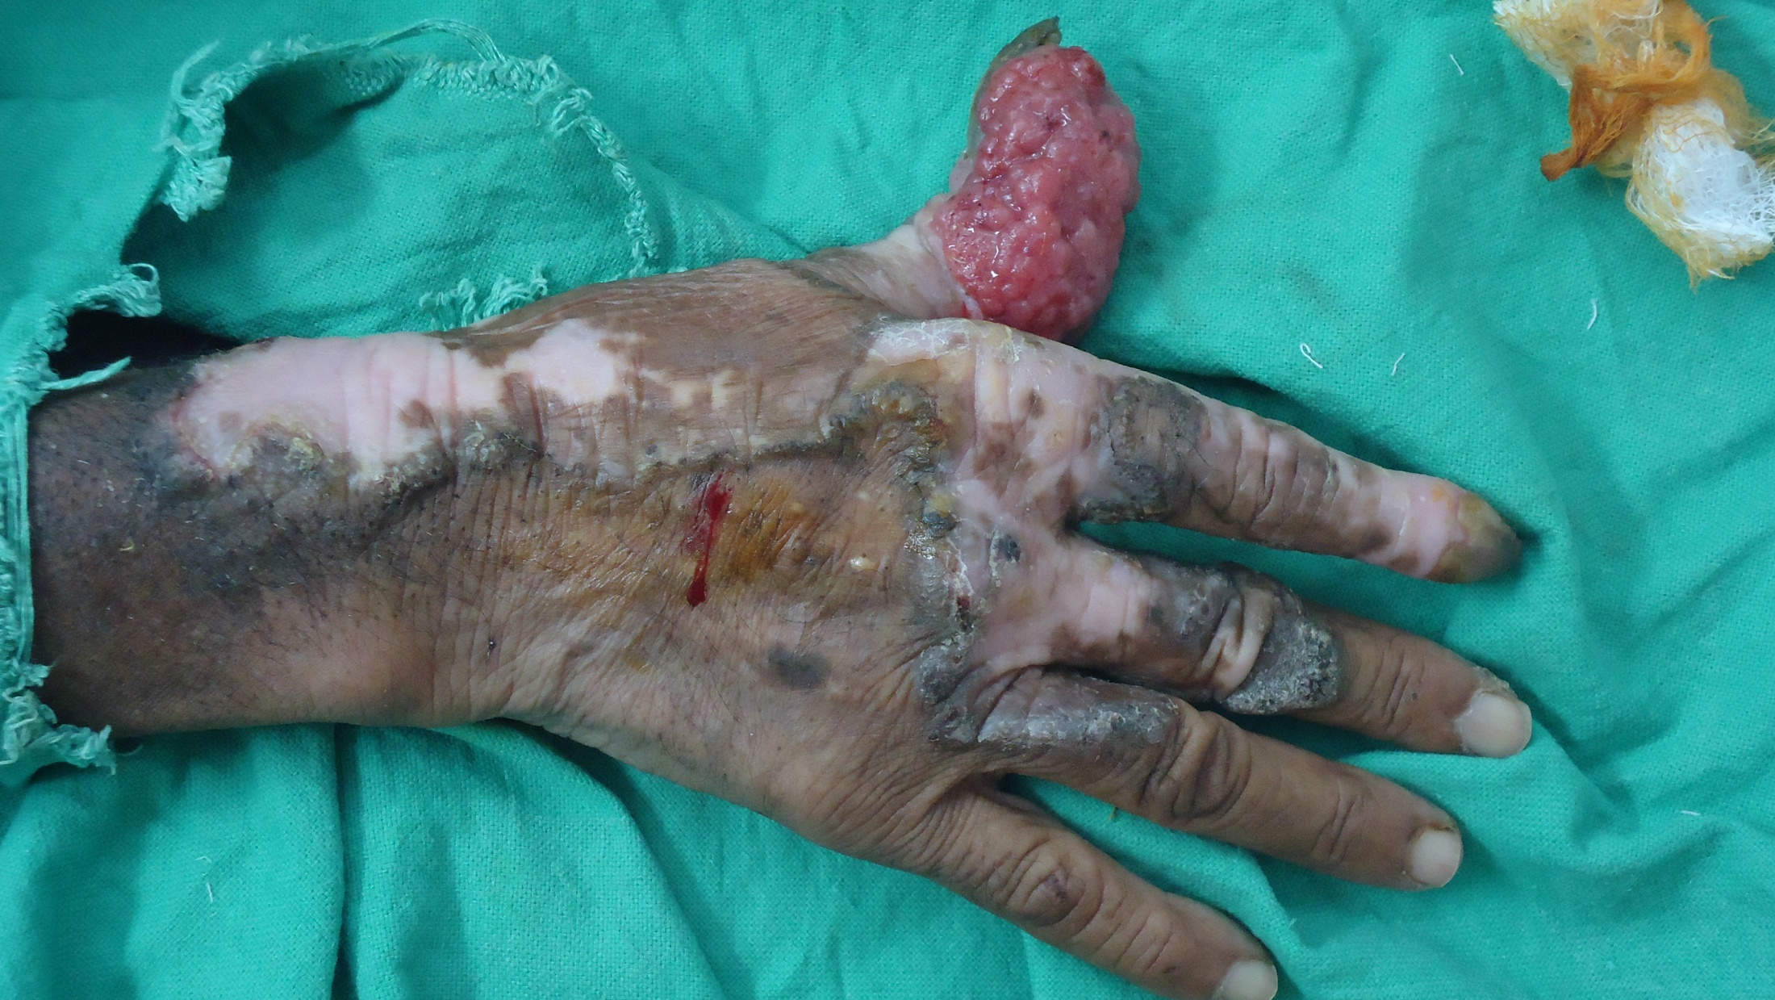
DIAGNOSIS
Notes:
SCC on the background of porokeratosis (longstanding porokeratosis of mibelli)

Slide 9
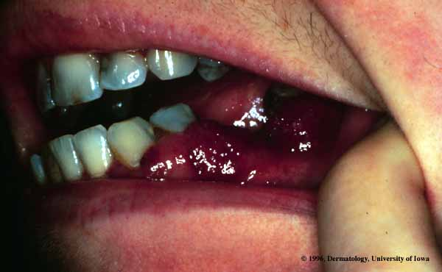
DIFFERENTIAL DIAGNOSIS
Notes:
Mucosal kaposi
Mucosal hemangioma
Drug induced gingival hyperplasia
Wegner’s granulomatosis

Slide 10
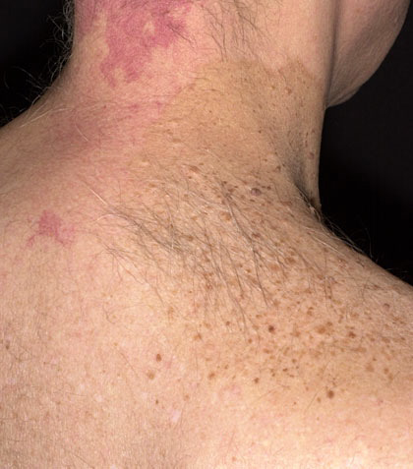
DIAGNOSIS
Notes:
Nevus spilus + port wine stain on neck is seen
In port wine there is ectasia of underlying blood vessels while in hemangioma there is proliferation of blood vessels

Slide 11
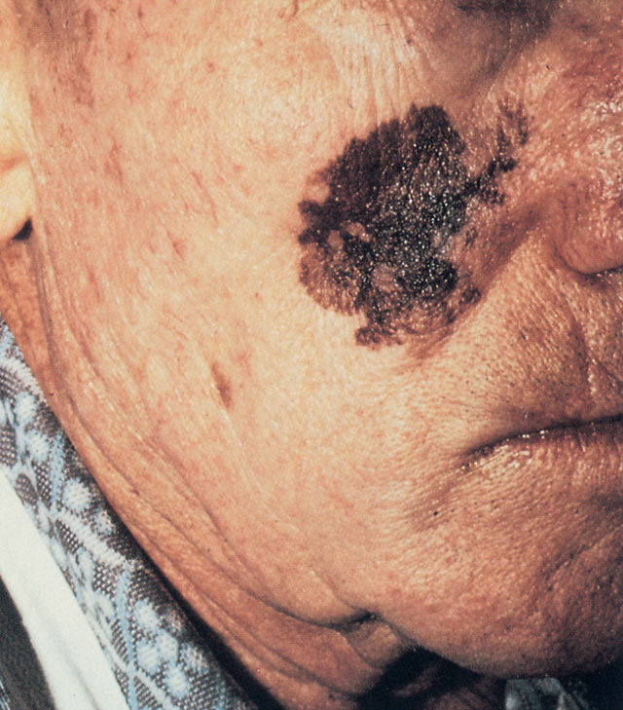
DIAGNOSIS
Notes:
Lantigo maligna

Slide 12
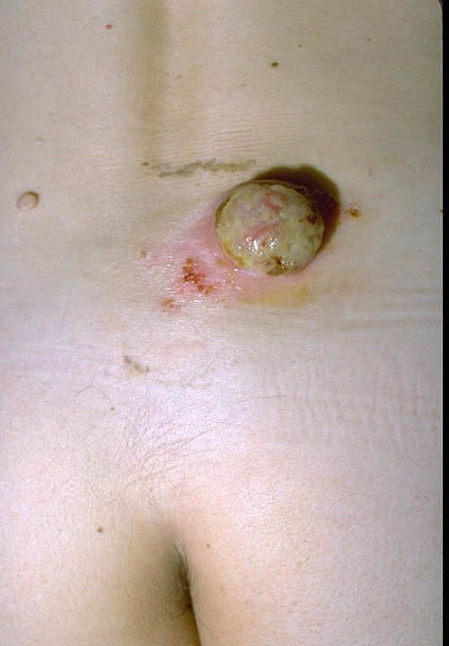
DIFFERENTIAL DIAGNOSIS
Notes:
Pyogenic granuloma
SCC
Amelanotic melanoma
Eccrine poroma

Slide 13
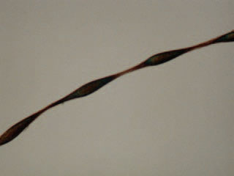
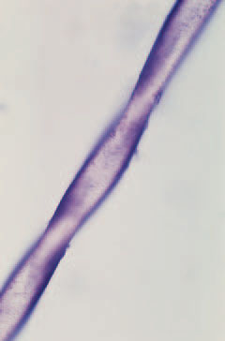
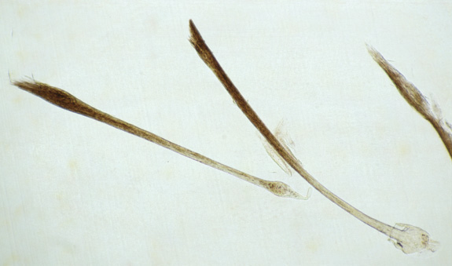
WHAT ABNORMALITIES ARE SHOWN
A
B
C
Notes:
A: beaded hair shown. There are nodes and inter nodes – Monlithrix
B: Twisted and flattened hair shaft – Pilar torti
C: exclamation mark hair – alopecia areata
Monlithrix: autosomal dominant
Associated with KP and arginine succinyl urea
Pseudomonlithrix: inflammatory disorders of hair follicles lead to this

Slide 14
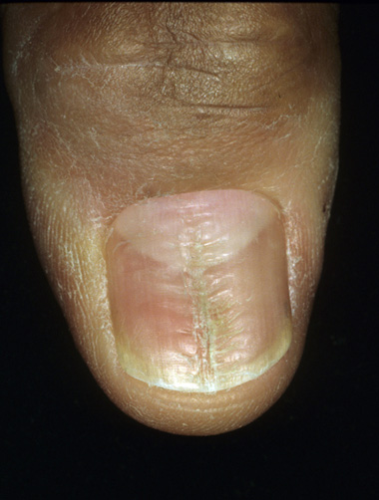
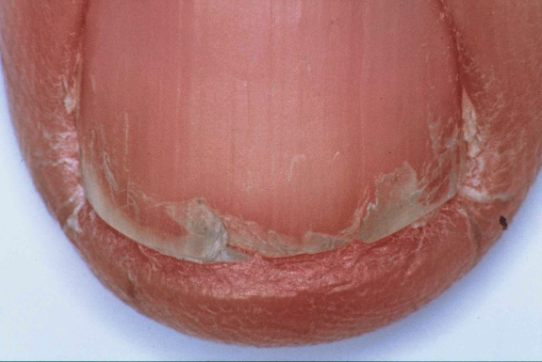
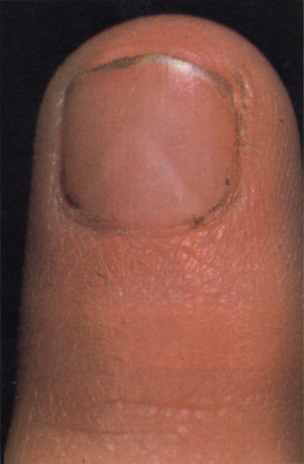
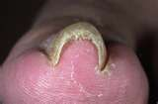
A
B
WHAT ABNORMALITIES ARE SHOWN
C
D
Notes:
A: onychoschisis (due to trauma and washing)
B: median canalicular deformity (after sometime it improves and heals spontaneously)
C: pincer nail (increase in transverse curvature of nail)- hereditary defect
D: triangular lunula- nail patella syndrome

Slide 15
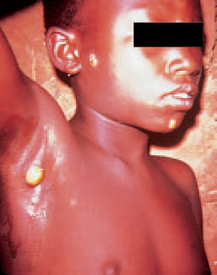
DIFFERENTIAL DIAGNOSIS
Notes:
Endemic syphilis

Slide 16
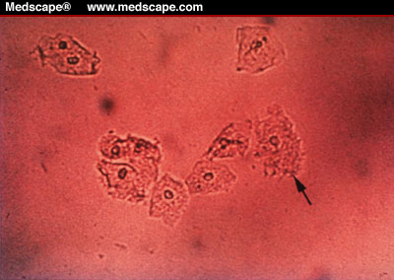
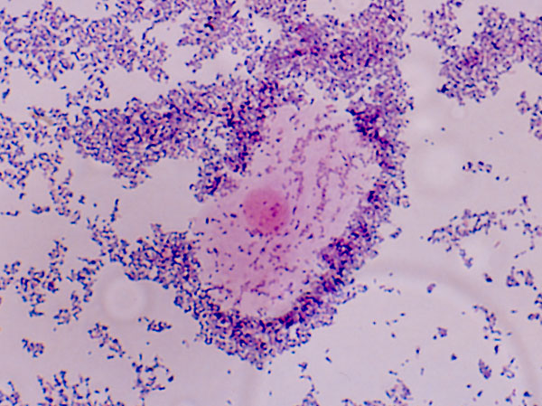
WHAT ARE THESE AND WHAT IS YOUR DIAGNOSIS
B
A
Notes:
A: Fresh water preparation . Clue cells/epithelial cells are seen. There is depression over these cells where bacteria are present
B: Gram stain prep
Diagnosis: Bacterial vaginosis

Slide 17
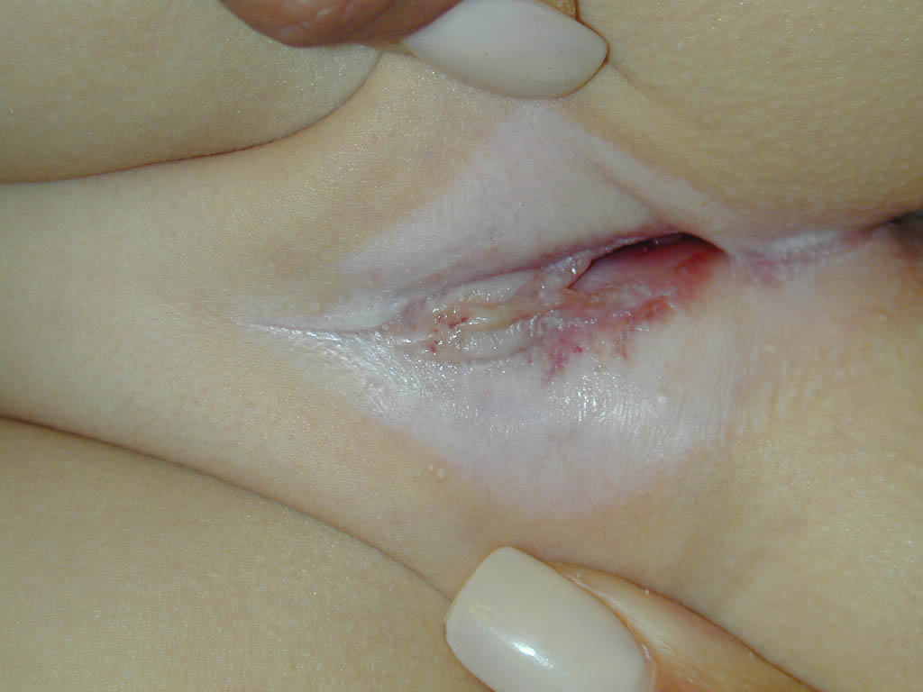
PROGNOSIS
Notes:
LSA. Good prognosis before puberty. It will resolve after puberty

Slide 18
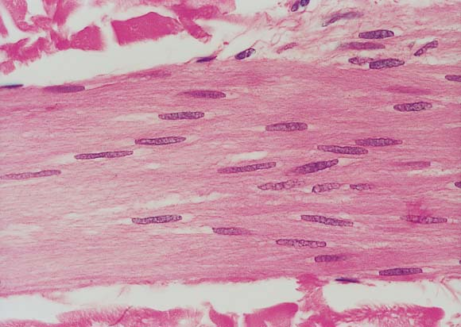
DIAGNOSIS
Notes:
Leiomyoma (smooth muscle with cigar shaped nuclei)

Slide 19
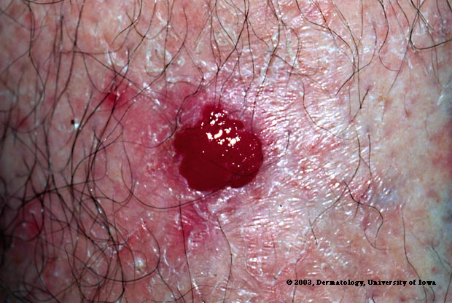
This lesion was present on the leg of 60years old man for the last one yeaars. Histopathology showed clear cells in the epidermis.
What is your likely diagnosis?
Notes:
Clear cell acanthoma

Slide 20
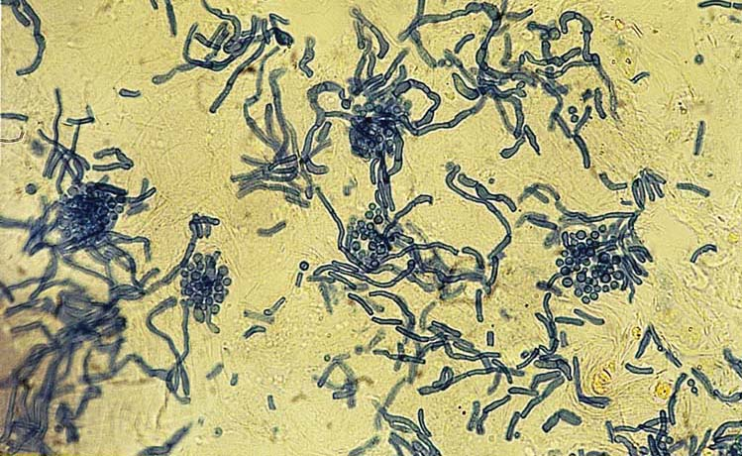
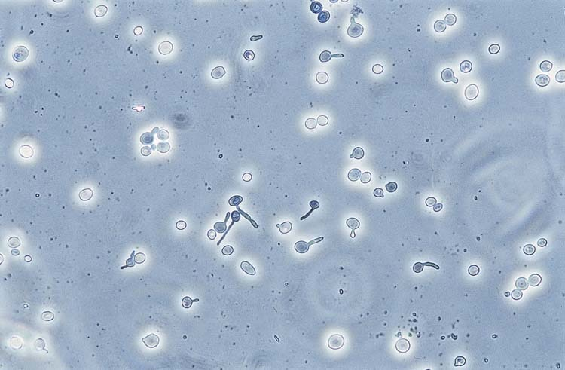
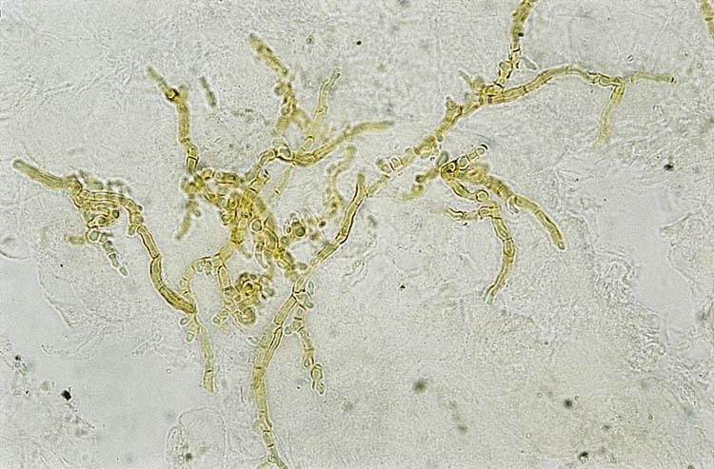
WHAT ARE YOUR FINDINGS AND DIAGNOSIS IN A B AND C?
C
B
A
C
A
Notes:
Fungal hyphae with KOH preparation shown
A: True hyphae of dermatophytes (septate hyphae)
B: spaghetti and meat ball appearance (p. versicolor)
C: pseudohyphae and budding yeasts (Candida)

