Slide 1
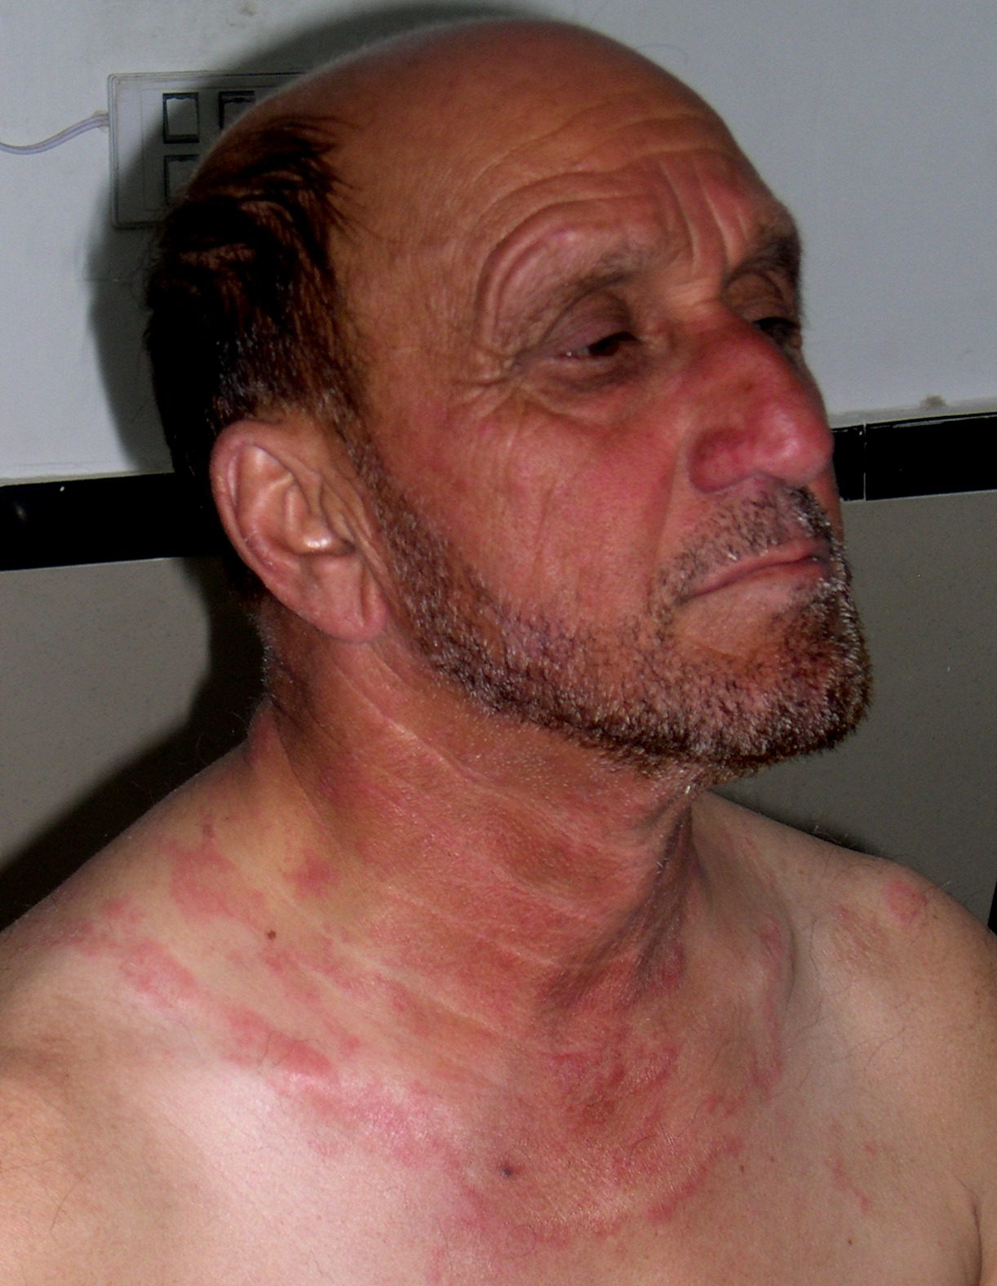
Differential diagnosis
Notes:
Granuloma Annulare
Granuloma multiforme

Slide 2
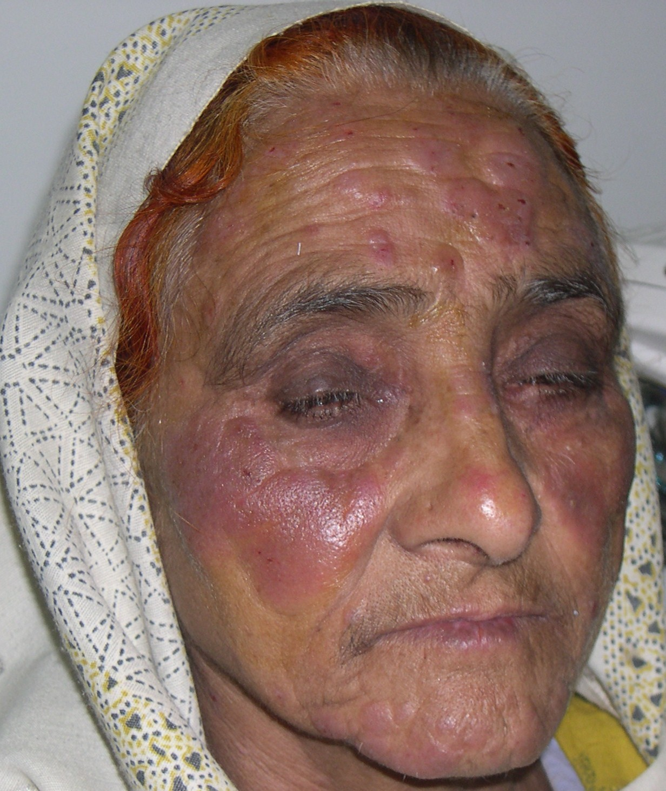
Differential diagnosis
Notes:
Sarcoidosis
Leprosy in reaction
Sweet syndrome
Tumid LE
Pseudolymphoma

Slide 3
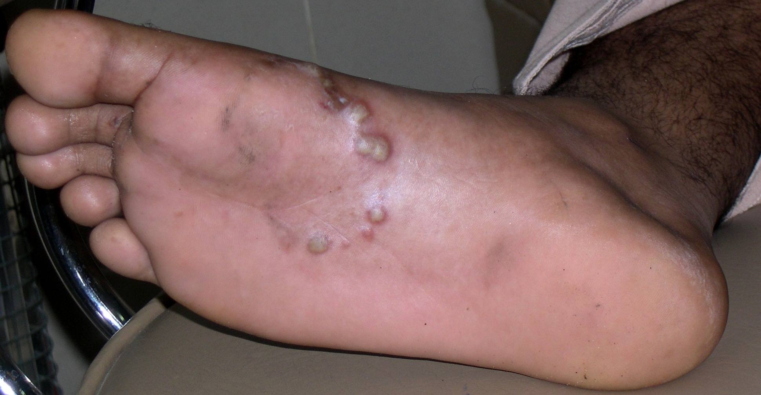
Likely diagnosis
Notes:
Vesiculobullous tinea pedis

Slide 4
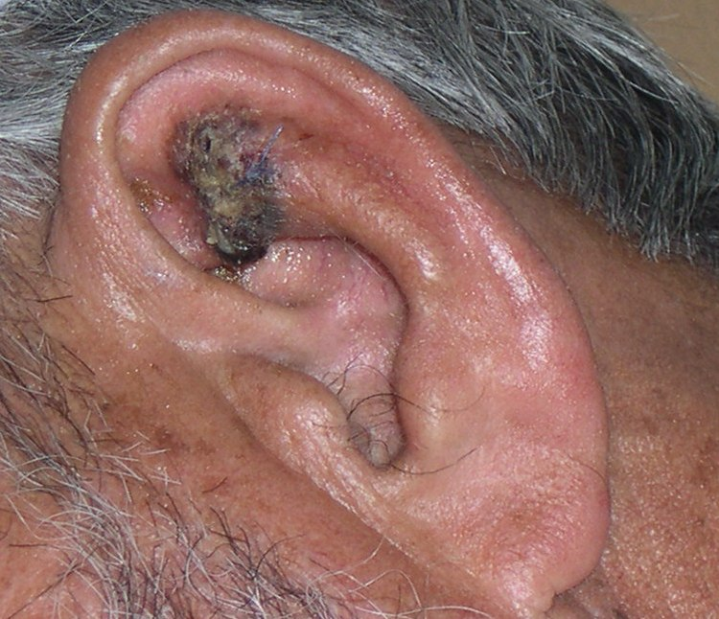
Differential diagnosis
Notes:
Bcc
Scc
Keratoacanthoma
Actinic Keratosis

Slide 5
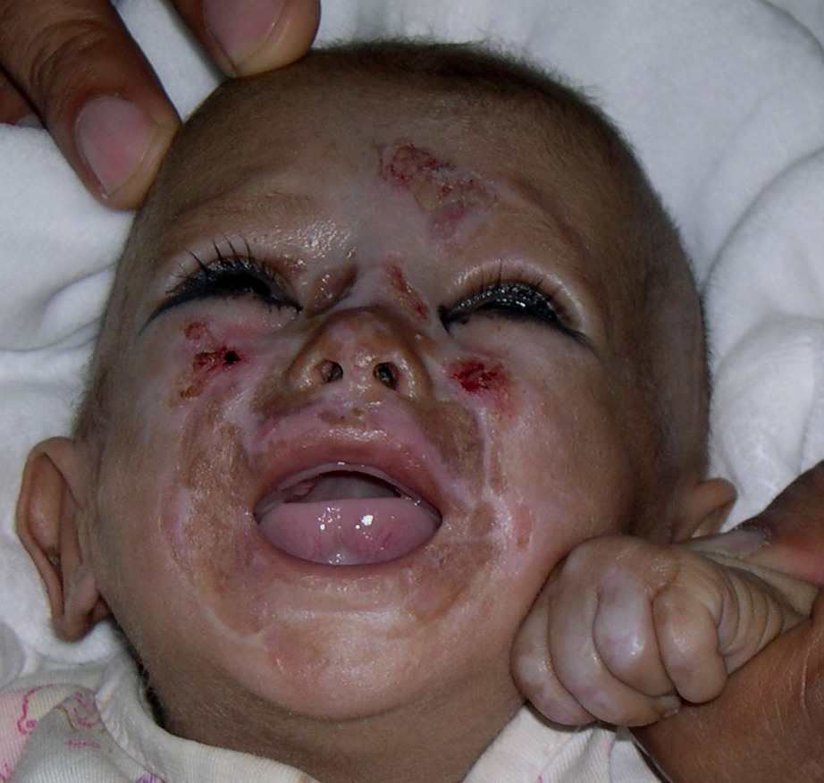
Likely diagnosis
Notes:
Acrodermatitis enteropathica

Slide 6
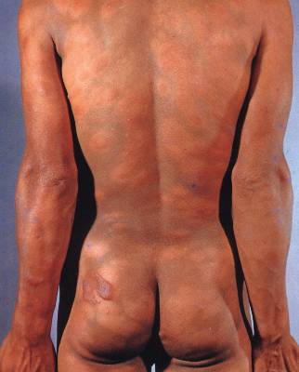
Likely diagnosis
Notes:
Lepromatous subpolar leprosy

Slide 7
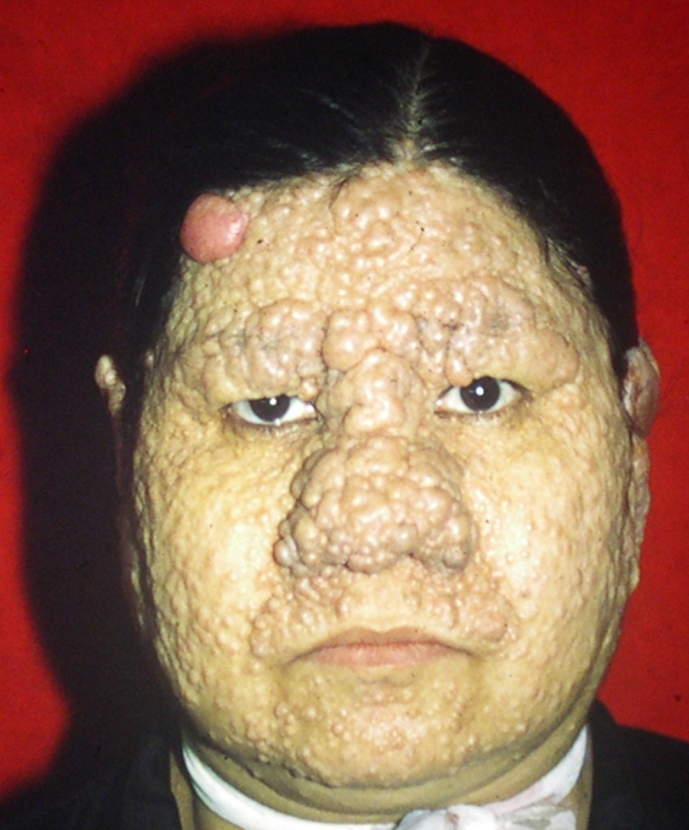
Likely diagnosis
Notes:
Trichoepitheliomas and turbin tumor

Slide 8
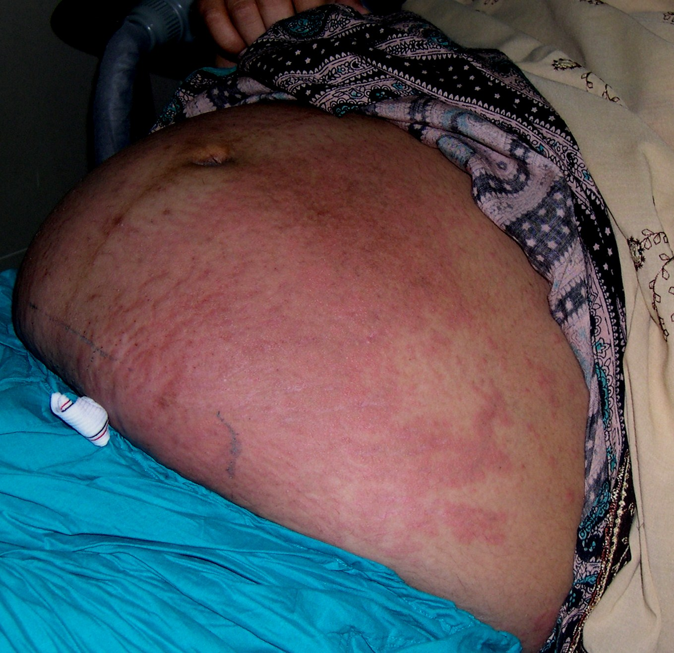
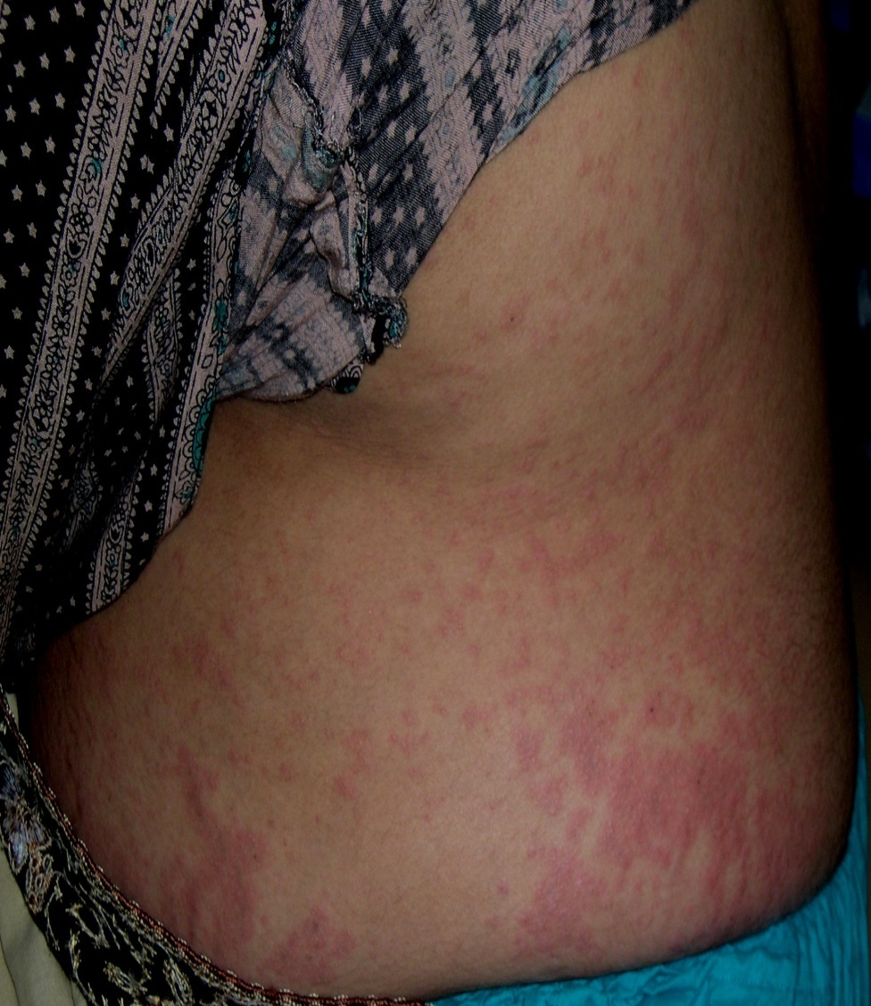
Diagnostic test in this pregnant lady
Notes:
DIF to differentiate between PUPP and Herpes gestationis

Slide 9
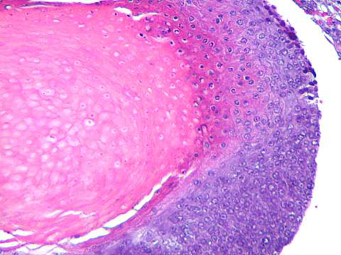
Likely diagnosis
Notes:
pilometricoma

Slide 10
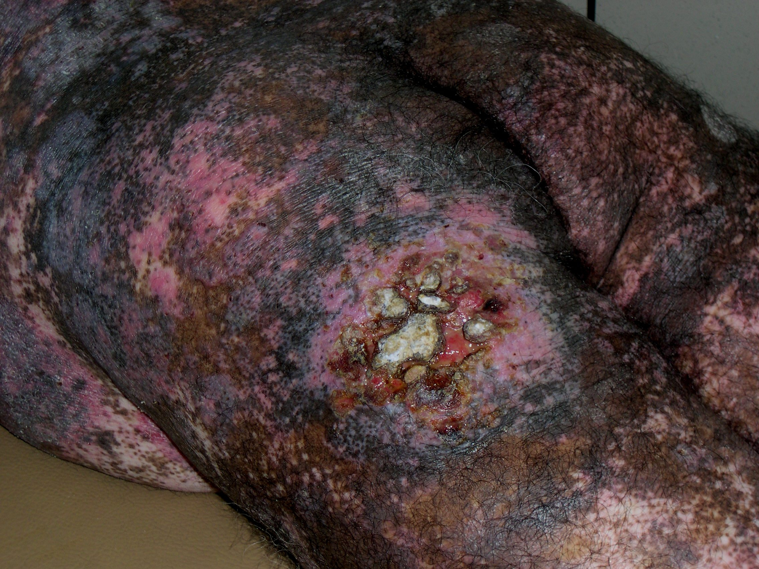
Differential diagnosis
Notes:
MF
GVHD
Lichenoid eruption
scc

Slide 11
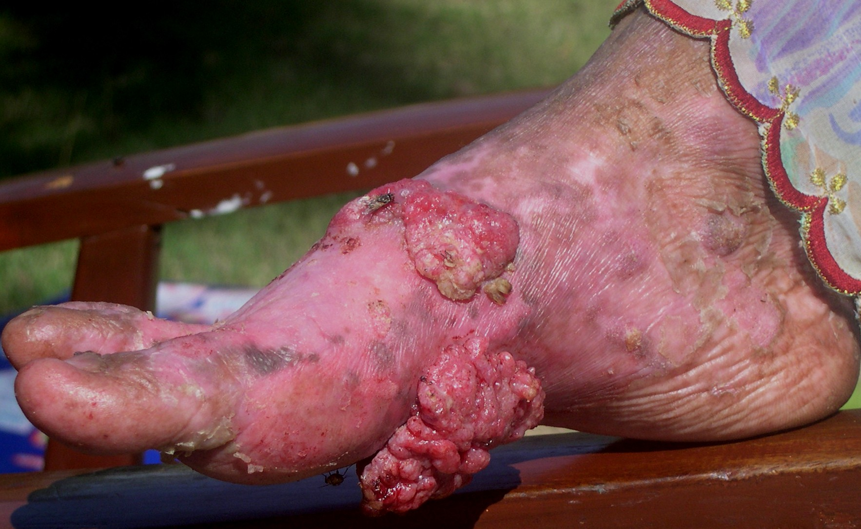
Likely diagnosis
Notes:
SCC on a background of Lichen planus

Slide 12
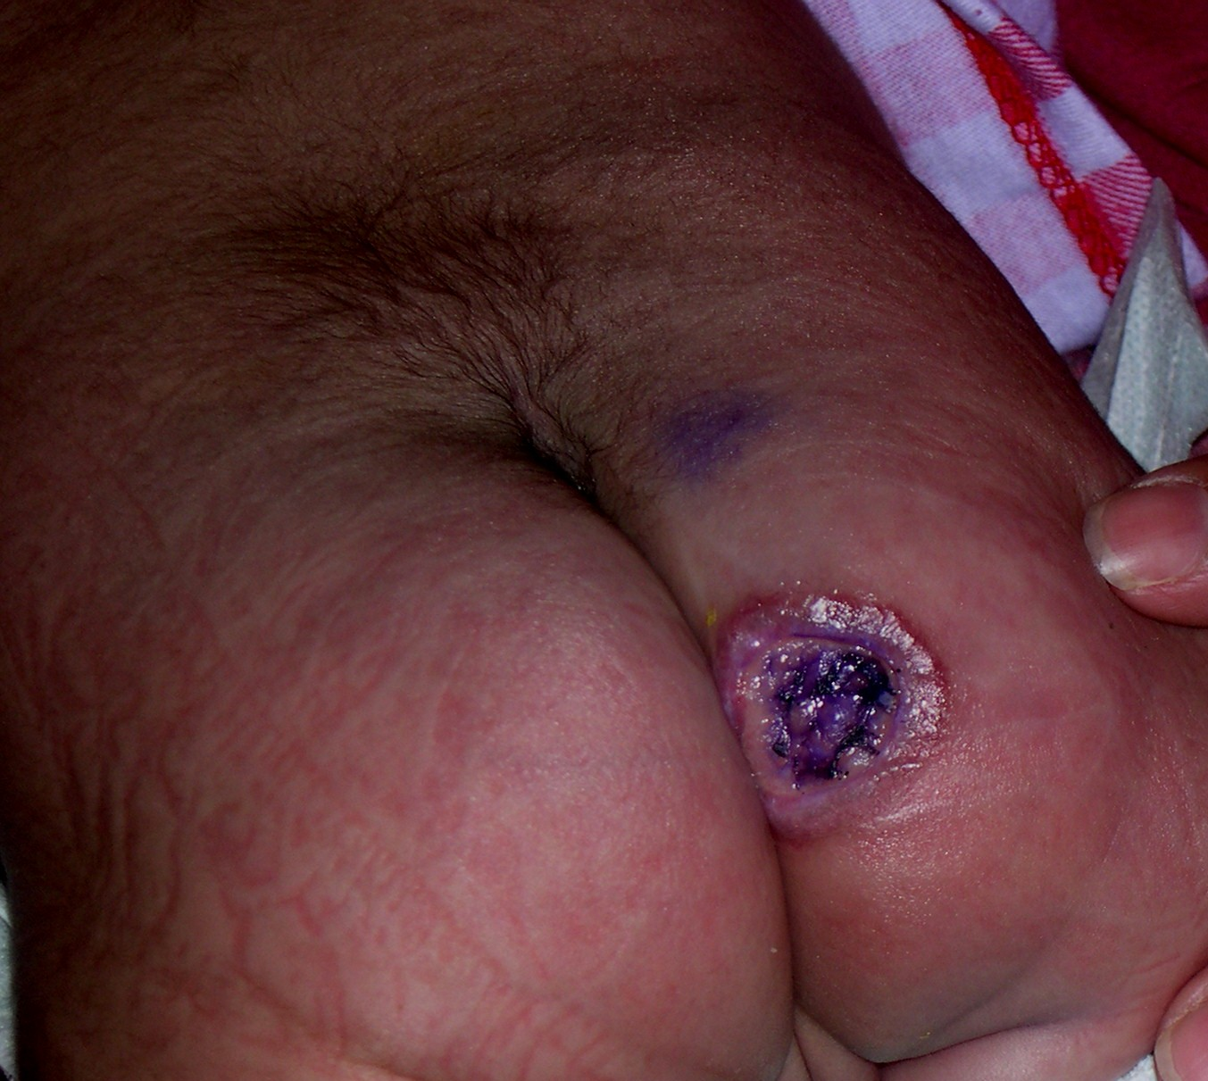
Likely diagnosis
Notes:
Lesion on buttock with rolled margins
Jxg
Tumors in child
JXG
Hemangioma

Slide 13
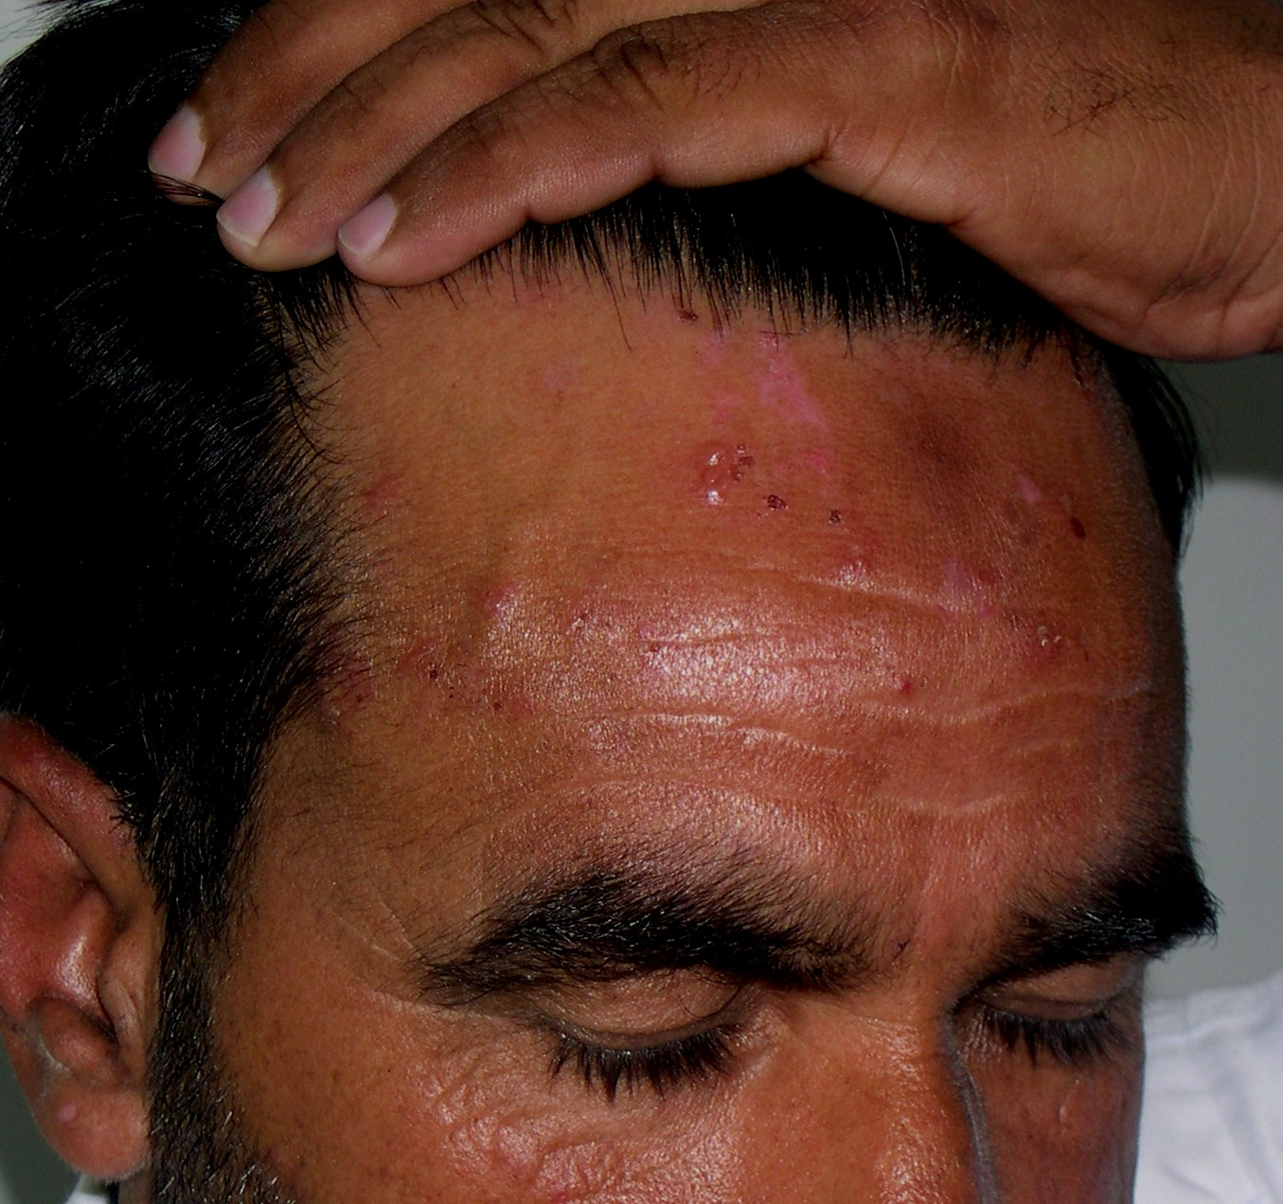
Differential diagnosis
Notes:
DH
BP

Slide 14
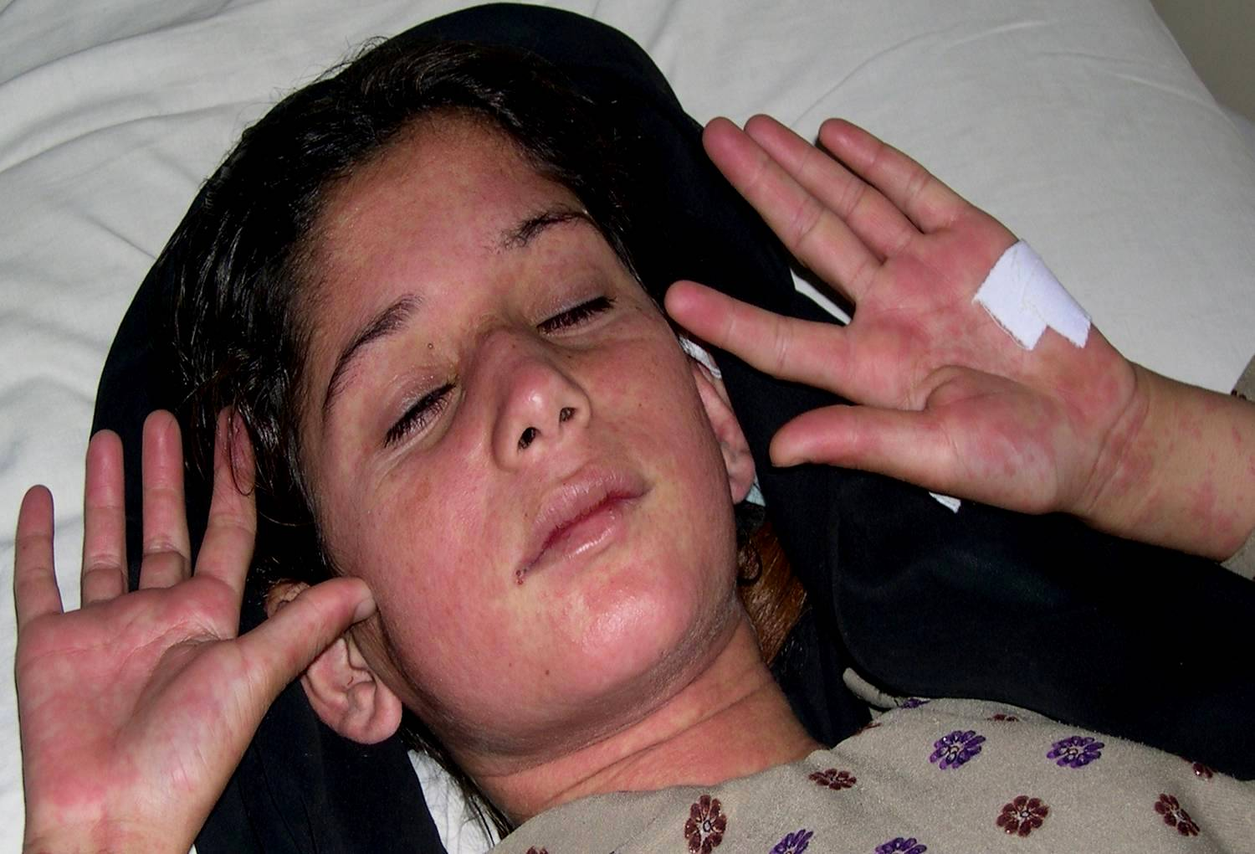
Differential diagnosis
Notes:
Kawasaki dis
Scarlet fever

Slide 15
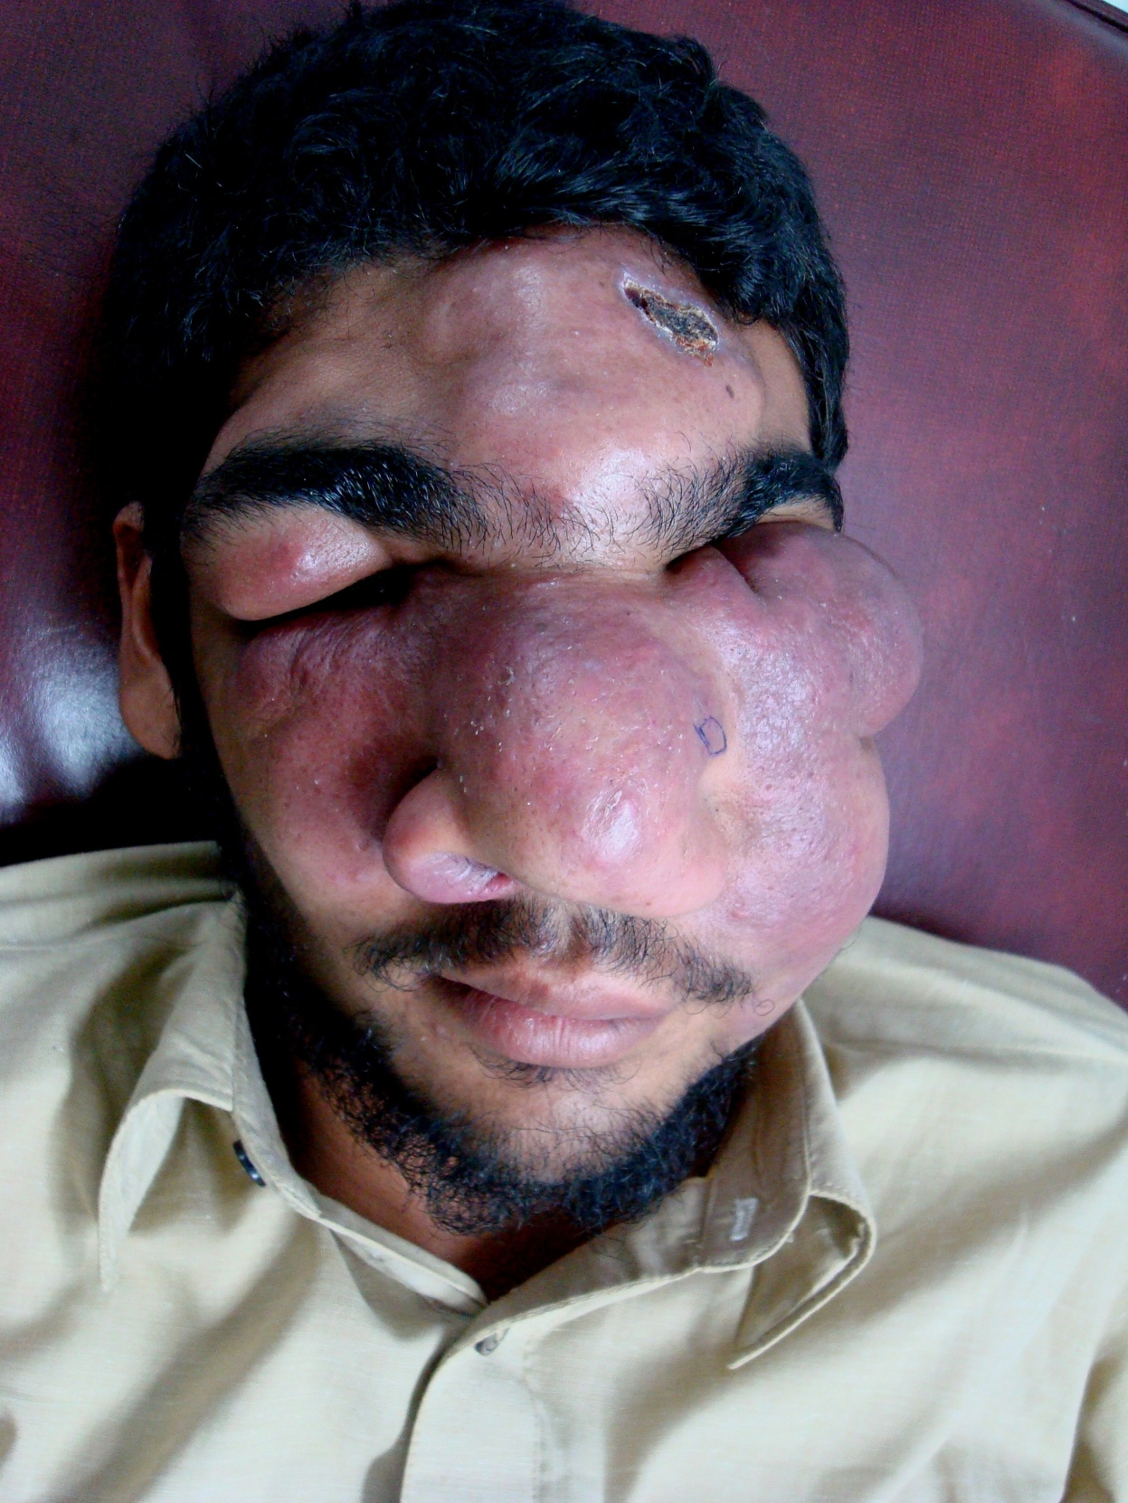
Differential diagnosis
Notes:
B-cell lymphoma
Vascular tumors
zygomycosis

Slide 16
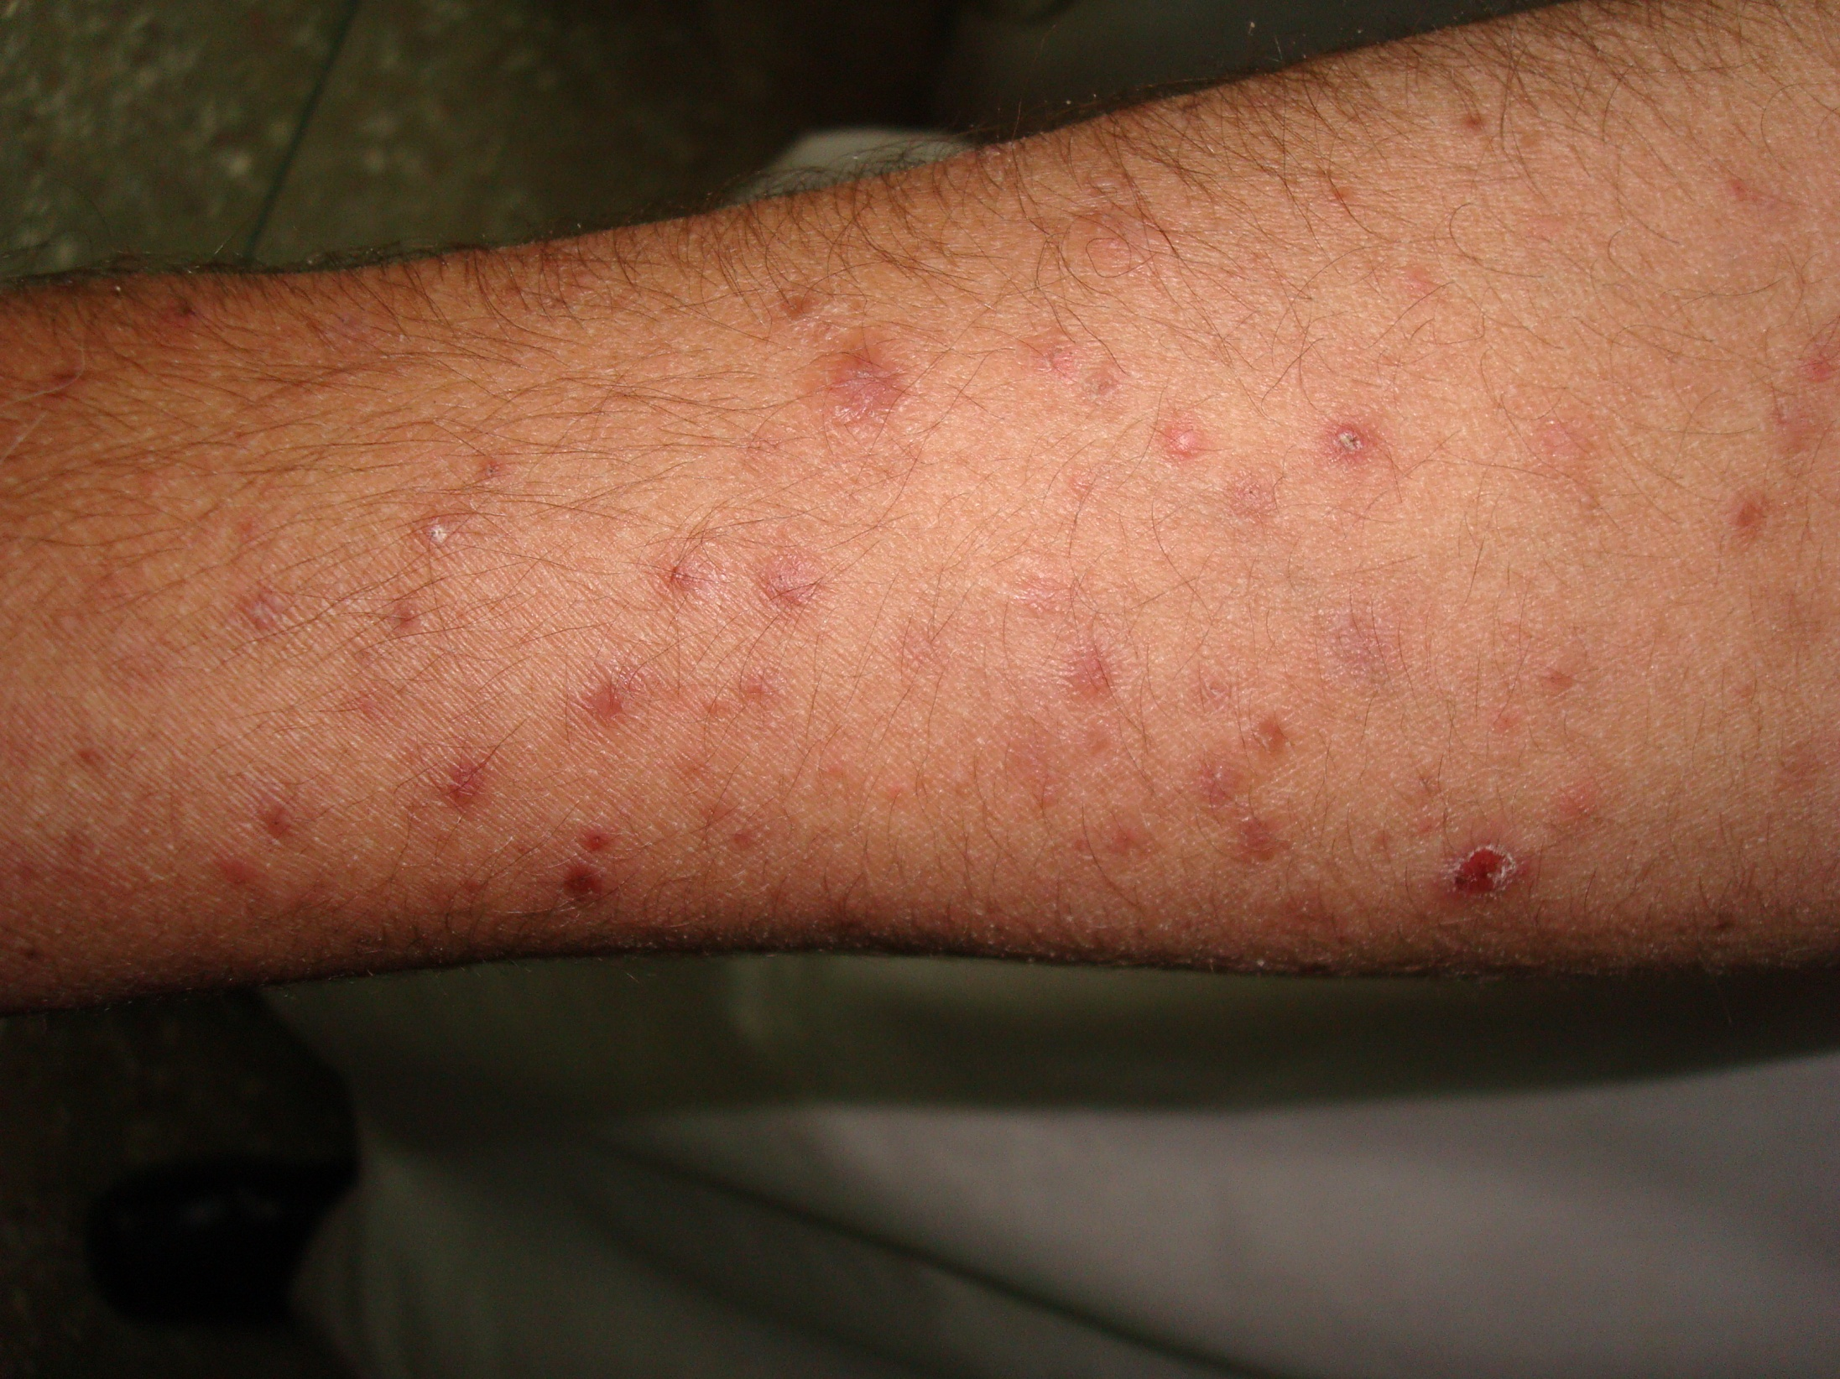
Likely diagnosis
Notes:
PLEVA (recurrent polymorphic papules in 14-yr-old )

Slide 17
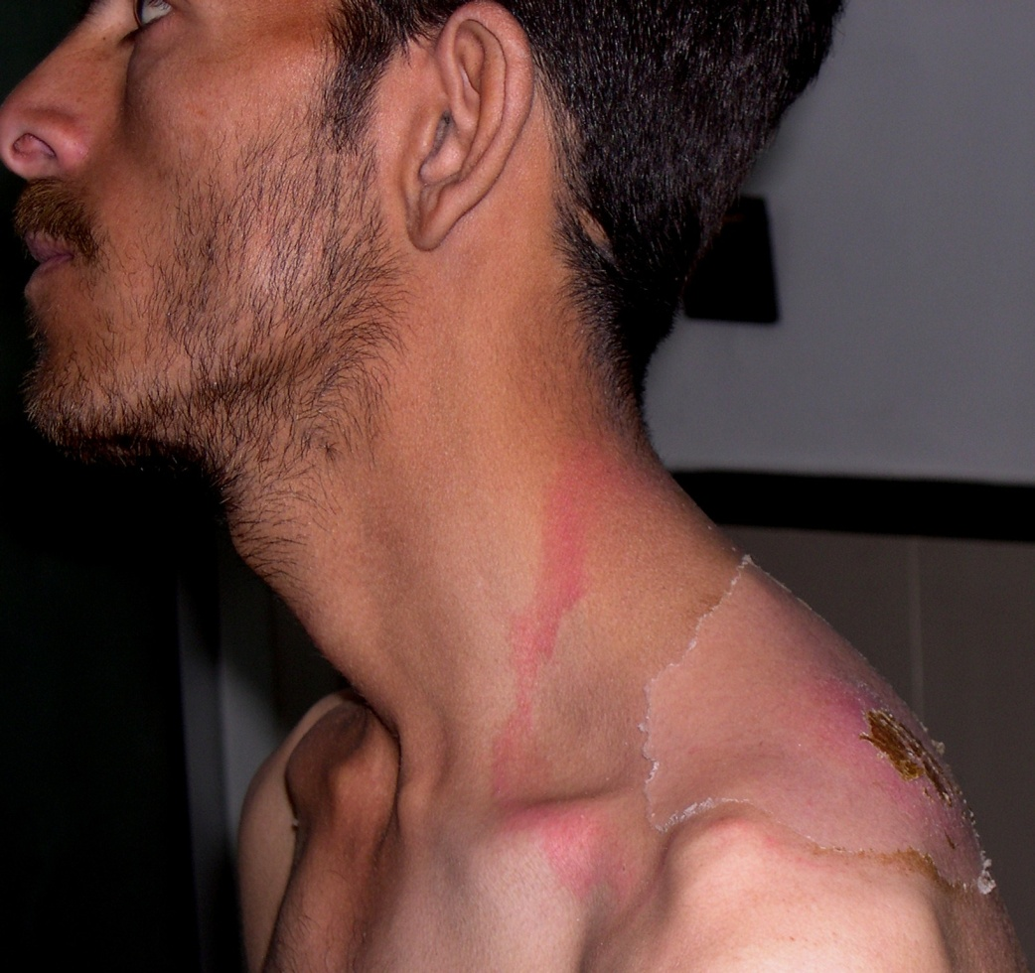
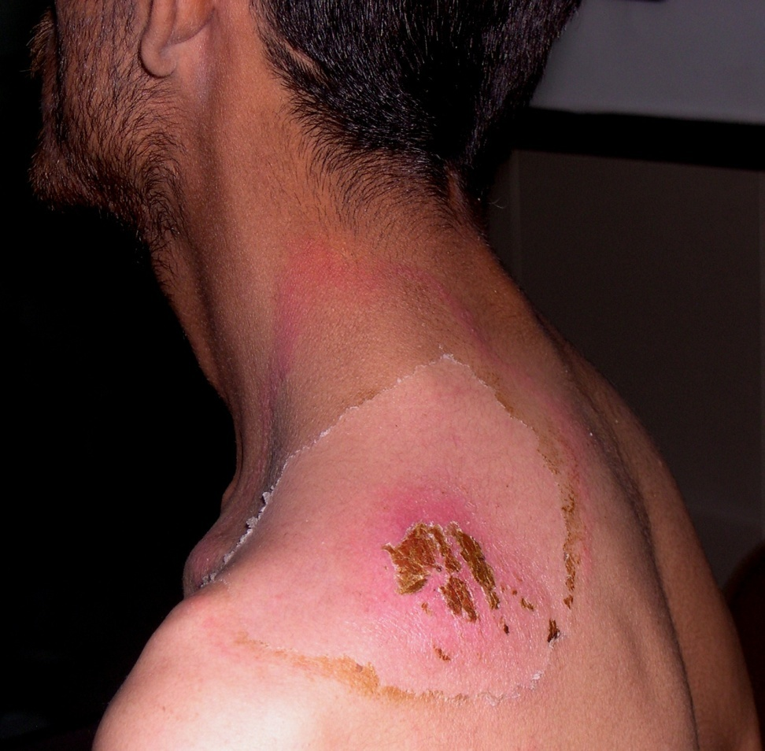
Likely diagnosis
Notes:
Insect bite

Slide 18
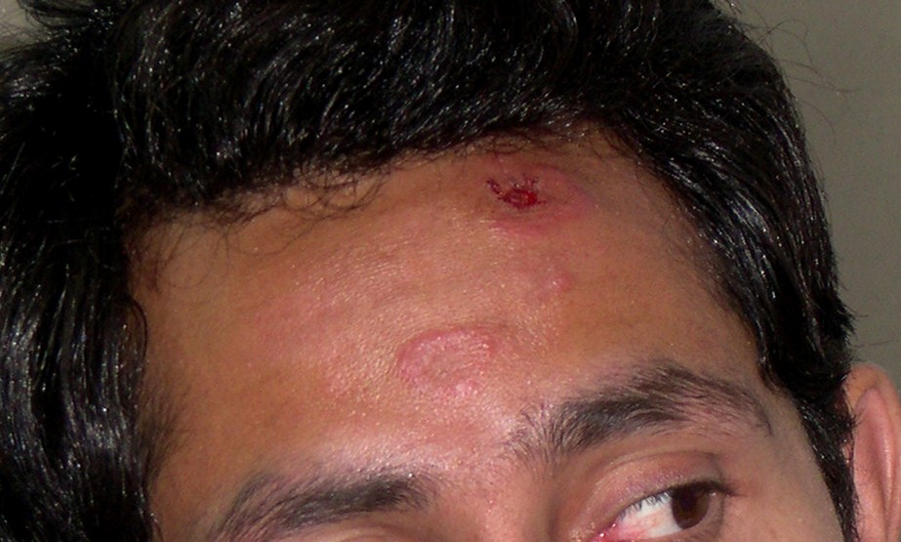
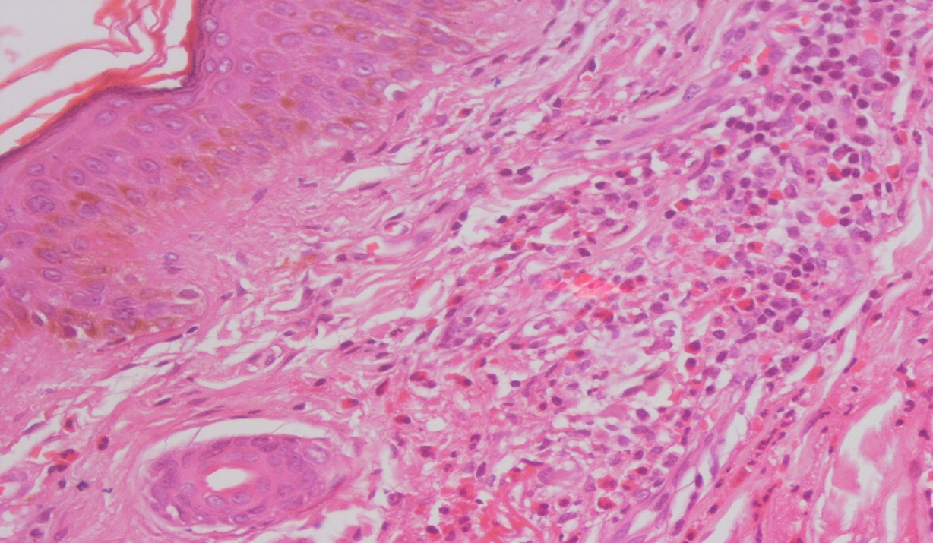
Likely diagnosis
Notes:
Granuloma Faciale (mixed inflammatory infiltrate of lympho, neutrophils n eosinophils)

Slide 19
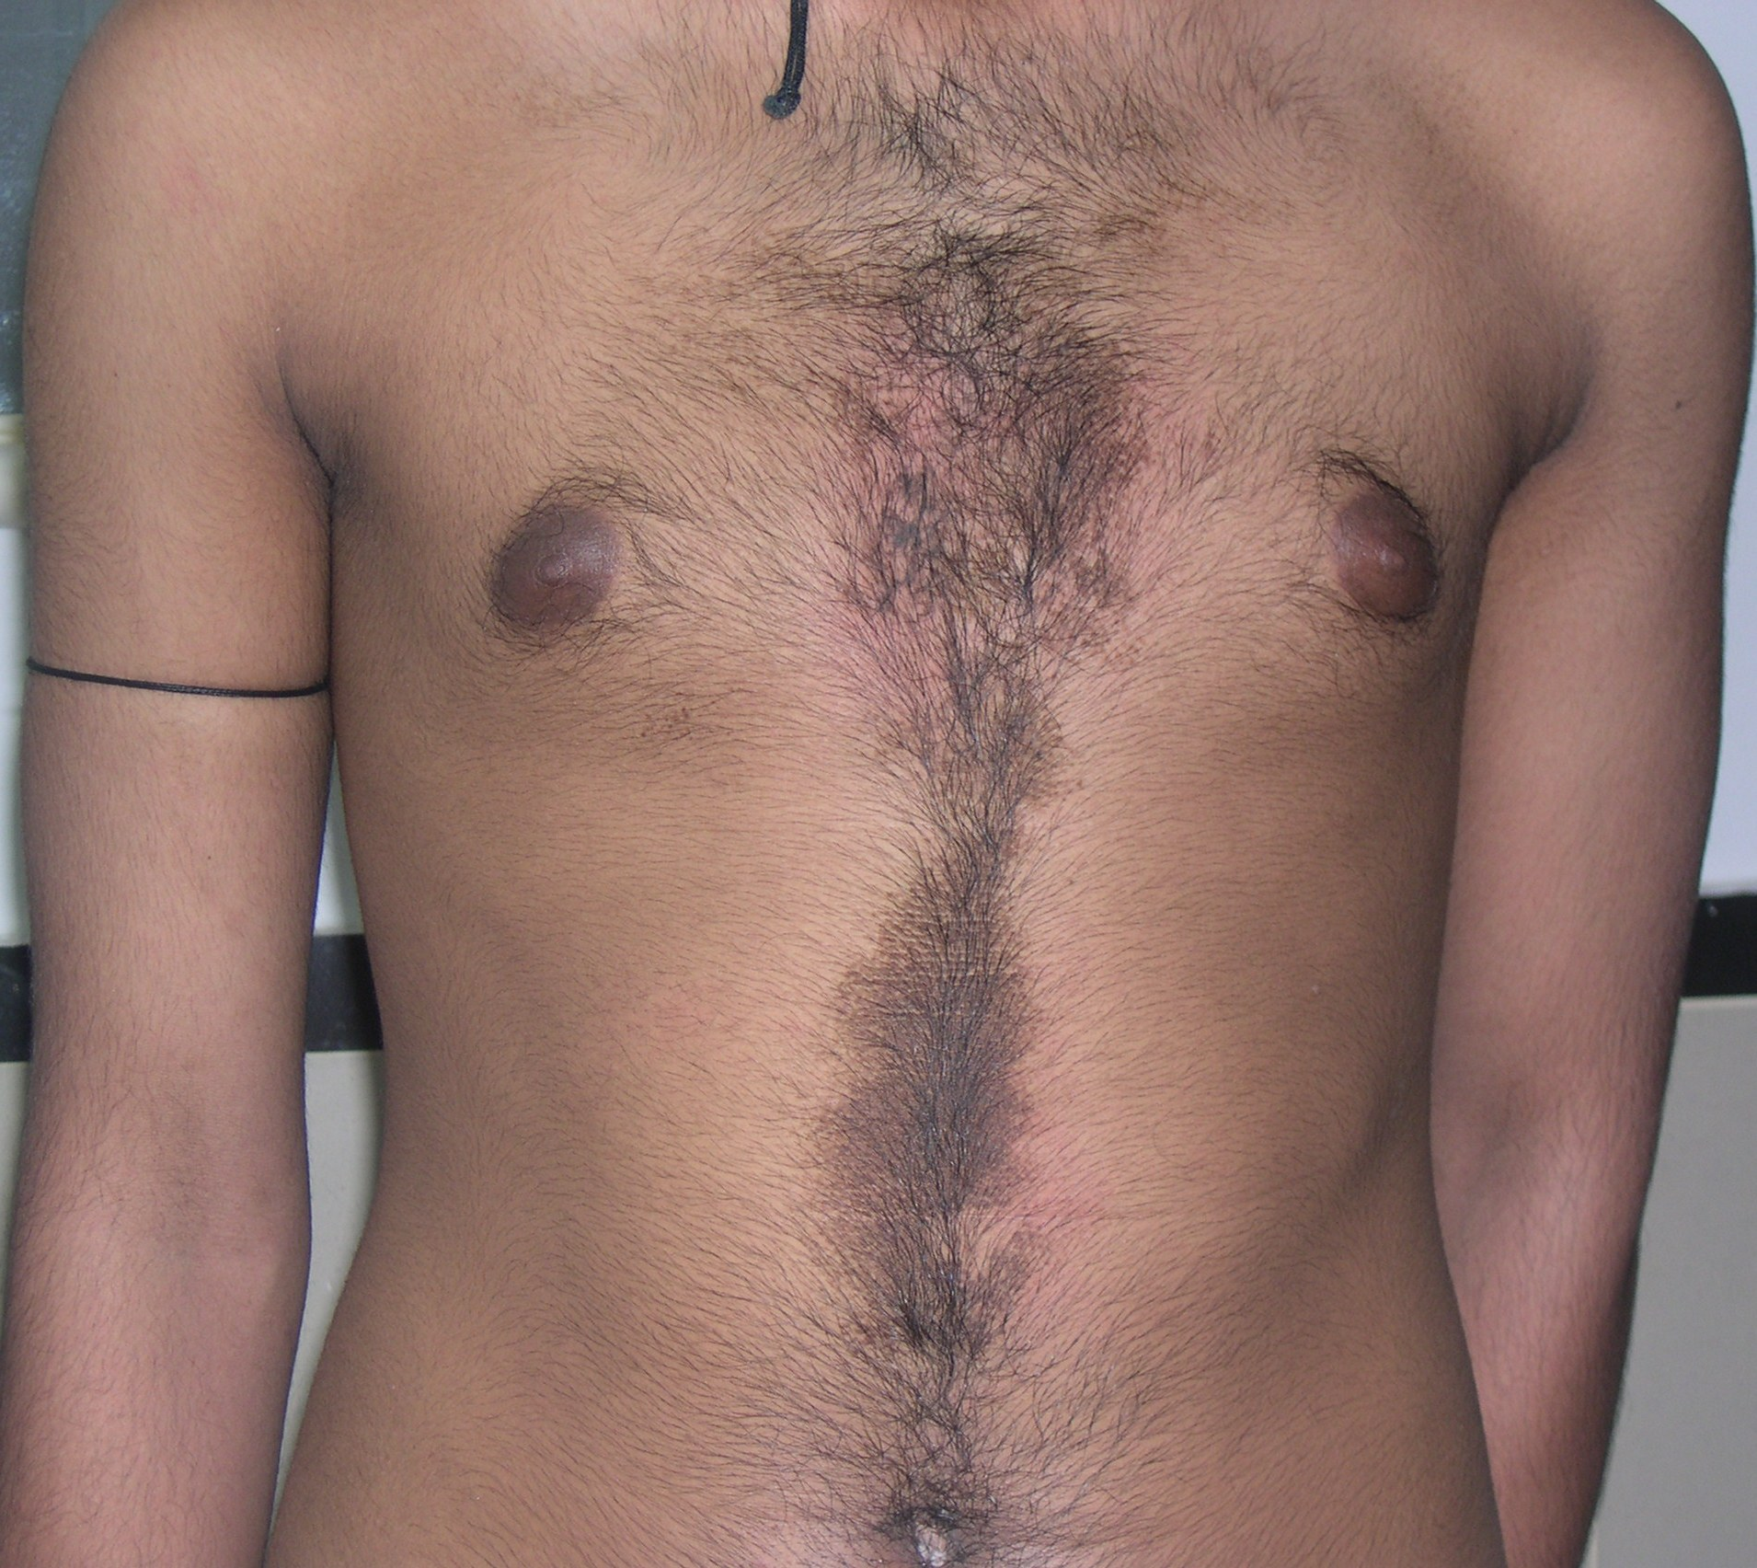
Likely diagnosis
Notes:
Dermatitis passivativa

Slide 20
