Slide 1
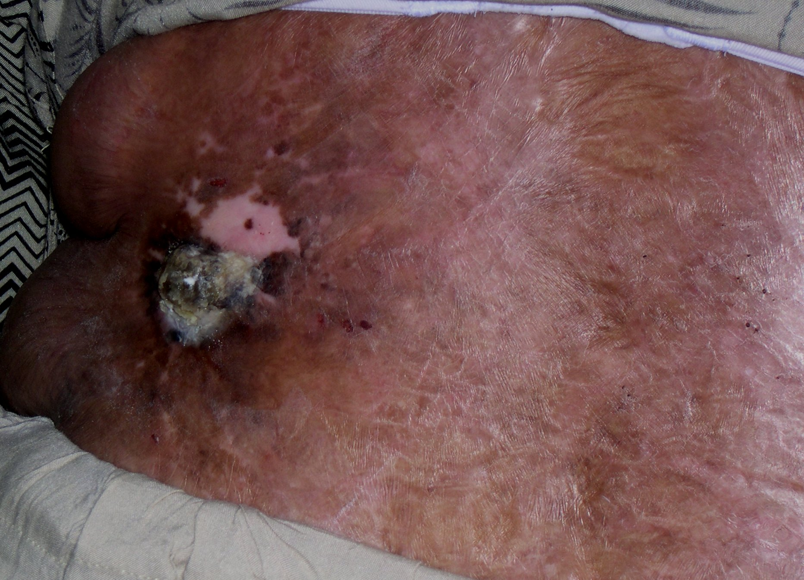
Likely Diagnosis
Notes:
Burn scar with cutaneous horn (can be SCC, keratosis)

Slide 2
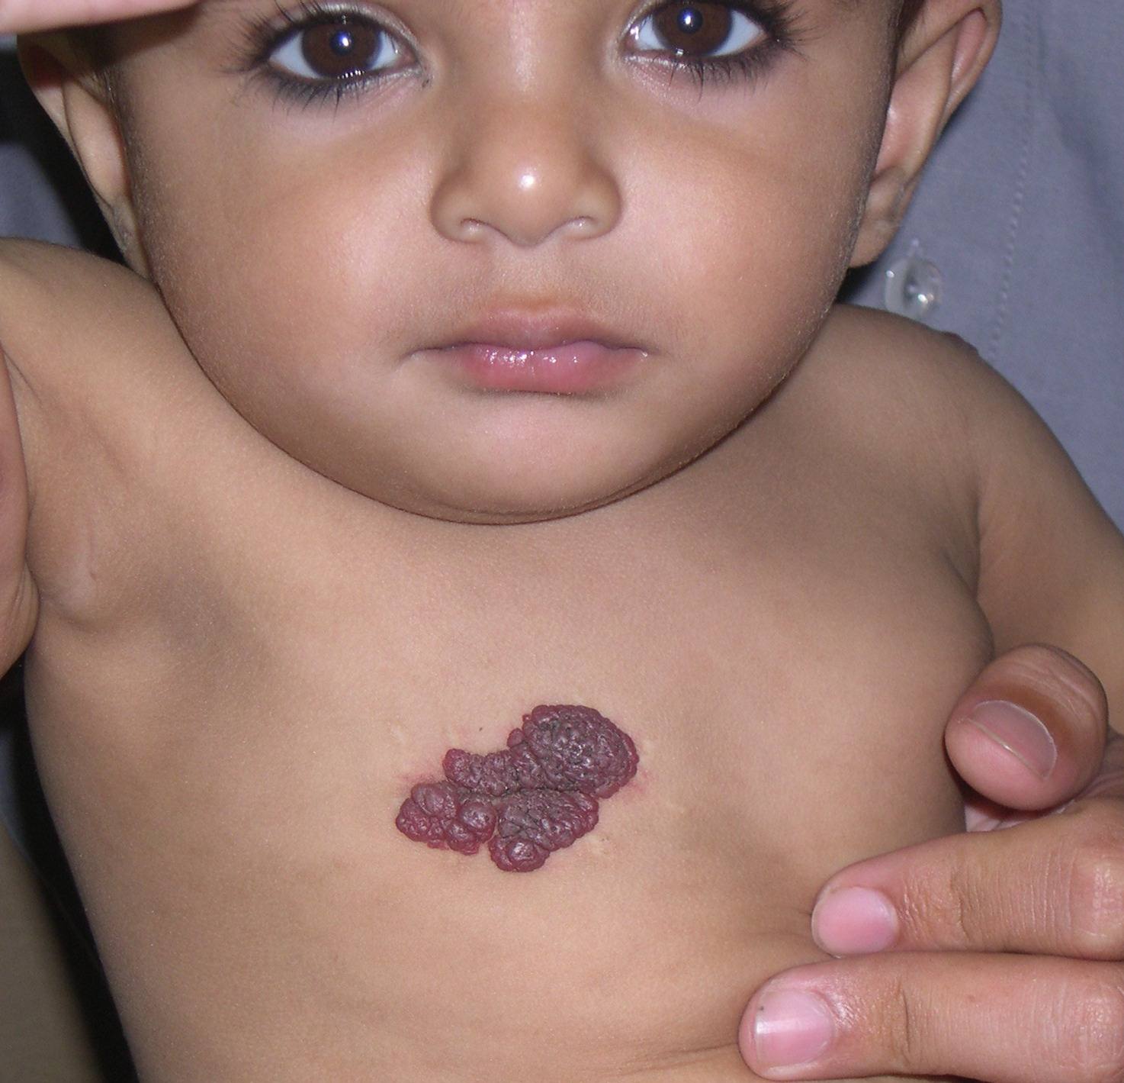
What single question will you ask that
will effect the prognosis .
Notes:
Whether it was present at birth or not? ( hemangioma)

Slide 3
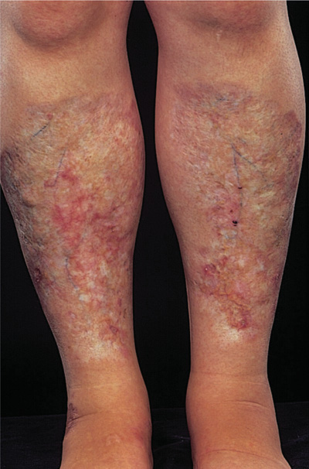
Likely Diagnosis
Notes:
Necrobiosis lipoidica

Slide 4
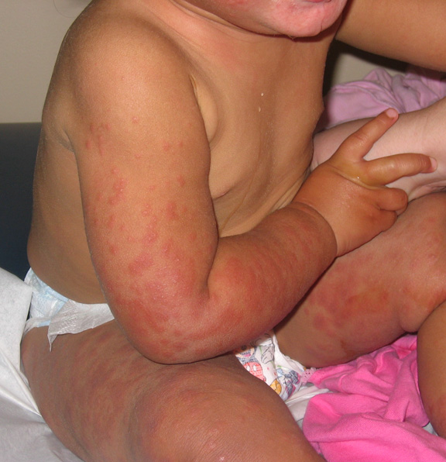
LikelyDiagnosis
Notes:
Gianotti crosti

Slide 5
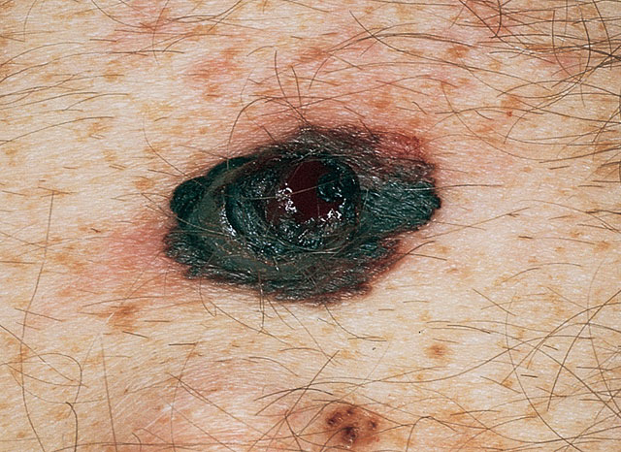
Diagnosis
Diagnosis
Notes:
Superficial spreading mlanoma with vertical growth

Slide 6
What is this?
Medical importance
Notes:
Flea

Slide 7
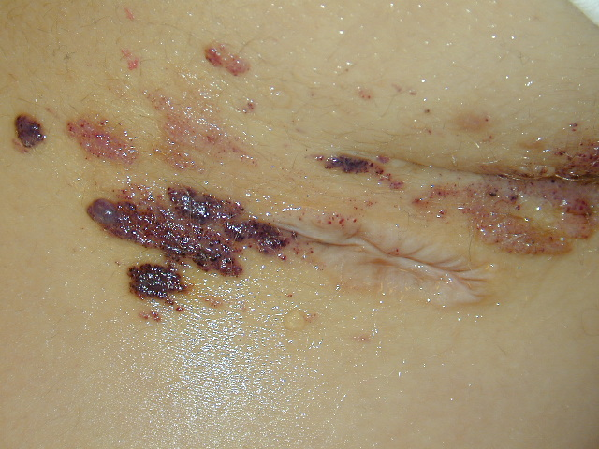
Diagnosis
Notes:
Lymphangioma circumscriptum

Slide 8
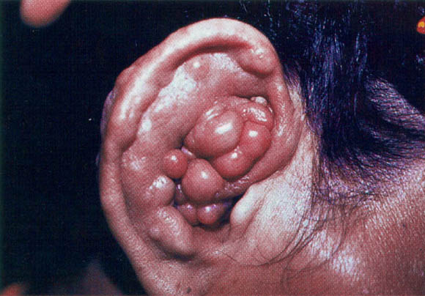
Diagnosis
Likely Diagnosis
Notes:
Kimura

Slide 9
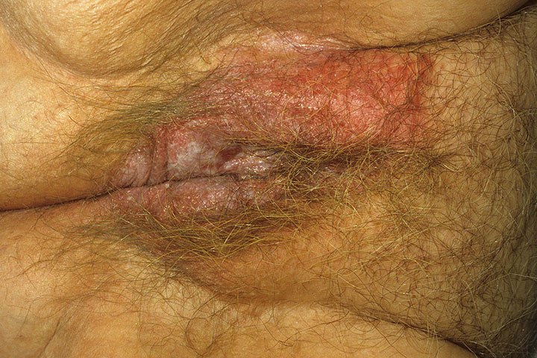
Likely Diagnosis
Notes:
Extramammary pagets (D/D candidiasis, hailey hailey)

Slide 10
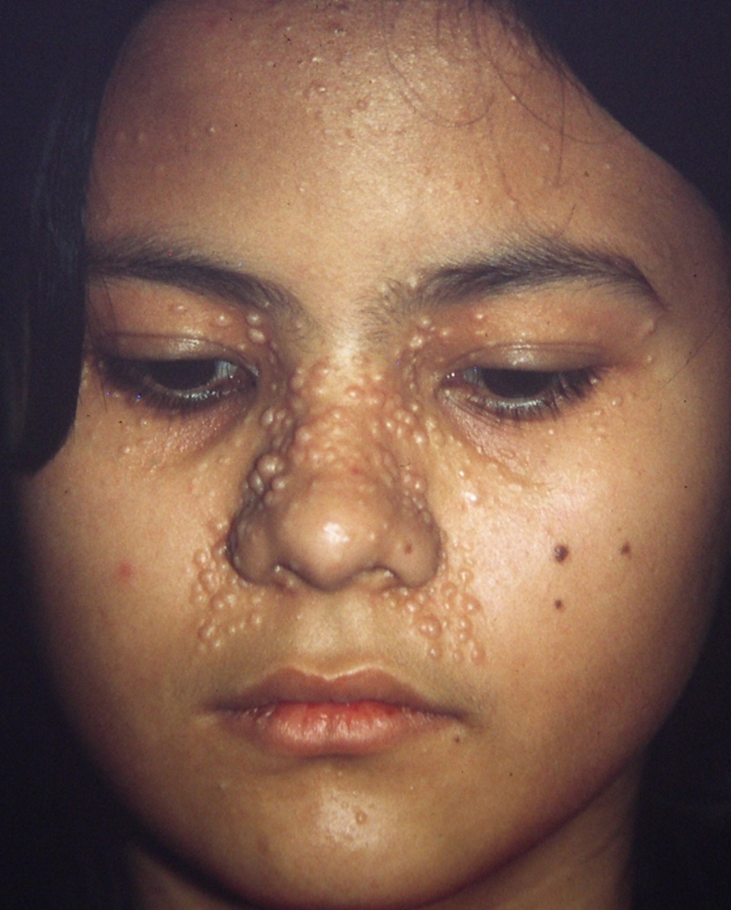
Diagnosis
Notes:
trichoepithelioma

Slide 11
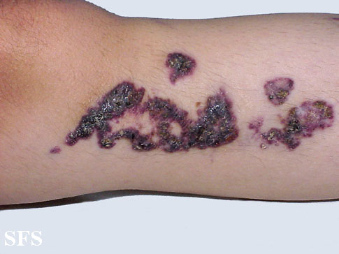
Diagnosis
Notes:
Angiokeratoma circumscript

Slide 12
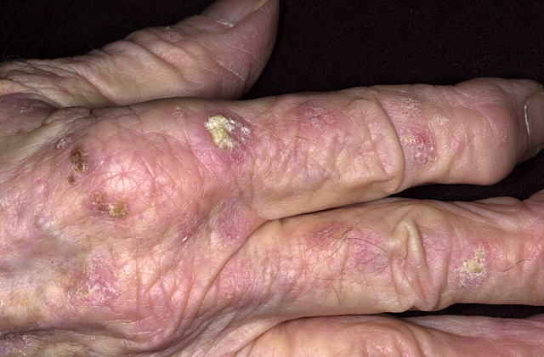
Diagnosis
Notes:
Actinic keratosis

Slide 13
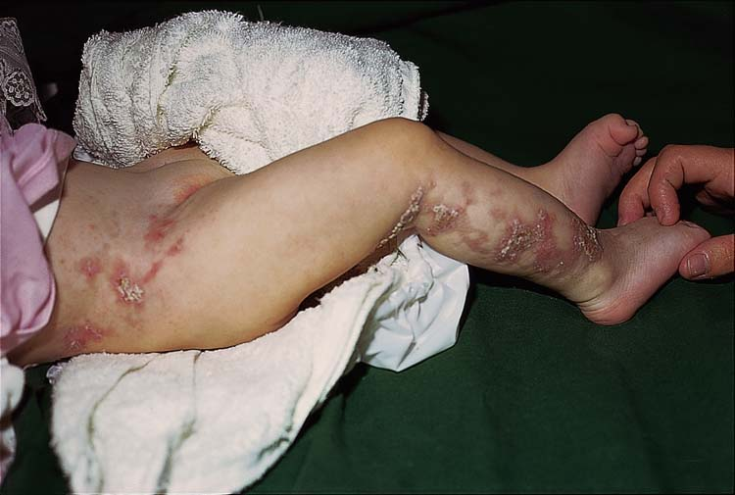
Diagnosis
Notes:
Incontinentia pigmenti

Slide 14
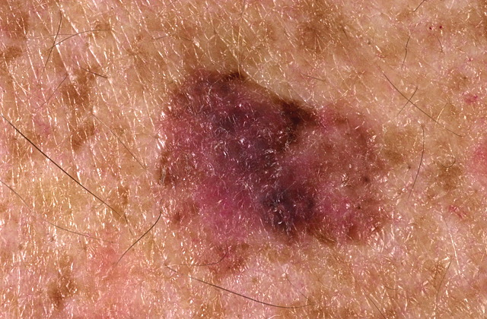
Differential Diagnosis
Notes:
Lentigo maligna melanoma, dysplastic naevus, superficial spreading BCC, Bowens disease

Slide 15
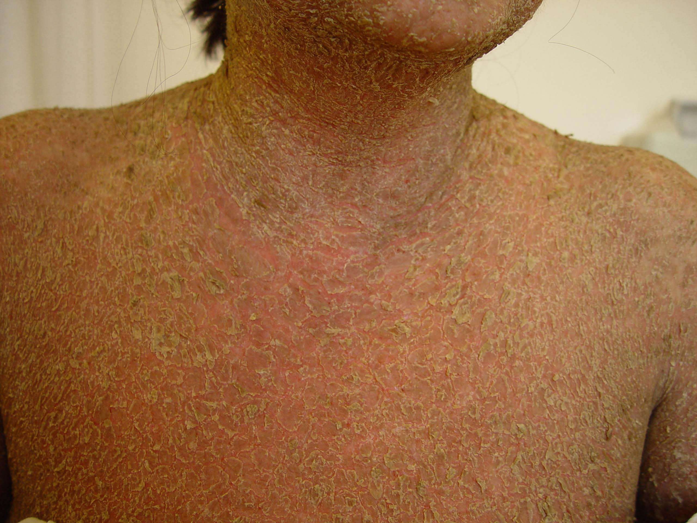
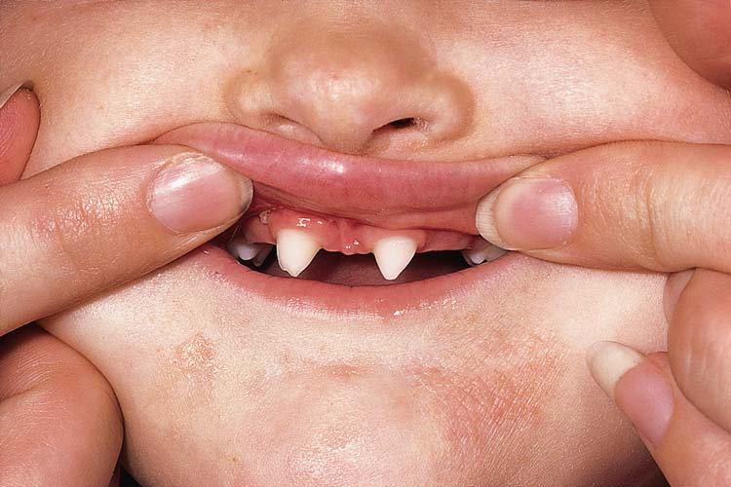
Differential Diagnosis
Notes:
Non bullous icthyosiform erythrodema, P. foliacous

Slide 16
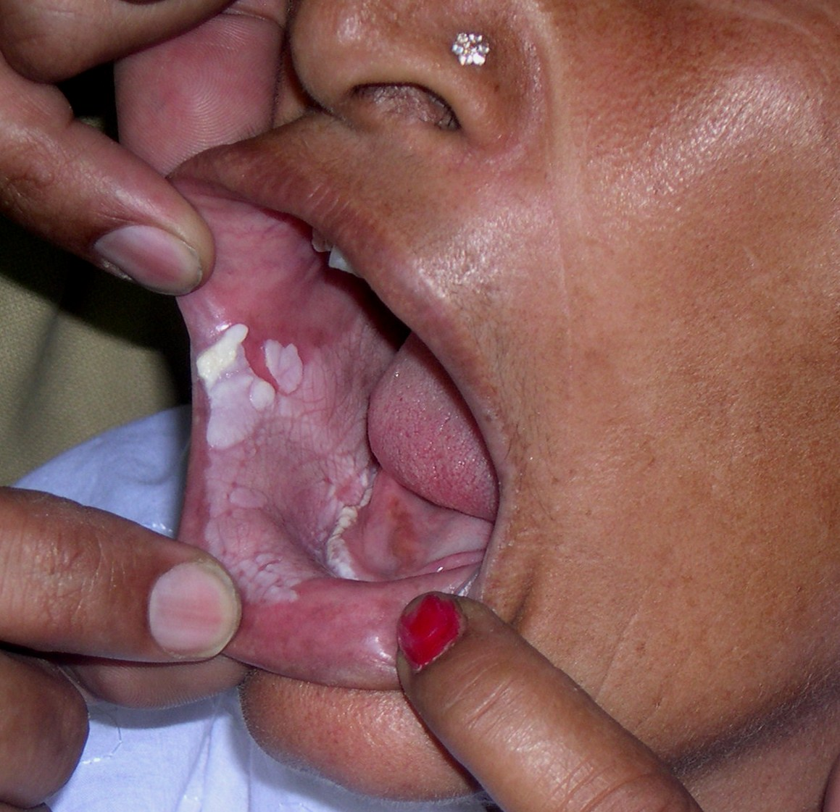
Differential diagnosis
Notes:
White sponge naevus, X disease

Slide 17
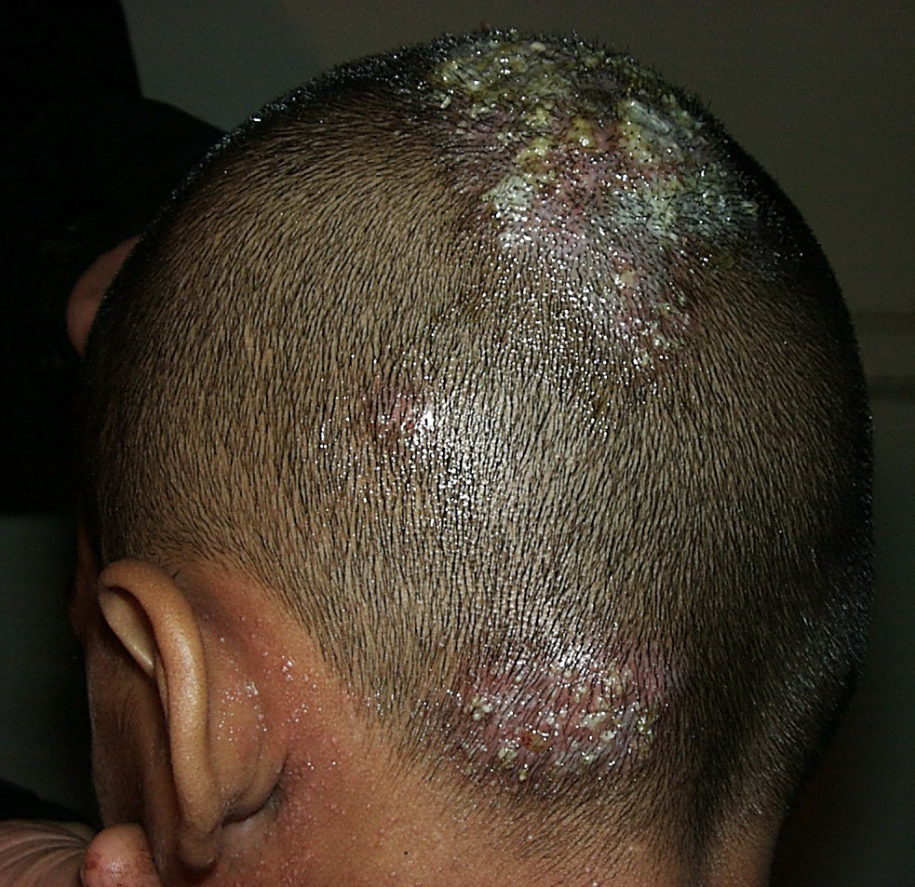
Likely Diagnosis
Notes:
kerion

Slide 18
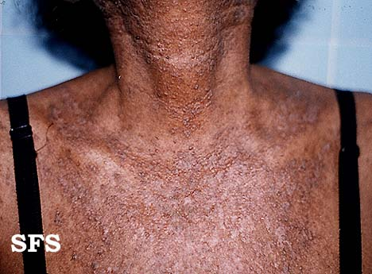
Likely Diagnosis
Notes:
Dariers disease

Slide 19
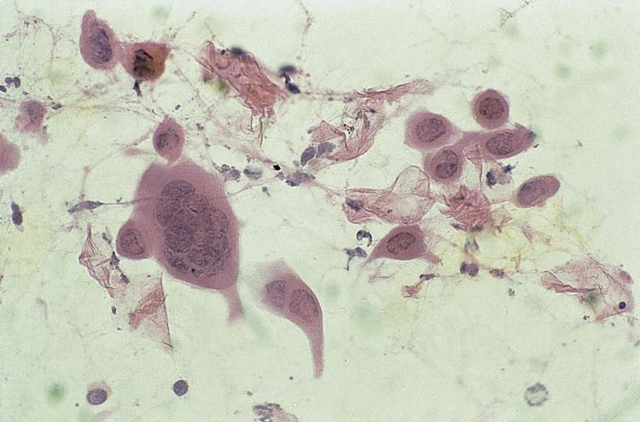
Diagnosis
Notes:
Herpes virus – tzank smear

