Slide 1


Slide 2
SURFACE ANATOMY OF FACE &
DERMAL FILLERS
Rheology & Injection Techniques
DR WAJIEHA SAEED
Associate Professor Dermatology

Slide 3
OUTLINE
Essential anatomy of face, important vessels, ligaments & fat compartments
Vascular danger zones of face
Types of dermal fillers
Rheology of fillers
How to choose ideal filler
Facial Assessment

Slide 4
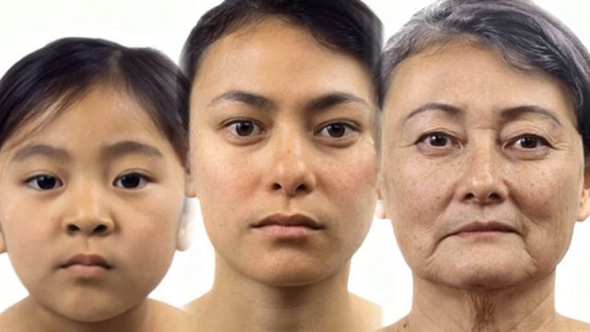

Slide 5
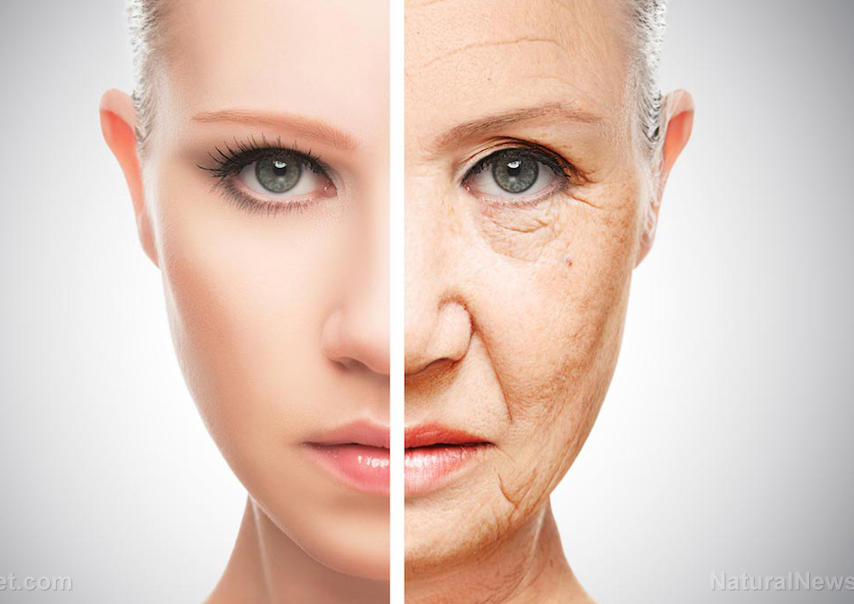

Slide 6
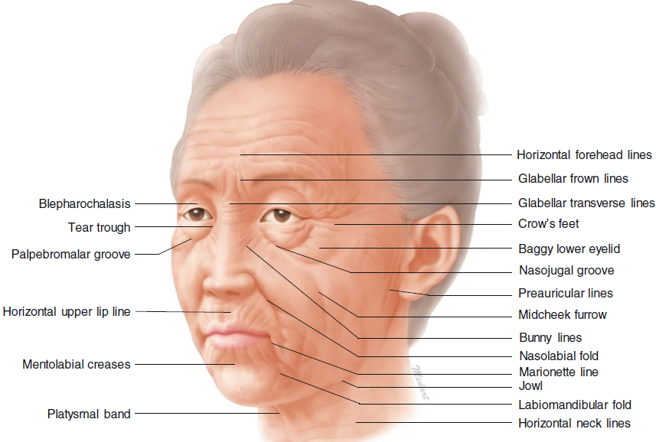

Slide 7
ANATOMICAL LAYERS OF SKIN

Slide 8
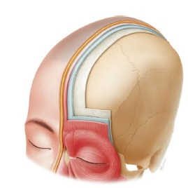

Slide 9
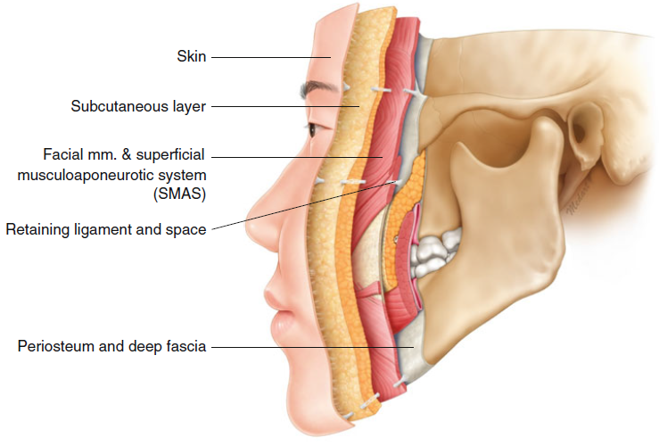

Slide 10
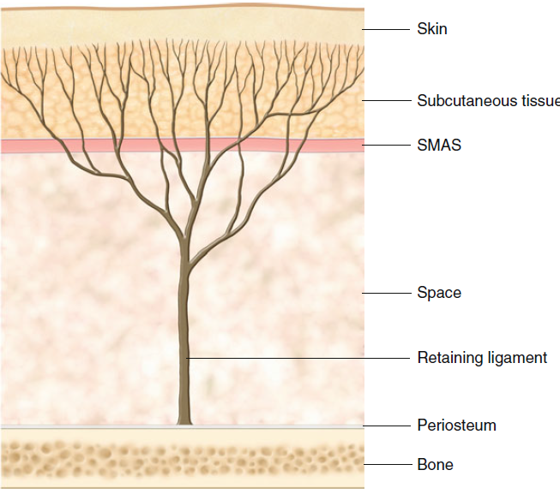

Slide 11
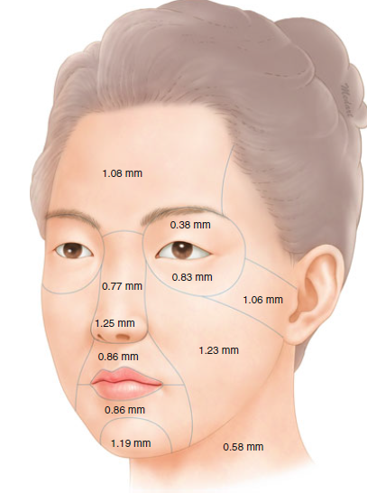

Slide 12
FAT COMPARTMENTS & LIGAMENTS

Slide 13
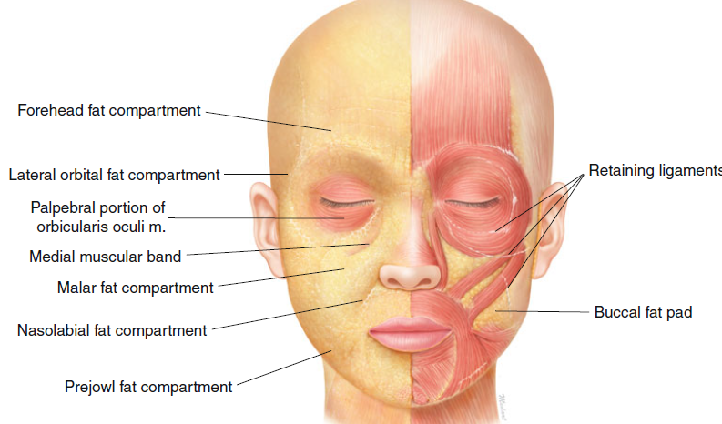

Slide 14
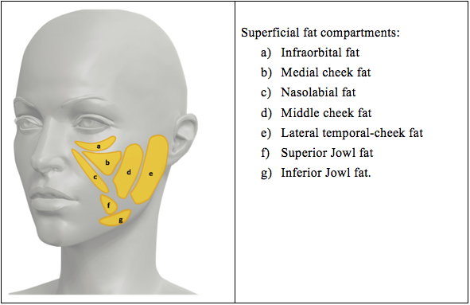

Slide 15
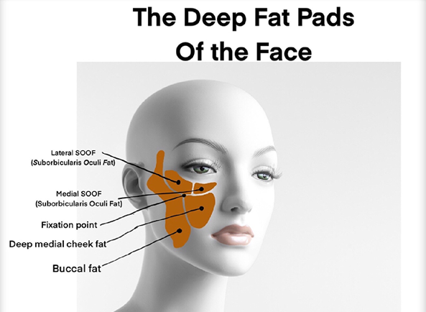

Slide 16
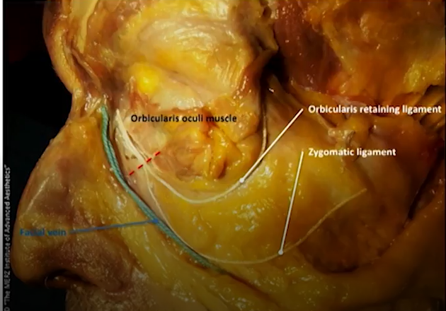

Slide 17
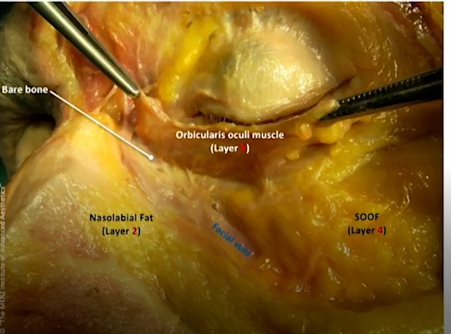

Slide 18
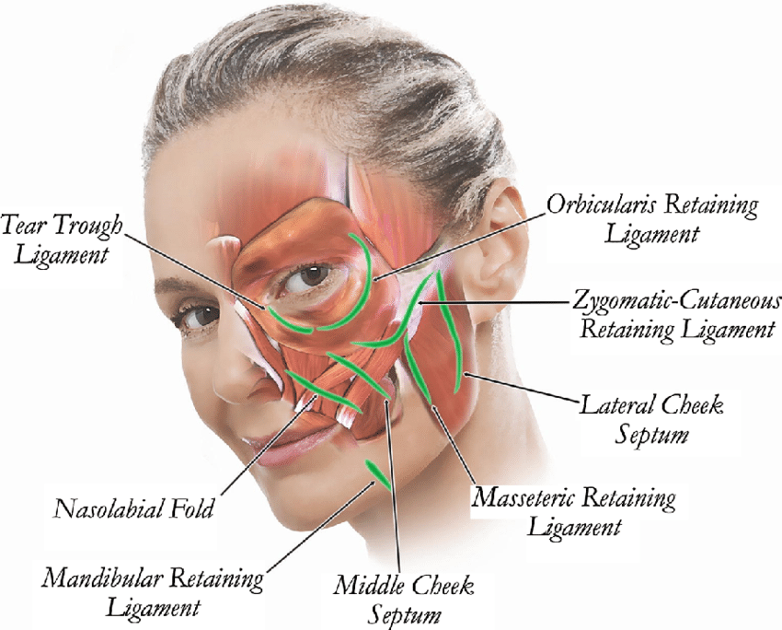

Slide 19
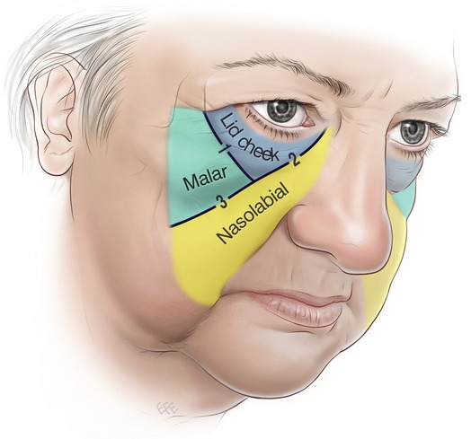

Slide 20
NERVE SUPPLY OF FACE

Slide 21
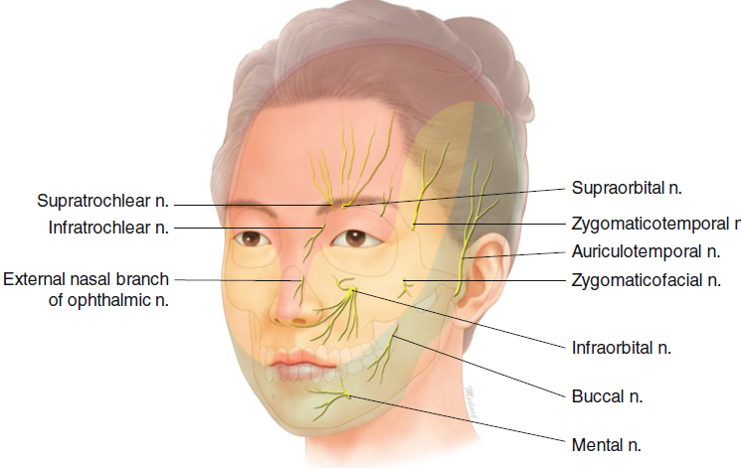

Slide 22
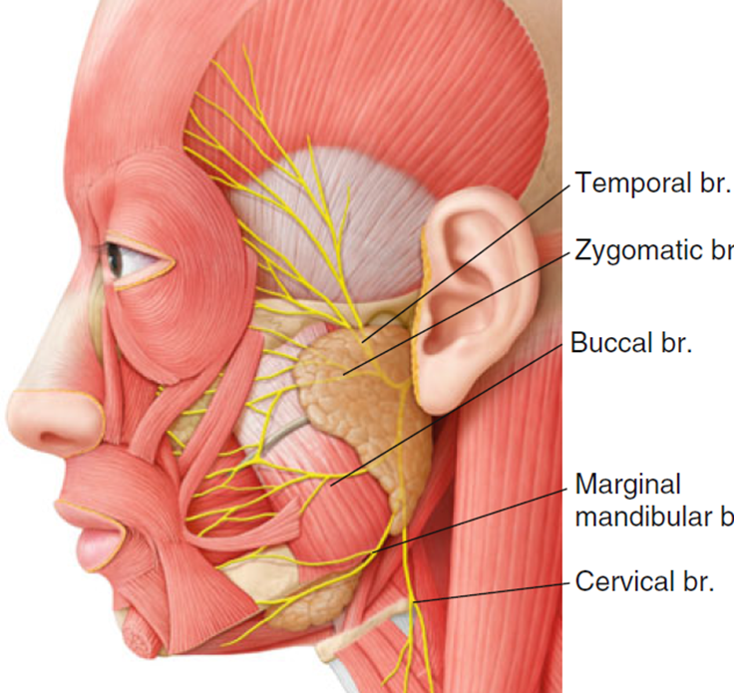

Slide 23
VASCULAR SUPPLY OF FACE

Slide 24
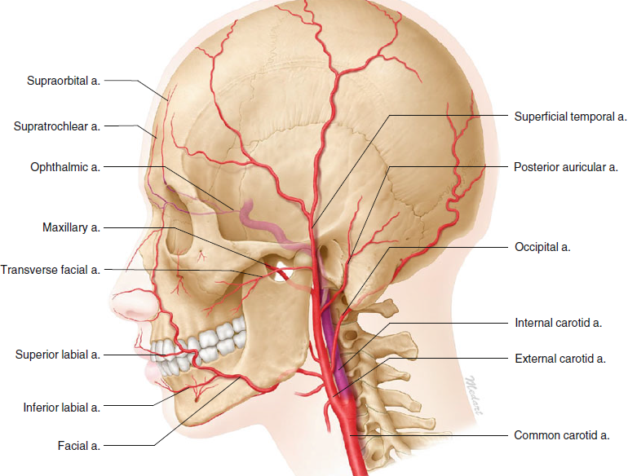

Slide 25
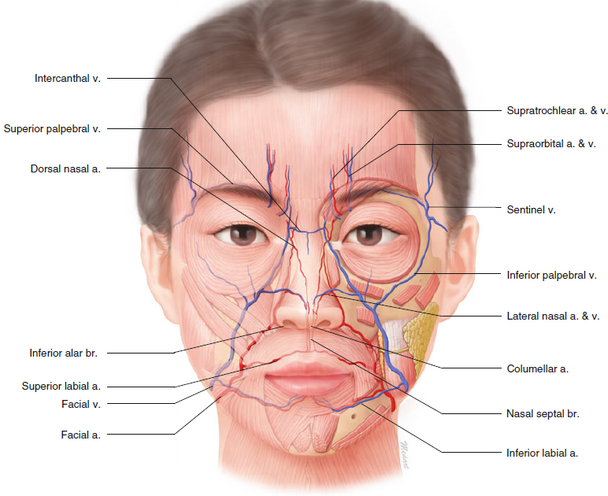

Slide 26
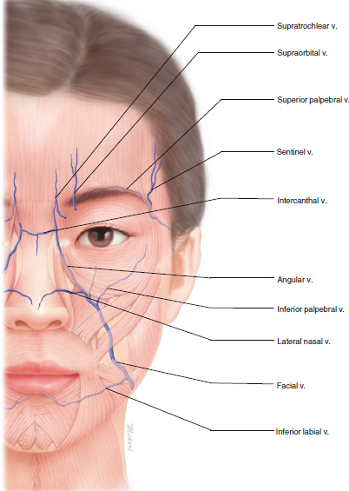

Slide 27
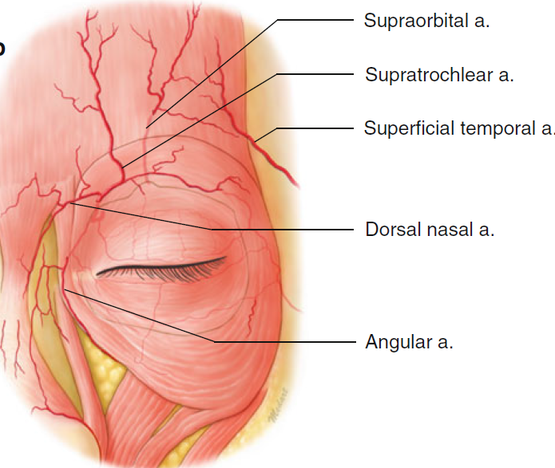

Slide 28
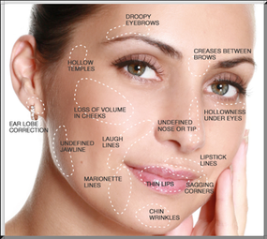
Areas Where Dermal Fillers Can Be Injected

Slide 29
VASCULAR DANGER ZONES OF THE FACE

Slide 30
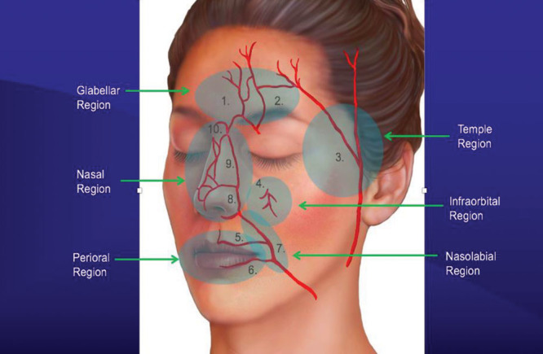

Slide 31
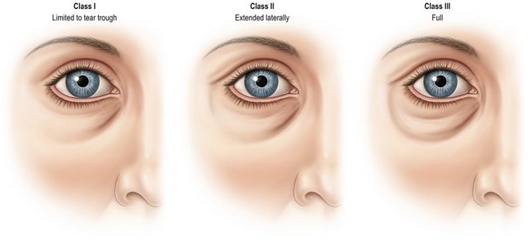

Slide 32
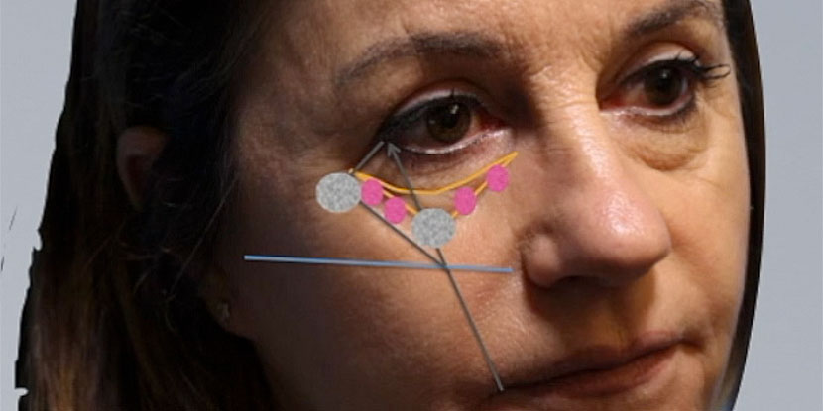

Slide 33
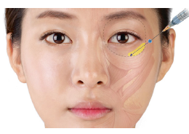
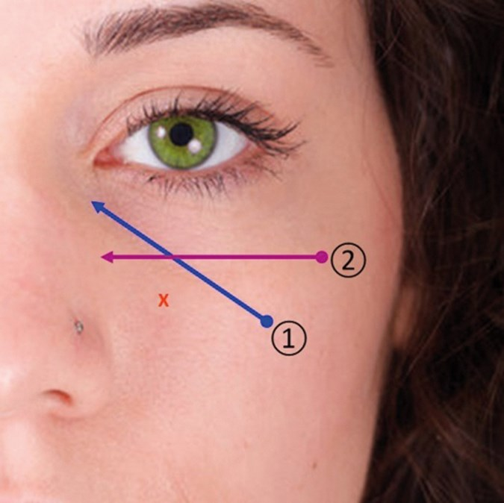
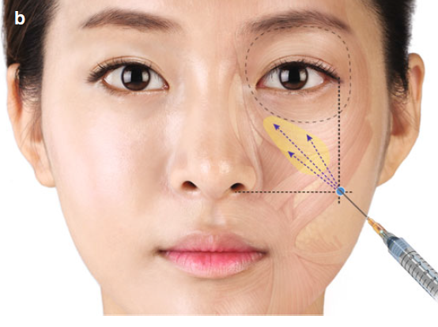

Slide 34
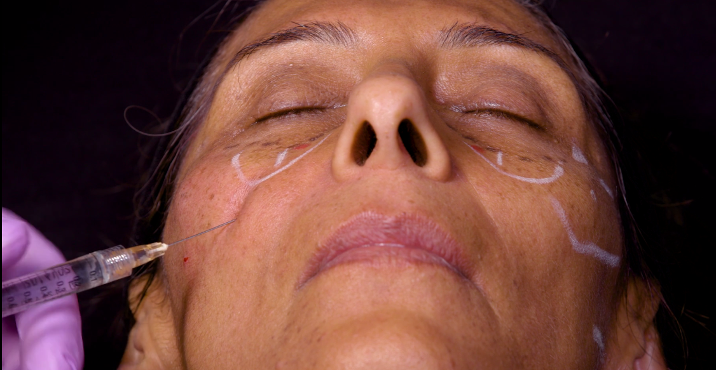

Slide 35

BE AWARE
Volume replacement can correct concavity but cannot correct pigmentation of skin

Slide 36
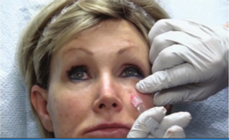
Medial one-third of tear trough:
Deep plane, from inferior/ lateral direction, small amount, cross-hatching technique or small bolus
Lateral two-third:
Deep plane, from lateral direction, retrograde liner or serial puncture or inferolateral direction with cannula in subcut plane
Within one finger breath below infra-orbital rim

Slide 37
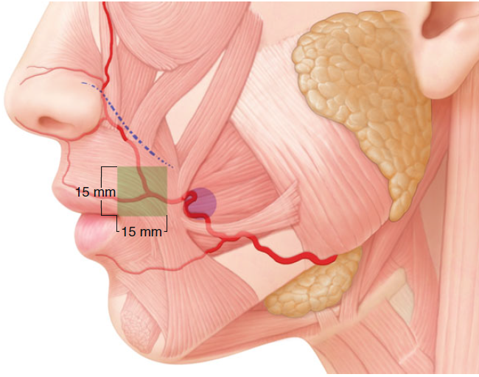

Slide 38
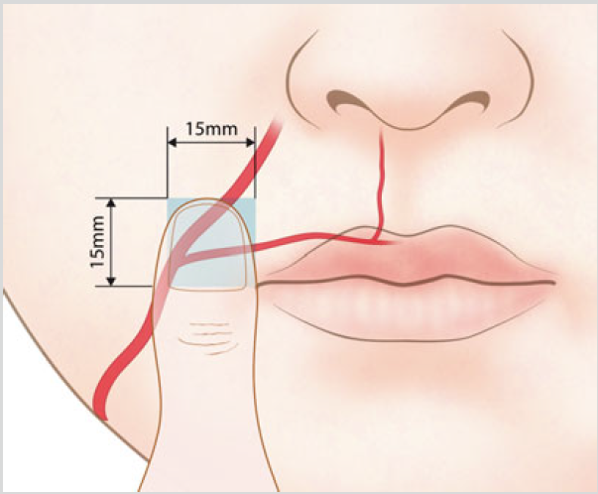

Slide 39
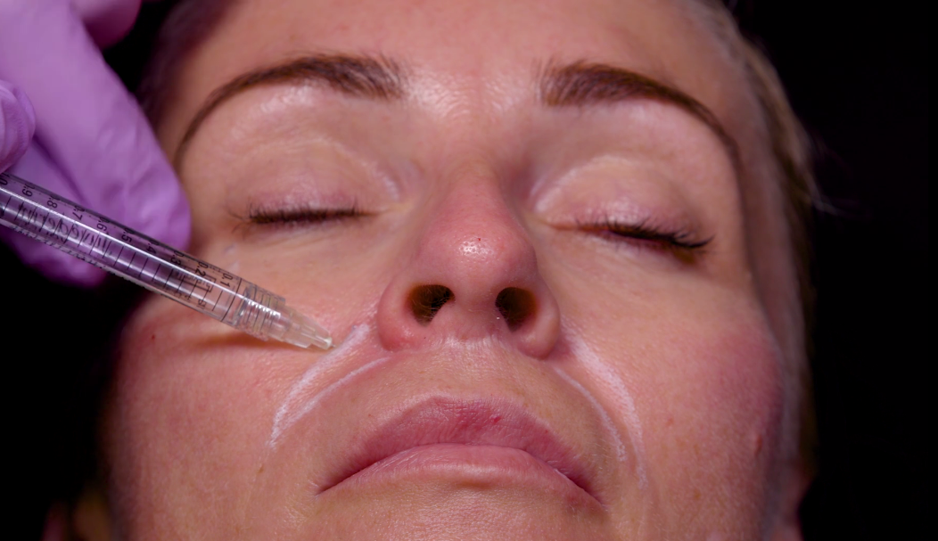

Slide 40
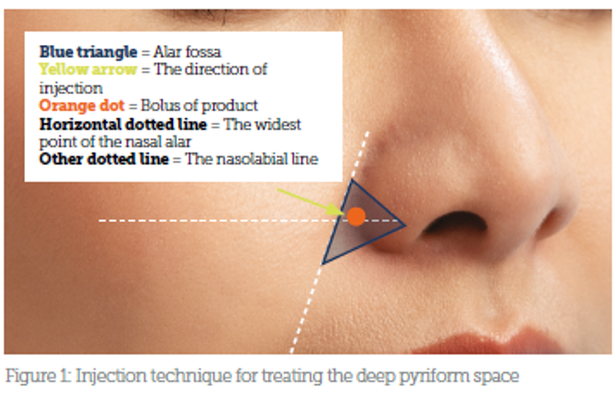

Slide 41
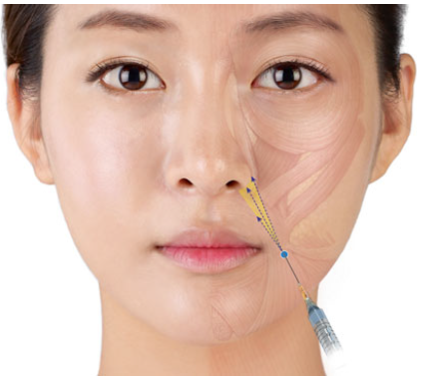

Slide 42
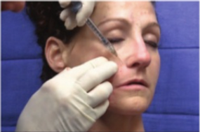
Upper one-third:
Deep plane, 1 finger breath lateral to ala or
very superficially, from lateral side
Lower two-third:
Superficial plane, from medial side,
retrograde linear thread technique

Slide 43
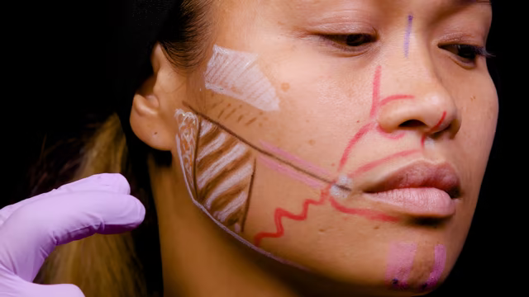

Slide 44
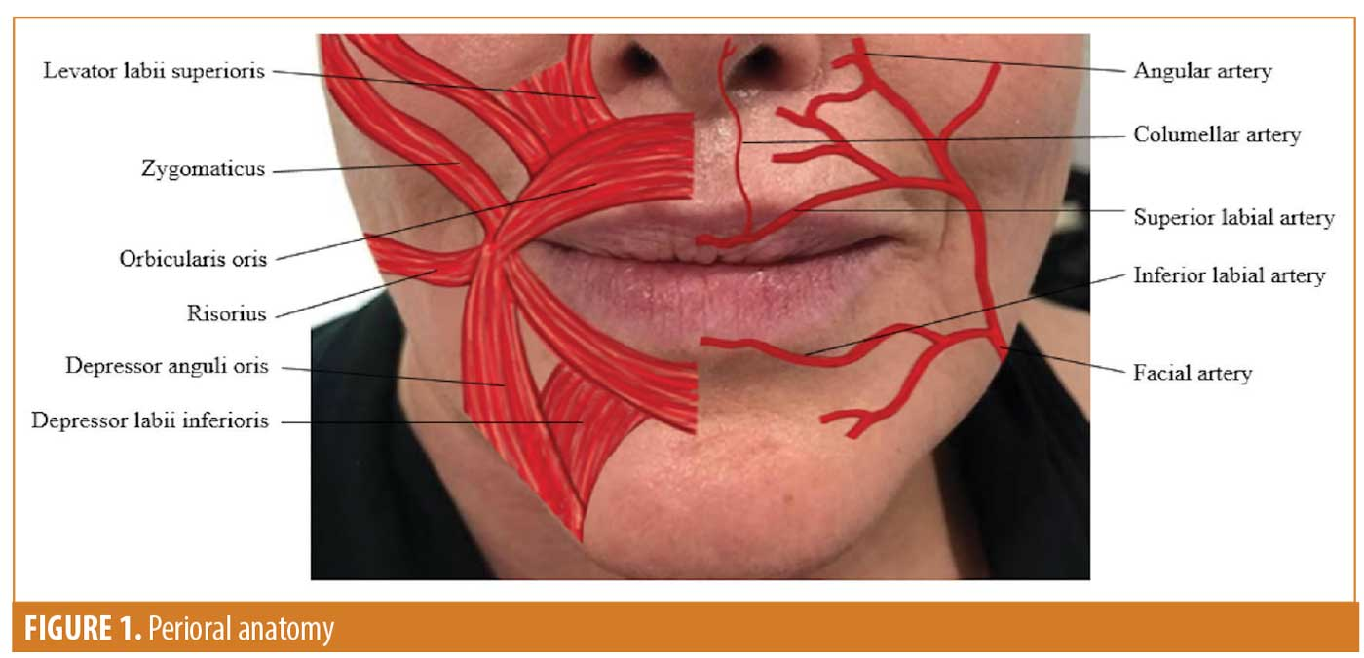
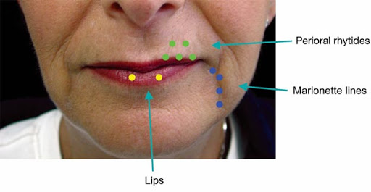
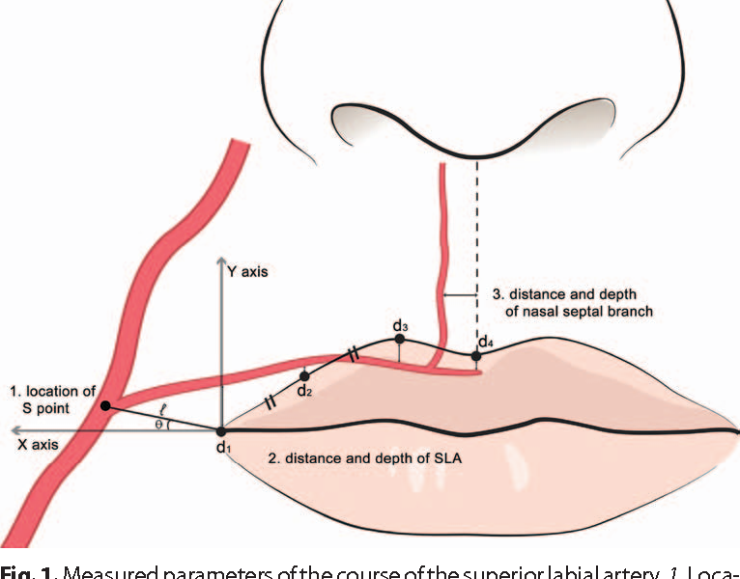

Slide 45
At Vermilion:
Inject in subcutaneous or superficial muscular plane
Linear retrograde threading
Staying more superficial in central lip
At corner of mouth/ oral commissure:
Superficial
Within 1 thumb-width from corner

Slide 46
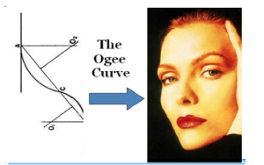
OGEE CURVE
The aesthetic goal is that this region keeps a natural “shadow” to the midface to highlight the cheek apex and maintain the ogee curve

Slide 47
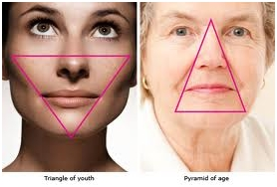

Slide 48
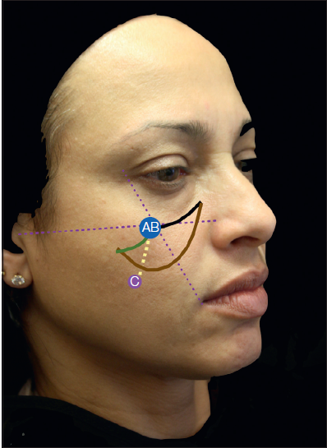

Slide 49
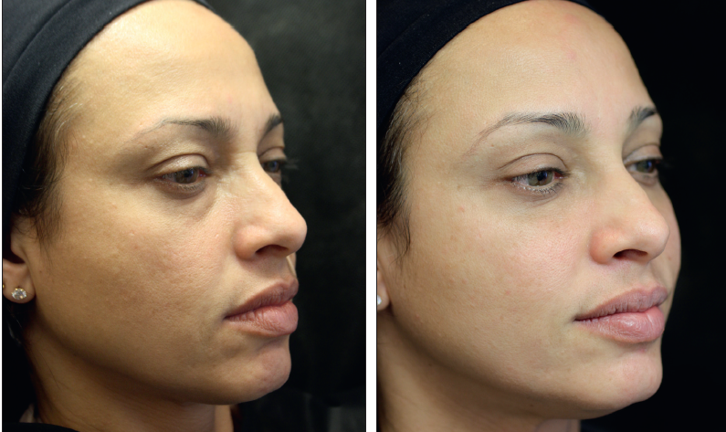

Slide 50
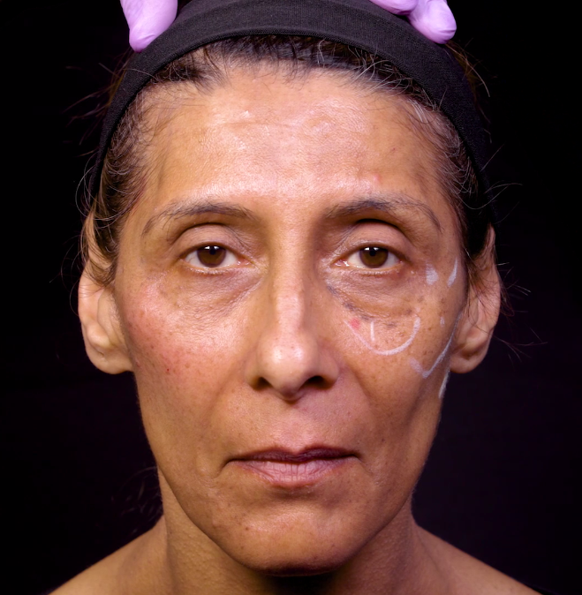

Slide 51
SOFT TISSUE FILLERS

Slide 52
INTRODUCTION
Substances used for soft tissue augmentation to enhance or replace volume
Effective tool in rejuvenation, either as a stand-alone treatment or in combination with other procedures

Slide 53
TYPES OF FILLERS
Fillers can be classified based on different criteria:
Based on longevity
Based on site of placement
Based on origin of filler material

Slide 54
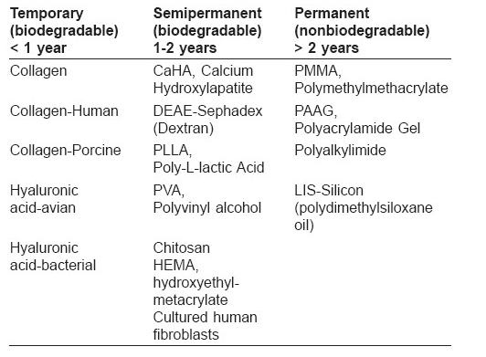

Slide 55
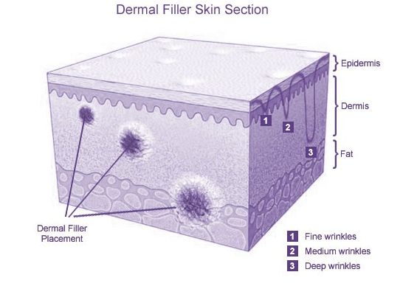

Slide 56
Based on origin of filler material
Heterografts:
(a) Bovine collagen- zyderm 1 and 2
zyplast
restoplast
artecoll
(b) Hyaluronic acid derivative implant- restylane
perlane
hylaform
dermalive
reviderm intra
(c) Porcine collagen- permacol
fibrel

Slide 57
Allografts : human derived collagen
dermalogen
alloderm
cosmoderm
Autograft: autologous fat
autologous collagen
Synthetic material: polytetrafluoroethylene
silicone
biopolymer 3
bioplastique

Slide 58
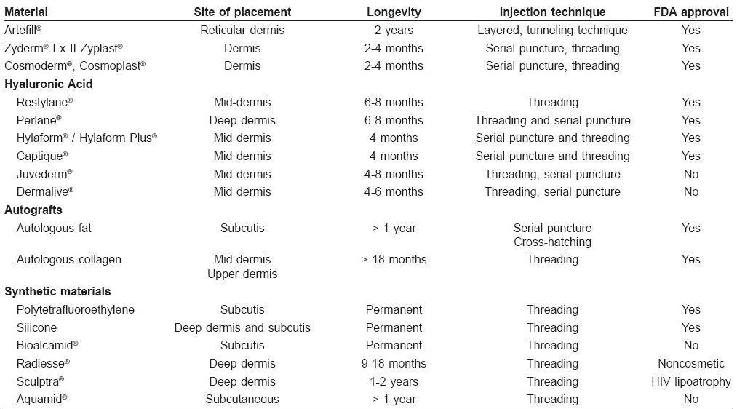

Slide 59
IDEAL INJECTABLE FILLER
Effective
Easy
Painless to inject
Feels natural
Nontoxic
Nonreactive
Non-carcinogenic
Non-immunologic
Low incidence of adverse events
Long-lasting

Slide 60
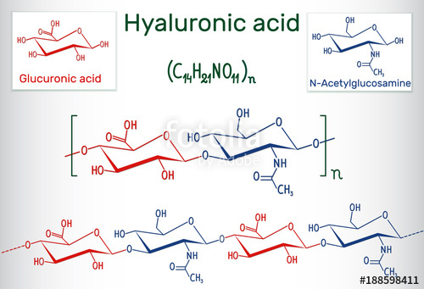
What is HA?
Disaccharide
No protein component , no potential for immunologic reaction

Slide 61
Where is it ?
ECM
­­15­g ­of ­hyaluronan­ in body,­ 1/3 is­ degraded­ &­ synthesized daily
50% …. in skin
Half-life is ­1 ­to ­2 ­days
Metabolized ­by the­ liver­ to­ carbon­ dioxide­ and­ water

Slide 62
Behavior ….Hydrophilic
Polyanionic polymer …highly charged
Soluble
High moisturizing power, 20mg HA can hold 10 gm of water
­Mechanism ­of­ action ­as ­a­ filler ­…hydration

Slide 63
PROPERTIES OF HA FILLER
6-12 months
Safe ­
Soft ­look
Predictable ­
Stable at room temperature
Single preloaded syringes
Good reversibility with hyaluronidase
Provide immediate lift
Easily injected through small gauge needles

Slide 64
RHEOLOGIC PROPERTIES
Molecular weight
Cross linking
Concentration
Modulus
  Viscous modulus
  Elastic modulus
Swelling
Particle size & extrusion force
Cohesivity

Slide 65
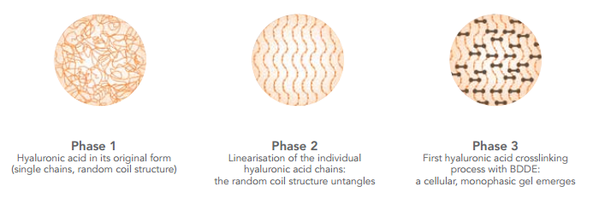
Why cross-linked?
Half life 1-2 days
Dissolve in water, behaves as a fluid
Excellent biocompatibility
Poor mechanical properties
Cross-linking improves mechanical properties by creating gels
Longevity ­
Degree­ of ­cross linking ­

Slide 66
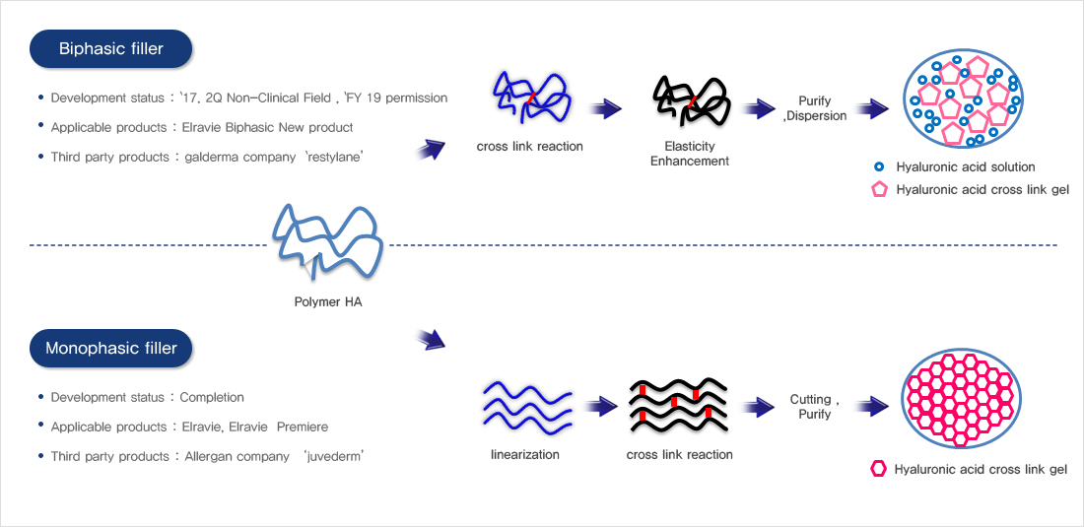
Monophasic vs Biphasic
  Homogeneous gels / Monophasic
  Suspensions of particles in gel carriers / Biphasic
Monophasic
Biphasic
Non-CL HA not added
Relatively longer duration of action
High cross linking ratio
Difficult to mold shape
Non-CL HA added
Disappear in 1-2 weeks
Big particle size
Low cross linking ratio
Easy to mold shape

Slide 67

Elastic modulus… G’ Prime
Firmness/hardness or softness of a gel
G’ represents the amount of stress required to produce a given amount of deformation
Modulus is affected by
  Degree of cross linking
  Concentration of gel

Slide 68
Gels with higher G’
Resist dynamic forces occurring during facial muscle movement
Provide better support and lift --- Deep filling
Longer duration of correction
Gels with low G’
Static and superficial wrinkles
Little volume at larger areas, softness and natural feel

Slide 69


BASIC INJECTION TECHNIQUES
Serial puncture
Linear threading
Cross-hatching
Fanning
Depot

Slide 70


