Slide 1


Slide 2
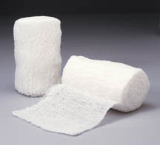
Wound dressing
Dr. ABDUL LATIF
PGR DERMATOLOGY UNIT I
MAYO HOSPITAL

Slide 3
Contents
Wound Healing
Definition of wound dressing
Historical background
Properties of ideal wound dressing
Types of dressings
Commonly used dressing
New advances in wound dressings

Slide 4
wound
Break in the epithelial integrity of the skin and may be accompanied by disruption of the structure and function of underlying normal tissue

Slide 5
Outline Of Wound Healing
Primary healing( healing by 1st intention)
Wound is closed within 12-24 hours
Edges approximated using suture, glue, tapes or mechanical device
Epithelial regeneration predominant over fibrosis
Delayed Primary healing
Contaminated or poorly delineated wounds
Left open for few days
Closure performed after host defenses have helped to debride the wound
Secondary healing (2nd intention)
In extensive loss of soft tissue

Slide 6
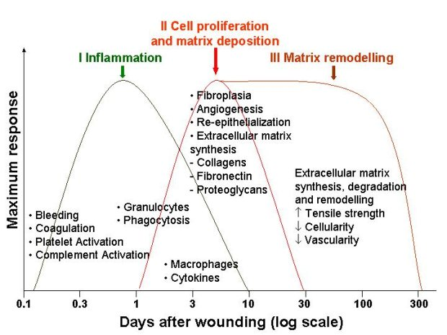
Phases Of Wound Healing

Slide 7
Local Factor Impeding Wound Healing
Reduce blood Supply
Increased skin tension
Poor venous drainage
Presence of FB, Slough, Non viable tissue.
Infection
Excess Local mobility
Malignant transformation
Underlying osteomyelitis
Reduced Local O2 Tension
suboptimal environment temperature

Slide 8
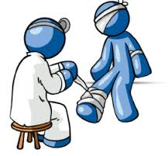
Wound Dressings

Slide 9
Definition
DRESSING:
Sterile pad applied to a wound to promote healing and prevent further harm

Slide 10
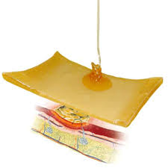
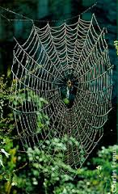
History
In past dressing was only a piece of material sometime cloth, use of cobweb, honey , dung and leaves
In 1860 Joseph Lister …… used carbolic acid
In 1870 Robert Wood …….. Iodine dressing
In 1960 George Winter …….. Research on moist healing
In 1990 ….. New expanded group of dressing ( hydrocolloid, hydrogel, alginates, vapor permeable adhesive films, foams etc. )

Slide 11
Primary Vs. Secondary dressing
Primary Dressing touches the wound
Secondary Dressing (Bandage) Keeps the primary dressing in site
some functions both primary as well as secondary

Slide 12
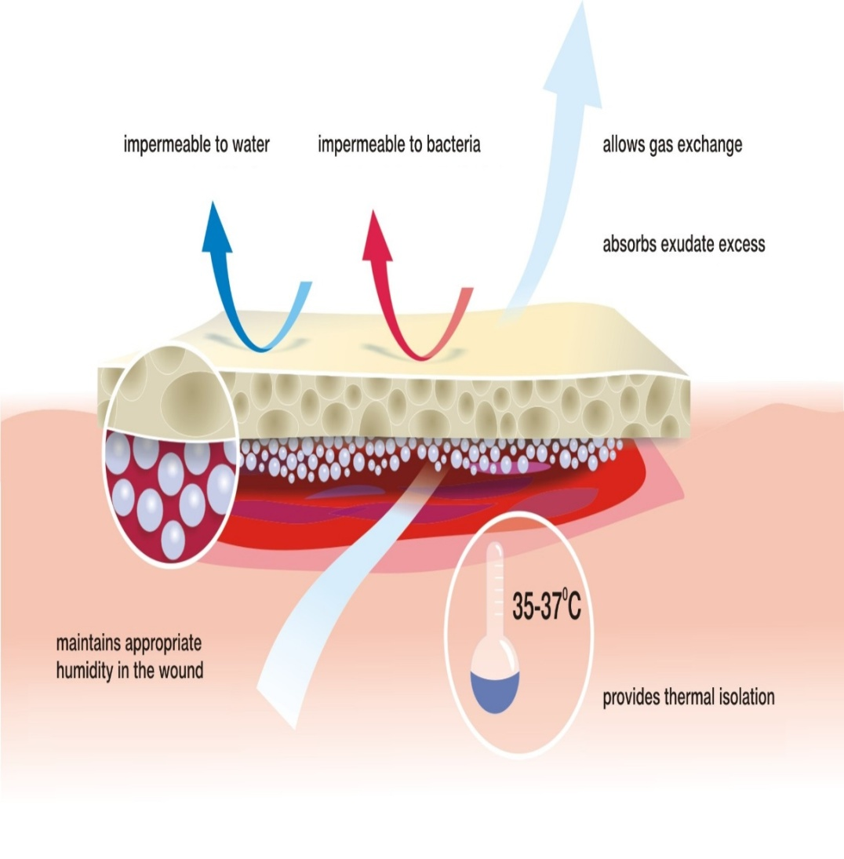
Characteristics of ideal dressing
Mechanical and bacterial protection
Moist environment at wound site
Gaseous and fluid exchange
Non adherent to the wound
Non toxic, non sensitizing, and non allergic
Well acceptable to the patient
Cost effective

Slide 13

Cont……
Highly absorbable
Absorb wound odor
Sterile
Easy to use
Require infrequent changing
Available in a suitable range of forms and sizes

Slide 14
Types of dressing
CLASSIFICATION:
Dry dressings
Moisture-keeping dressings
Bioactive Dressings
Skin Substitutes (Advanced Dressings)

Slide 15
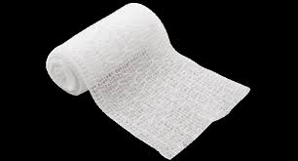
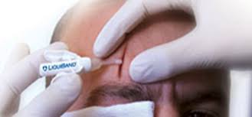
1: Dry dressings
Commonly available
Absorb exudate
Adherent to granulation tissue
Examples:
Gauze and bandages
Membranes and films
Foams
Tissue adhesives

Slide 16
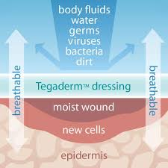
2: Moisture keeping dressings
Non adherent
Fast healing
Do not break granulation tissue on removal
Less painful

Slide 17
Cont…..
Examples:
Pastes, creams and ointments
Non permeable, semipermeable membranes or films
Hydrocolloids
Hydrogels

Slide 18
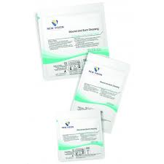
3: Bioactive dressings
Enhance granulation tissue formation
Reduce slough formation
Inhibits bacteria
Some provide growth factors

Slide 19
Cont…..
Examples:
Antimicrobial dressings
Single-component biologic dressings
Combination products

Slide 20
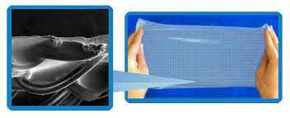
4: Skin Substitutes:
Heterogeneous group of wound coverage materials
Helps in wound closure
Replace the functions of the skin

Slide 21
Cont…..
EXAMPLES:
Epidermal substitutes
(autologous or allogenic)
Acellular skin (dermis) substitutes
(allogenic or xenogenic)
Autologous and Allogenic skin
Skin substitutes containing living cells

Slide 22
Commonly used dressings
Gauzes
Foams
Polymeric films
Tissue adhesives
Tulles
Hydrocolloids
Hydrogels
Enzymatic dressings
Bead dressings
Silicone dressings
VAC
Antimicrobial

Slide 23
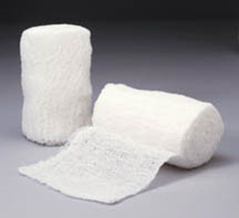
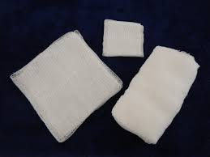
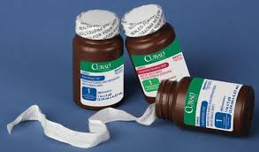
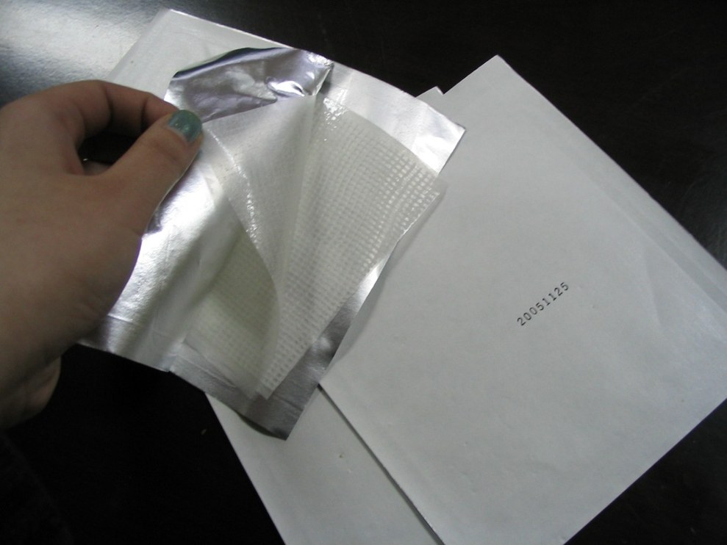
Gauze
Non adherent coating
Non occlusive
Highly permeable
In expensive
Used both as primary and secondary dressing
Promotes wound desiccation

Slide 24
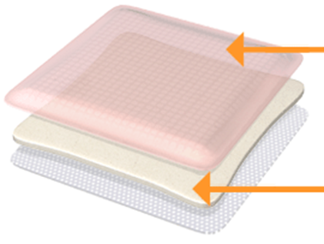
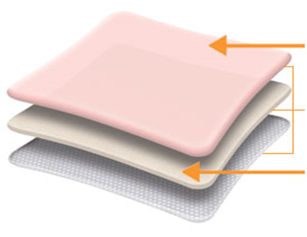
Foams
Polyurethane porous sponges or polyurethane foam films
Moderately absorbent
Can be left for……7 days
Allows autolytic debridement & gaseous exchange
Indications: mild to moderate exuding wound requiring a non-stick surface (e.g. venous stasis)

Slide 25
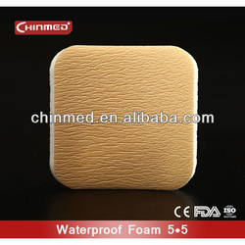
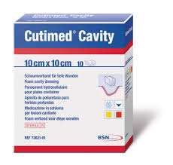
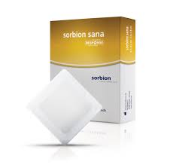
Foam dressing

Slide 26


Slide 27
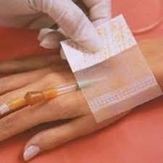
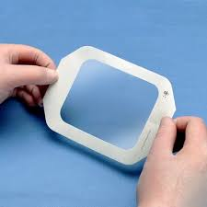
Polymeric Films
Semipermeable film dressings
Primary adhesive
Transparent
Waterproof
Impermeable to bacteria
Ultra thin & high elasticity

Slide 28
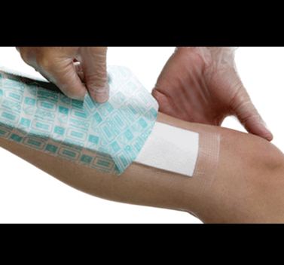
Polymeric Films
Uses:
General wound care
Skin biopsies
Donor sites
Superficial partial thickness burns
Surgical incisions
Securing of peripheral IV lines
Central venous catheters
Contraindicted in highly exudative wounds

Slide 29
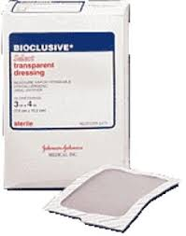
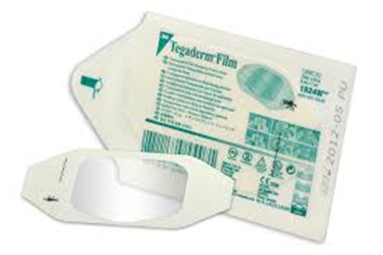
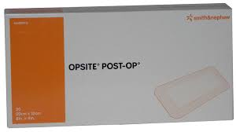
Polymeric Films

Slide 31
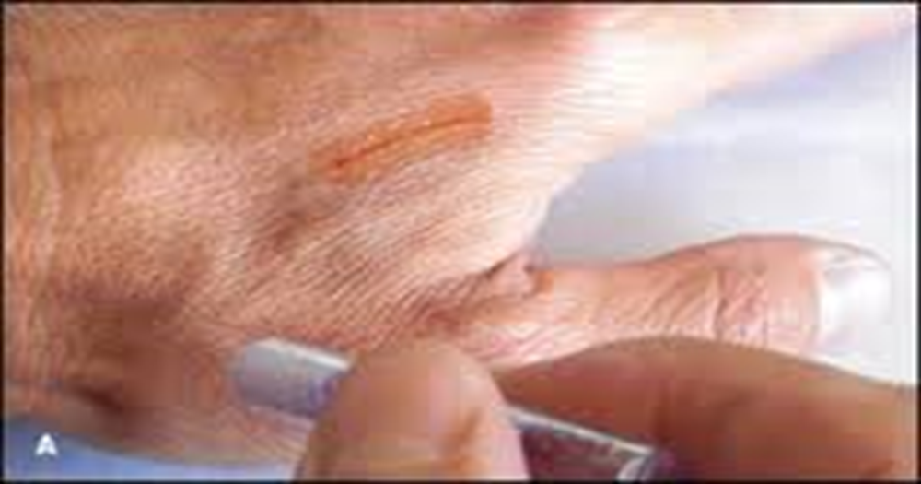
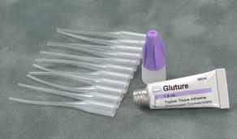
Tissue Adhesives
Needleless & Painless method
Cyanoacrylate glue
Does not require suture removal
Strength of healed tissue seen at 7 days
Wound closure, laceration
Dermaglue, Dermaflex, Gluture

Slide 32
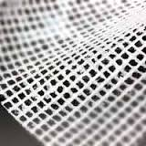
Tulles
Tulle: A light, thin type of cloth that is like a net
Gauze cloth impregnated with paraffin for non-traumatic removal
Antiseptics/Antibiotics…..for prevention /treatment of infection
Non adherent
Suitable for flat wound and sensitive skin
Require a secondary dressing

Slide 33
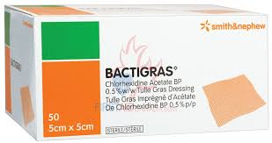
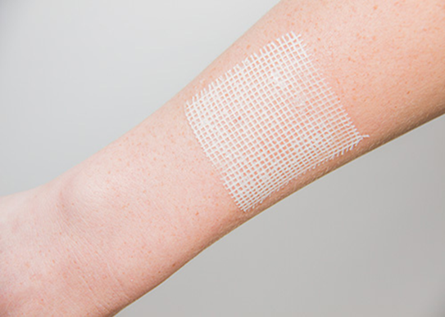
Bactigras/Para-Tulle
Soft paraffin dressing
Contains chlorhexidine…..an ANTISEPTIC
Drain wound freely into an absorbent secondary dressing
Used for covering wounds in superficial burns, lacerations, abrasions, graft sites and leg ulcers

Slide 35
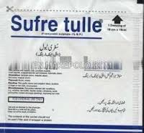
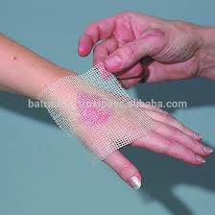
Sufra Tulle
Base composed of white soft paraffin, anhydrous lanolin, and 1.0% Framycetin Sulphate
Framycetin ……. aminoglycoside group
Used for Infected wounds, combining low adherence with antimicrobial activity

Slide 36
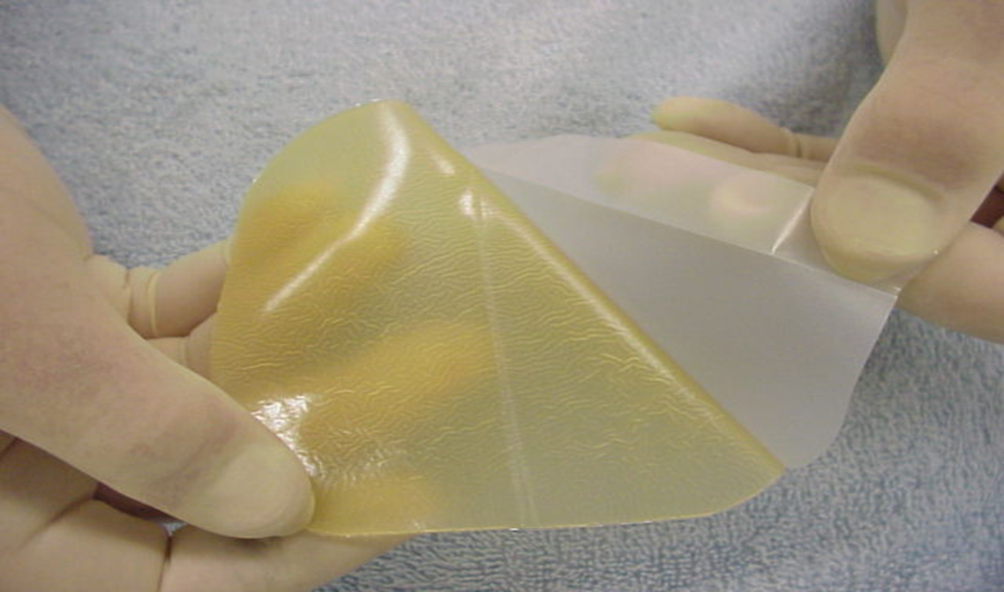
Hydrocolloids
Composed of methylcellulose, pectin, gelatin, and polyisobutylene
Highly absorbent gel (polyurethane)
Oxygen and water vapor permeable
Granulation tissue & Pain relief

Slide 37
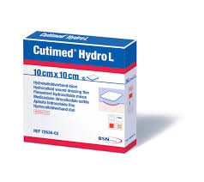
Hydrocolloids
Bacterial barrier & reduce bacterial proliferation
Autolytic debridement
Can stay in place for 72 hours
Indications: Venous ulcers, pressure ulcers, diabetic ulcers, 1st and 2nd degree burns

Slide 38
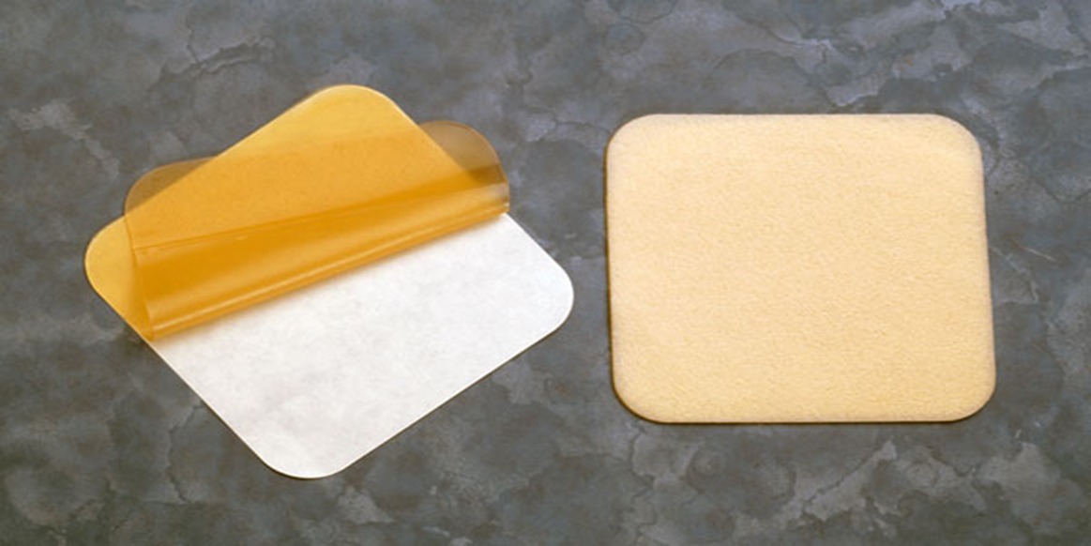
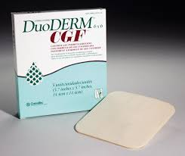
Hydrocolloids

Slide 40
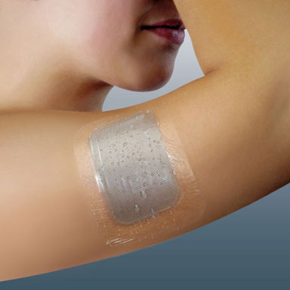
Hydrogel
Hydrophilic polysaccharide ( 50%-70% water)
Cooling & soothing effect
Facilitates autolytic debridement
Available in Amorphous gel, Sheets

Slide 41
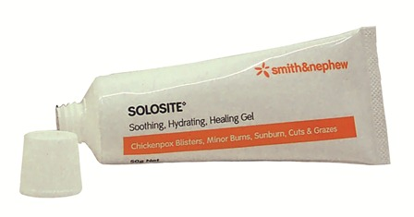
Hydrogel
Can stay in place for 24 hours
Indications: Dry, necrotic, mildly exuding wounds, clean wounds, partial thickness wounds
Do not used for infected and heavily exuding wounds

Slide 42
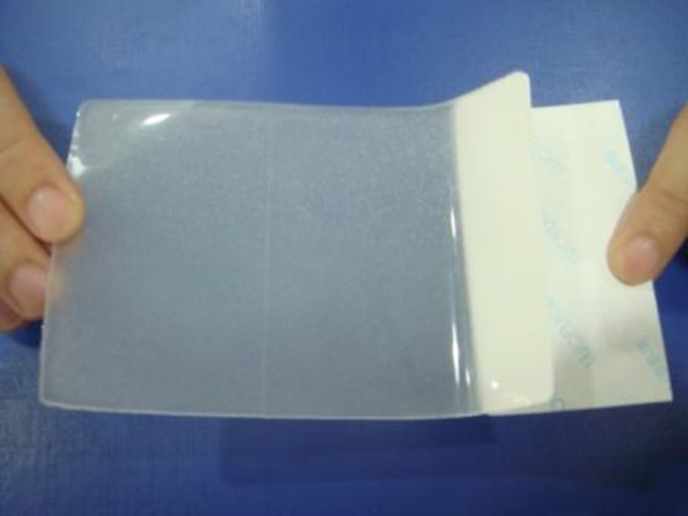
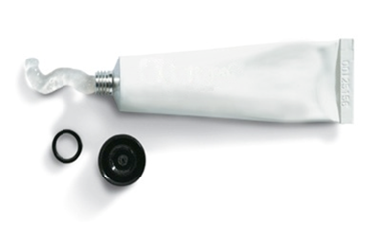
Hydrogels
Brands:
Tegagel®, Intrasite®
Sheet Form
Gel Form

Slide 44
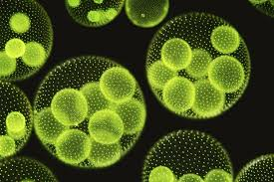
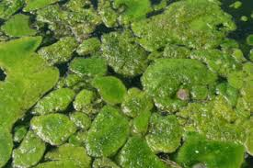
Fibrous Polymers
Alginate dressing…… derived from algae & seaweed
Absorbent (20 times to weight)
Sheets, strips, lose fiber packs
Moist the wound
Stay for 24- 72 hrs
Indicated for wound needs large amount of drainage

Slide 45
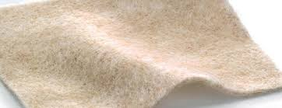
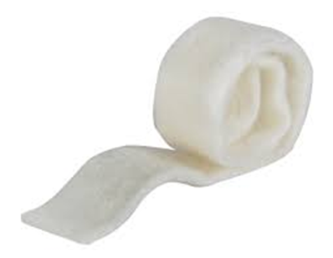

Fibrous Polymers
Brands:
Algisite
Kaltostat
Sorbsan
Tegagen etc.
Strip form

Slide 47
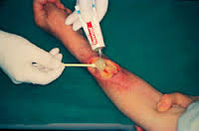
Enzymatic Debridement
Activate fibrinolysis and liquefy pus on CHRONIC SKIN ULCERS
Exogenous enzymes (collagenase, elastase, fibrinolysin)
Used for ….. Wound require debridement of fibrinous exudate & necrotic material

Slide 48
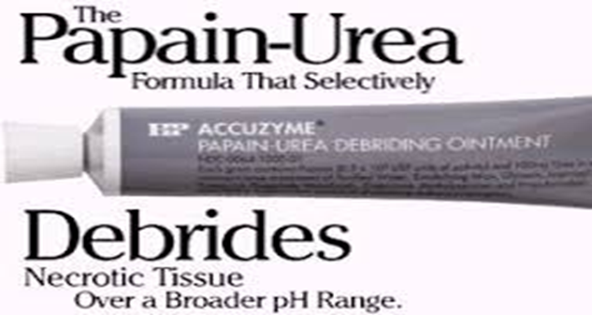
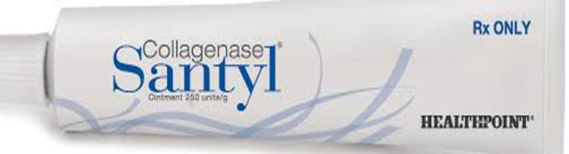
Enzymatic Debridement
Examples:

Slide 49
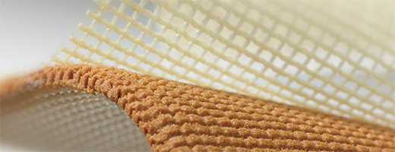
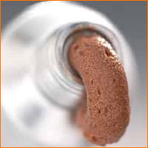

Bead dressing
Remove bacteria and excess moisture
by its capillary action
Useful in Deep Granulating Wounds, pressure sores, leg ulcers etc
EXAMPLES:
Debrisan®
Iodosorb®
sheet
ointment
powder

Slide 50

Silicon Dressing
Reduce Hypertrophic scarring and Keloid formation
Used as Antiadhesives
Useful in covering split-skin donor sites or fresh mesh grafts

Slide 51

Silicon Dressing
Flattening of scarring tissue
Increasing elasticity
Reducing discoloration
Available in gel form & foams
Foam

Slide 52


Silicon Dressing
Gel Sheets
Silicon sheet

Slide 53


Vacuum Assisted Closure Device
This therapy involves the controlled application of sub-atmospheric pressure to the local wound environment, using a sealed wound dressing connected to a vacuum pump

Slide 54

Antimicrobial
Indications: Infected wounds, wounds with bacterial counts greater than 10⁵
Bacterial count greater than this decrease wound healing rates
Bacterial proteases degrade growth factors
Water-based topical antibiotics

Slide 55
Antimicrobials
Silvadene cream
Sulfamylon
Acticoat
Iodoflex/Idosorb
Polysporin/Bacitracin
Dakin’s
Oxoferin

Slide 56

Sulfamylon
5 % Sulfamylon cream
(Mafenide Acetate, Bertek Pharm)
Bacteriostatic vs. Gram neg, Gram pos. (including pseudomonas), and some anaerobes
Inhibits carbonic anhydrase
Solution & cream

Slide 57

Acticoat
Non crystalline silver coating ( silver nitrate)
Gram negative bacteria, MRSA, VRE
Pseudomonas resistant
Bacteriostatic
Can stay in place for one week
Non-adherent
Indications: Venous ulcers, diabetic ulcers and other infected lesions

Slide 58
Recent Advances

Slide 59


Collagen Dressing
Deposit newly formed collagen in the wound bed
Bind to Matrix Metalloproteinases (MMPS)
Used for Chronic Nonhealing Wounds

Slide 60

Growth Factors
Exogenous application of various growth factors
PDGF ( Becaplermin)
EGF
FGF
Diabetic ulcers, pressure ulcers

Slide 61

Human skin Substitutes
CHARACTERISTICS OF AN IDEAL SKIN SUBSTITUTE:
Excellent adherence to the wound
Very low immunogenicity
Decrease of pain
Bacterial control
Stimulation of healing

Slide 62


Human Amniotic Membrane
Derived from the placenta after delivery
Relatively inexpensive
Translucent, allowing inspection of the wound
Superficial second-degree burns, deep second-degree burns after early debridement and donor sites

Slide 63


Human Amniotic Membrane
Sterilizing contaminated wounds and cleaning burns (3-5 days)
Need to be changed DAILY
Covered with gauze to prevent desiccation
Refrigerated for 6 weeks
Frozen for longer storage

Slide 64

Porcine Skin
Most common source of xenograft
Temporary dressing
Second-degree burns.
Scar-free healing
Average healing period -----10 days
Perforated porcine skin

Slide 65

BILAYER SKIN SUBSTITUTE
(BIOBRANE®)

Slide 66
BIOBRANE®
Bilayer Skin Substitute
Silicon Film with a Nylon fabric partially imbedded into the film to which Collagen has been chemically bound and cross-linked
Used in Severe burns and Donor sites
Reduce local wound pain
Speed up the healing process

Slide 67

Tissue-Engineered Skin Substitutes
Use of a combination of cells, engineering and materials methods to improve or replace biological functions
Developed to address the need for wound coverage and tissue repair

Slide 68
Tissue-Engineered Skin Substitutes
EXAMPLES:
TransCyte® was the first human-based, bioengineered, temporary skin substitute
Integra®
composed of chondroitin 6 sulphate & collagen on silicon sheet
Currently, NO engineered skin substitute can replace all of the functions of intact human skin

Slide 69
Natural Substances for wound Dressing
Honey
Turmeric
Potato
Papaya
Banana leaves
Beta Glucan
Alovera

Slide 70

MEDIHONEY
100% antibacterial
Leptospermum Scoparium
Broad spectrum ( drug resistant bacteria MRSA, VRE, Pseudomonas, Acinetobacter)
Autolytic debridement
Remove malodor

Slide 71

MEDIHONY
Moist environment
Kept for 7 days
Indicated in infected wound, necrotic and deep wounds & superficial burns

Slide 73
Summary
Wound with granulation | Crater | Necrotic/non viable tissue | Exuding wound | Wound with sinus | Wound with infection
Keep moist | Fill with uniform contact | Debride & cleanse | Absorb | Prevent premature closure, absorb exudate | Decrease bacterial count
Hydrogel | Hydrocolloid | Enzymatic dressing | Foam | Hydrogel | Pulse irrigation
VAC | Hydrogel | Alginate | VAC | Alginate | Antibiotics
Hydrocolloid | Alginate | Pulse irrigation | Alginate | VAC | VAC
 | Foam | Hypertonic salts
 | VAC | Hydrocolloid
 |  | VAC

Slide 74
Refrences.
Handbook of dermatological drug therapy
Textbook and atlas of dermatosurgery and cosmetology
Wikipedia
Google images
Youtube videos

Slide 75


